Slide 1
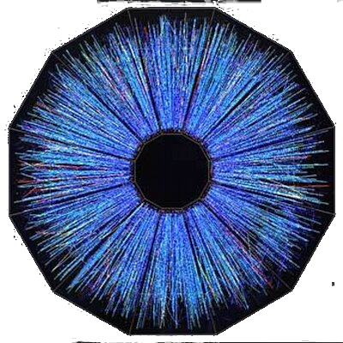
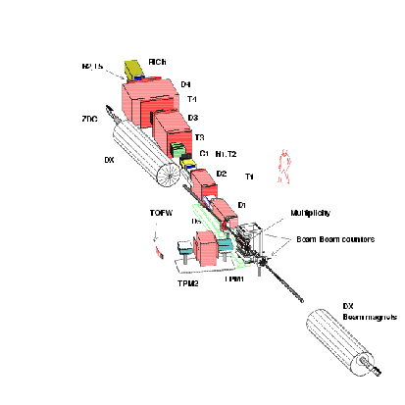
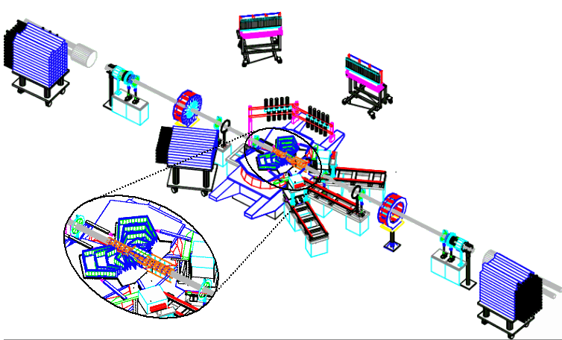
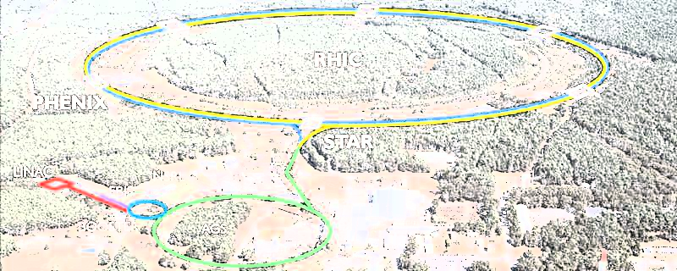
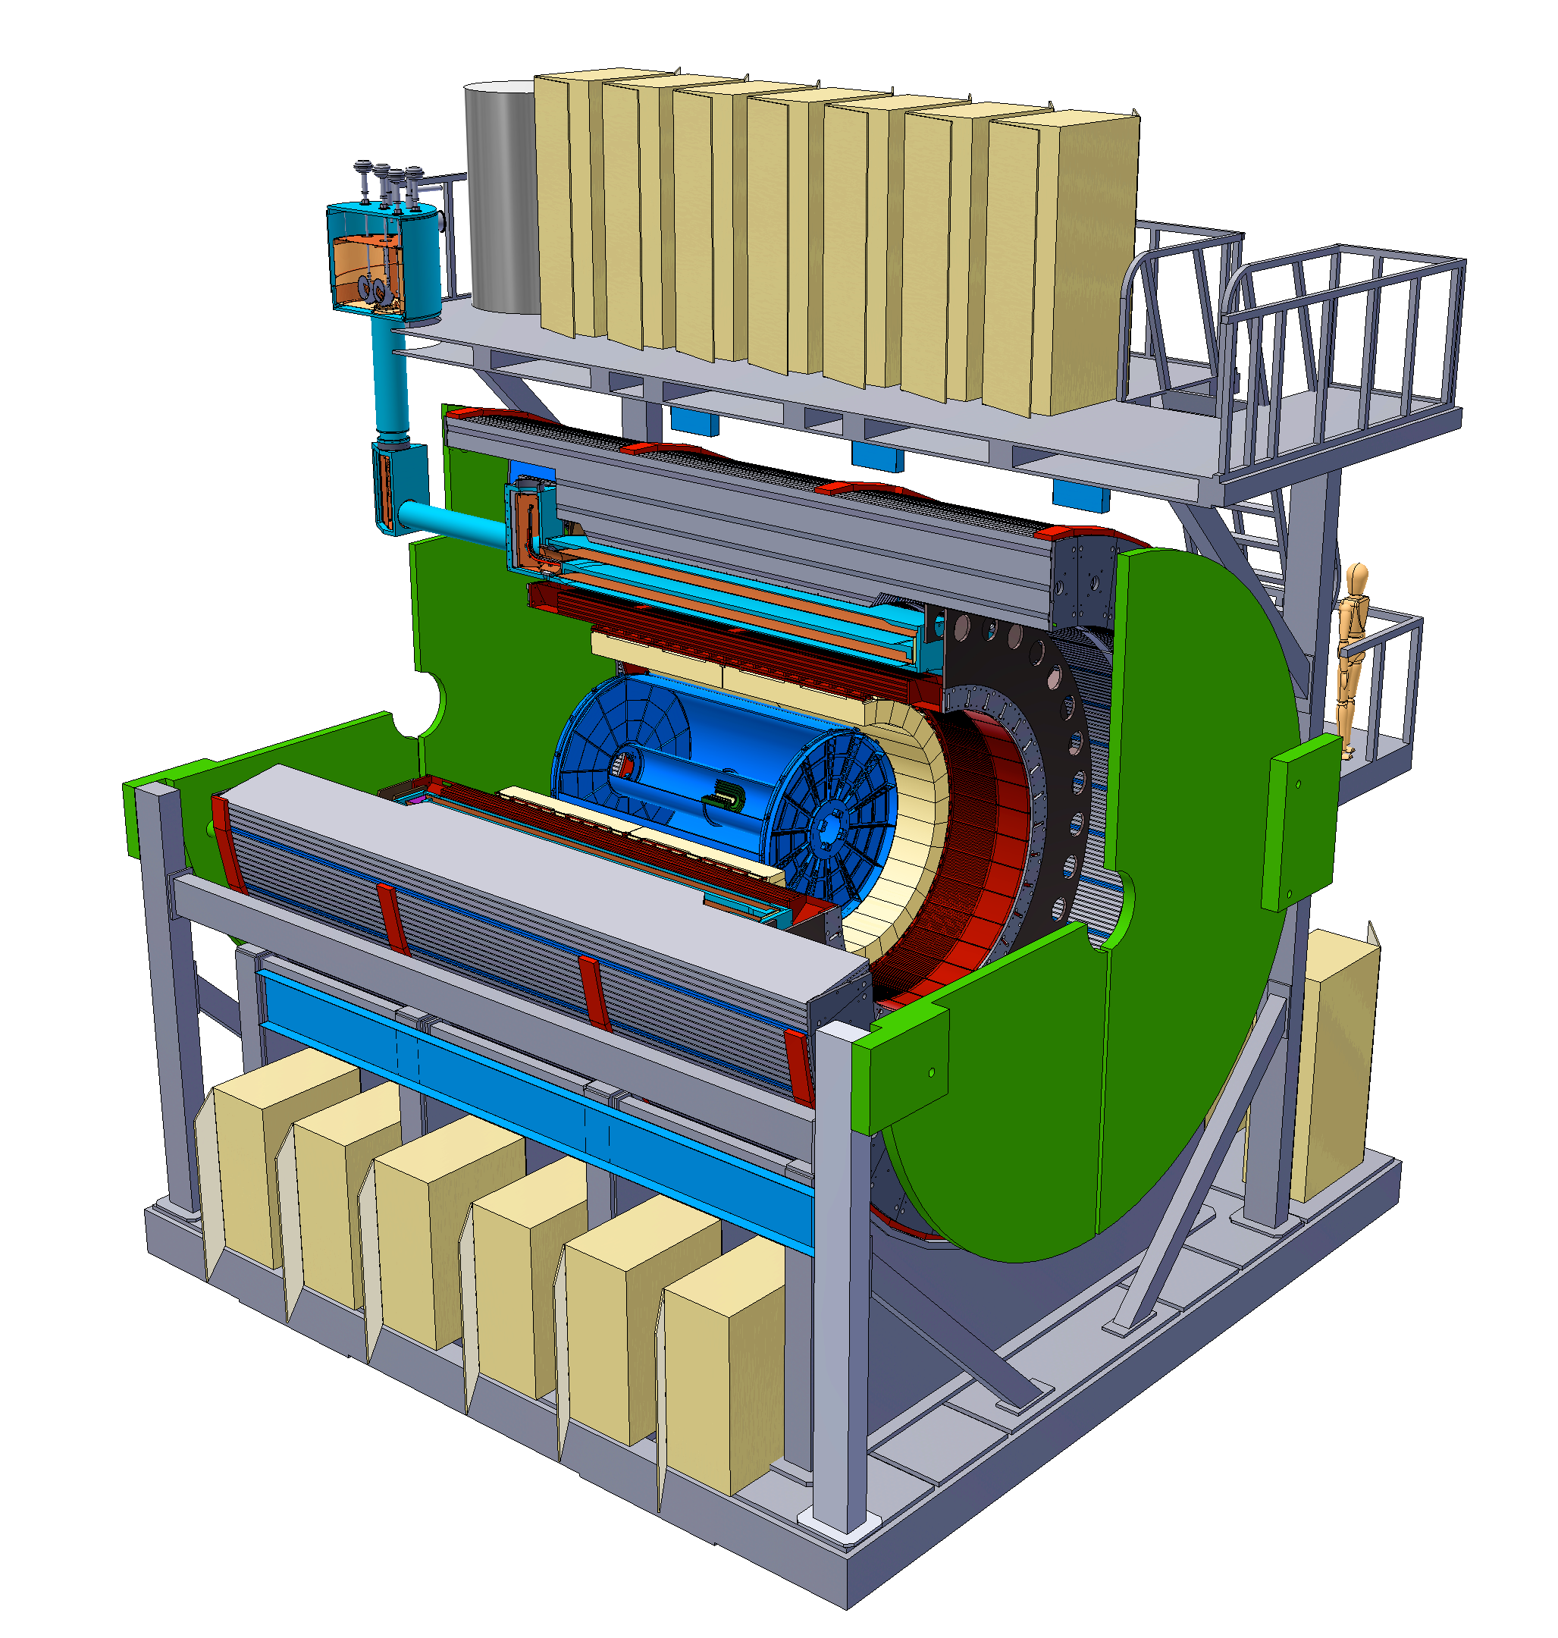
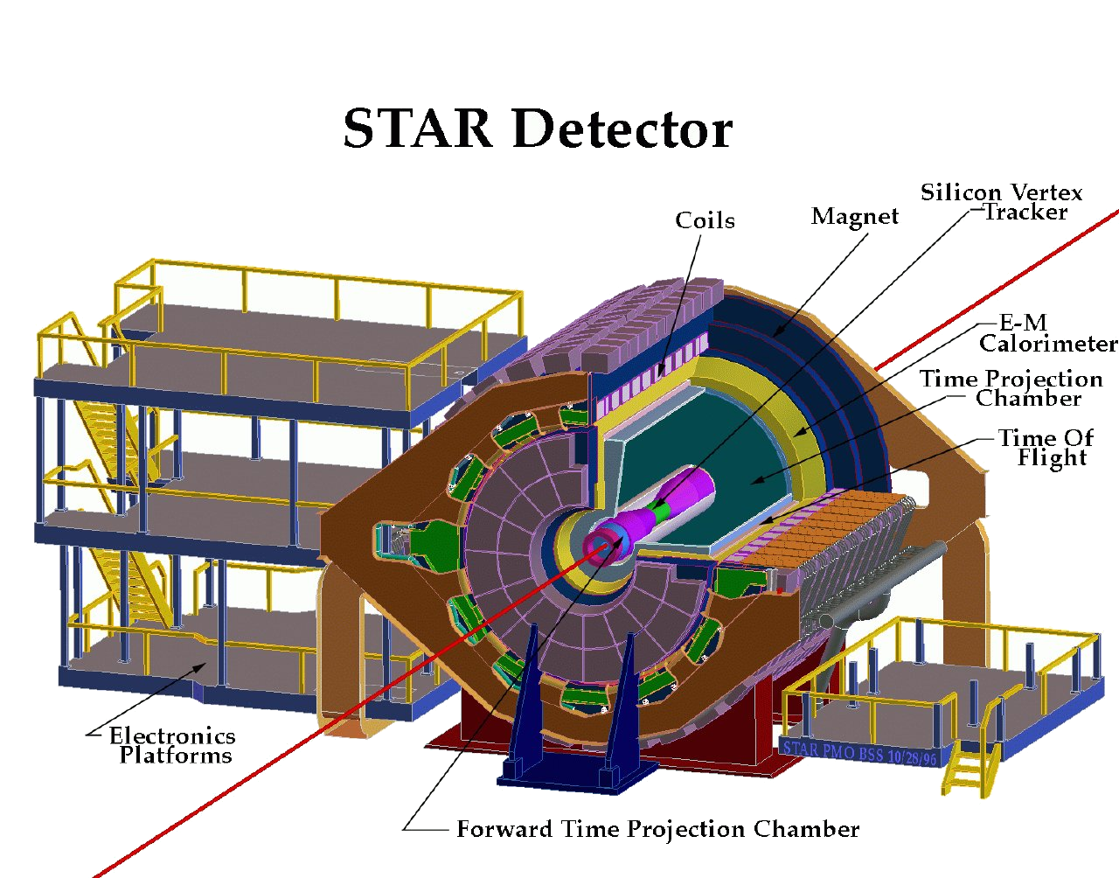
Quantifying properties of liquid nuclei
Or how I built my undergraduate army
Christine Nattrass, University of Tennessee, Knoxville
PHOBOS
Relativistic Heavy Ion Collider
BRAHMS
s

Slide 2
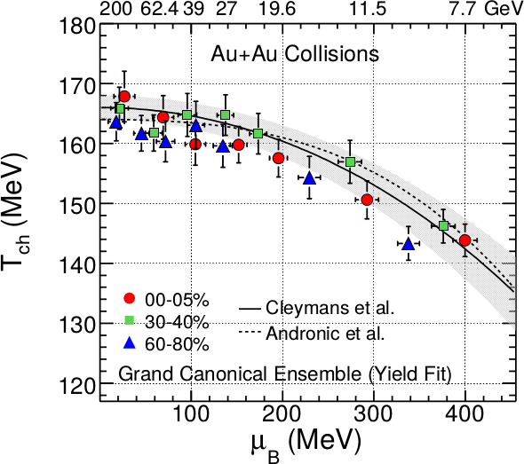
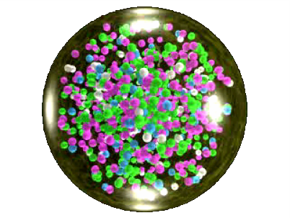
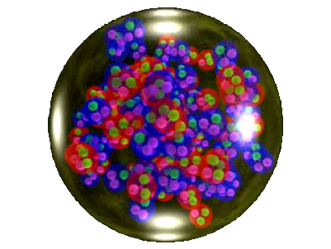
QCD Phase Diagram
Quark Gluon Plasma
Hadron Gas
Phys. Rev. C 96, 044904 (2017)
Notes:
But wait – how can we have a liquid of quarks and gluons? Doesn't asymptotic freedom tell us that we can't have free quarks and gluons? How, then, can we have a liquid of quarks and gluons?

Slide 3
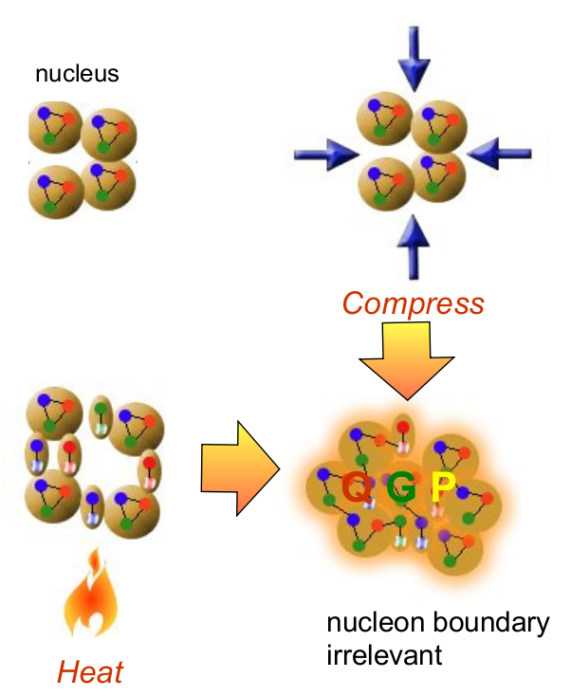
How to make a Quark Gluon Plasma

Slide 4
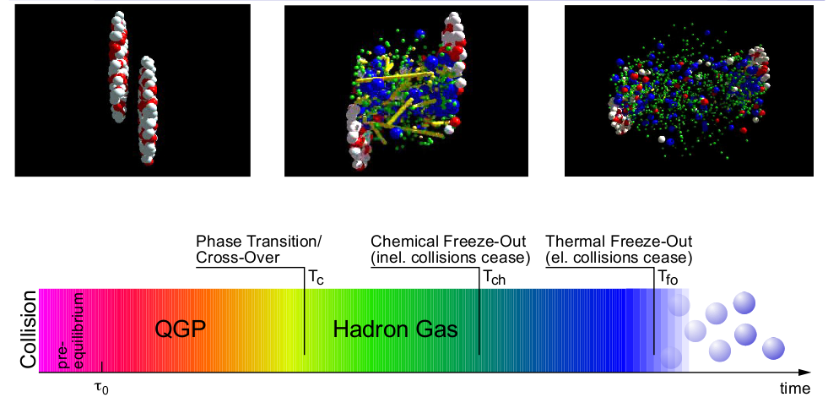
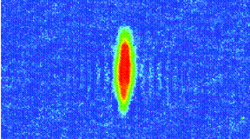
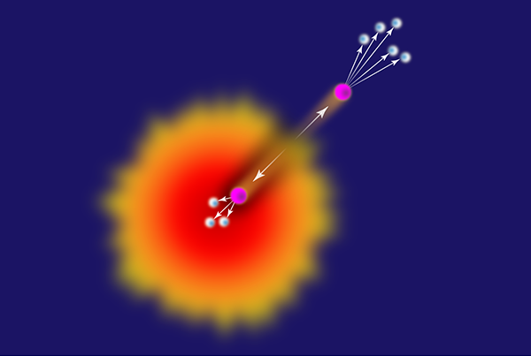
The phase transition in the laboratory
QGP
Freeze-out
Initial
State
Hydrodynamical flow
Jet quenching
K, O’Hara, S. Hemmer, M. Gehm, S. Granade, J. Thomas Science 298 2179 (2002)
https://physics.aps.org/articles/v7/97

Slide 5
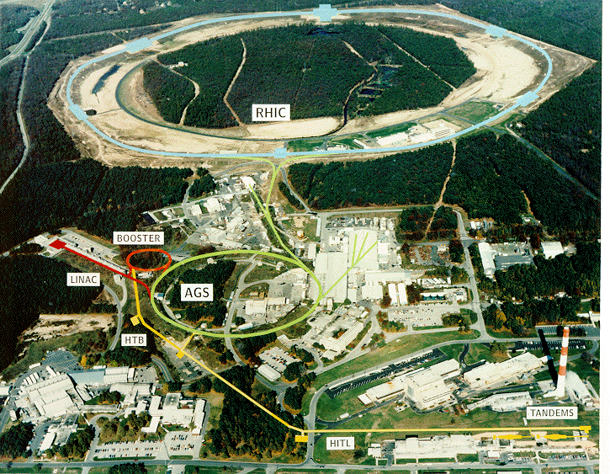
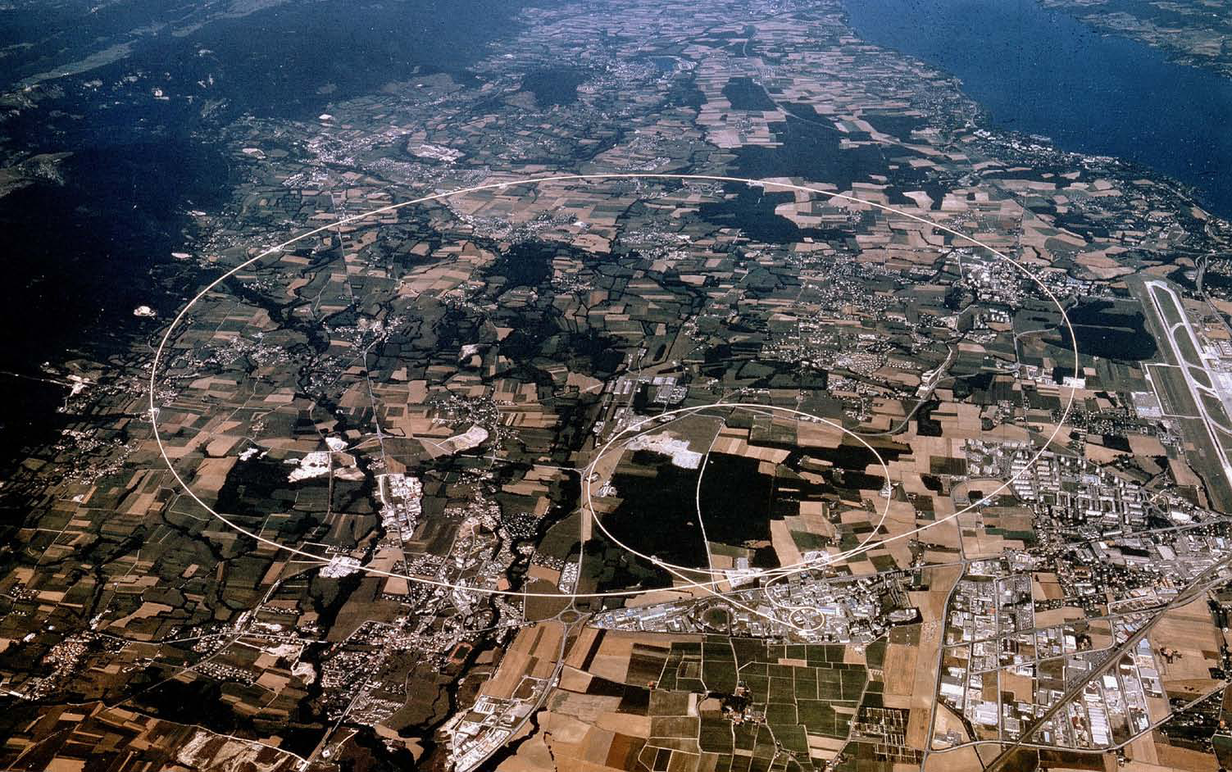
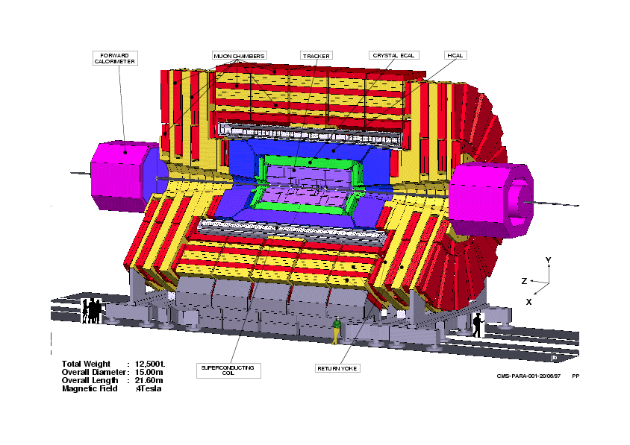
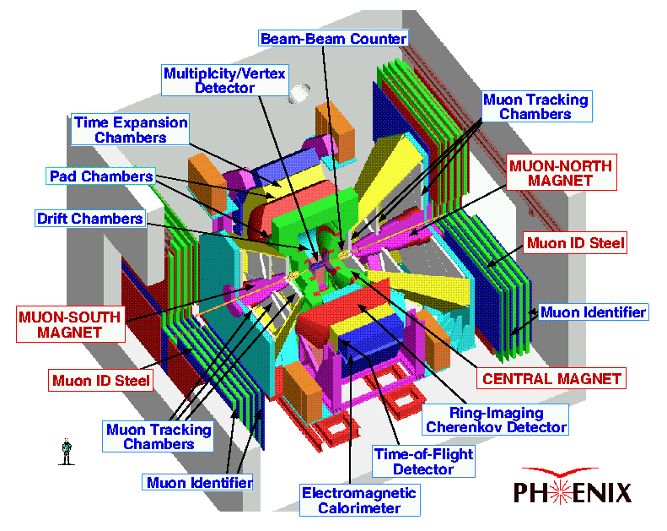
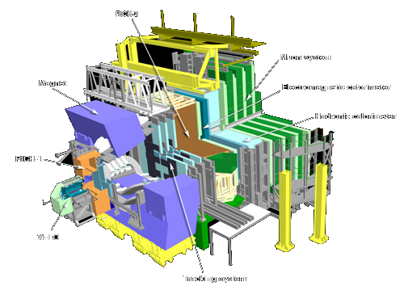
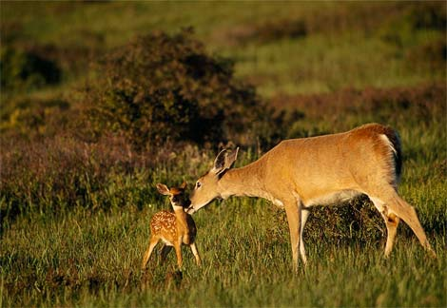
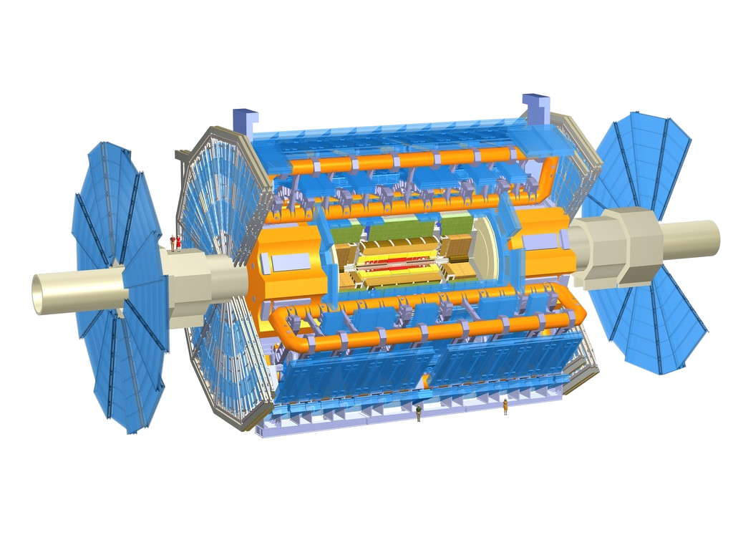
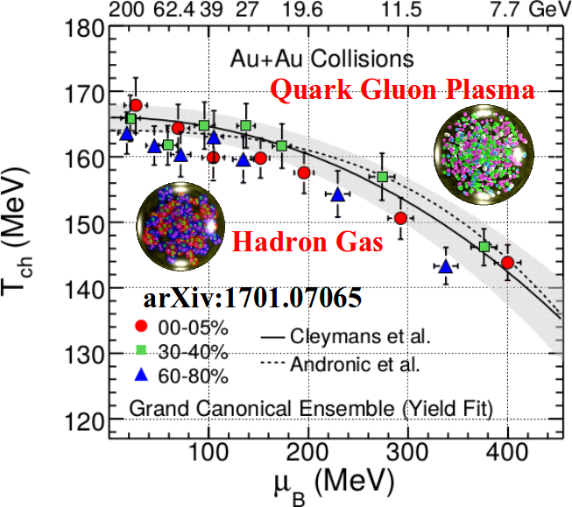
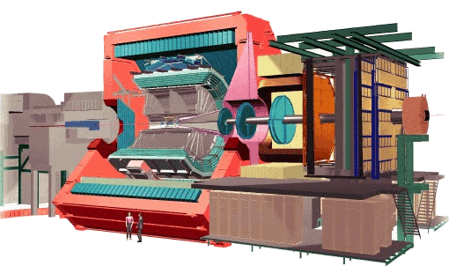
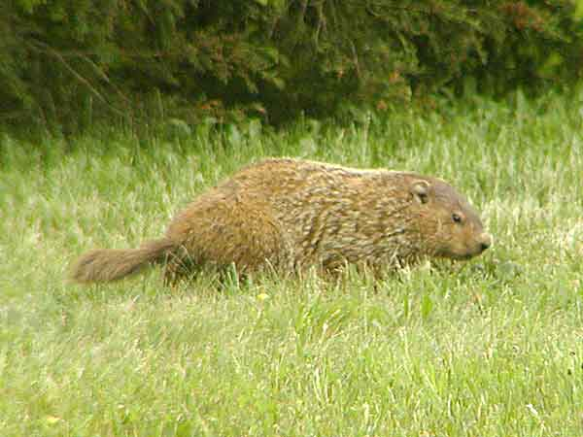
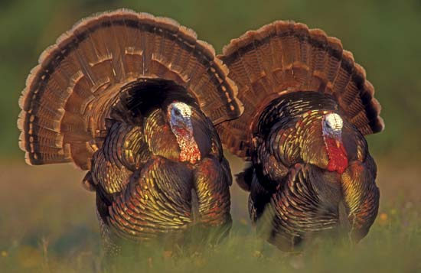
Relativistic Heavy Ion Collider
Large Hadron Collider
PHOBOS
BRAHMS
CMS
LHC
PHENIX
STAR
RHIC
LHCb
RHIC
ALICE
ATLAS LHCf
Upton, NY
1.2km diameter
p+p, d+Au, Cu+Cu, Au+Au, U+U
√s_{NN} = 9 - 200 GeV
Geneva, Switzerland
8.6km diameter
p+p, p+Pb, Pb+Pb
√s_{NN} = 2.76 GeV, 5.5 TeV
Notes:
Mention that RHIC planning began 1983

Slide 6
Particle Detectors

Slide 7
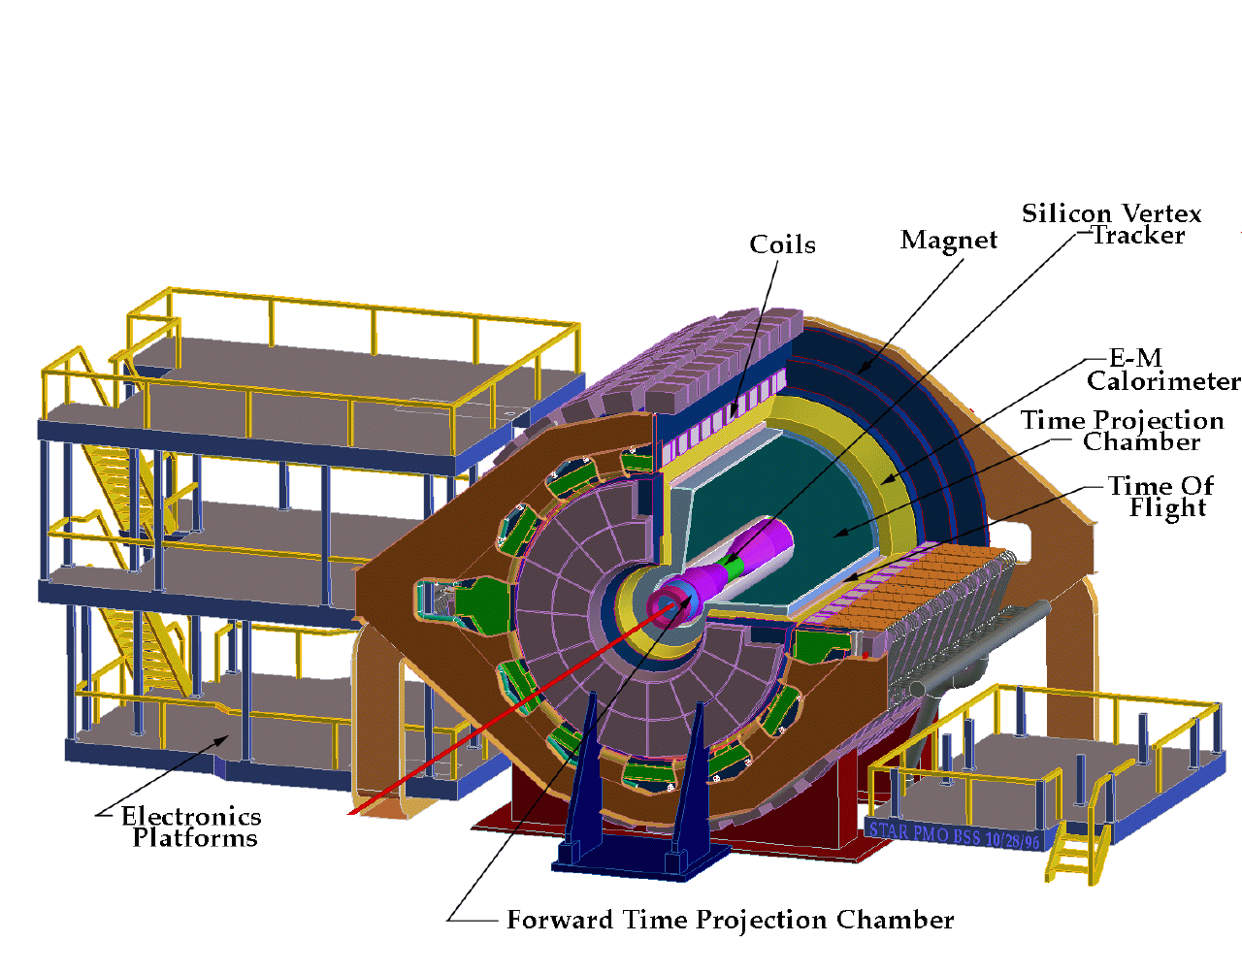
ALICE
ATLAS
CMS
STAR
sPHENIX
PHENIX
Notes:
Mention that RHIC planning began 1983

Slide 8
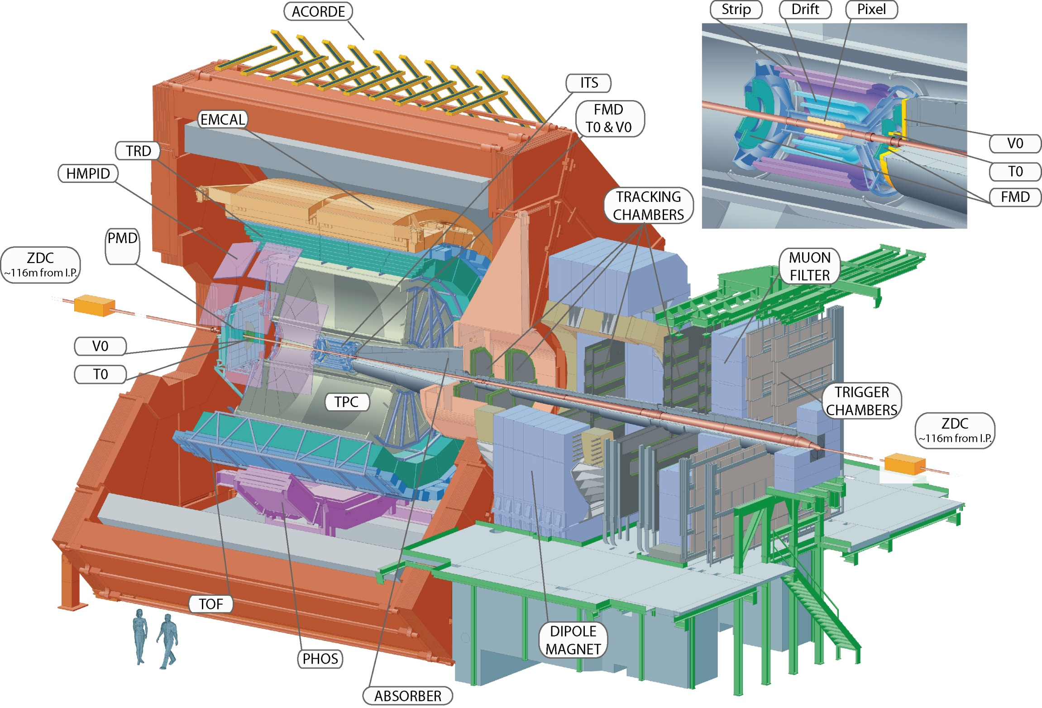
Size: 16 x 26 meters
Weight: 10,000 tons
Detectors: 18
Trigger detectors: When do we have a collision?
Tracking detectors: Where did the particle go?
Identification detectors: What kind of particle is it?
Calorimeters: How much energy does the particle have?
<number>
Notes:
By comparison ATLAS is 25 meters in diameter and 44 meters long – not quite twice as large

Slide 9
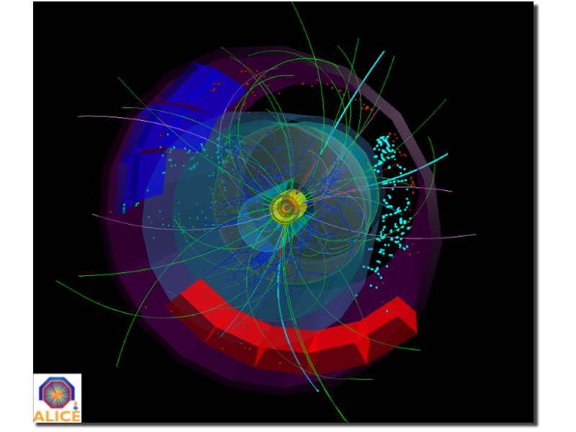
p+p collisions
3D image of each collision

Slide 10
Pb+Pb collisions
5

Slide 11
Forming the QGP

Slide 12
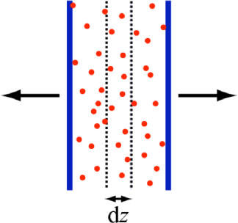
How can we estimate the energy density?
Transverse energy (E_{T})
sum of particle energies in transverse direction
Volume V = A_{T} τc
τ = formation time
Energy density ε
QGP formation for ε > 0.5 GeV/fm³
A_{T}
= τc
$ϵ=\frac{1}{V}\frac{{dE}_{T}}{dy}=\frac{J}{A_{T}τc}\frac{{dE}_{T}}{dη}$

Slide 13
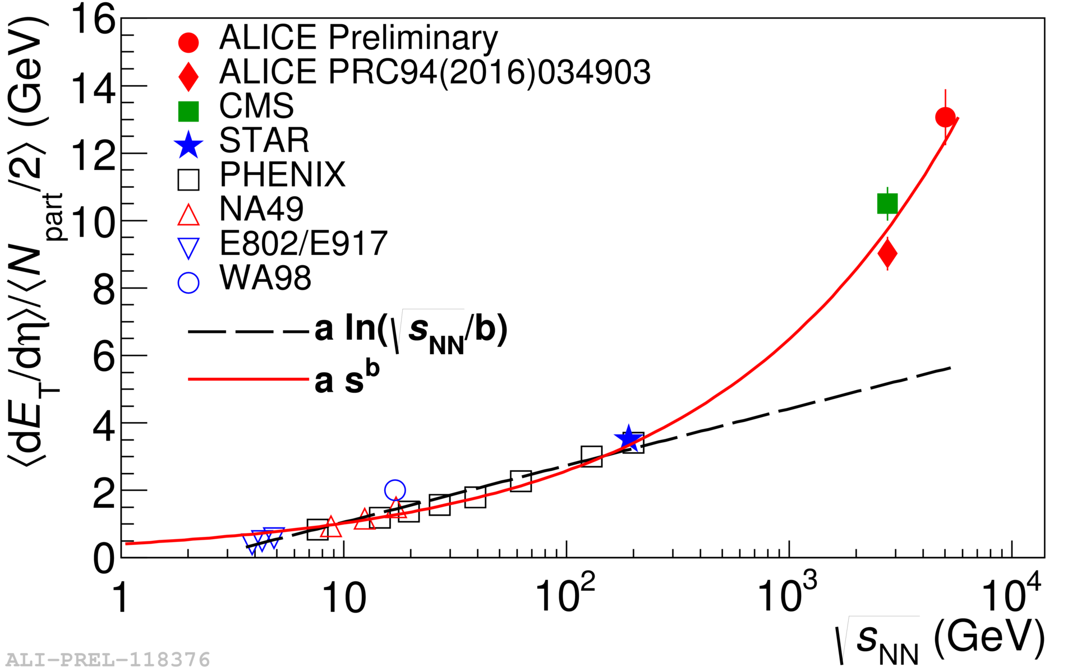
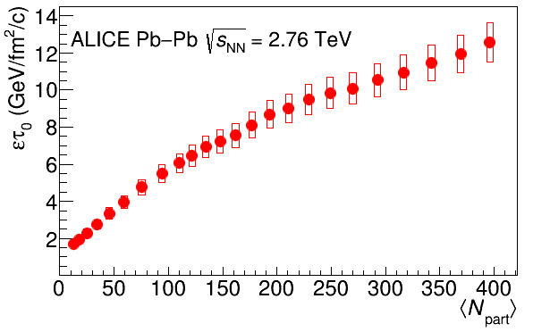
Energy dependence from dE_{T}/dy
Phys. Rev. C 94 (2016), 034903
RHIC
Standard estimate τ₀ ≈ 1 fm/c
QGP formation
Collision energy
$ϵ=\frac{1}{Acτ_{0}}\frac{{dE}_{T}}{dy}$
Higher than extrapolations of RHIC data

Slide 14
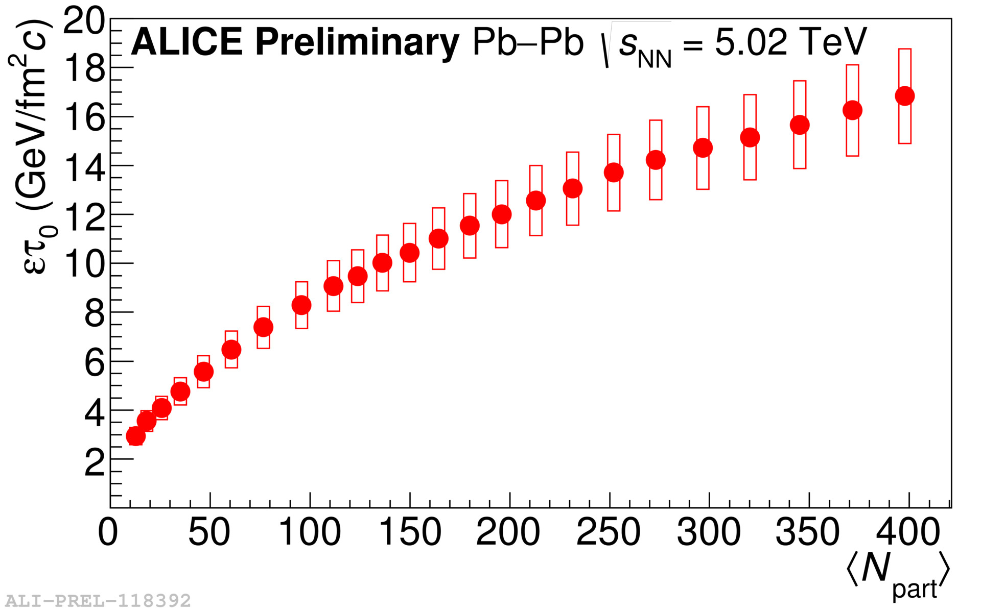
Energy dependence from dE_{T}/dy
Phys. Rev. C 94 (2016), 034903
RHIC
Standard estimate τ₀ ≈ 1 fm/c
QGP formation
Collision energy
$ϵ=\frac{1}{Acτ_{0}}\frac{{dE}_{T}}{dy}$
Higher than extrapolations of RHIC data

Slide 15
QGP Chemistry

Slide 16
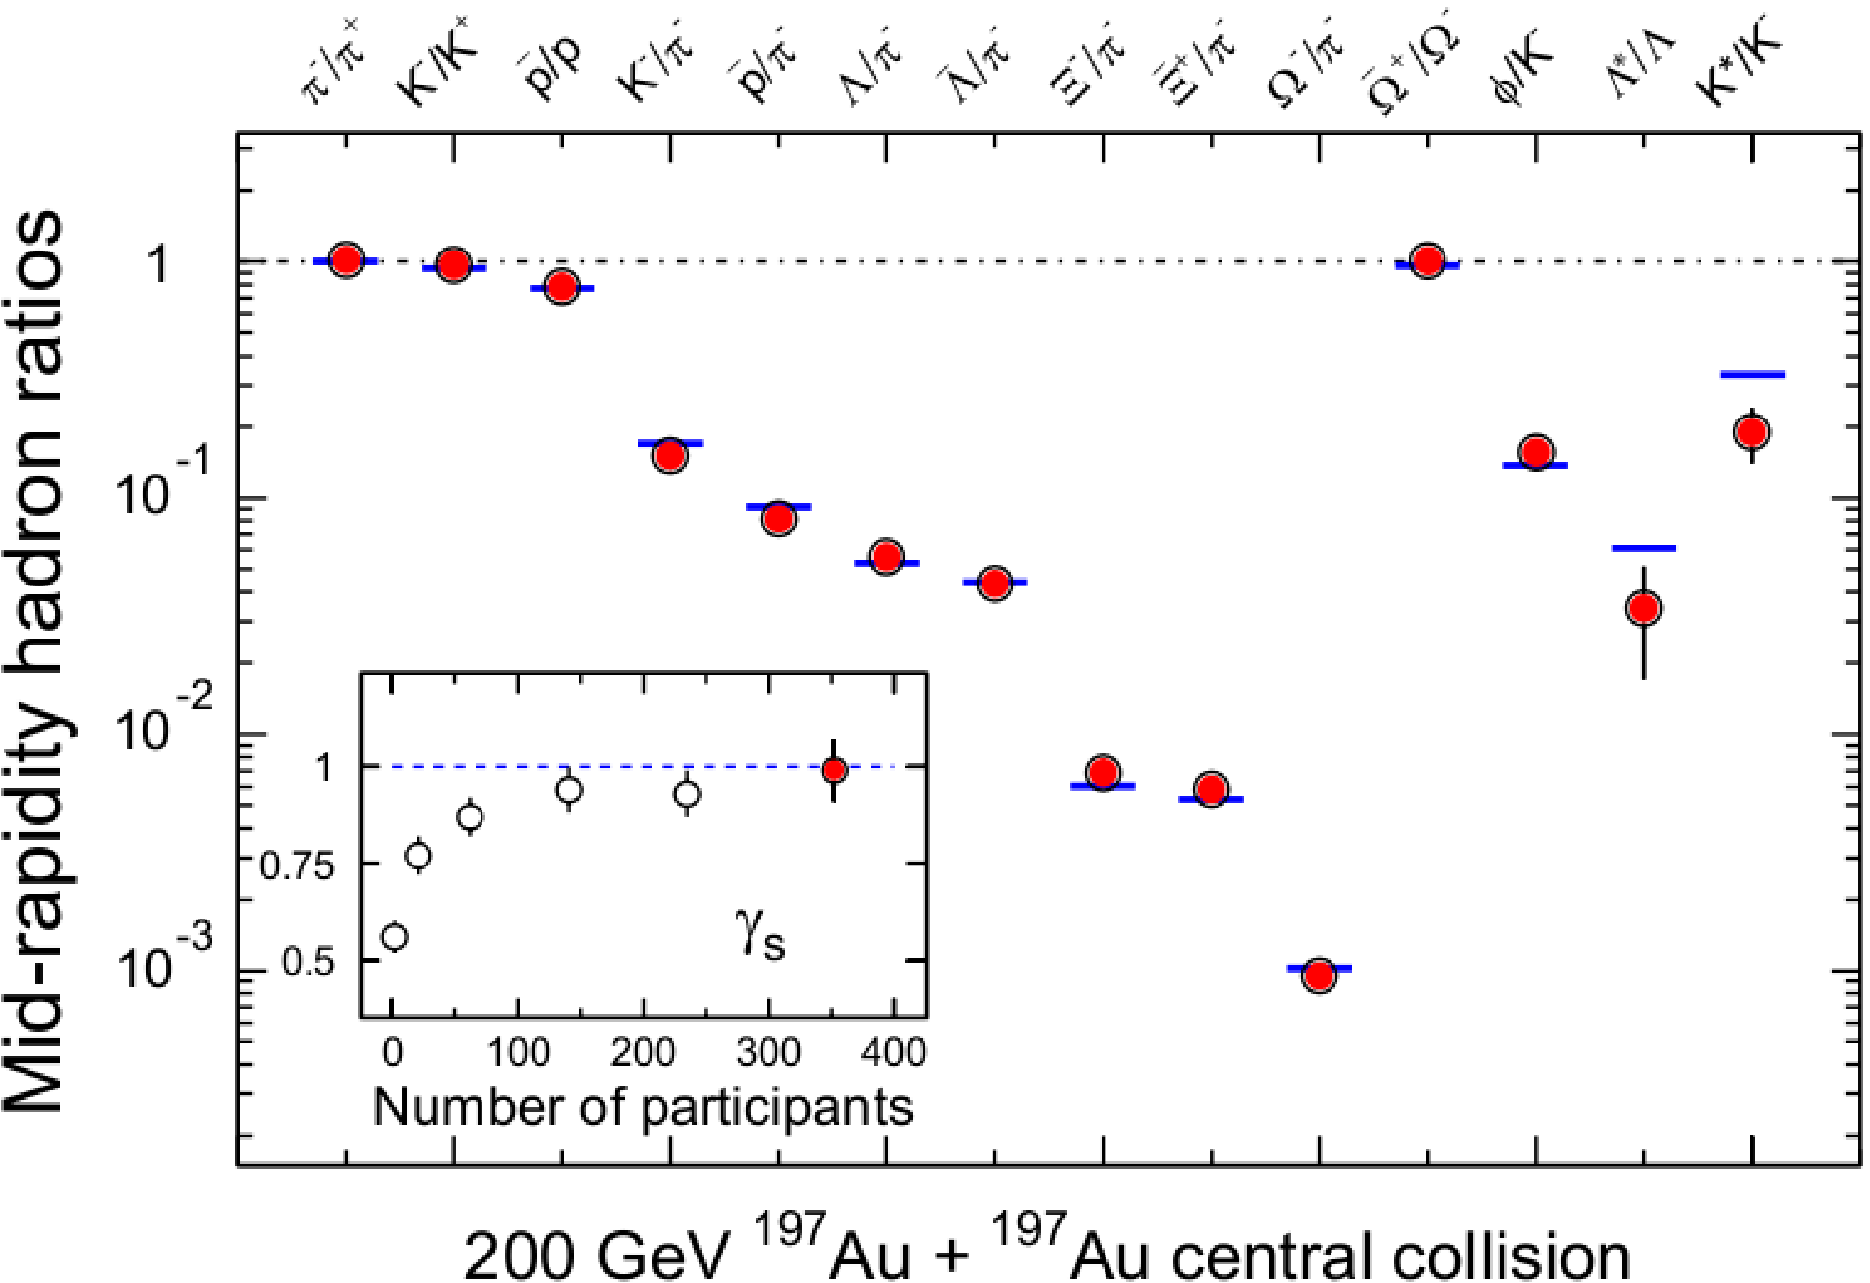
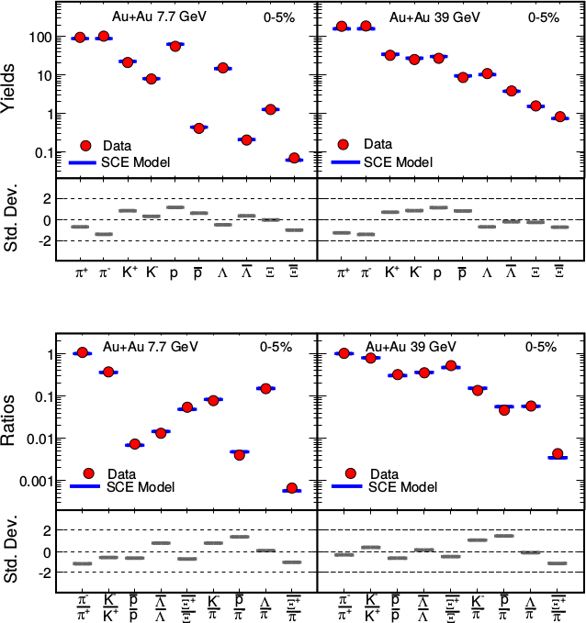
Chemistry - equilibrium
arXiv:1701.07065
T~170 MeV
Ratios of particles expected from a model
Even strange quarks are at equilibrium!
Nuclear Physics A Volume 757, 102-183

Slide 17
Quark Gluon Plasma
arXiv:1701.07065
Hadron Gas
Notes:
But wait – how can we have a liquid of quarks and gluons? Doesn't asymptotic freedom tell us that we can't have free quarks and gluons? How, then, can we have a liquid of quarks and gluons?

Slide 18
trajectory of system
Quark Gluon Plasma
arXiv:1701.07065
Hadron Gas

Slide 19
QGP Thermometers

Slide 20
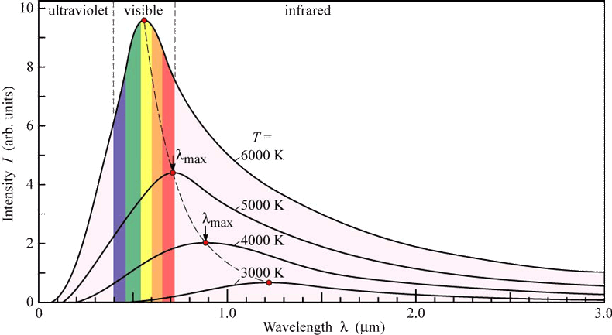
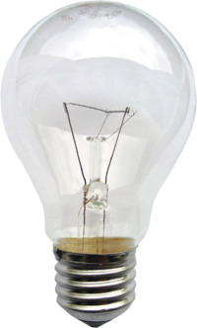
Measuring temperature

Slide 21
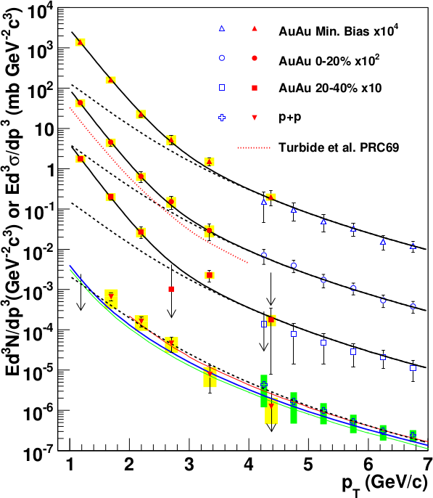
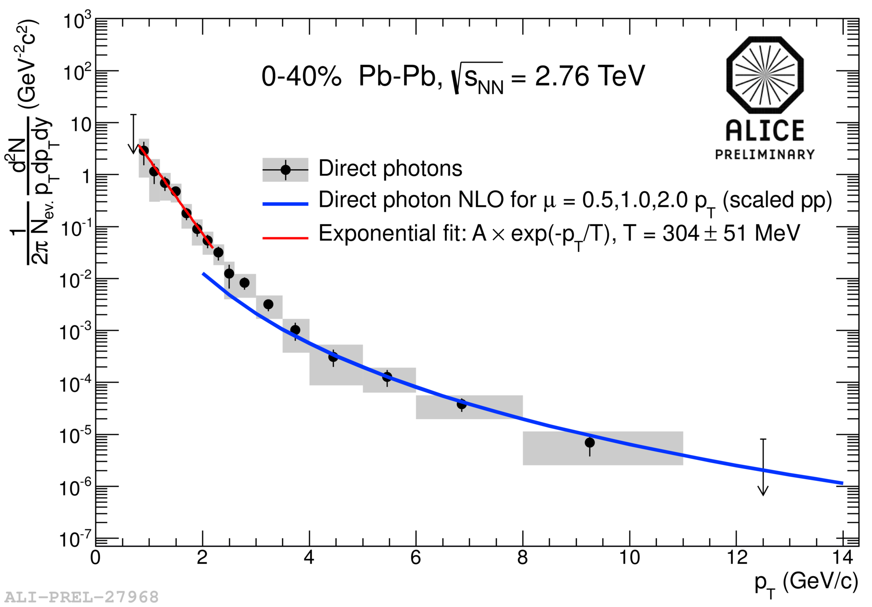
Thermal photons
Phys.Rev.Lett.104:132301,2010
Thermal photons
QCD processes
ALICE collaboration:
Pb+Pb collisions at √s_{NN}=2.76 TeV
Inverse slope: T = 304 +/-51
PHENIX collaboration: Au+Au collisions at √s_{NN}=200 GeV
Inverse slope: T = 221 +/- 19 (stat) +/- 19 (syst) MeV

Slide 22
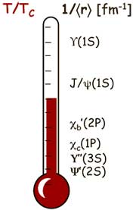
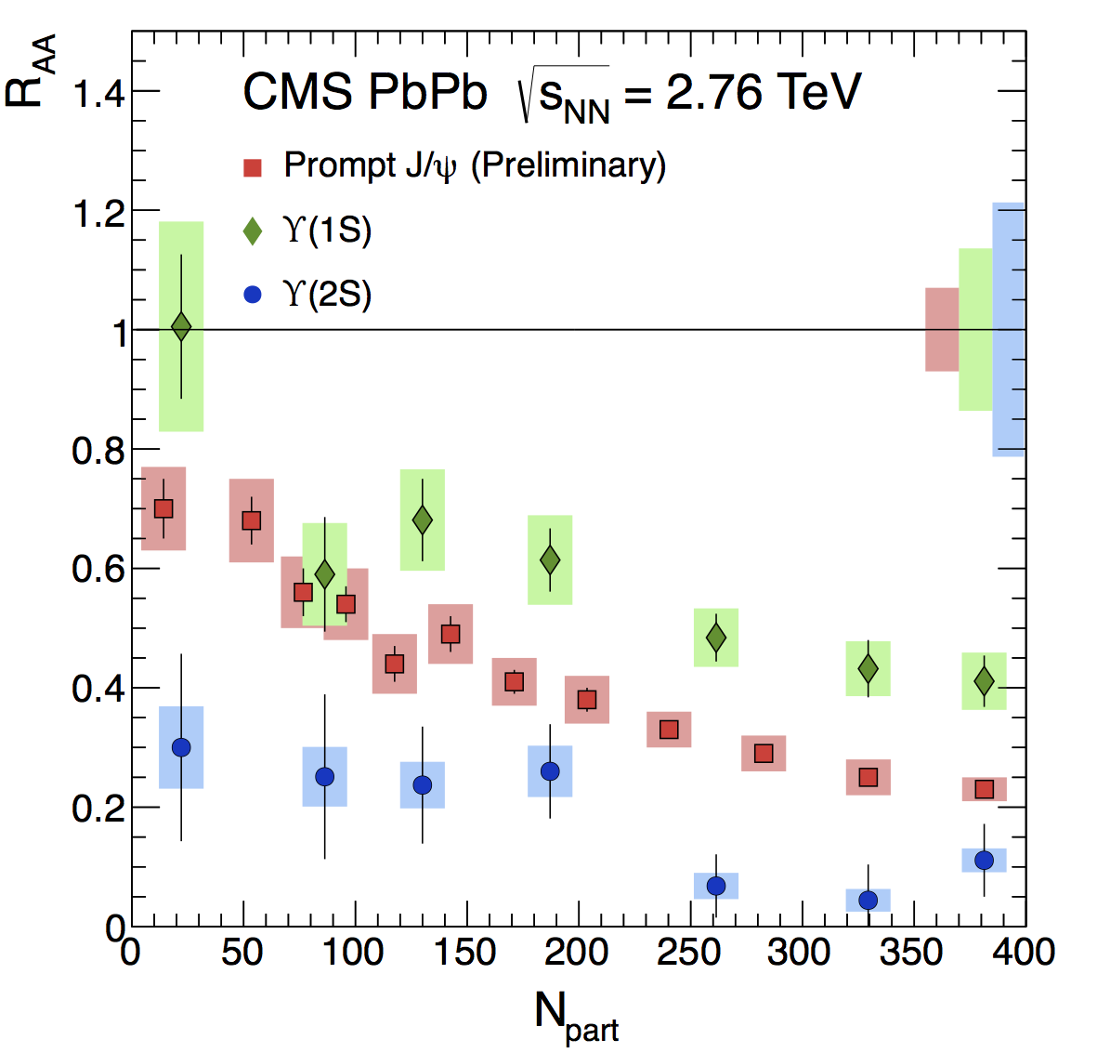
Building a quarkonium-thermometer
CMS-PAS HIN-11-011
Fraction survival
N_{part}
c
c
b
b
Clear hierarchy in R_{AA} of different quarkonium states

Slide 23
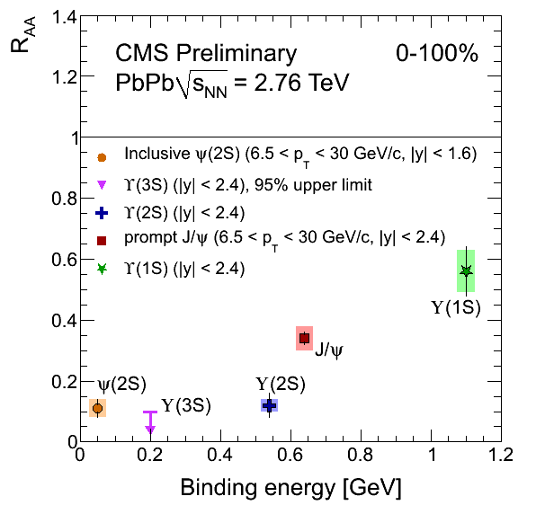
Building a quarkonium-thermometer
Note: 6.5<p_{T}<30 GeV for J/ψ and ψ(2s)
CMS-PAS HIN-11-011
Fraction survival
Fraction survival
Clear hierarchy in R_{AA} of different quarkonium states
CMS-PAS HIN-12-014, HIN-12-007

Slide 24
QGP Spectroscopy

Slide 25
Probing the Quark Gluon Plasma
Medium
Probe
Detector
Want a probe which traveled through the collision
QGP is very short-lived (~1-10 fm/c) →
cannot use an external probe

Slide 26
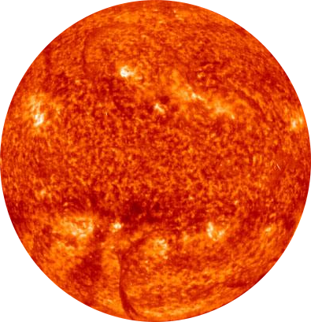
Probes of the Quark Gluon Plasma
nucleus
nucleus
Want a probe which traveled through the medium
QGP is short lived → need a probe created in the collision

Slide 27
Probes of the Quark Gluon Plasma
nucleus
nucleus
Want a probe which traveled through the medium
QGP is short lived → need a probe created in the collision We expect the medium to be dense → absorb/modify probe

Slide 28
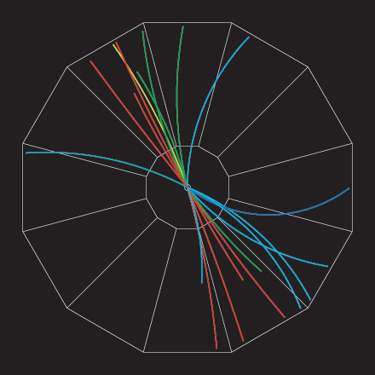
Jets
p+p → dijet
D
c, x_{c}
Beam pipe
a, x_{a}
b, x_{b}
p
σ_{ab}
p
d, x_{d}
D
Jets – hard parton scattering leads to back-to-back quarks or gluons, which then fragment as a columnated spray of particles

Slide 29
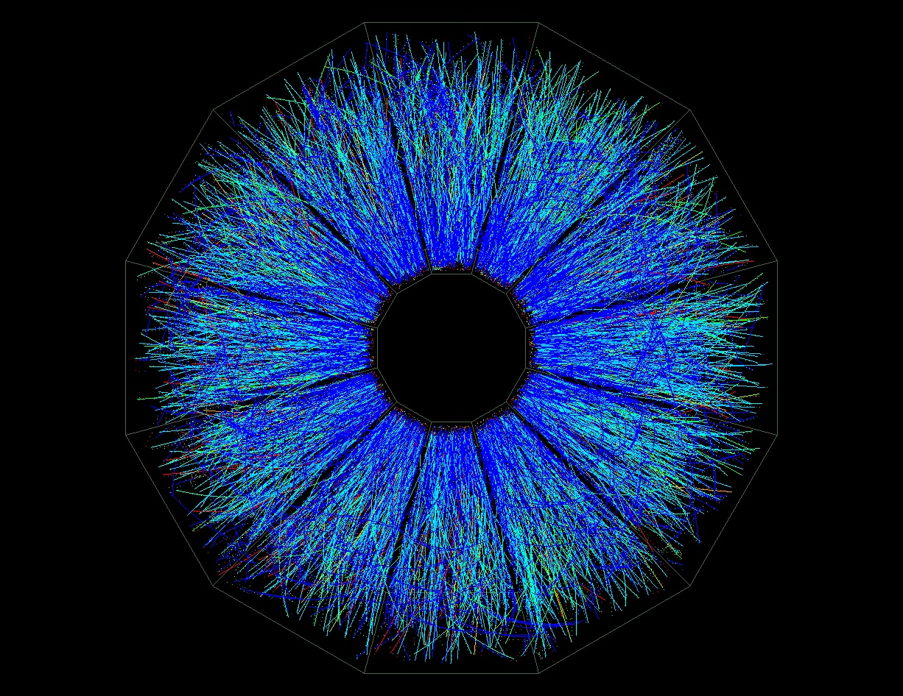
Jet reconstruction
p+p di-jet event in STAR
Central Au+Au collision in STAR
Identify all of the particles in the jet → parton energy, momentum
Difficult in heavy ion collisions – but possible!

Slide 30
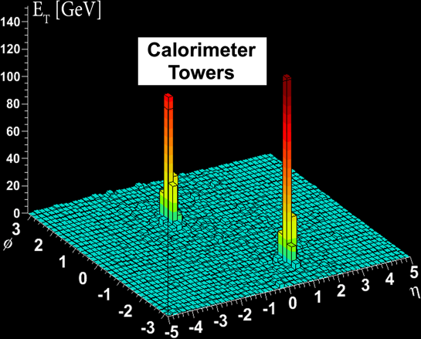
Jets
Phys.Rev.Lett. 105 (2010) 252303
nucleus
nucleus
ATLAS

Slide 31
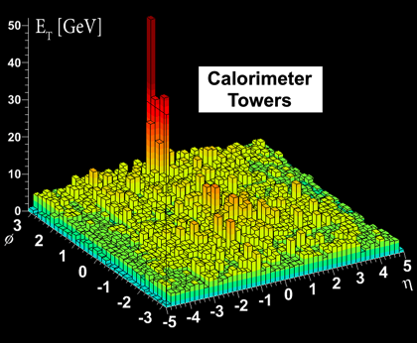
Quenched jets
nucleus
nucleus
One of the jets is absorbed by the medium
The quark or gluon has equilibrated with the medium
Phys. Rev. Lett. 105, 252303 (2010)
ATLAS

Slide 32
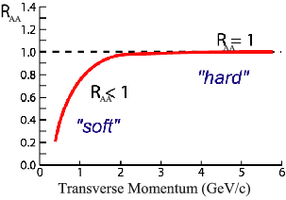
Nuclear modification factor
Measure spectra of probe (jets) and compare to those in p+p collisions or peripheral A+A collisions
If high-p_{T} probes (jets) are suppressed, this is evidence of jet quenching
Enhancement
Suppression

Slide 33
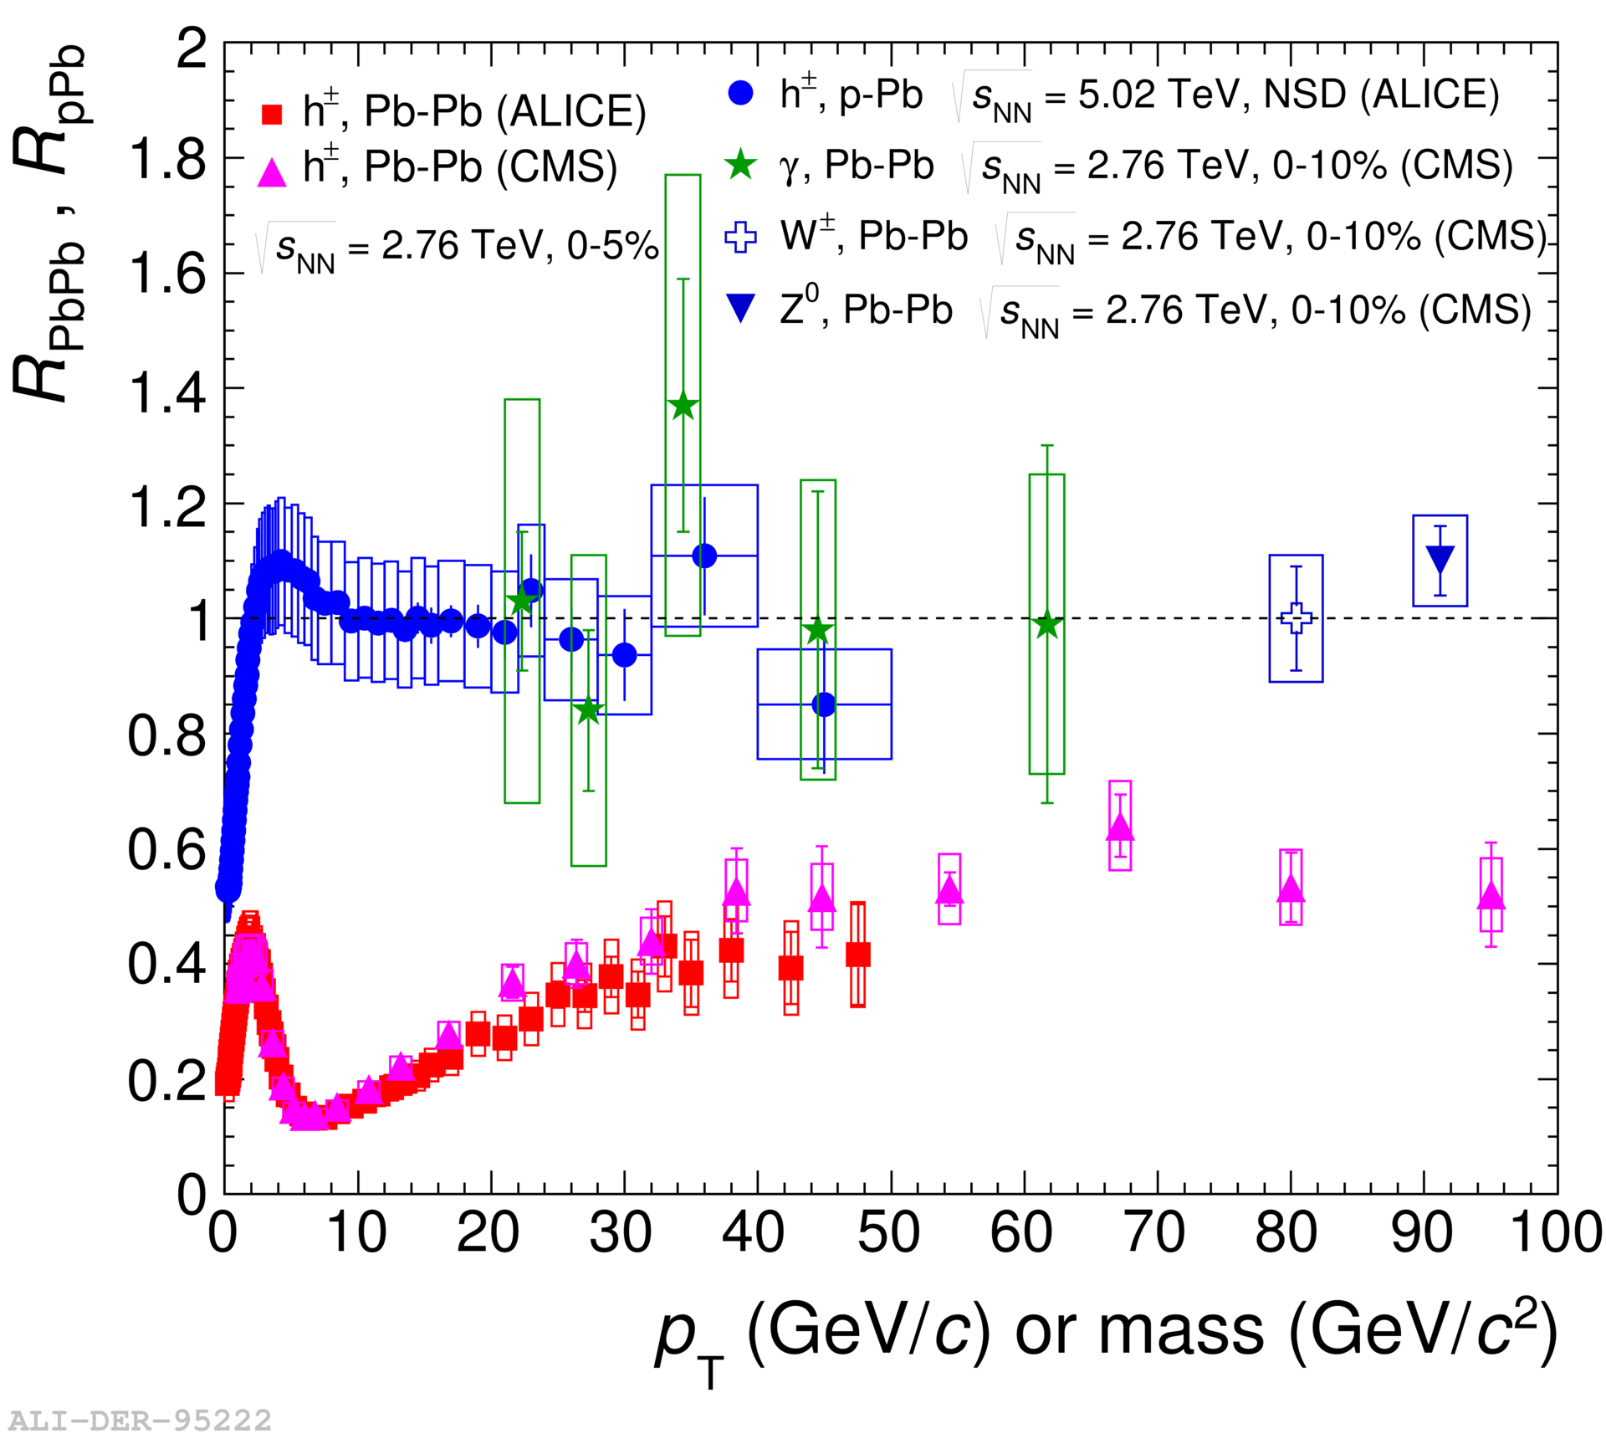
Nuclear modification factor
LHCb-PAPER-2017-015
Control
Control
Probe

Slide 34
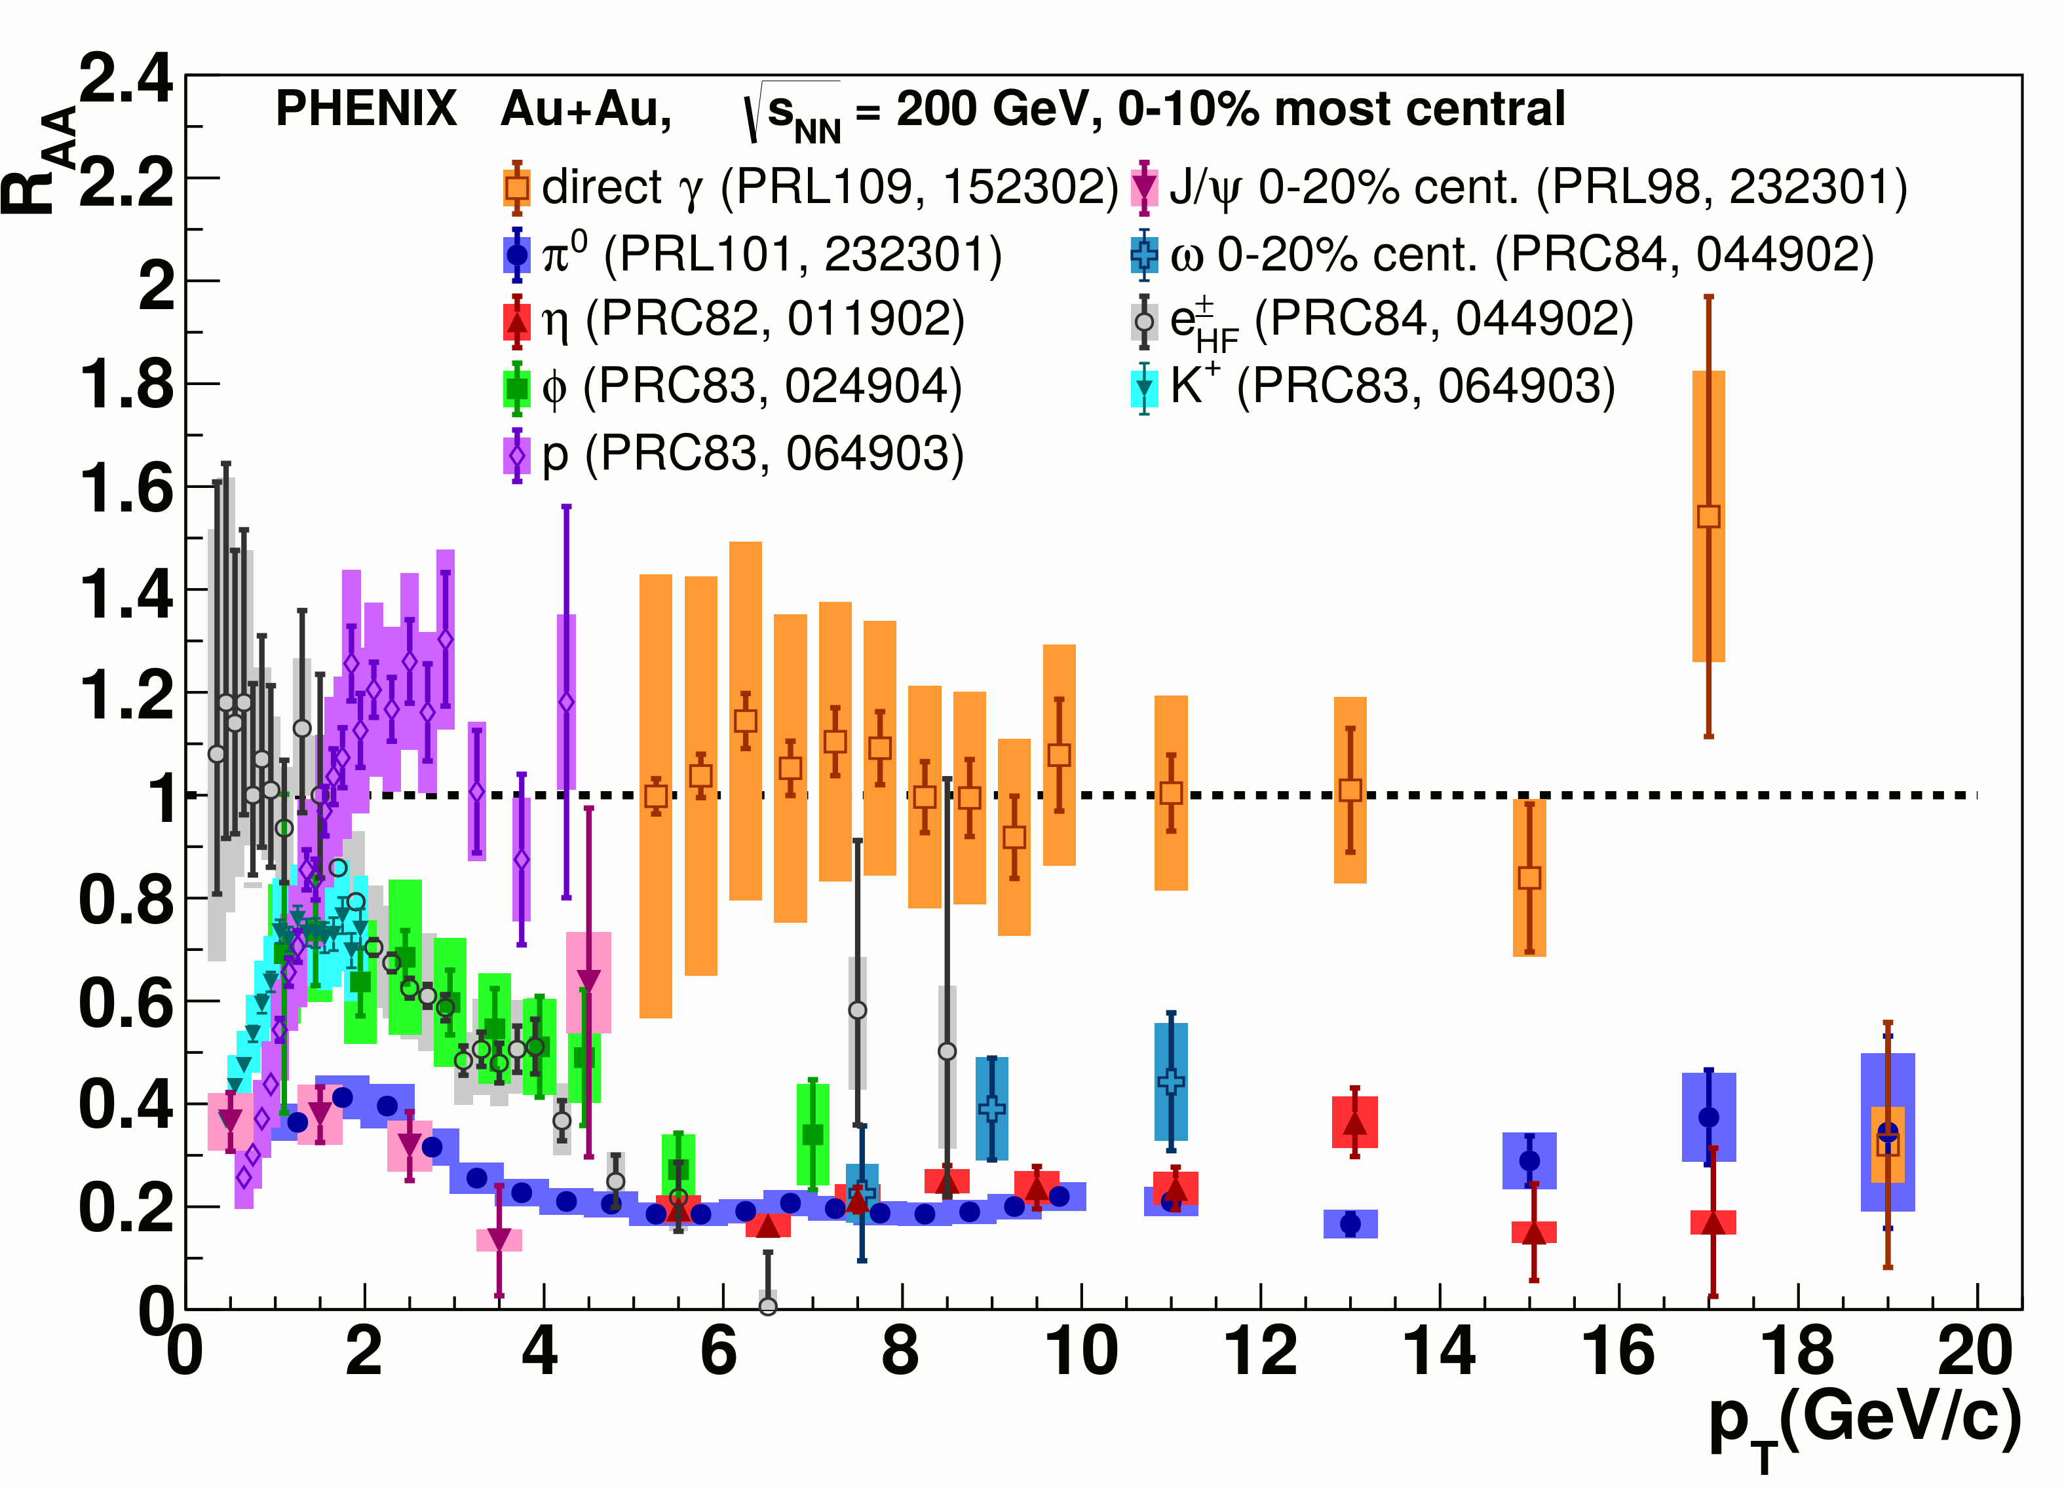
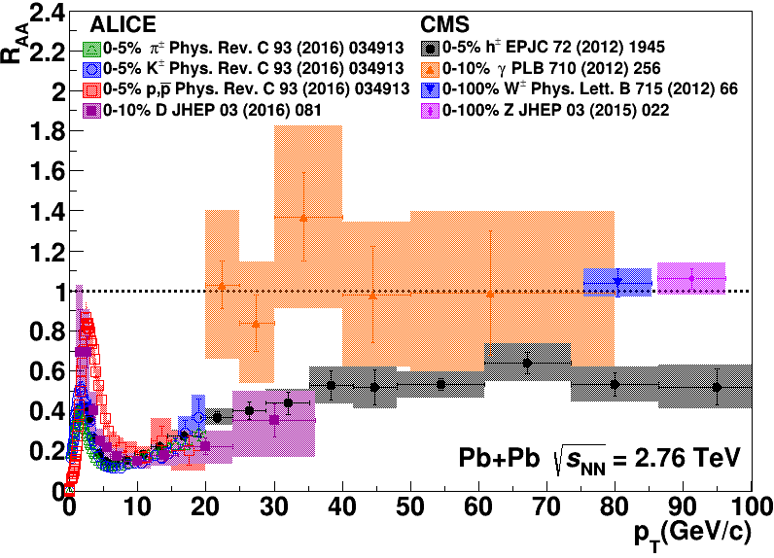
Nuclear modification factor R_{AA}
RHIC
LHC
Connors, Nattrass, Reed, SalurarXiv:1705.01974 [nucl-ex]
Electromagnetic probes – consistent with no modification – medium is transparent to them
Strong probes – significant suppression – medium is opaque to them - even heavy quarks!

Slide 35
Towards quantitative understanding

Slide 36
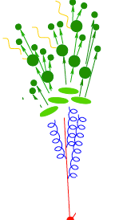
JET collaboration Phys. Rev. C 90, 014909 (2014)
Martini
HTM
$χ^{2}minimization$
QGP brick + jet
McGill
HTBW
Data
$\hat{q}=1.2±0.3 {GeV}^{2}$
200 GeV Au+Au
$\hat{q}=1.9±0.7 {GeV}^{2}$
2.76 TeV Pb+Pb

Slide 37
Bayesian Statistical Analysis Models and Data Analysis Initiative http://madai.us
Data
Prior
Monte Carlo
models
Model emulation
Run full model ~1000 times
MCMC parameter search uses emulator (interpolator) in lieu of full model
Posterior
Constraint of QGP properties Novak et al, Phys.Rev. C89 (2014) no.3, 034917
Optimization

Slide 38
Signal vs Background: The standard paradigm
Background
Signal

Slide 39
Signal vs Background: The standard paradigm
Background
Combinatorial jets
Signal

Slide 40
Signal vs Background: The standard paradigm
Background
Combinatorial jets
Signal
= “fake” jets

Slide 41
Signal vs Background: The standard paradigm
Background
Combinatorial jets
Signal
*Some gray areas

Slide 43
JETSCAPE Event generator Jet Energy-loss Tomography with a Statistically and Computationally Advanced Program Envelope http://jetscape.wayne.edu/
Realistic medium
Realistic
theoretical
calculations
Experimental
techniques
Realistic Monte Carlo Model
Realistic jets

Slide 44
Event Generator + Bayesian Statistical analysis
Realistic theoretical calculations
Data
Bayesian Statistical Analysis
Constraint of QGP properties

Slide 45
JETSCAPE Event generator Jet Energy-loss Tomography with a Statistically and Computationally Advanced Program Envelope http://jetscape.wayne.edu/
Realistic medium
Realistic
theoretical
calculations
Experimental
techniques
Realistic Monte Carlo Model
Works here
Realistic jets

Slide 46
Few heavy ion analyses in Rivet
Theorists don’t use Rivet
http://iterated-reality.com/en/2015/03/17/the-chicken-or-the-egg-causality-dilemma-solved-by-unity-consciousness/

Slide 47
Undergraduates!*
Left to right: Ricardo Santos (Berea), James Neuhaus, Jerrica Wilson, Mariah McCreary, Christine Nattrass, Austin Schmier (UTK)
*And one beginning graduate student with no programming experience

Slide 48
Course-based undergraduate research experience Ask me if you want more info!
3 semesters
15 students
8 women
3 minorities
3 non-traditional
All Rivet students
22 students
11 women
7 minorities
4 non-traditional

Slide 49
https://i.ytimg.com/vi/mZnv6LXD9qs/maxresdefault.jpg

Slide 50
Format data
Write analysis

Slide 51
Skills
Overview of high energy nuclear physics and how particle detectors work
Read a technical paper and understand it well enough to implement an analysis
Work well in a group where you are evaluated by the group’s success
Proficiency with the command line
Write a piece of code in C++
Code management with git
Write a paper in latex
Give a presentation

Slide 52
Keys to success
The right project
High physics emphasis, few prerequisite skills
Useful output for the PI
Low cost for project failure
Not time-sensitive
Feasible in ~135 hours
Diverse group of student skills, levels
Previous PI experience supervising UG research
Especially on the topic of research

Slide 53
Diversity
Results definitely sensitive to the instructor
Provides easy access to research
Lowers effort/student to supervising undergraduates
Allows C students to demonstrate skills
Develops faculty connections to students

Slide 54
Take home messages
If we get nuclear matter dense enough, we make a new phase of matter, which we produce in high energy heavy ion collisions.
This medium is extremely hot and dense...
...and opaque to colored probes and translucent to electromagnetic probes.
Build your own undergraduate army!

Slide 55
More information
Introductory lectures on the QGP
Overview of jets in heavy ion collisions
My syllabus

