Slide 1
Implementation of heavy ion analyses in Rivet
Antonio Da Silva
Christine Nattrass, Antonio Da Silva
University of Tennessee, Knoxville

Slide 2
The Lisbon Accord
Lisbon Accord proposed that heavy ion experiments adopt Rivet in July 2014
Fully heavy ion capable with June 2019 release of Rivet 3.0
https://www.aworldtotravel.com/things-lisbon-is-famous-for/

Slide 3
What is Rivet?
Robust Independent Validation of Experiment and Theory

Slide 4
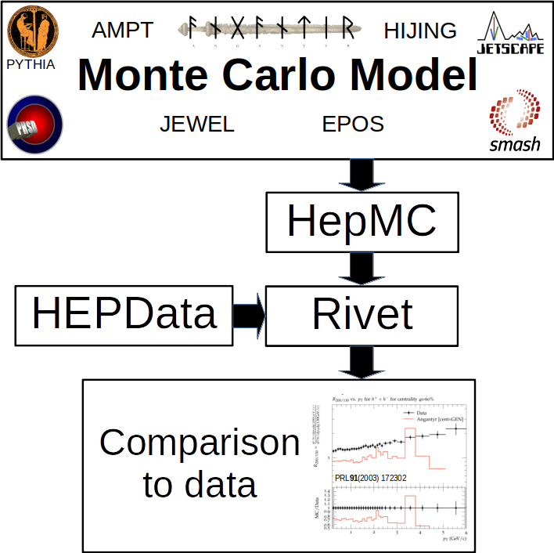

Slide 5
Why use Rivet?
Facilitates comparisons between Monte Carlos and data
It’s not that hard
It preserves analysis details
You can treat Monte Carlo like data

Slide 6
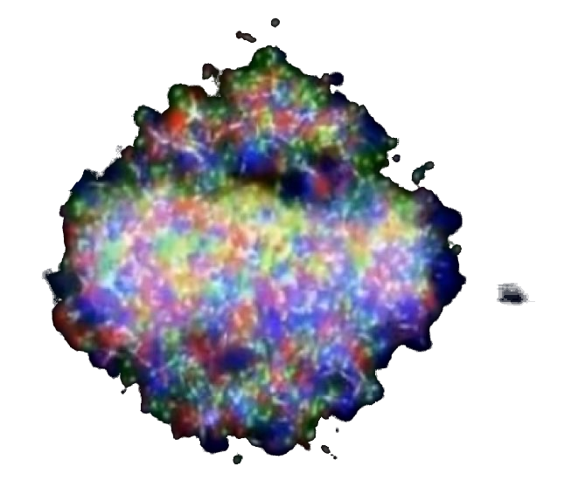
Signal vs Background: The standard paradigm
Background
Signal

Slide 7
Signal vs Background: The standard paradigm
Background
Combinatorial jets
Signal

Slide 8
Signal vs Background: The standard paradigm
Background
Combinatorial jets
Signal
*Some gray areas

Slide 9
Snowmass Accord: Apply the same algorithm to data and your model. Then the measurement and the calculation are the same.

Slide 10
Rivet: Apply the same algorithm to data and your model. Then the measurement and the calculation are the same.

Slide 11
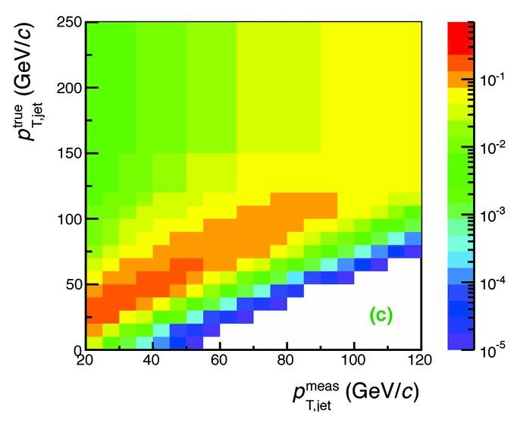
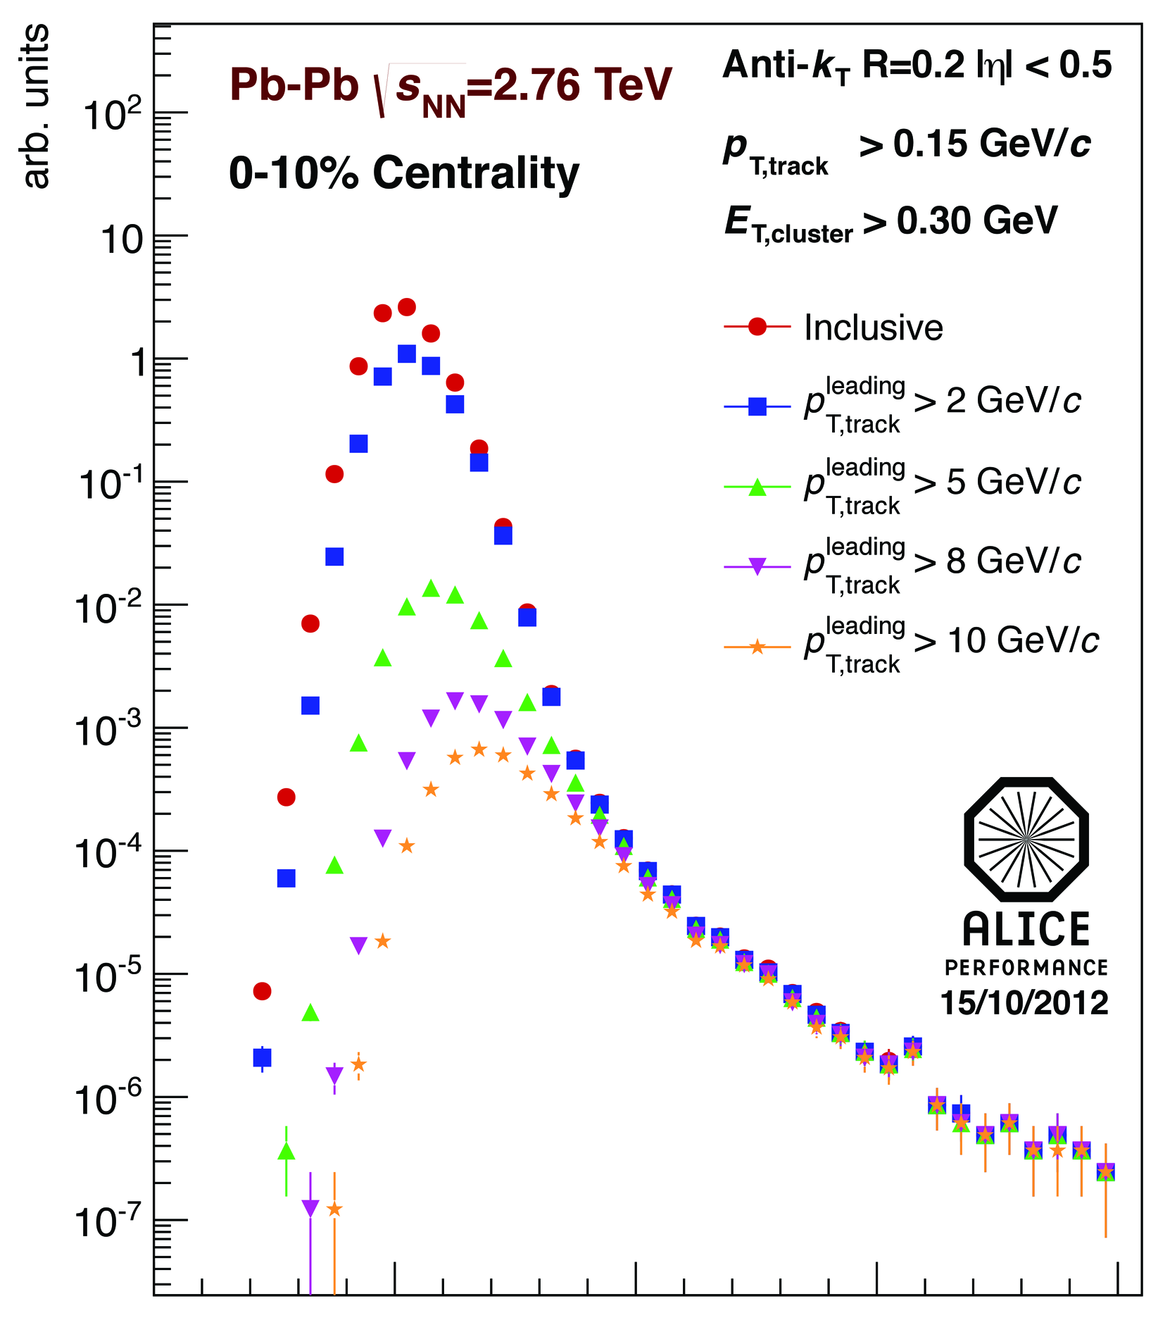
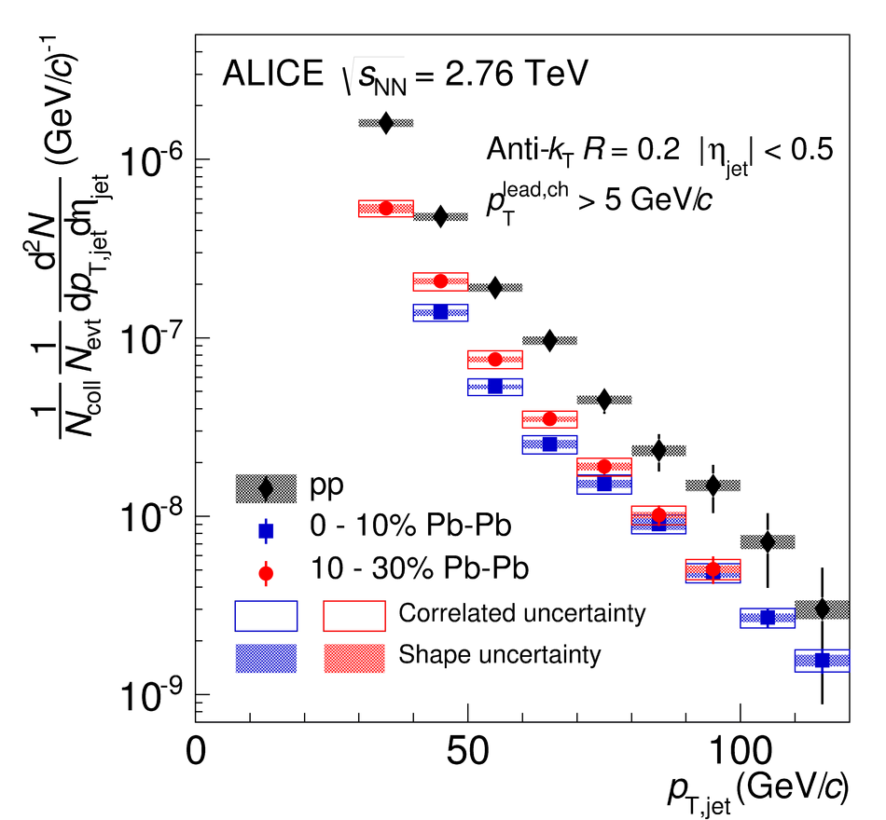
Analysis steps – Data
Tracks
Jet finding algorithm
Jet candidates
Background subtraction
Clusters
Phys. Lett. B 722 (2013) 262-272
Jet spectrum smeared by energy resolution, background fluctuations
Unfolding – corrects for single track reco ε, E resolution, background fluctuations
Corrected spectra

Slide 12
<footer>
Jets in ALICE: Response Matrix Construction
RMdet X RMbkg = RM
NOT A DETECTOR EFFECT!!
DETECTOR EFFECT
RM_{bkg} and RM_{det} are approximately factorizable
Notes:
----- Meeting Notes (6/24/13 16:47) -----
Put Large Labels on
b) change pT true -> pT rec so consistence
c) change gT true ->pT gen
<number>

Slide 13
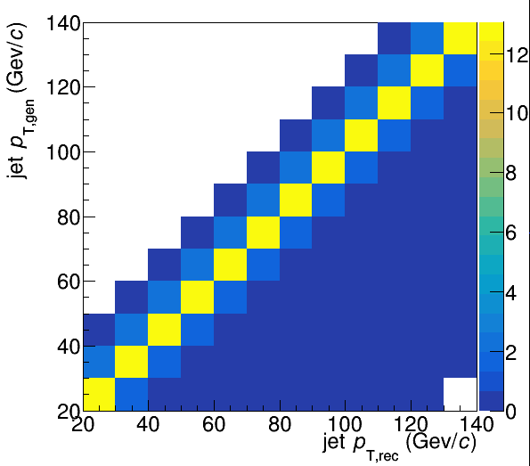
Energy is smeared in Monte Carlo!
PYTHIA Angantyr
See W. Witt, HP2020, A. Da Silva RHIC/AGS AUM 2020

Slide 14
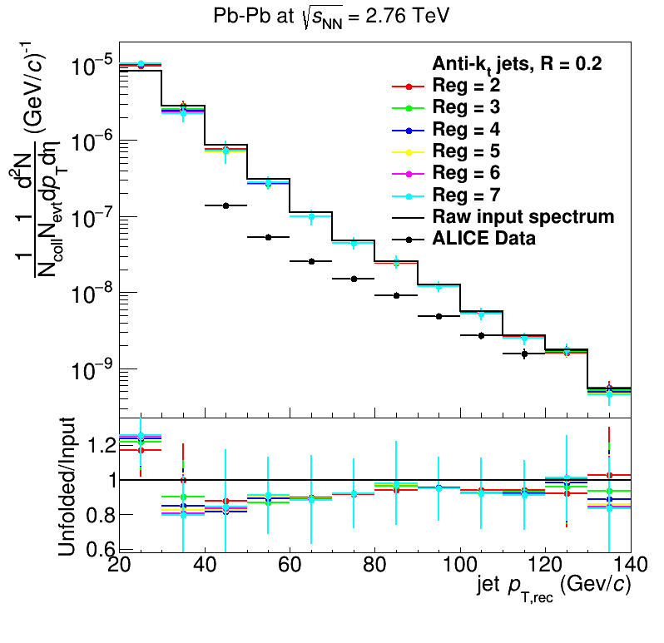
Analysis steps – Monte Carlo
Jet finding algorithm
Jet candidates
Background subtraction
Particles
PYTHIA Angantyr
JHEP 03 (2014) 013
Jet spectrum smeared by energy resolution, background fluctuations
Unfolding – corrects for background fluctuations
Corrected spectra

Slide 15
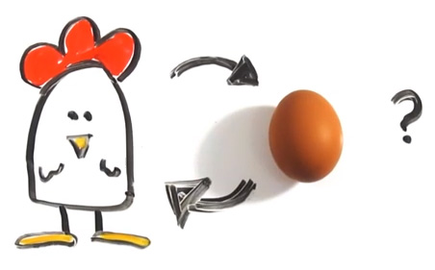
Few heavy ion analyses in Rivet
Theorists don’t use Rivet
http://iterated-reality.com/en/2015/03/17/the-chicken-or-the-egg-causality-dilemma-solved-by-unity-consciousness/

Slide 16
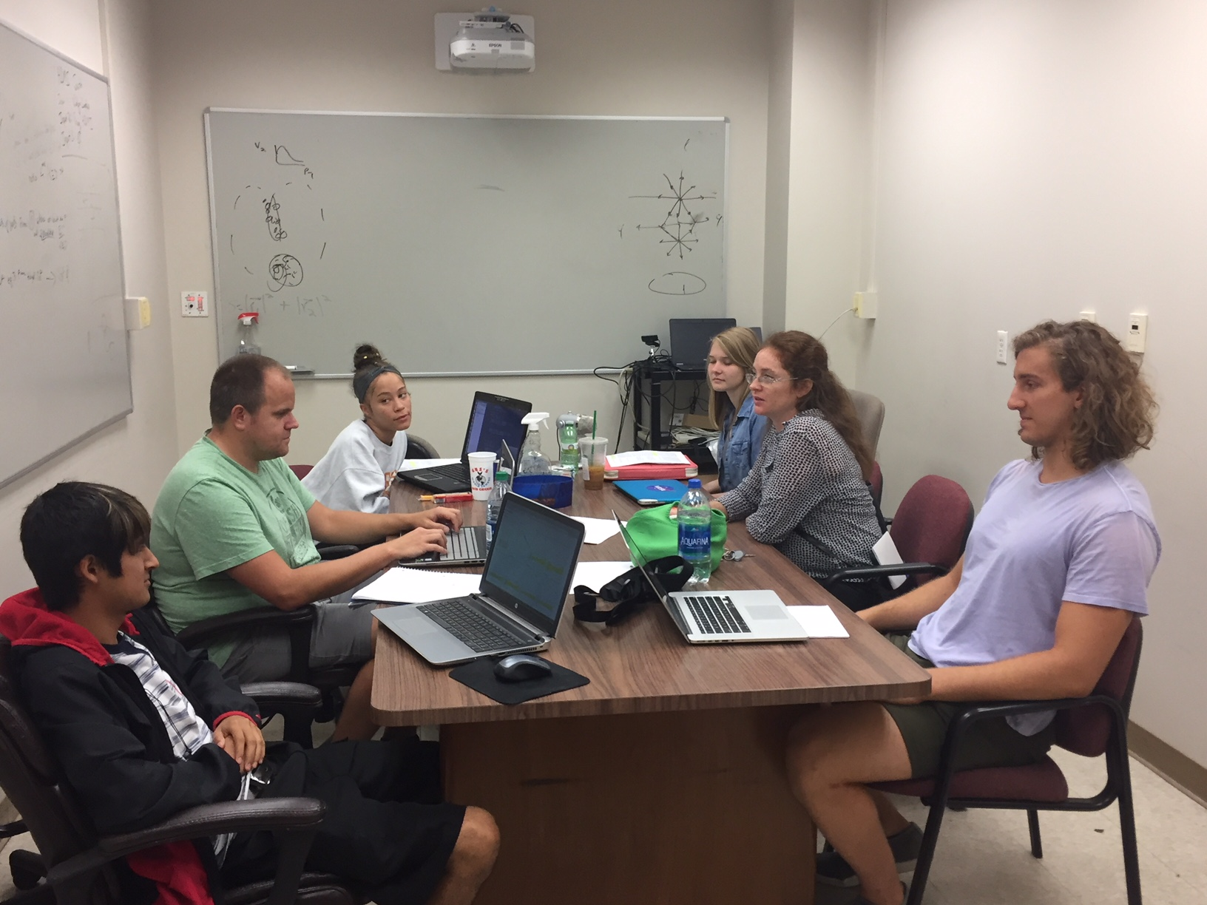
Undergraduates!*
Left to right: Ricardo Santos (Berea), James Neuhaus, Jerrica Wilson, Mariah McCreary, Christine Nattrass, Austin Schmier (UTK)
*And one beginning graduate student with no programming experience

Slide 17
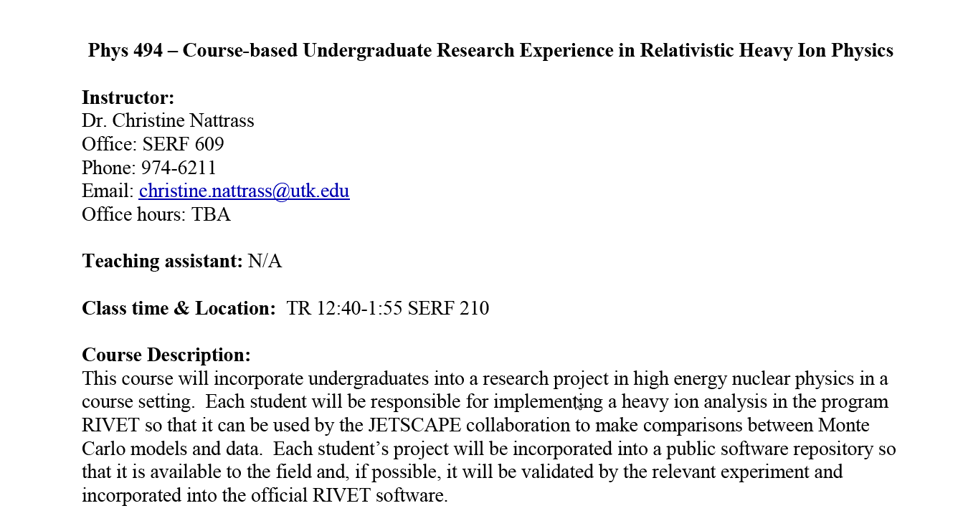
Course-based undergraduate research experience Ask me if you want more info!
3 semesters
15 students
8 women
3 minorities
3 non-traditional
All Rivet students
22 students
11 women
7 minorities
4 non-traditional

Slide 18
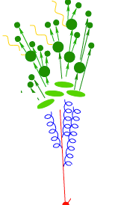
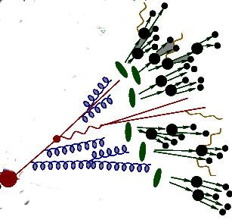
https://i.ytimg.com/vi/mZnv6LXD9qs/maxresdefault.jpg

Slide 19
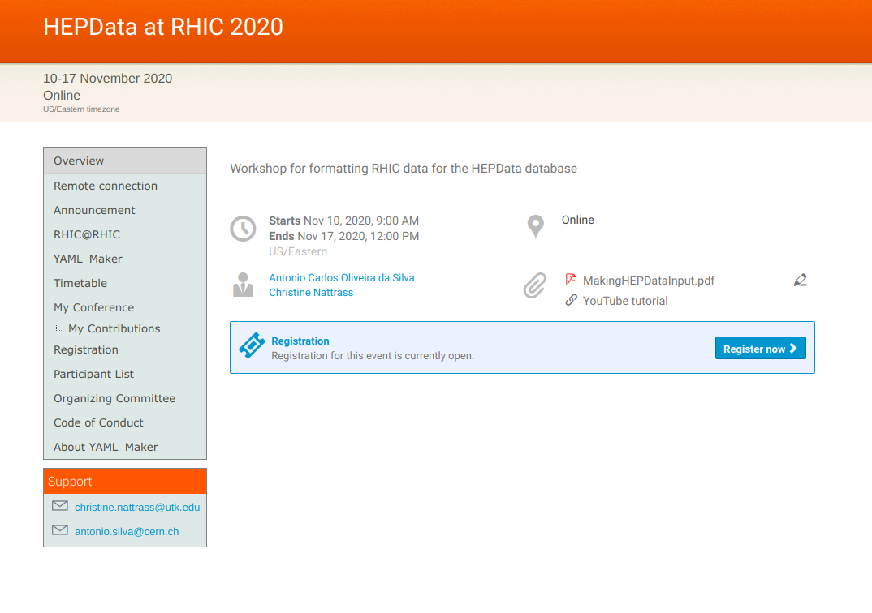
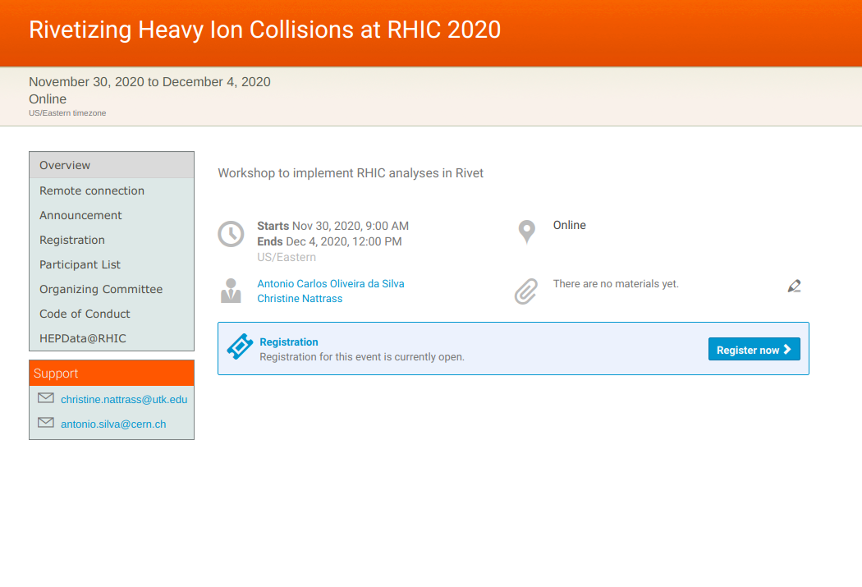
Learn Rivet yourself! Or send your students & postdocs!
https://indico.bnl.gov/event/8843/
https://indico.bnl.gov/event/8840

