Slide 1
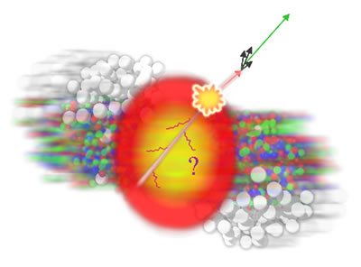
A skeptic’s guide to jets
Part 1: Jet spectra
Christine Nattrass
University of Tennessee, Knoxville

Slide 2
A skeptic’s guide to jets
Part 1: Jet spectra
Christine Nattrass
University of Tennessee, Knoxville

Slide 3
Acknowledgements
The following people contributed ideas and/or slides, but of course I take full responsibility for anything you don’t like:
Rosi Reed, Megan Connors, Sevil Salur
Abhijit Majumder, Raghav Kunnawalkam Elayavalli
Marta Verweij, Laura Havener
Austin Schmier, Charles Hughes, Will Witt

Slide 4
Questions an experimentalist should ask
What do I want to learn?
What am I measuring?
What assumptions am I making?
What are the dominant uncertainties?
How do I compare to models?
The answers for jets are highly non-trivial!

Slide 5

What do I want to learn?
The cartoon picture

Slide 6
Probing the Quark Gluon Plasma
Medium
Probe
Detector
Want a probe which traveled through the collision
QGP is very short-lived (~1-10 fm/c) →
cannot use an external probe

Slide 7
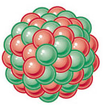
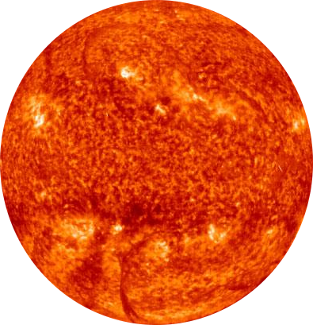
Probes of the Quark Gluon Plasma
Want a probe which traveled through the medium
QGP is short lived → need a probe created in the collision
nucleus
nucleus

Slide 8
Probes of the Quark Gluon Plasma
Want a probe which traveled through the medium
QGP is short lived → need a probe created in the collision
We expect the medium to be dense → absorb/modify probe
nucleus
nucleus

Slide 9
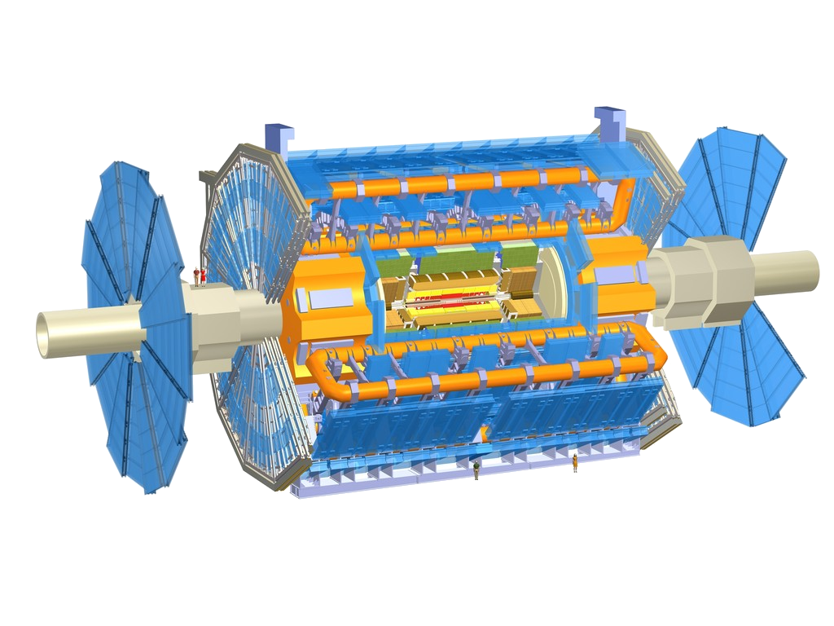
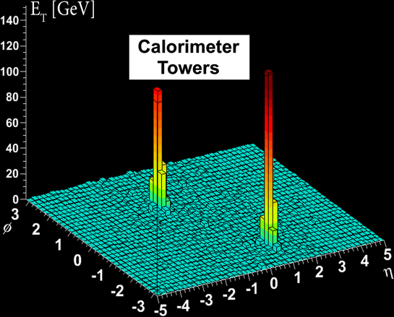
Probes of the Quark Gluon Plasma
ATLAS
nucleus
Phys.Rev.Lett. 105 (2010) 252303
nucleus

Slide 10
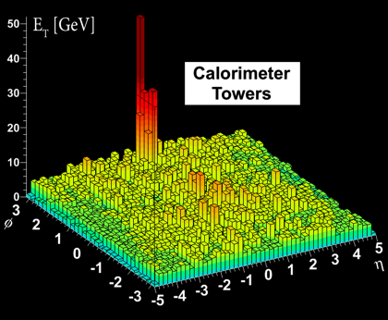
Probes of the Quark Gluon Plasma
ATLAS
Phys.Rev.Lett. 105 (2010) 252303
nucleus
Phys.Rev.Lett. 105 (2010) 252303
nucleus

Slide 11
“Simple” example: Single hadrons

Slide 12
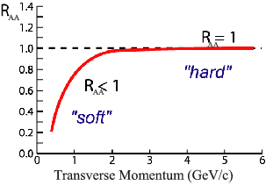
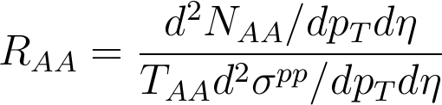
Nuclear modification factor
Measure spectra of probe (jets) and compare to those in p+p collisions or peripheral A+A collisions
If high-p_{T} probes (jets) are suppressed, this is evidence of jet quenching
Enhancement
Suppression

Slide 13
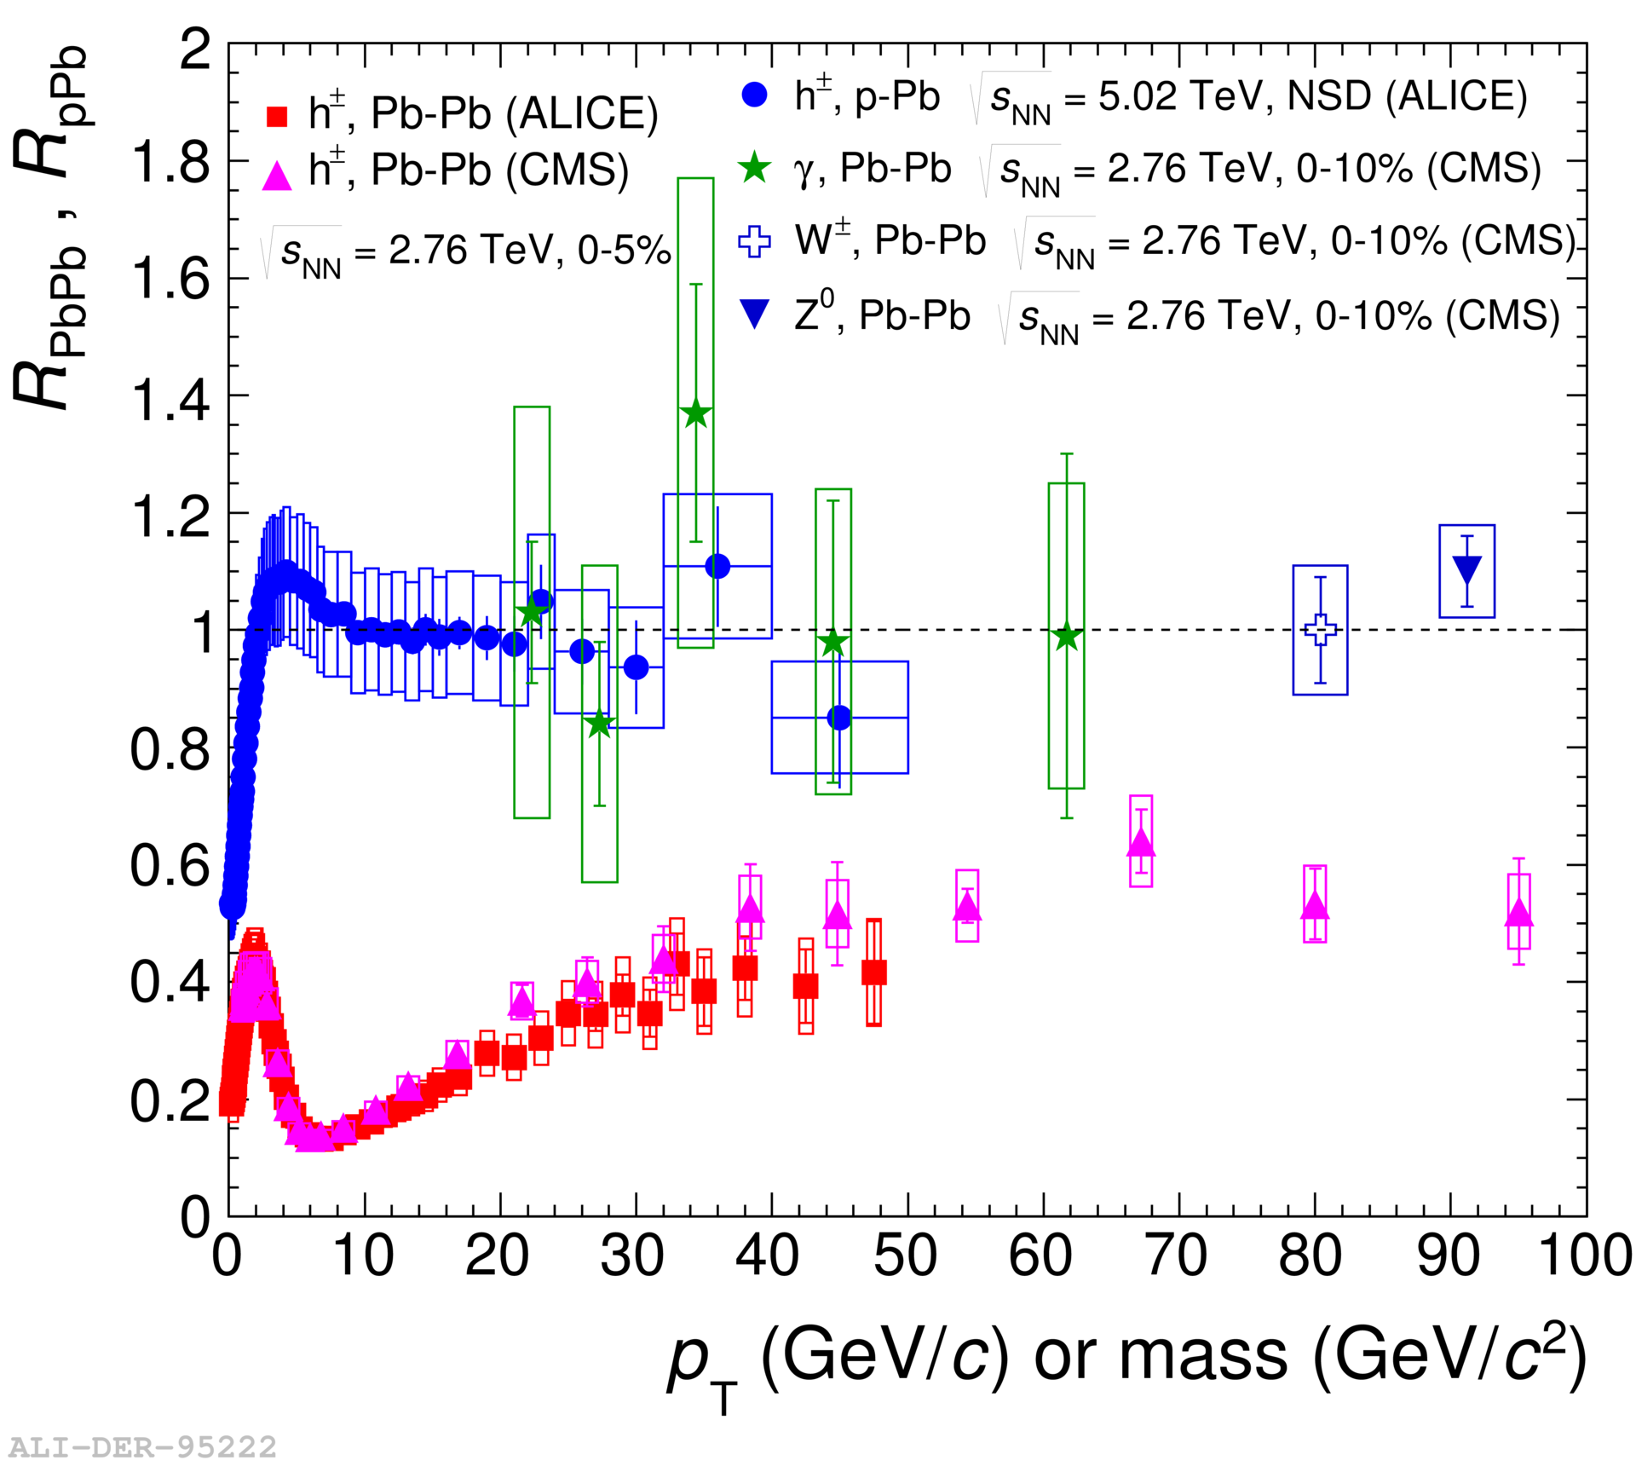
Nuclear modification factor
LHCb-PAPER-2017-015
Control
Control
Probe
Charged hadrons (colored probes) suppressed in Pb—Pb
Charged hadrons not suppressed in p—Pb at midrapidity
Electroweak probes not suppressed in Pb—Pb

Slide 14
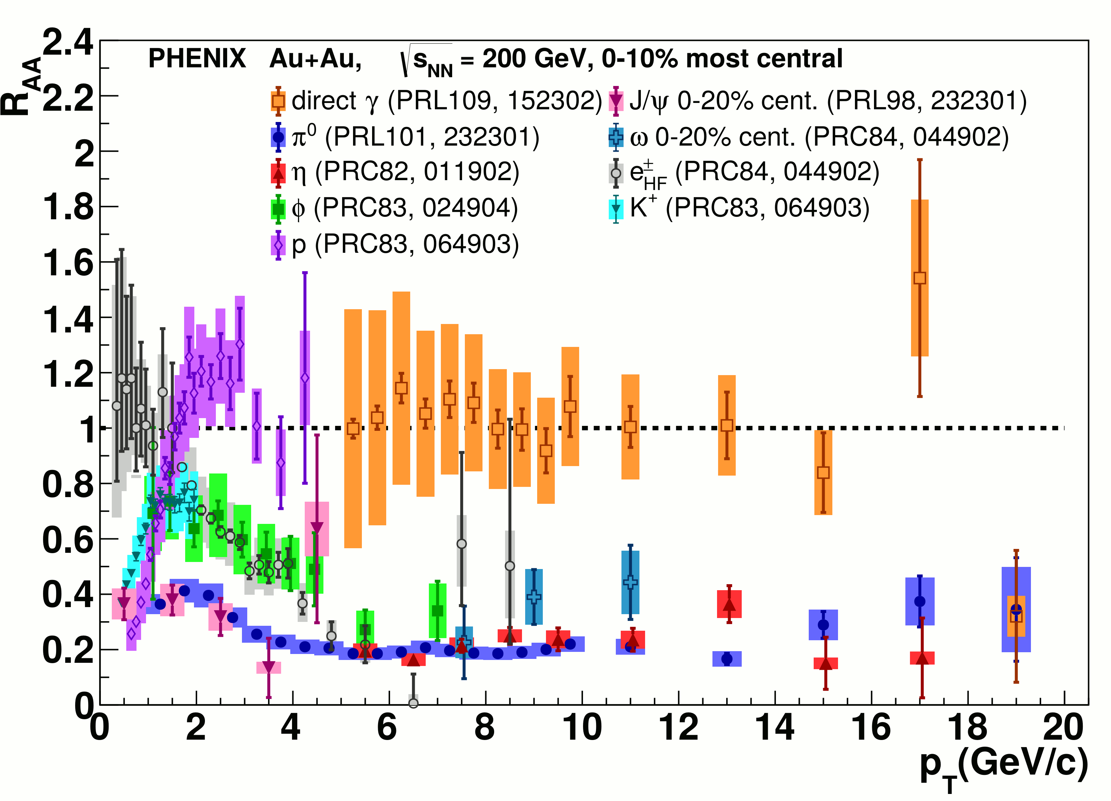
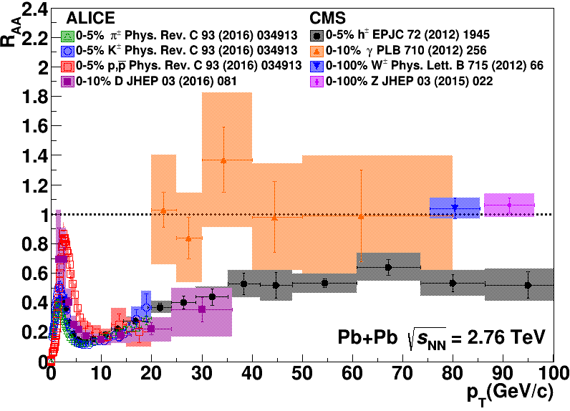
Nuclear modification factor R_{AA}
Connors, Nattrass, Reed, Salur
Rev. Mod. Phys. 90, 025005 (2018).
RHIC
LHC
Electromagnetic probes – consistent with no modification – medium is transparent to them
Strong probes – significant suppression – medium is opaque to them - even heavy quarks!

Slide 15
What am I measuring?
Definition of a jet

Slide 16
Theoretical calculations

Slide 17
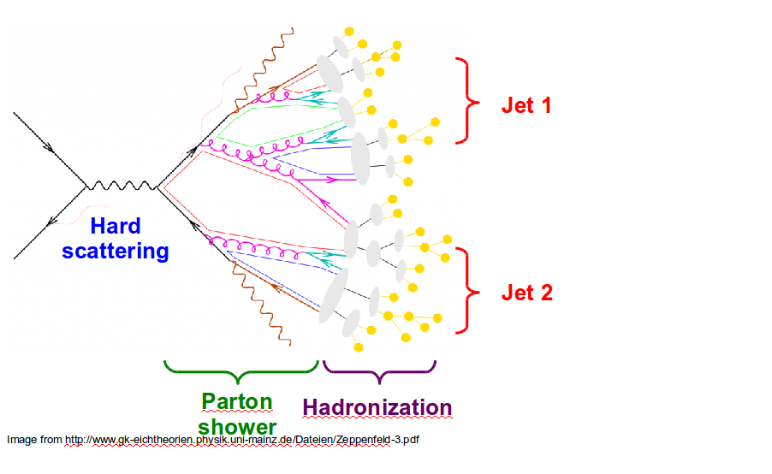
Factorization theorem
perturbative
fragmentation
Assumption: Parton distribution functions, perturbative cross section, fragmentation function factorize
What people really mean by “perturbatively calculable”
  D and f are explicitly non-perturbative!
  D is for parton c → hadron h
  Not what is experimentally measured
Most theories for jet quenching modify fragmentation function D
a
b
$\frac{d^{3}σ^{h}}{dyd^{2}p_{T}}=\frac{1}{π}\int{d}x_{a}\int{d}x_{b}f_{a}^{A}\left(x_{a}\right)f_{b}^{B}\left(x_{b}\right)\frac{dσ_{ab→cX}}{d\hat{t}}\frac{D_{c}^{h}\left(z\right)}{z}$

Slide 18
Jet finders

Slide 19
What is a jet?

Slide 20
What is a jet?
A measurement of a jet is a measurement of a parton.

Slide 21
What is a jet?
A measurement of a jet is a measurement of a parton.

Slide 22
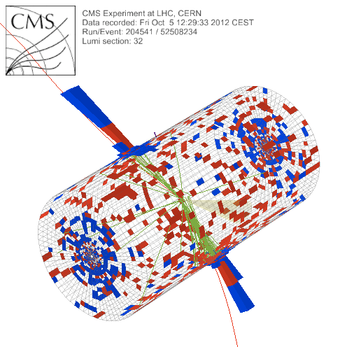
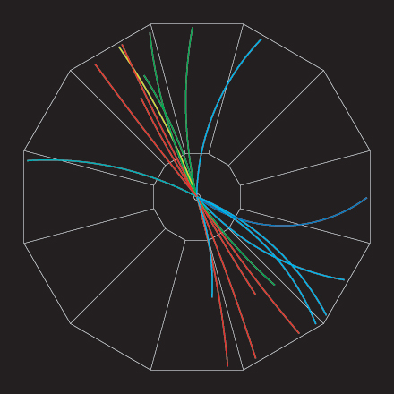
What is a jet?
p+p dijet
Beam pipe

Slide 23
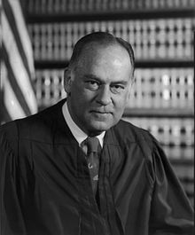
What is a jet?
p+p dijet
Beam pipe
“I know it when I see it”
US Supreme Court Justice Potter Stewart, Jacobellis v. Ohio

Slide 24
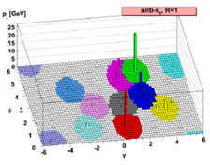
Jet finding algorithms
Tracks
Jet finding algorithm
Jet candidates
Clusters
Particles
Any list of objects works as input
Use the same algorithm on theory & experiment
Output only as good as input
M. Cacciari, G. P. Salam, G.Soyez, JHEP 0804:063,2008

Slide 25
in pp collisions
Jet finding
Jet finder: groups final state particles into jet candidates
  Anti-k_{T} algorithm
  JHEP 0804 (2008) 063 [arXiv:0802.1189]
Depends on hadronization
Ideally
  Infrared safe
  Colinear safe
Snowmass Accord: Theoretical calculations and experimental measurements should use the same jet finding algorithm. Otherwise they will not be comparable.

Slide 26
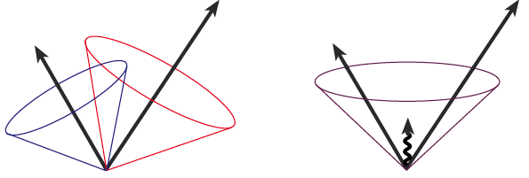
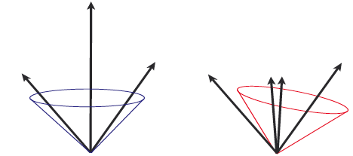
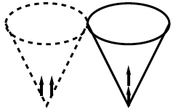
Jets in principle
Jet measures partons
Hadronic degrees of freedom are integrated out
Algorithms are infrared and colinear safe
OK
BAD: 2 jets are merged in one

Slide 27
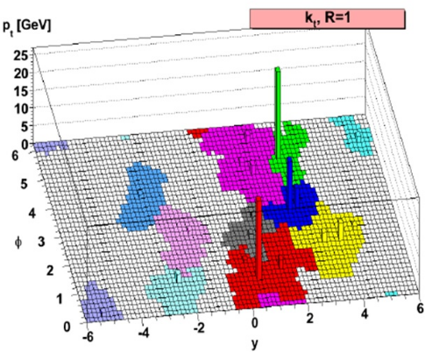
k_{T} jet finding algorithm
Particles, clusters
k_{T} algorithm
$k_{T}=p_{T},ΔR_{ij}=\sqrt{{\left(η_{i}−η_{j}\right)}^{2}+{\left(ϕ_{i}−ϕ_{j}\right)}^{2}}$
For all i,j calculate:
Combine smallest d_{ij}.
If d_{iB} smallest, d_{iB}→ jet
Repeat until no particles left
$d_{ij}=min\left(p_{T,i}^{2},p_{T,j}^{2}\right)\frac{ΔR_{ij}^{2}}{R^{2}}$
$d_{iB}=p_{T,i}^{2}$
Jet candidates

Slide 28
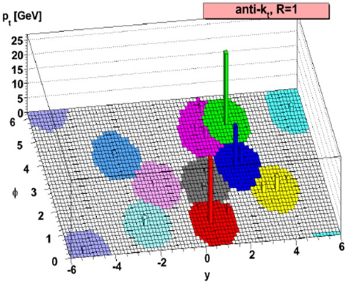
anti-k_{T} jet finding algorithm
Particles, clusters
k_{T} algorithm
$k_{T}=p_{T},ΔR_{ij}=\sqrt{{\left(η_{i}−η_{j}\right)}^{2}+{\left(ϕ_{i}−ϕ_{j}\right)}^{2}}$
For all i,j calculate:
Combine smallest d_{ij}.
If d_{iB} smallest, d_{iB}→ jet
Repeat until no particles left
$d_{ij}=min\left(p_{T,i}^{−2},p_{T,j}^{−2}\right)\frac{ΔR_{ij}^{2}}{R^{2}}$
$d_{iB}=p_{T,i}^{−2}$
Jet candidates

Slide 29
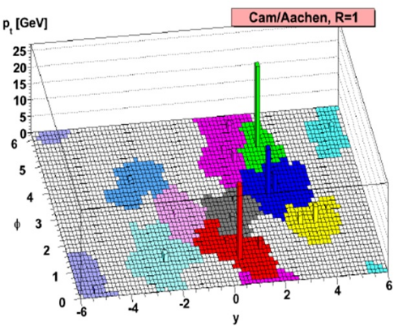
Cambridge/Aachen jet finding algorithm
Particles, clusters
k_{T} algorithm
$k_{T}=p_{T},ΔR_{ij}=\sqrt{{\left(η_{i}−η_{j}\right)}^{2}+{\left(ϕ_{i}−ϕ_{j}\right)}^{2}}$
For all i,j calculate:
Combine smallest d_{ij}.
If d_{iB} smallest, d_{iB}→ jet
Repeat until no particles left
$d_{ij}=\frac{ΔR_{ij}^{2}}{R^{2}}$
$d_{iB}=1$
Jet candidates

Slide 30
A jet is what a jet finder finds.

Slide 31
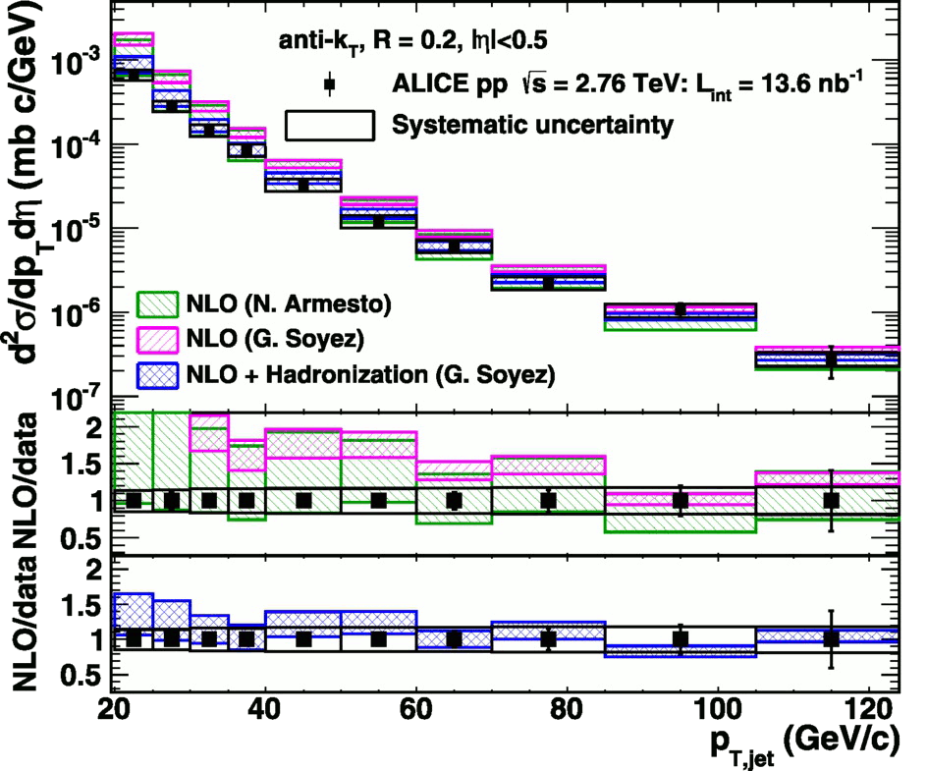

<footer>
Jet cross-section in pp
√s = 2.76 TeV, R = 0.2 Inclusive
arXiv:1301.3475
PLB: 10.1016/j.physletb.2013.04.026
Green and magenta bands: NLO on Parton level
Blue band: NLO + hadronization
Hadronization calculations necessary to describe data
Notes:
----- Meeting Notes (6/24/13 16:47) -----
PRB -> PLB
Mention lack of bias
Make Large figure
<number>

Slide 32
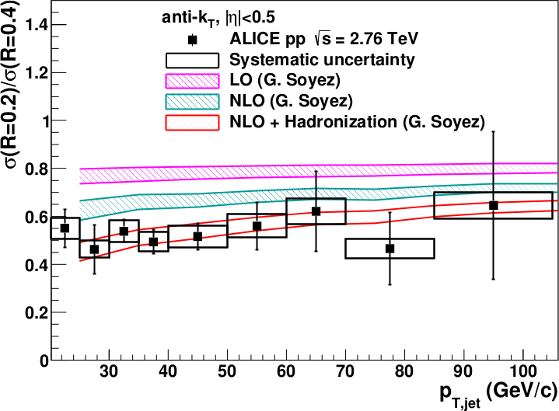
<footer>
Jet ratios in pp
√s = 2.76 TeV, R = 0.2, 0.4 Inclusive
arXiv:1301.3475
PLB: 10.1016/j.physletb.2013.04.026
Data and NLO+ hadronization calculations agree well
Notes:
----- Meeting Notes (6/24/13 16:47) -----
PRB -> PLB
mention ratio
<number>

Slide 33
Mini-summary
Tracks
Jet finding algorithm
Jet candidates
Clusters
Particles
Jets are not partons
Good jet finders:
  Infrared and colinear safe
  k_{T}, anti-k_{T}, Cambridge/Aachen, SISCone
Jet is defined by jet finder, its parameters
PDFs, fragmentation functions non-perturbative
→ all jet measurements sensitive to somewhat non-perturbative effects
Good agreement between theory and experiment

Slide 34
Jets in A+A collisions
What assumptions am I making?

Slide 35
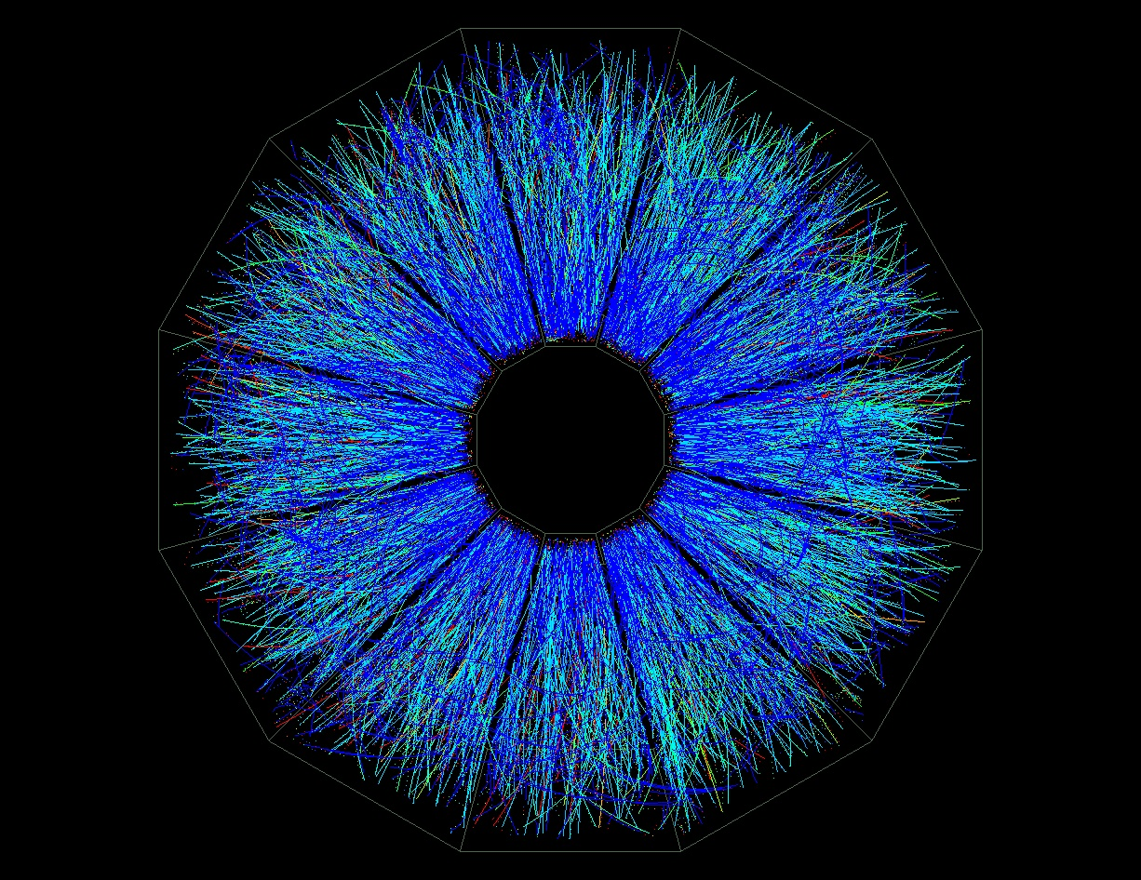
p+p vs A+A
p+p di-jet event in STAR
Central Au+Au collision in STAR

Slide 36
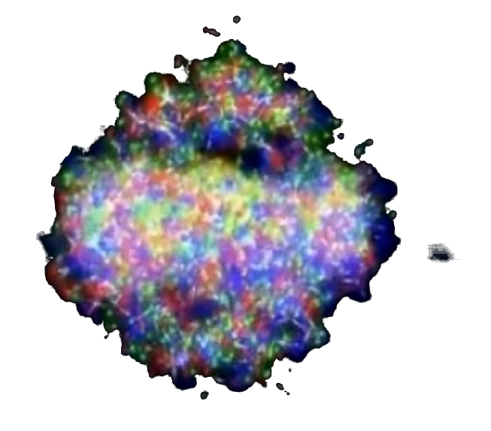
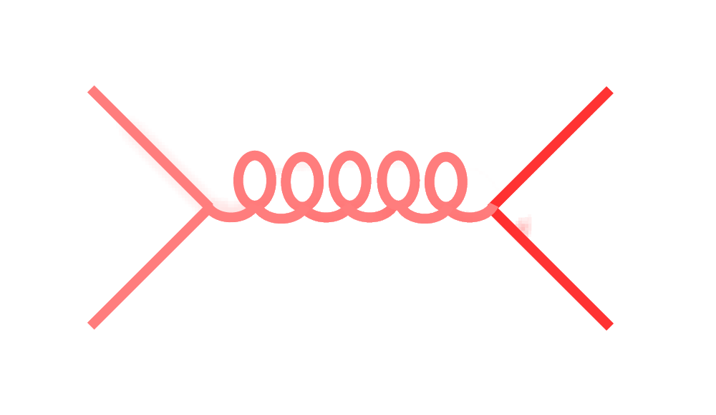
Signal vs Background:
The standard paradigm
Background
Signal

Slide 37
Signal vs Background:
The standard paradigm
Background
Combinatorial jets
Signal

Slide 38
Signal vs Background:
The standard paradigm
Background
Combinatorial jets
Signal
= “fake” jets

Slide 39
Signal vs Background:
The standard paradigm
Background
Combinatorial jets
Signal
*Some gray areas

Slide 40
in AA collisions
Jet finding
Jet finder: groups final state particles into jet candidates
  Anti-k_{T} algorithm
  JHEP 0804 (2008) 063 [arXiv:0802.1189]
Combinatorial jet candidates
Energy smearing from background
Sensitive to methods to suppress combinatorial jets and correct energy
Focus on narrow/high energy jets

Slide 41
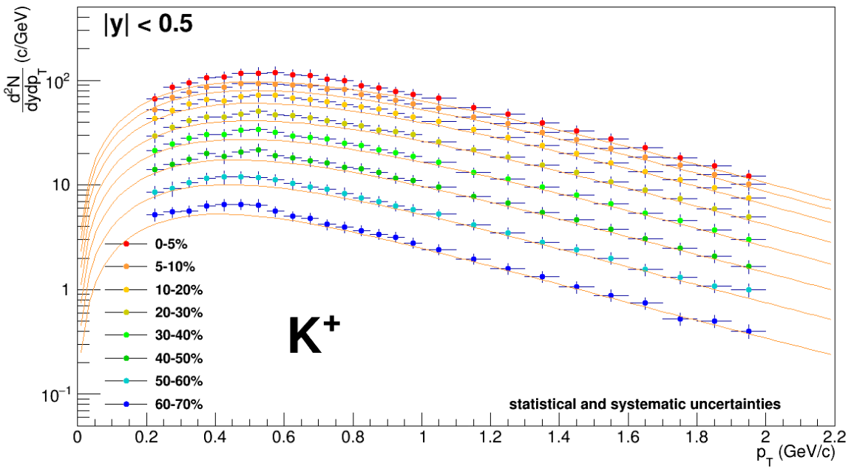
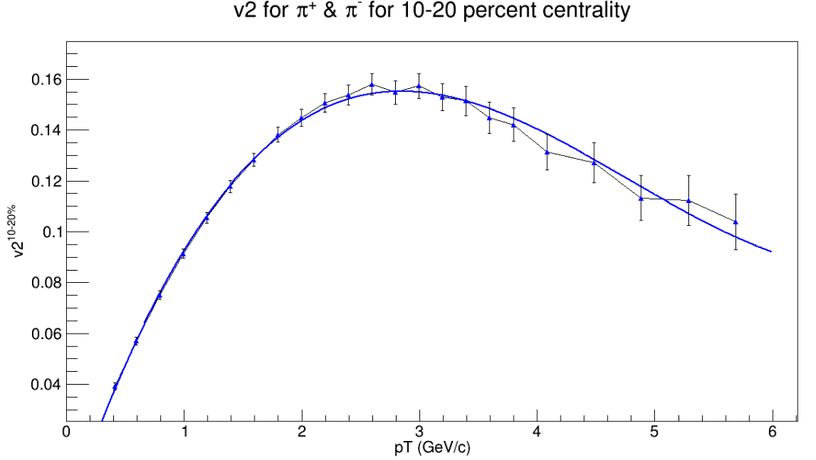

TennGen background generator
Event properties
Track properties
ε₁
ε₃
Momentum spectra
Blast Wave Fit
dN/dy
Random p_{T}
ε₂, ε₄, ε₆
ALICE PLB720 (2013) 52-62
ε₅
p_{T}
Even event planes fixed at Ψ=0
Odd planes at random φ
Multiplies from ALICE PRC88 (2013) 044910
Polynomial Fit
v_{n}
v_{n}
ALICE JHEP 1609 (2016) 164
Azimuthal asymmetries
Random φ
No jets! No resonances
Emulates hydro correlations
p_{T}

Slide 42
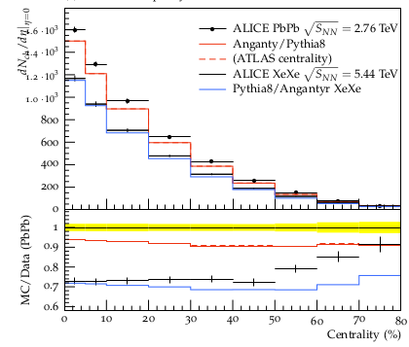
PYTHIA Angantyr
JHEP (2018) 2018: 134
Based on PYTHIA 8
Sjöstrand, Mrenna & Skands,
JHEP05 (2006) 026
Comput. Phys. Comm. 178 (2008) 852.
Based on Fritiof & wounded nucleons
N-N collisions w/fluctuating radii → fluctuating σ
Lots of jets! And resonances!
No hydrodynamics, no jet quenching

Slide 43
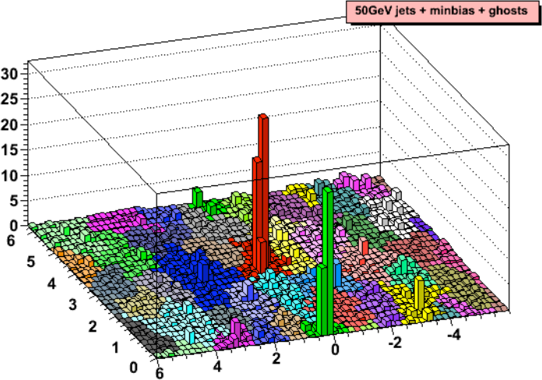
Area-based background subtraction
Cacciari & Salam, PLB659:119–126,2008
Particles, clusters
k_{T} algorithm
Cacciari DIS 2006
$k_{T}=p_{T},ΔR_{ij}=\sqrt{{\left(η_{i}−η_{j}\right)}^{2}+{\left(ϕ_{i}−ϕ_{j}\right)}^{2}}$
For all i,j calculate:
Combine smallest d_{ij}.
If d_{iB} smallest, d_{iB}→ jet
Repeat until no particles left
$d_{ij}=min\left(p_{T,i}^{2},p_{T,j}^{2}\right)ΔR_{ij}^{2}$
Energy (arb. units)
$d_{iB}=p_{T,i}$
Cacciari & Salam
Phys.Lett.B641:57-61,2006
Jet candidates
$ϕ$
Median ρ=p_{T}/A
$η$
$p_{T}^{jet}=p_{T}^{reco}−ρ_{median}A^{jet}$

Slide 44
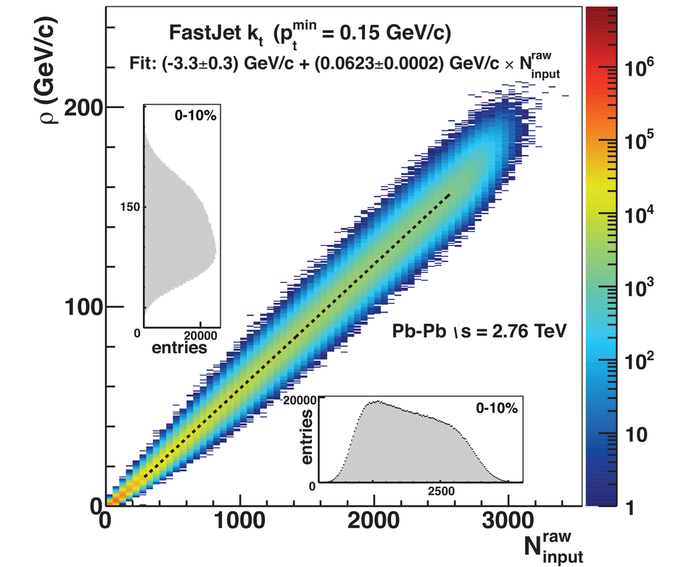
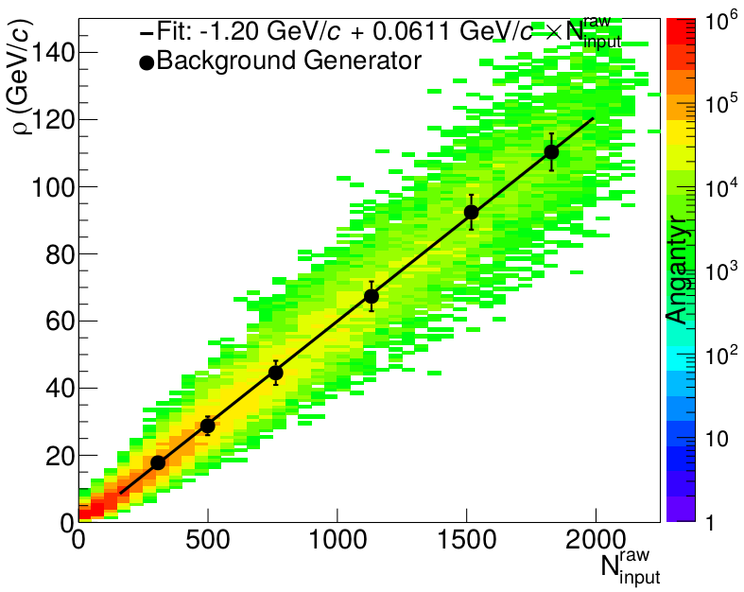
Background density ρ
`
ALICE
arXiv:2005.02320

Slide 45
Random cones
X
Excluded
$ϕ$
R=0.4
Real jets
Excluded
$η$

Slide 46
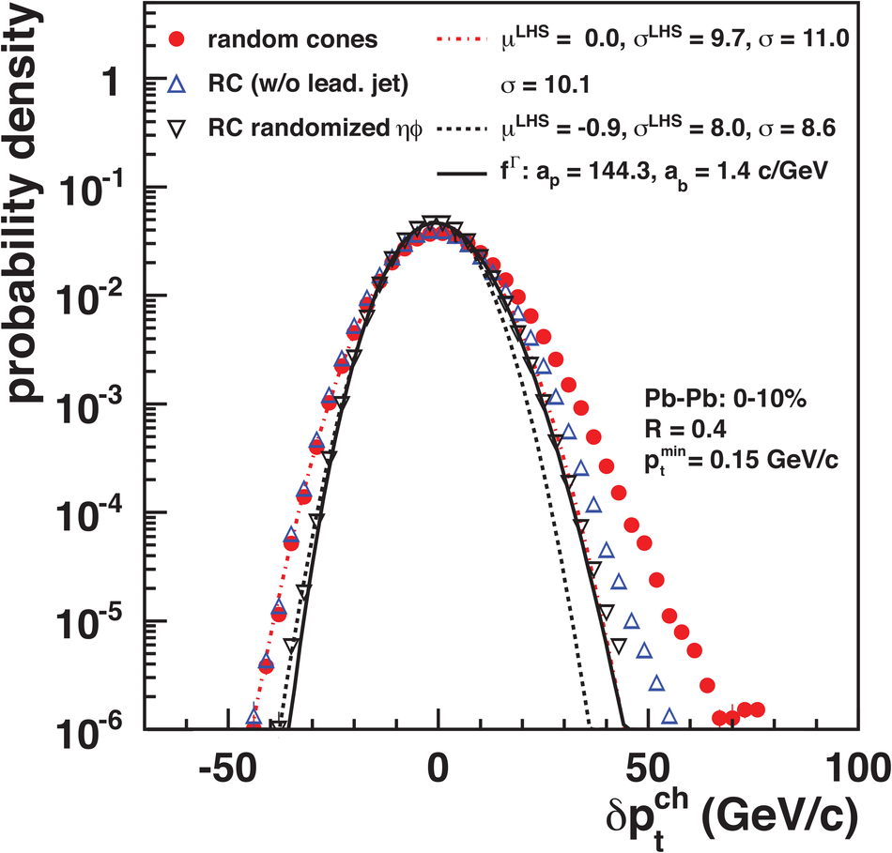
Random cones in ALICE
Estimate ρ
  k_{T} jet finder→jet candidates
  ρ = Median(p_{T}/A)
Draw Random cone
JHEP 03 (2012) 053
$δp_{T}=p_{T}^{reco}−ρA$

Slide 47
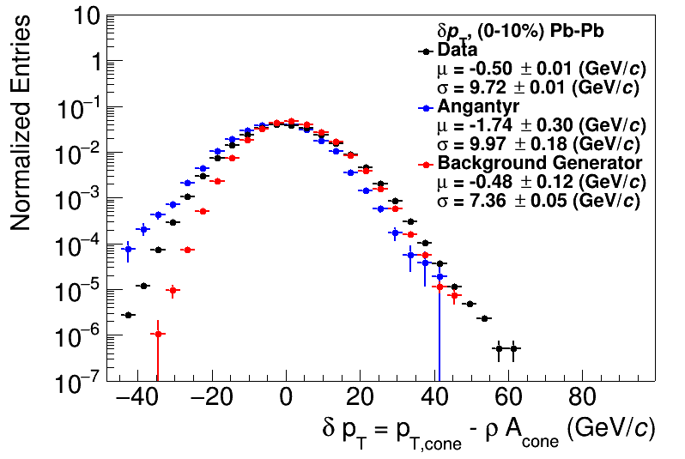
Random cones
JHEP 03 (2012) 053
ALICE
arXiv:2005.02320

Slide 48
Shape of width of the distribution
Single particle spectra
$f_{Γ}\left(p_{T},p,b\right)=\frac{b}{Γ\left(p\right)}{\left(bp_{T}\right)}^{p−1}e^{−bx}$
Σp_{T} of N particles→N-fold convolution:
$\frac{{dpT}^{total}}{dy}∝f_{N}\left(p_{T},Np,b\right)$
$f_{N}\left(p_{T},p,b\right)=f_{Γ}\left(p_{T},Np,b\right)$
$\frac{dN}{dy}∝f_{Γ}\left(p_{T},2,b\right)=b^{2}p_{T}e^{−kp_{T}}$
$N=\frac{N_{total}}{A_{total}}πR^{2}$
$μ_{total}=\frac{Np}{b}=Nμ_{p_{T}},σ_{total}=\frac{\sqrt{Np}}{b}=\sqrt{N}σ_{p_{T}}$
$μ_{p_{T}}=\frac{p}{b},σ_{p_{T}}=\frac{\sqrt{p}}{b}$
Tannenbaum, PLB(498),1–2,Pg.29-34(2001)
Add Poissonian fluctuations in N:
$σ_{total}=\sqrt{Nσ_{p_{T}}^{2}+Nμ_{p_{T}}^{2}}$
Add non-Poissonian fluctuations in N due to flow
$σ_{total}=\sqrt{Nσ_{p_{T}}^{2}+\left(N+2\sum{v_{n}^{2}}\right)μ_{p_{T}}^{2}}$

Slide 49
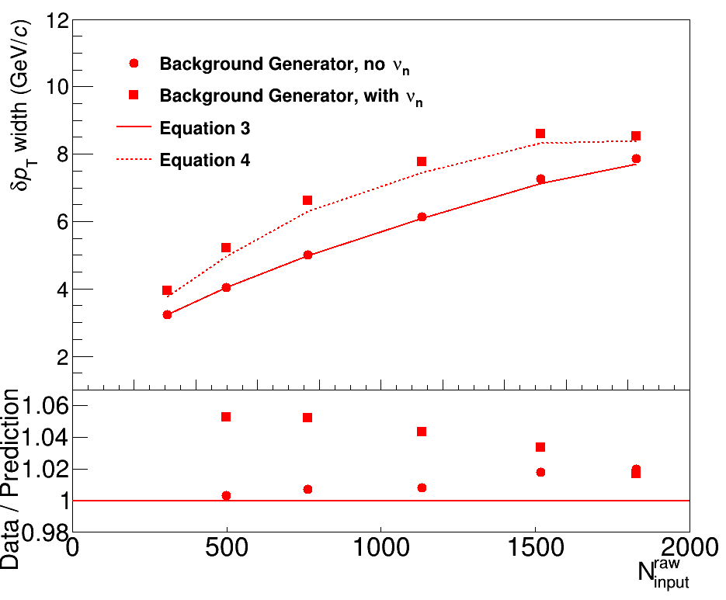
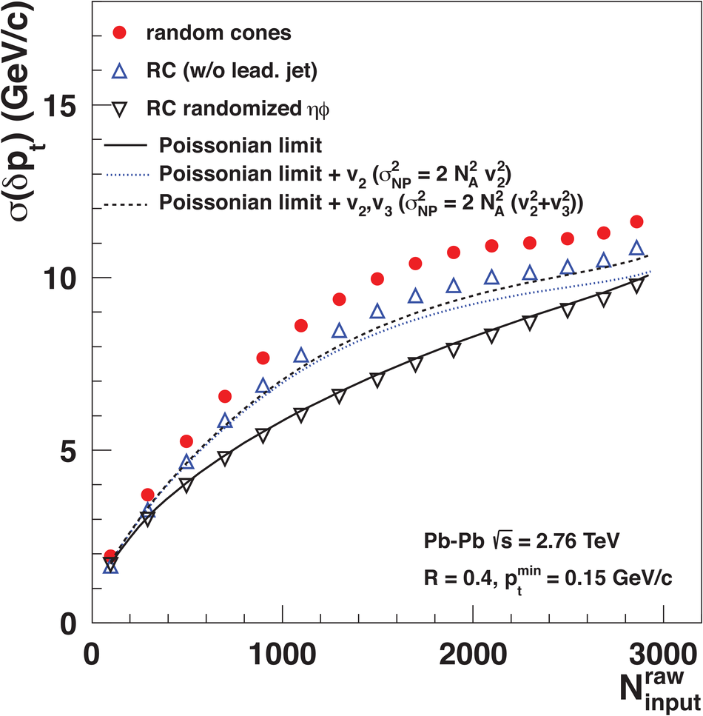
Width vs multiplicity
TennGen
ALICE
Small deviations

Slide 50
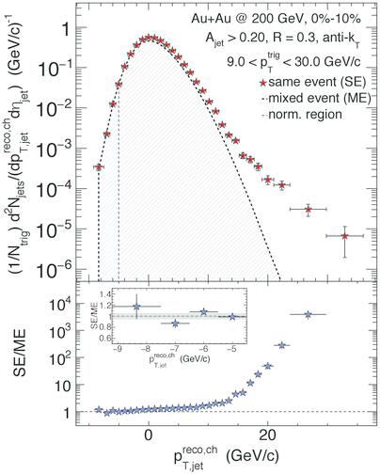
Mixed events
Gets background up to a normalization factor
Good agreement with the data… but 20% discrepancies still within uncertainties
In measurement with background suppressed (h-jet correlations)
Did not see such agreement at the LHC
STAR
Phys. Rev. C 96 (2017) 24905

Slide 51
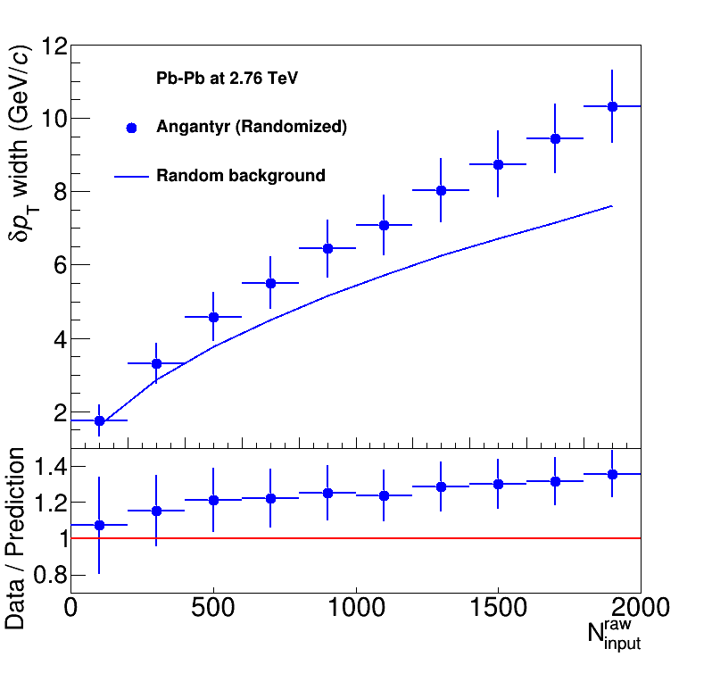
Width vs multiplicity
Angantyr
ALICE
Doesn’t go away with random track orientation!

Slide 52
Shape of width of the distribution
Single particle spectra
$f_{Γ}\left(p_{T},p,b\right)=\frac{b}{Γ\left(p\right)}{\left(bp_{T}\right)}^{p−1}e^{−bx}$
Σp_{T} of N particles→N-fold convolution:
$\frac{{dpT}^{total}}{dy}∝f_{N}\left(p_{T},Np,b\right)$
$f_{N}\left(p_{T},p,b\right)=f_{Γ}\left(p_{T},Np,b\right)$
$\frac{dN}{dy}∝f_{Γ}\left(p_{T},2,b\right)=b^{2}p_{T}e^{−kp_{T}}$
$N=\frac{N_{total}}{A_{total}}πR^{2}$
$μ_{total}=\frac{Np}{b}=Nμ_{p_{T}},σ_{total}=\frac{\sqrt{Np}}{b}=\sqrt{N}σ_{p_{T}}$
$μ_{p_{T}}=\frac{p}{b},σ_{p_{T}}=\frac{\sqrt{p}}{b}$
Tannenbaum, PLB(498),1–2,Pg.29-34(2001)
Add Poissonian fluctuations in N:
$σ_{total}=\sqrt{Nσ_{p_{T}}^{2}+Nμ_{p_{T}}^{2}}$
Assumes shape
Add non-Poissonian fluctuations in N due to flow
Assumes uncorrelated number fluctuations
$σ_{total}=\sqrt{Nσ_{p_{T}}^{2}+\left(N+2\sum{v_{n}^{2}}\right)μ_{p_{T}}^{2}}$

Slide 53
Mini-summary
Jet finders put all input clusters, tracks in a jet candidate
Background is dominated by random particles
  But 5% effects from flow
Models have background too!
  And it doesn’t agree with data!
  Sensitive to multiplicity,
  shape of spectrum
Cacciari DIS 2006
Energy (arb. units)
Cacciari & Salam
Phys.Lett.B641:57-61,2006
$ϕ$
$η$

Slide 54
Jets in A+A collisions: Dealing with background

Slide 55
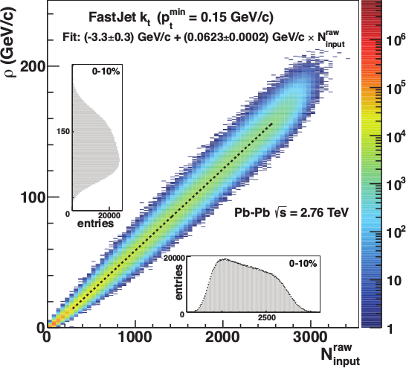
Focus on smaller angles
Pros
  Background is smaller
  Background fluctuations smaller
Cons:
  Modifications expected at higher R
  Biases sample towards quarks
JHEP 03 (2012) 053
Aside: “quark” and “gluon” jet only defined at leading order.

Slide 56
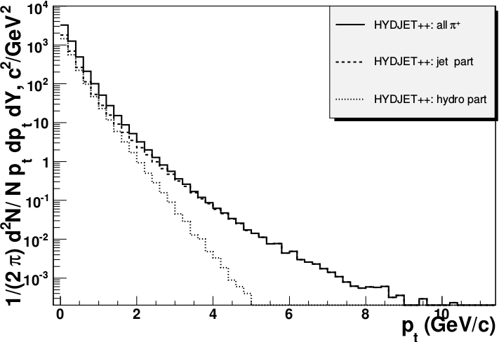
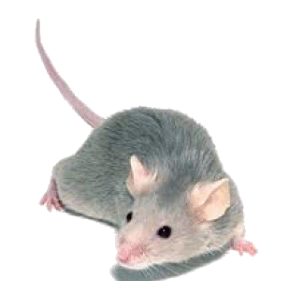
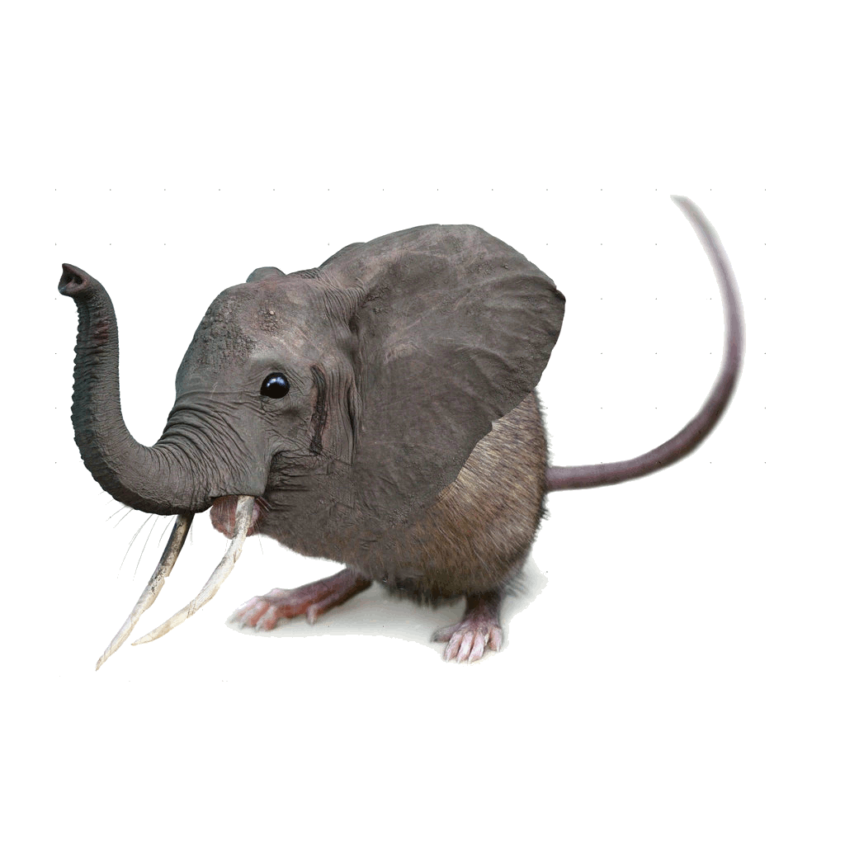

Focus on high p_{T}
Pros:
  Reduces combinatorial background
Cons:
  Cuts signal where we expect modifications
  Could bias towards partons which have not interacted
  Biases sample towards quark jets
PoS High-pTphysics09:023,2009
“Quark” and “gluon” jets only defined at leading order!

Slide 57
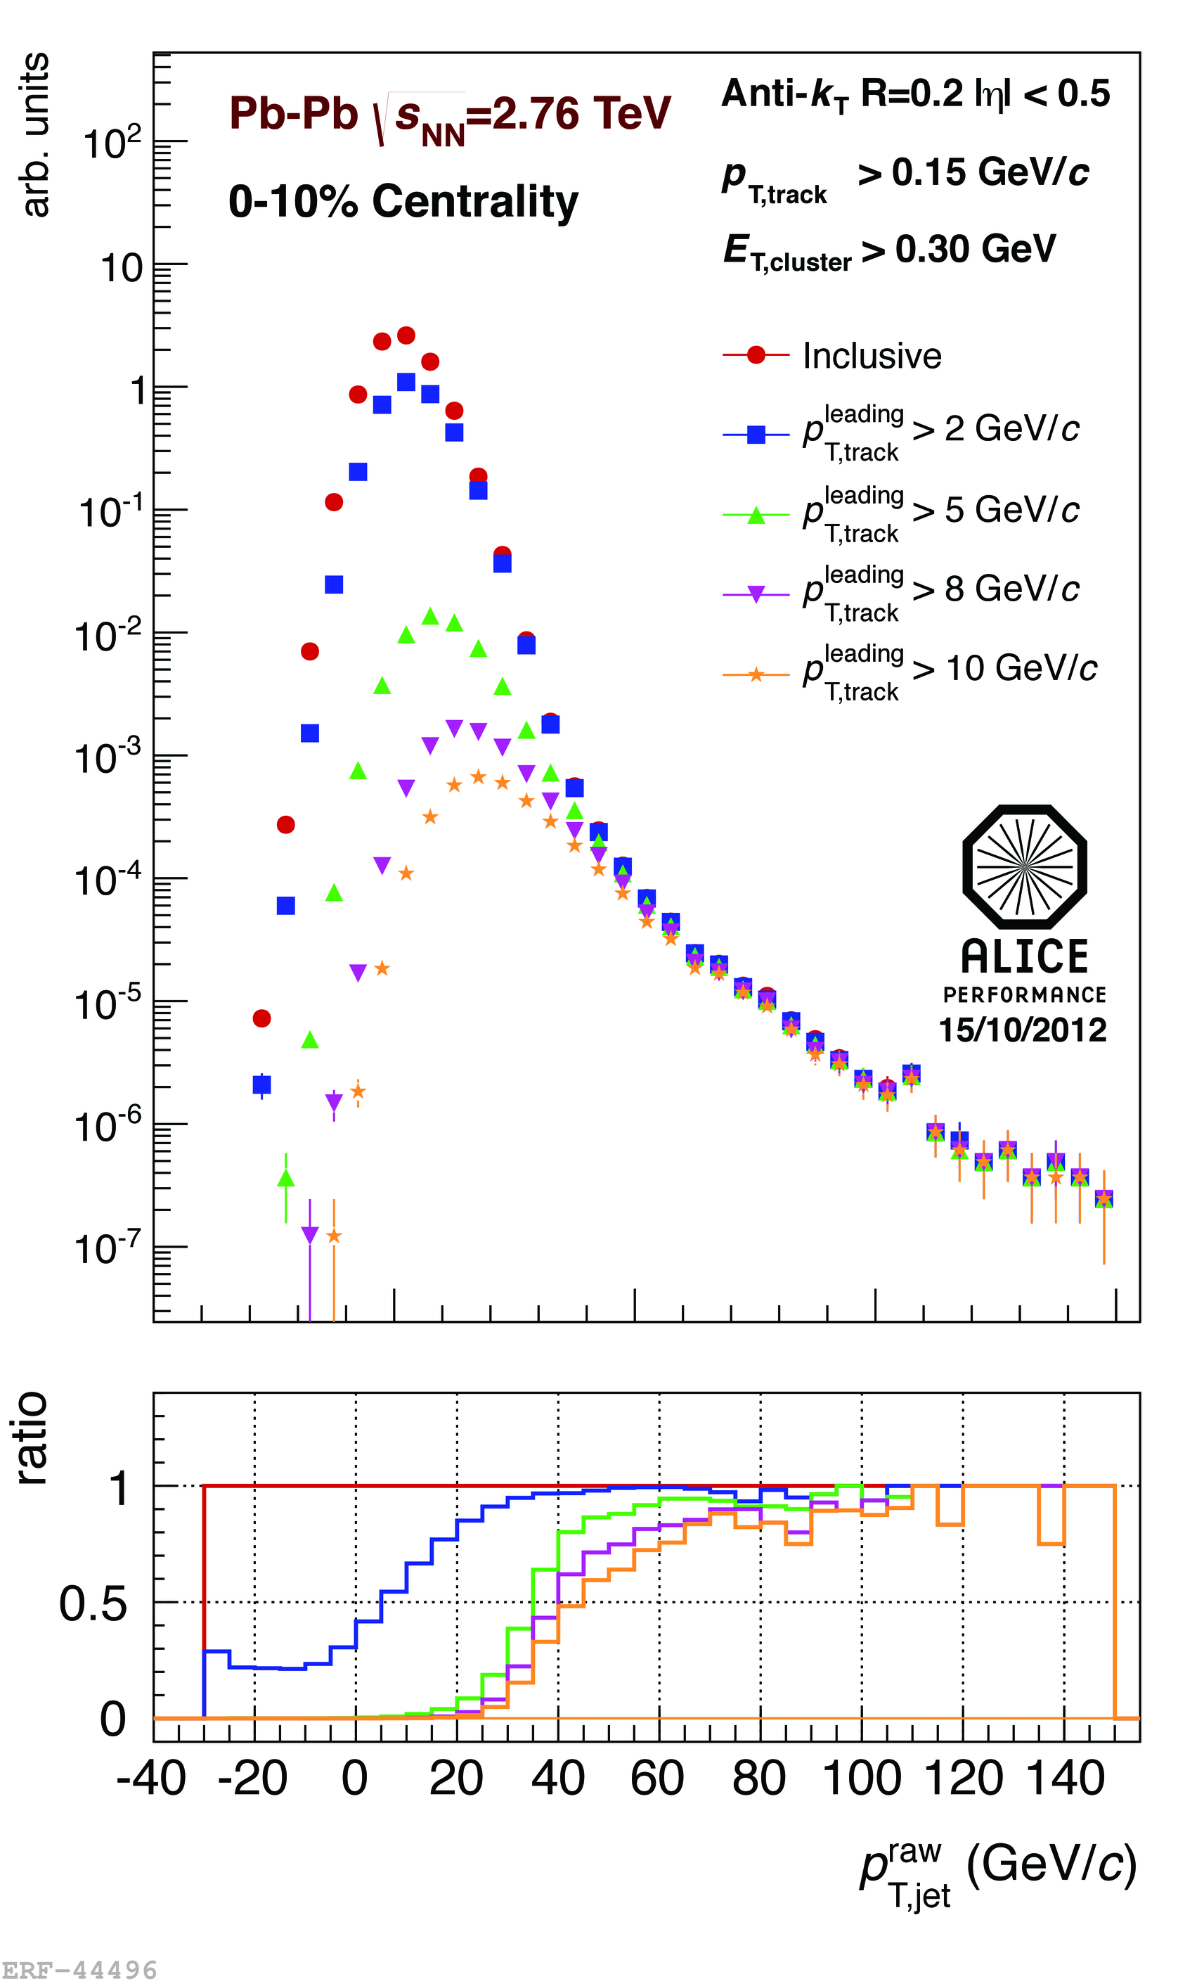


<footer>
Area-based subtraction
ALICE/STAR
Require leading track p_{T} > 5 GeV/c
  Suppresses combinatorial “jets”
  Biases fragmentation
No threshold on constituents
Limited to small R
Combinatorial “jets”
Notes:
<number>

Slide 58
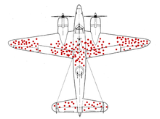
Survivor bias
WWII Example: holes planes returning indicate where it’s safer to get hit
We’re looking at the jets which remain

Slide 59
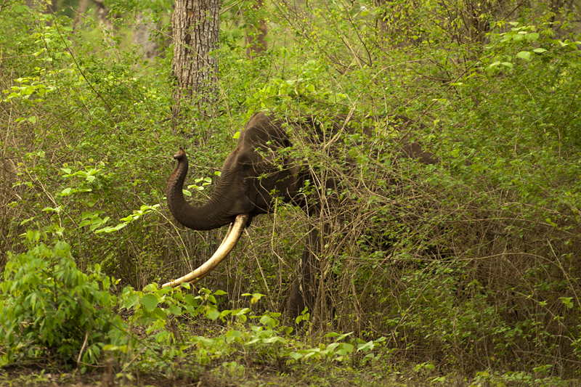
http://walkthewilderness.net/animals-of-india-72-asiatic-elephant/

Slide 60

http://walkthewilderness.net/animals-of-india-72-asiatic-elephant/

Slide 61

What you see depends on what you're looking for
http://walkthewilderness.net/animals-of-india-72-asiatic-elephant/

Slide 62
Bias & background
Experimental background subtraction methods: complex, make assumptions, apply biases
Survivor bias: Modified jets probably look more like the medium
Quark/Gluon bias:
  Quark jets are narrower, have fewer tracks, fragment harder [Z Phys C 68, 179-201 (1995), Z Phys C 70, 179-196 (1996), ]
  Gluon jets reconstructed with k_{T} algorithm have more particles than jets reconstructed with anti-k_{T} algorithm [Phys. Rev. D 45, 1448 (1992)]
  Gluon jets fragment into more baryons [EPJC 8, 241-254, 1998]
Fragmentation bias: Experimental measurements explicitly select jets with hard fragments
http://walkthewilderness.net/animals-of-india-72-asiatic-elephant/

Slide 63
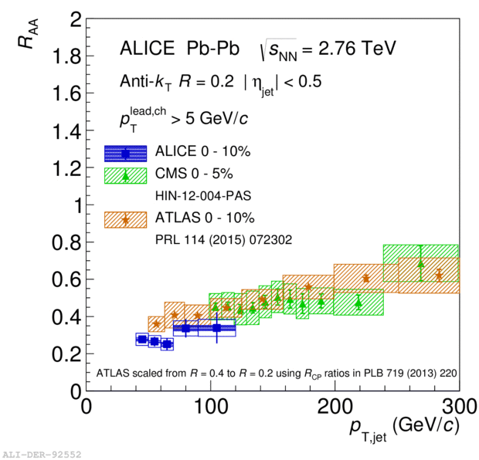
Iterative procedure
Constituent biases don't matter that much up here
Used by ATLAS & CMS
ATLAS
  Calorimeter jets: Reconstruct jets with R=0.2. v₂ modulated <Bkgd> estimated by energy in calorimeters excluding jets with at least one tower with
  E_{tower} > <E_{tower}>
  Track jets: Use tracks with p_{T}>4 GeV/c
  Calorimeter jets from above with E>25 GeV and track jets with p_{T}>10 GeV/c used to estimate background again.
  Calorimeter tracks matching one track with p_{T}>7 GeV/c or containing a high energy cluster E >7 GeV are used for analysis down to E_{jet} = 20 GeV
But they do matter down here!
Phys. Lett. B 719 (2013) 220-241

Slide 64
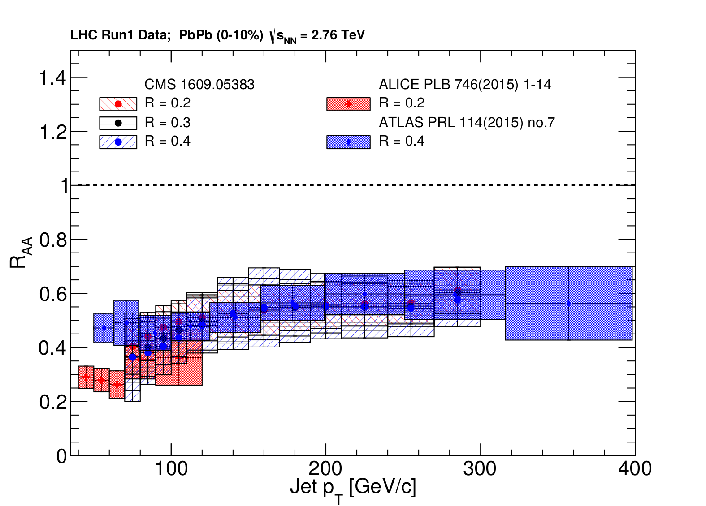
Jet R_{AA}
arXiv:1705.01974

Slide 65
Jet R_{AA}
arXiv:1705.01974
Tension between ATLAS & ALICE/CMS

Slide 66
ATLAS
Background subtraction method:
Iterative procedure
  Calorimeter jets: Reconstruct jets with R=0.2. v₂ modulated <Bkgd> estimated by energy in calorimeters excluding jets with at least one tower with
  E_{tower} > <E_{tower}>
  Track jets: Use tracks with p_{T}>4 GeV/c
  Calorimeter jets from above with E>25 GeV and track jets with p_{T}>10 GeV/c used to estimate background again.
Calorimeter tracks matching one track with p_{T}>7 GeV/c or containing a high energy cluster E >7 GeV are used for analysis down to E_{jet} = 20 GeV
Constituent biases don't matter that much up here
Phys. Lett. B 719 (2013) 220-241
But they do matter down here!

Slide 67
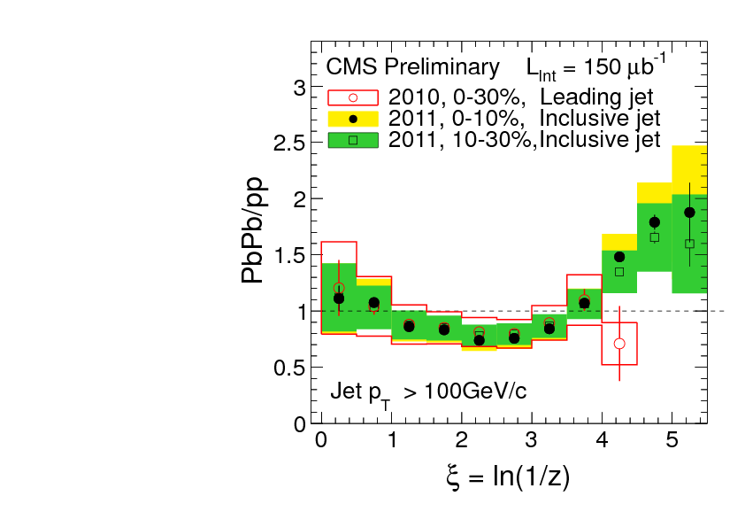
What you see depends on where you look
?
Phys. Rev. C 90, 024908 (2014)
JHEP10(2012)087
High p_{T}
z = p_{T}/E_{jet}
Low p_{T}
Low p_{T}
Low p_{T}
Low p_{T}
Low p_{T}
High p_{T}
Low p_{T}
High p_{T}
High p_{T}
High p_{T}

Slide 68
Mini-summary
Most studies do one or more of the following:
  Explicitly apply a (non-purturbative) bias
  Implicitly apply a (non-purturbative) bias
  Focus on small R
  Focus on high pT
May also → survivor bias
Background subtraction should be part of definition of algorithm

Slide 69
What are the dominant uncertainties?

Slide 70
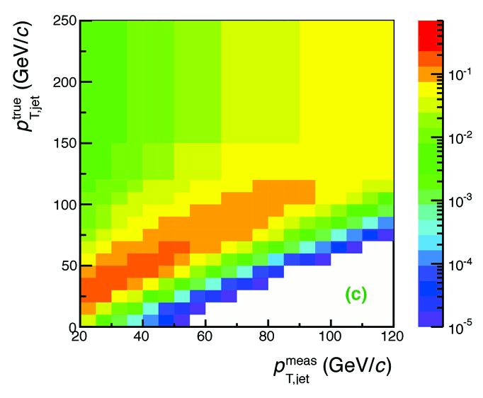

Analysis steps
Tracks
Jet finding algorithm
Jet candidates
Background subtraction
Clusters
Jet spectrum smeared by energy resolution, background fluctuations
Unfolding – corrects for single track reco ε, E resolution, background fluctuations
Corrected spectra

Slide 71

Unfolding
: the “true” histogram
: the actual data we measure
: background
R : the response matrix
$\vec{μ}$
$\vec{ν}$
$\vec{β}$

Slide 72

Simple Solution (Inversion)

Slide 73

Iterative Bayesian Method

Slide 74
RooUnfold-Bayes
RooUnfoldTest.cxx
method = Bayes
Exponential training and testing

Slide 75
About unfolding...
d'Agostini (author of Bayesian unfolding algorithm) says you should avoid it if you can
Necessary when experimental resolution is poor
  Ex: Single particle spectra → unfolding unnecessary
  Ex: Jet spectra → unfolding necessary
Algorithm assumes response matrix is correct
  Matching reconstructed and simulated jets is non-trivial!
Corrects for multiple experimental effects simultaneously
  Difficult to disentangle different effects
  Leads to non-trivial uncertainty correlations between data points due to algorithm
  May not handle systematic correlations between effects correctly
$\frac{σ_{p}}{p}≪w_{bin}$
$\frac{σ_{p}}{p}≈w_{bin}$

Slide 76




<footer>
Jets in ALICE: Response Matrix Construction
RMdet X RMbkg = RM
RM_{bkg} and RM_{det} are approximately factorizable
Notes:
----- Meeting Notes (6/24/13 16:47) -----
Put Large Labels on
b) change pT true -> pT rec so consistence
c) change gT true ->pT gen
<number>

Slide 77
<footer>
Jets in ALICE: Response Matrix Construction
RMdet X RMbkg = RM
DETECTOR EFFECT
RM_{bkg} and RM_{det} are approximately factorizable
Notes:
----- Meeting Notes (6/24/13 16:47) -----
Put Large Labels on
b) change pT true -> pT rec so consistence
c) change gT true ->pT gen
<number>

Slide 78
<footer>
Jets in ALICE: Response Matrix Construction
RMdet X RMbkg = RM
NOT A DETECTOR EFFECT!!
DETECTOR EFFECT
RM_{bkg} and RM_{det} are approximately factorizable
Notes:
----- Meeting Notes (6/24/13 16:47) -----
Put Large Labels on
b) change pT true -> pT rec so consistence
c) change gT true ->pT gen
<number>

Slide 79
Response matrix includes assumptions about
Detector response
  Including particle composition of jets!
Fragmentation and hadronization
  How does hadronization influence the width of your jet?
Background and/or background fluctuations
How you match reconstructed (“detector level”) and true (“particle level”) jets

Slide 80


<footer>
Jet Momentum Resolution
Full
Charged
Jet resolution
  Dominated by background fluctuations at low momentum
  Dominated by detector effects at high momentum
Notes:
----- Meeting Notes (6/24/13 16:47) -----
Ask Marta for R = 0.2 plots for this
make sure performance
increase label size
<number>

Slide 81
Mini-summary
Jet energy resolution is fundamentally large
  Measuring multiple correlated particles!
  Be skeptical of jet measurements with <10% uncertainties
Unfolding is complicated, often unstable, and hard
Construction of response matrix includes several assumptions

Slide 82
Jets in A+A collisions: How to compare to models

Slide 83
Snowmass Accord: Apply the same algorithm to data and your model. Then the measurement and the calculation are the same.

Slide 84
Rivet: Apply the same algorithm to data and your model. Then the measurement and the calculation are the same.

Slide 85
What is Rivet?

Slide 86


Slide 87
Why use Rivet?
Facilitates comparisons between Monte Carlos and data
It’s not that hard
It preserves analysis details

Slide 88


Slide 89
<footer>
Jets in ALICE: Response Matrix Construction
RMdet X RMbkg = RM
NOT A DETECTOR EFFECT!!
DETECTOR EFFECT
RM_{bkg} and RM_{det} are approximately factorizable
Notes:
----- Meeting Notes (6/24/13 16:47) -----
Put Large Labels on
b) change pT true -> pT rec so consistence
c) change gT true ->pT gen
<number>

Slide 90


Analysis steps: Full Monte Carlo
Jet finding algorithm
Jet candidates
Background subtraction
Particles
Unfolding – corrects for background fluctuations
Jet spectrum smeared by energy resolution
Corrected spectra

Slide 91




Comparison to data
HepMC
Rivet
Unfold to correct for fluctuations
HEPData
HepMC
Rivet
arXiv:2005.02320
[hep-ph]
Comparison to data
See poster by
Nattrass et al
PRL91(2003) 172302
Unfold to correct for fluctuations
Comparison to data
PRL91(2003) 172302

Slide 92
Mini-summary
Experimental techniques can bias measurement in subtle ways
  Background subtraction
  Kinematic cuts
  Choice of jet finder, R
  Centrality determination
  Technique for finding reaction plane
Unclear how these influence the measurement
Safest to do the same analysis on data and model
  But unfolding is necessary in a full Monte Carlo model!

Slide 93
A skeptic’s guide to jets
Part 2: Where we are going
Christine Nattrass
University of Tennessee, Knoxville

Slide 94


There is no partionic energy loss.

Slide 95


There is only partionic energy redistribution.

Slide 96
What is jet (sub)structure?
Whatever I am measuring!
Any new jet observable
Any observable which measures the structure of jets.
A cool buzzword
I don’t know but it sounds cool and gets me talks/grants

Slide 97



Types of observables
I. Minimally sensitive to structure
II. Sensitive to <structure> of <jets>
Observables
(Jet) R_{AA}
A_{j}
I_{AA}
(Jet) v₂
Observables
Fragmentation functions
Jet shapes
Correlations
...
Jet properties:
E
Const. p_{T}, φ, η
Jets not required
Jet properties:
E
Higher precision
Average background subtraction OK
Higher/different sensitivity?
Need new background subtraction technique
III. Sensitive to distribution of structures
IV. Sensitive to parton shower structure
Observables
Girth
Dispersion
p_{T}D
Jet mass
...
Jet properties:
E
Const. p_{T}, φ, η
Observables
Grooming
N_{subjettiness}
...
Jet properties:
E
Const. p_{T}, φ, η
Multi-const. correlations
Jets required

Slide 98
Type I: Energy loss

Slide 99



Jet v₂
[Phys.Lett. B 753 (2016) 511-525,
Phys. Rev. Lett.111 152301 (2013)]
suppression
[Phys.Rev.C80:024908,2009,
Phys.Rev.D82:072001,2010,
Phys.Rev.C82:034909,2010
Physics Letters B 760 (2016)]
[Too many to list]
γ-jet
correlations
[Phys. Lett. B 718 (2013) 773]
suppression
Jets lose energy!
Di-hadron correlations
High-p_{T} hadron v₂
[too many to list]
γ-hadron correlations
Au+Au √s_{NN}=200 GeV
$\hat{q}=1.2±0.3 {GeV}^{2}$
[JHEP 09 (2015) 170,
Phys. Rev. C 96, 024905 (2017)]
[Phys.Rev.C84:024906,2011,
Phys. Lett. B 712 (2012) 176,
Phys.Rev.Lett.105:252303,2010,
Phys. Rev. Lett. 119, 062301 (2017)]
suppression
Pb+Pb √s_{NN}=2.76 TeV
$\hat{q}=1.9±0.7 {GeV}^{2}$
[Phys. Rev. C 90, 014909 (2014)]
Hadron-jet correlations
Dijet asymmetry

Slide 100
Type II: Fragmentation

Slide 101


Fragmentation functions with jets
arXiv:1609.03878
Di-jet asymmetry
Leading jet
Fragmentation functions with jets
Jets get wider and constituents get softer
Kolja Kauder, RHIC/AGS
User's Meeting 2016
z=p_{T}/E_{γ}
Subleading jet
$0A_{j}=\frac{p_{T}^{leading}−p_{T}^{subleading}}{p_{T}^{leading}+p_{T}^{subleading}}$
Di-hadron correlations
[Lots of papers]
Jet shapes
[arXiv:1708.09429,
arXiv:1512.07882,
arXiv:1704.03046]
Jet-hadron
correlations

Slide 102
Type III: Distribution of properties

Slide 103



Jet mass
arXiv:1702.00804
Quenching models (JEWEL, Q-PYTHIA) show a larger mass than pp-like PYTHIA jets
Pb-Pb measurement can discriminate among these predictions

Slide 104


Girth g
Dispersion p_{T}D
LeSub
$g=\sum_{i∈jet}{\frac{p_{T}^{i}}{p_{T}^{jet}}r_{i}}$
$p_{T}D=\frac{\sqrt{\sum_{i∈jet}{{\left(p_{T}^{i}\right)}^{2}}}}{\sum_{i∈jet}{p_{T}^{i}}}$
$LeSub=p_{T}^{leading}−p_{T}^{subleading}$
Jets are slightly more collimated than in pp
Agrees with PYTHIA

Slide 105
Type IV: Declustering
Note: These slides are from Laura Havener
*A selection. Don’t be offended if I skip your favorite.

Slide 106

New tool: jet splittings
Interested in the original parton shower splittings of the jet
Which form subjets inside the jet!

Slide 107

Jet splittings: in vacuum
Vacuum jets splittings form at different times
θ
θ
time
Wider jets form earlier and narrower jets form later

Slide 108

Jet splittings: in medium
Notes:
The emission now becomes a subjeT.

Slide 109

Jet splittings: in medium
Notes:
So we can add this additional case to our diagram where in the medium the medium can or can not resolve the splitting.

Slide 110

Exploring the Lund Plane: in vacuum
    Lund Diagram*: phase space of jet splitting
pT1 = (1-z)pT
ln(kT)
*Z. Phys. C43 (1989)
JHEP 12 (2018)
pT2 = zpT
    log(kT) > 0 separates perturbative from non-perturbative regime
soft, large angle radiation
hard, collinear radiation
    Formation time: how long until the splitting occurred
constant z
Y. L. Dokshitzer, et.al.
ln(1/ΔR)
arXiv:1808.03689
Notes:
And finally diagonal lines along the plane representing splitting formation time so you can separate out splittings that happened earlier from splittings that happened later.
Here you can see that widersplittngs happen earlier and narrower splittings happen later. 1:30

Slide 111

Soft drop grooming
Notes:
How do we access the splittings in experiment.
Specifically in this analysis, we first find and reconstruct charged jets from tracks in the TPC between 80-120 GeV using the anti-kt algorithm with R=0.4, where jets with a HI background receive a jet-by-jet constituent subtraction.

Slide 112

Soft drop grooming
Notes:
Where this constituent subtraction is actually remove the background from each constituent or track instead of the jet as a whole.

Slide 113

Groomed variables
Notes:
Finally, nSD which is not stopping at the first splitting but going back through the the splittings and counting all the ones that would pass SD, which address the question of how many subjets are inside of the jet. 45: = 10:25

Slide 114

zg: jet splitting
Notes:
When we apply the ln(kt)>0 cut on the right we see a more significant suppression of symmetric splitting.
1:25 = 15:30

Slide 115

zg: opening angle
Notes:
We looked again at the zg as a function of angel. Where the right is more collimated jet with dR < 0.1 and the left is wide jets with dR > 0.2. We see a hint of more significant suppresion again for wide jets We also see an enhancement for small angles. This is consistent with the picture of wider jets being produced earlier and thus seeing more of the medium and being suppressed. 0:45 = 16:15

Slide 116
Background

Slide 117

Unfolding: jet splitting
Notes:
so instead we embeds Pythia 8 into real pbpb data as a reference which takes into account the background effects in any comparisions since the background contribution should be the same in embedded MC and data.
Once caveat is if there is the potential fragmentation dependence in the regions dominated by the background such that differences in observable between data and embedded mc can only be attributed solely to quenching if the background splittings don’t different largely for medium vs. vacuum. fragmentation.
1:40 = 14:05

Slide 118
Mini-summary
“Jet substructure” is used inconsistently
Search for new observables
  Haven’t really used most of the “old” ones!
So far it’s a mixed bag
  Many are insensitive
  Some may have some promise
  Background tricky

Slide 119
JETSCAPE

Slide 120







JET collaboration
Phys. Rev. C 90, 014909 (2014)
Martini
HTM
$χ^{2}minimization$
QGP brick + jet
McGill
HTBW
Data
$\hat{q}=1.2±0.3 {GeV}^{2}$
200 GeV Au+Au
$\hat{q}=1.9±0.7 {GeV}^{2}$
2.76 TeV Pb+Pb

Slide 121




Bayesian Statistical Analysis
Models and Data Analysis Initiative
http://madai.us
Data
Prior
Monte Carlo
models
Model emulation
Run full model ~1000 times
MCMC parameter search uses emulator (interpolator) in lieu of full model
Posterior
Constraint of QGP properties
Novak et al, Phys.Rev. C89 (2014) no.3, 034917
Optimization

Slide 122

JETSCAPE Event generator
Jet Energy-loss Tomography with a Statistically and Computationally Advanced Program Envelope
http://jetscape.wayne.edu/
Realistic medium
Realistic
theoretical
calculations
Experimental
techniques
Realistic Monte Carlo Model
Realistic jets

Slide 123



Event Generator + Bayesian Statistical analysis
Realistic theoretical calculations
Data
Bayesian Statistical Analysis
Constraint of QGP properties

Slide 124
Conclusions

Slide 125
Conclusions
Jets are complicated and hard to measure to high precision
Much of the physics we want does not require them
Extra insight from studying them anyways
Be skeptical, especially of background subtraction
Make sure the measurement is comparable to model

Slide 126
The End

Slide 127
Backup

Slide 128

Exploring the Lund Plane: in medium
Notes:
We can also ask the question of rather the medium resolved the splitting, so probing coherence vs. decoherence

Slide 129

Exploring the Lund Plane: in medium
Notes:
And finally we can actually break up our diagram in four areas.
This s highly model dependent but the qualitative ideas motivate us to use jet splittings as tool the understand the medium.

Slide 130



Jets in ALICE: Response matrix RM_{det}
RM_{det} quantifies detector response to jets
  “Particle” level jets – defined by jet finder on MC particles
  Pythia with Pb-Pb tracking efficiency
  “Detector” level jets – defined by jet finder after event reconstruction through GEANT
  Particle level jets are geometrically matched to detector level jets
  Matrix has a dependence on spectral shape and fragmentation
Jet-finding efficiency is probability of a matched particle level jet
Notes:
----- Meeting Notes (6/24/13 16:47) -----
Say "matched jets" instead of 2 jets -> so people don't get confused with dijets
<number>

Slide 131
Modified fragmentation
z=p_{T}/E_{γ}
Enhancement at low z
No modification/enhancement at high z?

Slide 132

nSD: iterative declustering
Notes:
Now we can look at this in the higher statistics 5.02 TeV data. where here again the data is in back and the embedded pythia is in red. So here you can see a larger effect than was seen in previous analysis - a suppression between 4-7 and an enhancement at low nSD both with and without the kt cut.
This is consistent with the picture that the wider jets are formed earlier and suppressed in the medium. Wider jets will also will have more subjets and a large nSD so we see a suppression of lower nSD values.

Slide 133
Di-jet asymmetry
Leading jet
Sys. Uncertainties:
Tracking:6%
Tower energy scale: 2%
Kolja Kauder, RHIC/AGS
User's Meeting 2016
arXiv:1609.03878
Subleading jet
$A_{j}=\frac{p_{T}^{leading}−p_{T}^{subleading}}{p_{T}^{leading}+p_{T}^{subleading}}$
Au+Au di-jets more imbalanced than p+p for pTcut>2 GeV/c
Au+Au AJ ~ p+p AJ for matched di-jets (R=0.4)

Slide 134

Width vs multiplicity
Angantyr
ALICE
Discrepancy not from an excess of jets!

Slide 135
Jet-hadron correlations
Jets are broader, constituents are softer
Also seen in:
  Di-hadron correlations [Lots of papers]
  Jet shapes [arXiv:1708.09429, arXiv:1512.07882, arXiv:1704.03046]
  Dijet asymmetry with soft constituents [PRL119 (2017) 62301]

