Slide 1
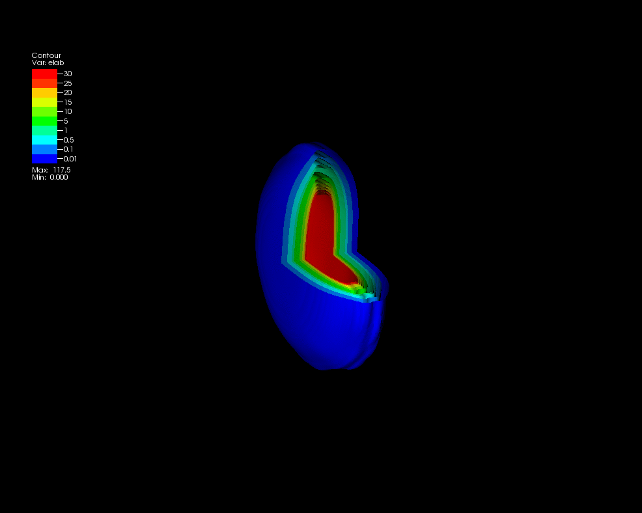
Measuring the energy density of the QGP
Christine Nattrass
University of Tennessee at Knoxville
Calculations done on the Titan supercomputer by the CJet collaboration https://sites.google.com/site/cjetsite/

Slide 2
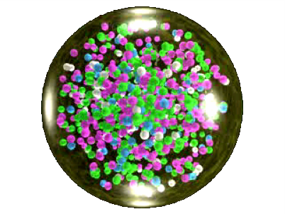
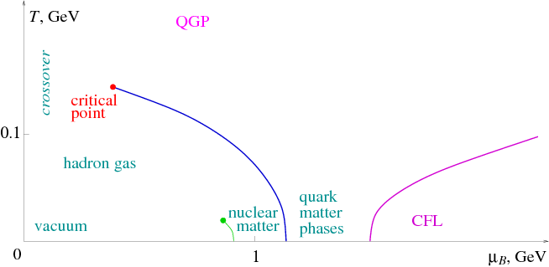
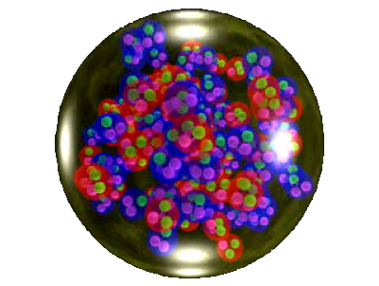
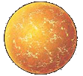
Phase diagram of nuclear matter
Quark Gluon Plasma
Core of neutron stars?
Quark Gluon Plasma – a liquid of quarks and gluons created at temperatures above ~170 MeV (2·10¹²K) – over a million times hotter than the core of the sun
Notes:
But wait – how can we have a liquid of quarks and gluons? Doesn't asymptotic freedom tell us that we can't have free quarks and gluons? How, then, can we have a liquid of quarks and gluons?

Slide 3
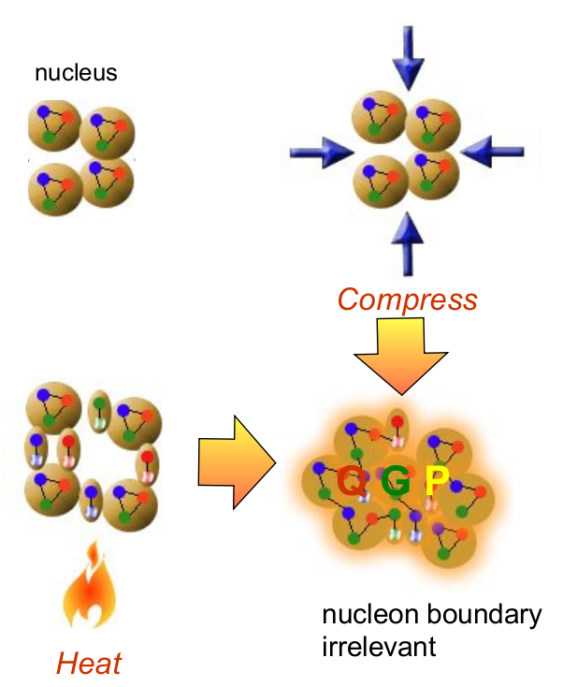
How to make a Quark Gluon Plasma

Slide 4
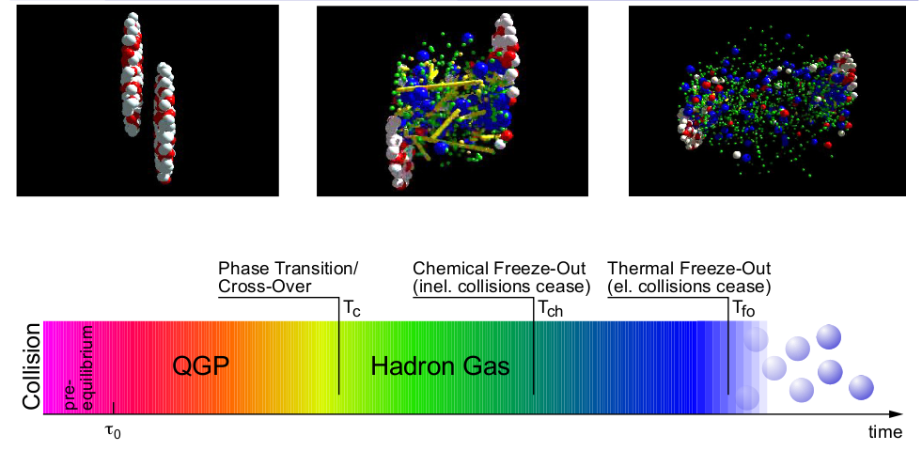
The phase transition in the laboratory

Slide 5
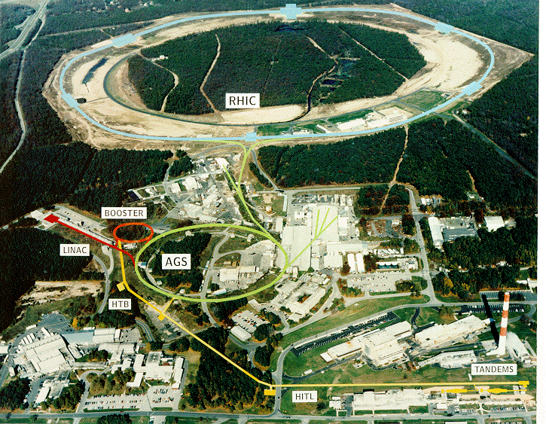
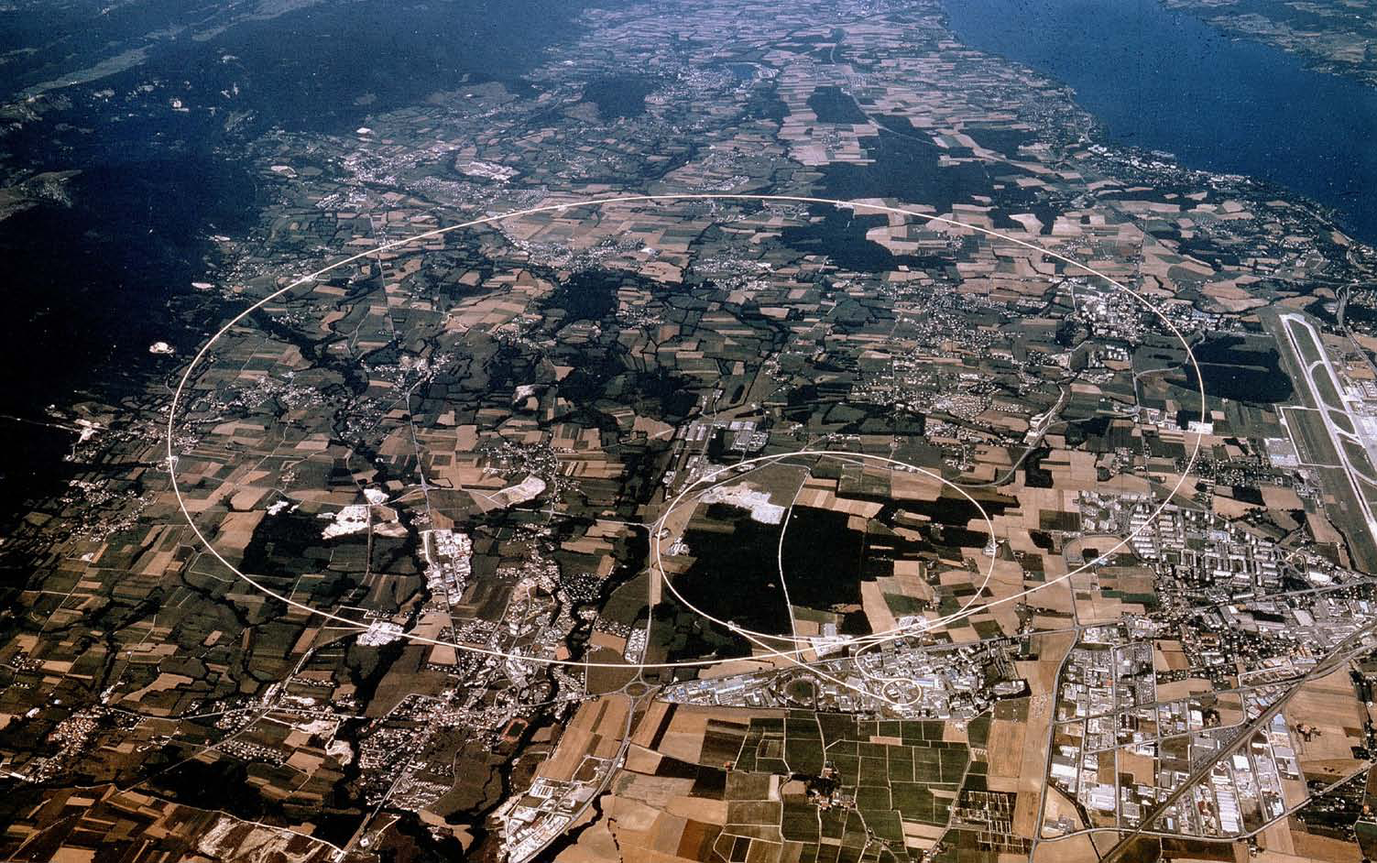
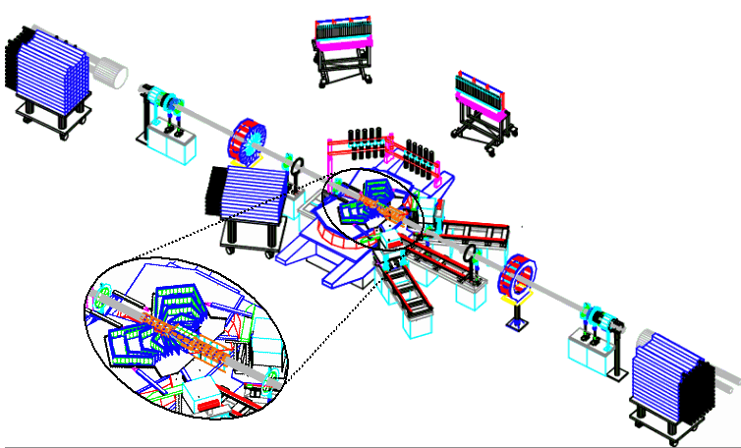
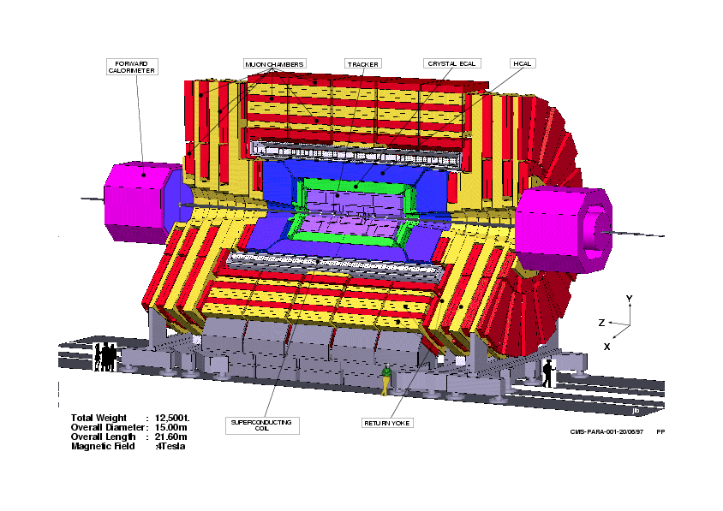
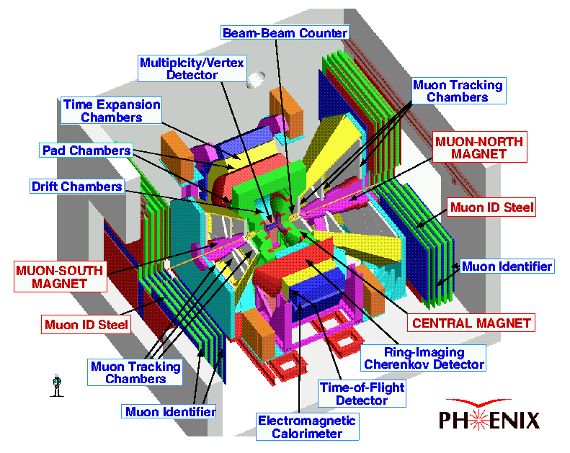
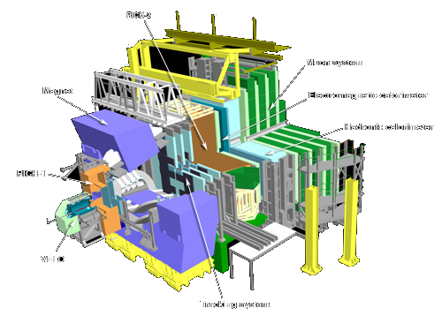
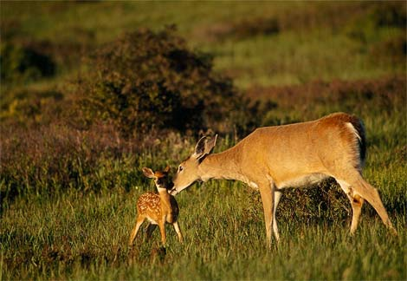
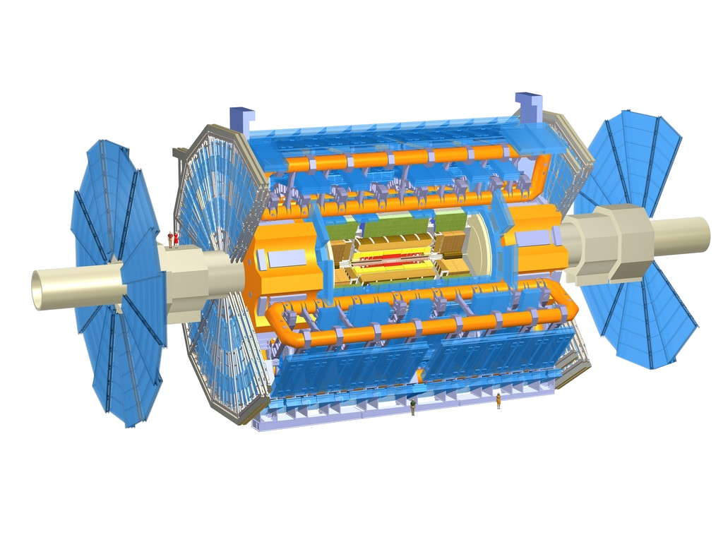
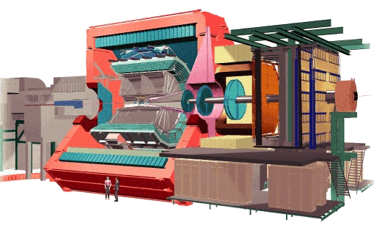
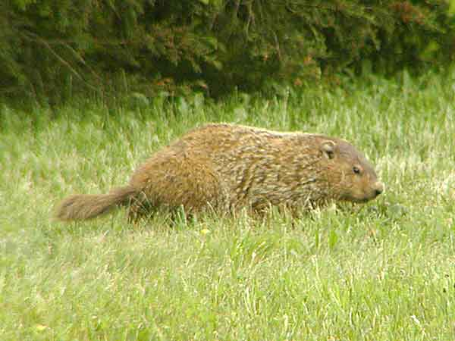
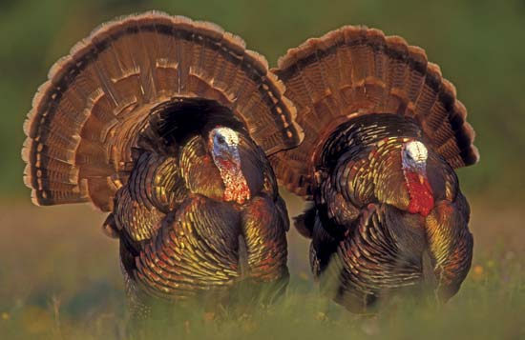
Relativistic Heavy Ion Collider
Large Hadron Collider
PHOBOS
BRAHMS
CMS
PHENIX
STAR
RHIC
LHCb
ALICE
ATLAS LHCf
Upton, NY
1.2km diameter
p+p, d+Au, Cu+Cu, Au+Au, U+U
√s_{NN} = 9 - 200 GeV
Geneva, Switzerland
8.6km diameter
p+p, p+Pb, Pb+Pb
√s_{NN} = 2.76 GeV, 5.5 TeV
LHC
Quark Gluon Plasma
RHIC
Core of neutron stars?
Notes:
Mention that RHIC planning began 1983

Slide 6
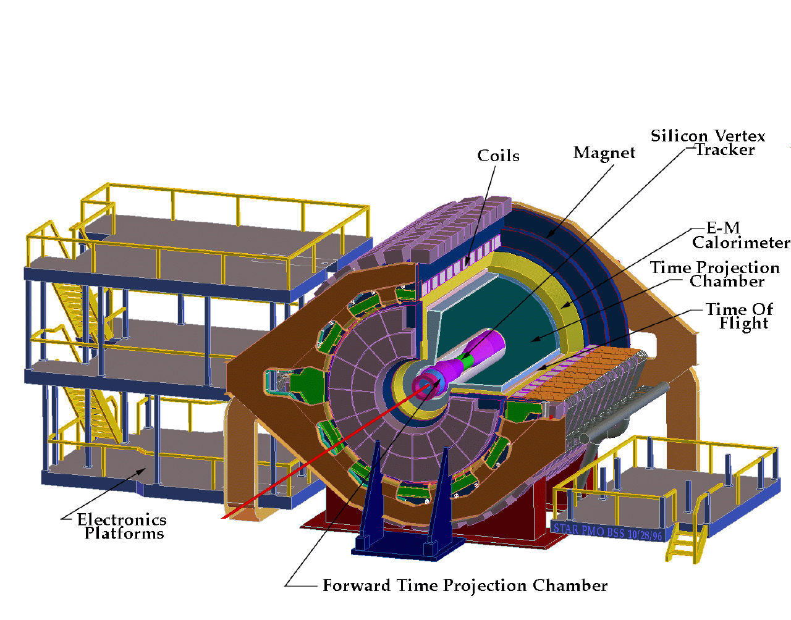
ALICE
ATLAS
CMS
STAR
PHENIX
Notes:
Mention that RHIC planning began 1983

Slide 7
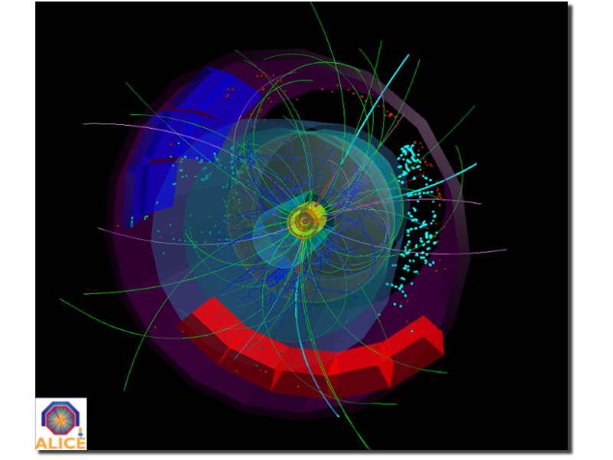
p+p collisions
3D image of each collision

Slide 8
Pb+Pb collisions
5

Slide 9
Measurements of transverse energy
Fluid of quarks and gluons
Energy density (Bjorken)

Slide 10
Where is energy distributed in an event?
43% neutral – not 1/3!
...but 1/3 of what hits the detector is neutral

Slide 11
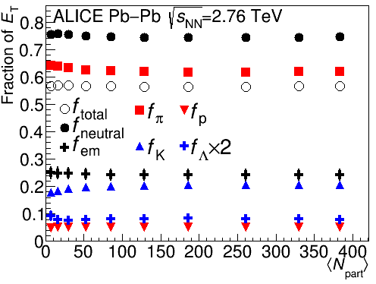
Calculations from spectra
The distribution of energy is surprisingly centrality independent.

Slide 12
Where is the energy?
p
_{L}
π⁰
K⁰
‾p
K⁺
_{S}
π⁺
K⁰
K⁻
π⁻
n
Λ
‾n
‾Λ
Scale: diameter in inches = √fraction * 5

Slide 13
Where is the energy?
_{L}
π⁺
K⁰
p
π⁰
_{S}
K⁰
K⁺
Λ
n
π⁻
‾n
K⁻
‾Λ
43% neutral
‾p
Not 33%
Not 33%
57% charged
Not 67%
Scale: diameter in inches = √fraction * 5

Slide 14
How does it hit your detector?
γ
γ
π⁺
π⁰
π⁺
π⁻
_{L}
~69%
K⁰
_{S}
π⁻
K⁰
~31%
π⁰
π⁰
γ
γ
π⁰
π⁰
γ
γ
Λ
~64%
p
π⁻
‾Λ
~64%
‾p
π⁺
n
n
γ
~36%
π⁰
γ
n
n
γ
K⁺
K⁻
~36%
π⁰
γ
‾n
n
‾p
p
Scale: diameter in inches = √fraction * 5

Slide 15
How does it hit your detector?
γ
γ
π⁺
_{L}
K⁰
π⁺
π⁻
_{S}
K⁰
π⁰
π⁻
‾n
p
Λ
γ
_{S}
n
n
γ
π⁻
γ
Λ
‾p
π⁺
K⁰
γ
π⁰
π⁰
n
γ
γ
‾Λ
γ
‾Λ
γ
35% neutral
11% in neutral hadrons
65% charged
7% in secondaries
K⁺
K⁻
‾p
p
Scale: diameter in inches = √fraction * 5

Slide 16
How does it hit your detector?
γ
γ
π⁺
π⁻
γ
_{S}
γ
K⁰
π⁰
π⁰
γ
γ
γ
‾Λ
K⁺
π⁰
γ
Λ
γ
γ
24% as a γ
K⁻
p
‾p
n
‾Λ
Λ
n
_{L}
58% in primary hadrons
K⁰
n
‾n
π⁻
π⁺
p
π⁻
‾p
π⁺
_{S}
Λ
‾Λ
K⁰
11% as a neutral hadron
7% in secondary hadrons
Scale: diameter in inches = √fraction * 5

Slide 17
How does it hit your detector? Tracking detectors
γ
γ
π⁺
π⁻
π⁰
π⁺
π⁻
_{S}
K⁰
n
γ
_{L}
p
π⁻
‾Λ
K⁰
γ
γ
_{S}
γ
Λ
K⁰
π⁰
π⁰
K⁺
n
γ
γ
γ
K⁻
Λ
π⁺
γ
‾p
‾Λ
n
‾n
7% Secondaries
p
‾p
35% No signal
58% Primaries
Scale: diameter in inches = √fraction * 5

Slide 18
How does it hit your detector? Electromagnetic calorimeters
π⁺
π⁻
n
‾Λ
Λ
n
γ
γ
γ
_{S}
γ
K⁰
π⁰
π⁰
γ
γ
n
γ
‾Λ
π⁰
γ
π⁺
π⁻
‾n
Λ
γ
_{S}
K⁺
K⁻
γ
K⁰
Deposit 100% of energy
p
π⁻
_{L}
35% of energy in event
Λ
K⁰
p
‾p
‾p
π⁺
‾Λ
Deposit about 1/3 of energy
65% of energy in event
Scale: diameter in inches = √fraction * 5

Slide 19
How can we measure <E_{T}> in Pb-Pb collisions?
Tracking detectors are really good!

Slide 20
Methods for measuring E_{T}
CMS: Tracking + electromagnetic calorimeter + hadronic calorimeter
PHENIX: Electromagnetic calorimeter
STAR: Tracking + Electromagnetic calorimeter
ALICE: Tracking*
*Other methods tried – focusing on this one here

Slide 21
CMS
γ
γ
γ
_{S}
γ
K⁰
π⁰
π⁰
γ
γ
π⁺
π⁻
γ
‾Λ
π⁰
γ
Λ
γ
K⁺
γ
24% as a γ
Measure in electromagnetic calorimeter
K⁻
p
‾p
n
‾Λ
Λ
n
_{L}
58% in primary hadrons
K⁰
n
‾n
π⁻
π⁺
p
π⁻
‾p
π⁺
_{S}
Λ
‾Λ
K⁰
11% as a neutral hadron
7% in secondary hadrons
Measure in hadronic calorimeter
Measure in tracking detectors and hadronic calorimeter
Scale: diameter in inches = √fraction * 5

Slide 22
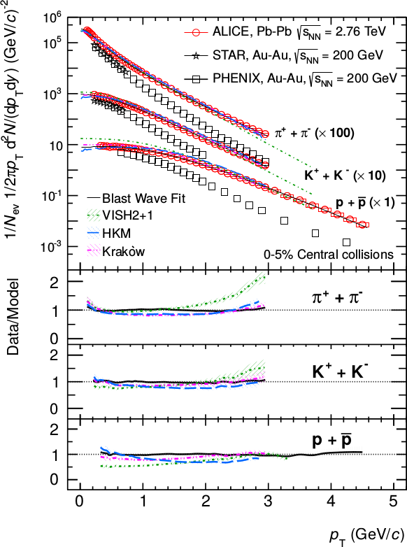
CMS
Tracks: p_{T}>900 MeV/c
Clusters: limited by B
→ ~62% of energy measured
Phys. Rev. Lett. 109, 252301 (2012)
<p_{T}> ~ 700 MeV/c Phys. Lett. B 727 (2013) 371-380

Slide 23
PHENIX
Uses electromagnetic calorimeter
γ
γ
π⁺
π⁻
γ
_{S}
γ
K⁰
n
‾Λ
π⁰
π⁰
Λ
n
γ
γ
γ
‾Λ
n
π⁰
γ
Λ
γ
γ
Deposit 100% of energy
π⁺
π⁻
‾n
_{S}
K⁺
K⁻
K⁰
35% of energy in event
p
π⁻
_{L}
Λ
K⁰
p
‾p
→ Measure ~57% of energy
‾p
π⁺
‾Λ
Deposit about 1/3 of energy
65% of energy in event
Scale: diameter in inches = √fraction * 5

Slide 24
STAR
γ
γ
γ
_{S}
γ
K⁰
π⁰
π⁰
γ
γ
π⁺
π⁻
γ
‾Λ
π⁰
γ
Λ
γ
K⁺
γ
24% as a γ
Measure in electromagnetic calorimeter
K⁻
p
‾p
Backgrounds
58% in primary hadrons
n
‾Λ
Λ
n
_{L}
K⁰
Measure in tracking detector
n
‾n
Background
11% as a neutral hadron
π⁺
π⁻
p
π⁻
‾p
π⁺
_{S}
Λ
‾Λ
K⁰
7% in secondary hadrons
Scale: diameter in inches = √fraction * 5

Slide 25
ALICE
γ
γ
γ
_{S}
γ
K⁰
π⁰
π⁰
π⁺
π⁻
γ
γ
γ
‾Λ
π⁰
γ
K⁺
Λ
γ
γ
24% as a γ
K⁻
p
‾p
n
‾Λ
Λ
n
_{L}
K⁰
n
‾n
Measure ~56%
58% in primary hadrons
Measure in tracking detector
11% as a neutral hadron
π⁺
π⁻
p
π⁻
‾p
π⁺
_{S}
Λ
‾Λ
K⁰
Don't measure
7% in secondary hadrons
Cut out using tight DCA cut
Scale: diameter in inches = √fraction * 5

Slide 26
ALICE
3%
2%
3%
40%
But known well!
What we measure directly
45%
Corrections

Slide 27
ALICE: f_{total}
= 0.567 ± 0.009
π⁺
π⁻
‾p
K⁺
K⁻
p
‾p
K⁺
K⁻
Λ
π⁺
π⁻
π⁰
p
_{S}
_{L}
‾Λ
K⁰
K⁰
‾n
n
Scale: diameter in inches = √fraction * 5

Slide 28
Measuring energy with tracking detectors
f_{total} is robust
Other corrections are either small or known well

Slide 29
What can we learn from measuring E_{T}?
E_{T} higher than expected at LHC
Similar trends to those seen at RHIC
At LHC increasing energy → increasing energy/particle, not more particles
Reach energy densities around 10 GeV/fm³
ET seems to scale with N_{quark}

Slide 30
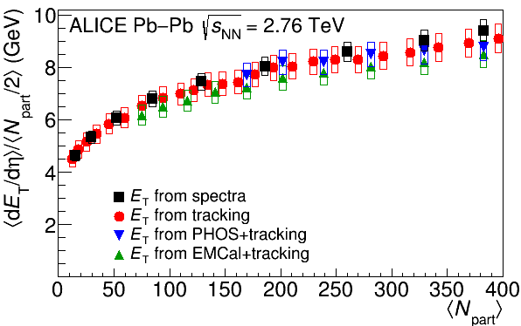
Comparison of different methods
ALICE

Slide 31
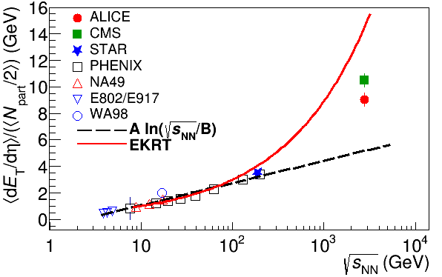
Energy dependence
Higher than extrapolations of RHIC data

Slide 32
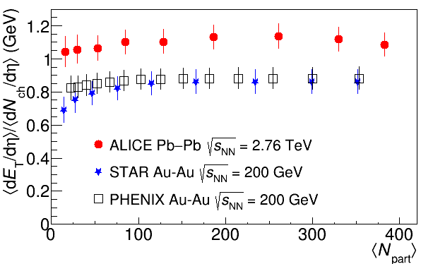
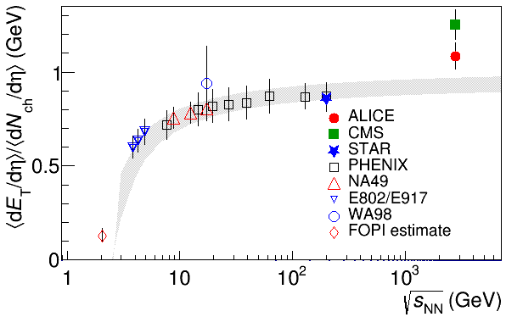
Average energy/particle
Same centrality dependence as at RHIC
At RHIC: more energy → more particles At LHC: more energy → higher energy/particle

Slide 33
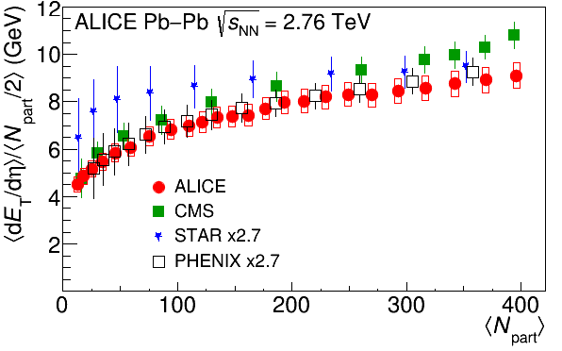
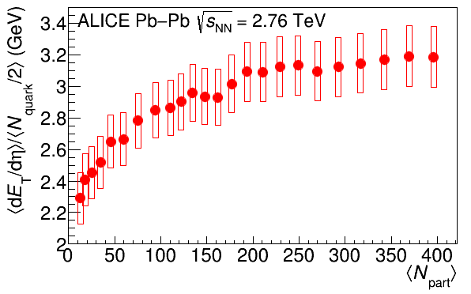
Scaling
Same centrality dependence as at RHIC
E_{T} appears to scale better with N_{quark} than N_{part}

Slide 34
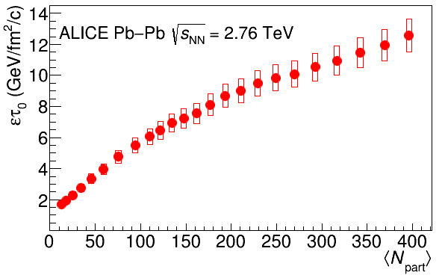
Energy density
RHIC
Standard estimate τ₀ ≈ 1 fm/c
QGP formation

Slide 35
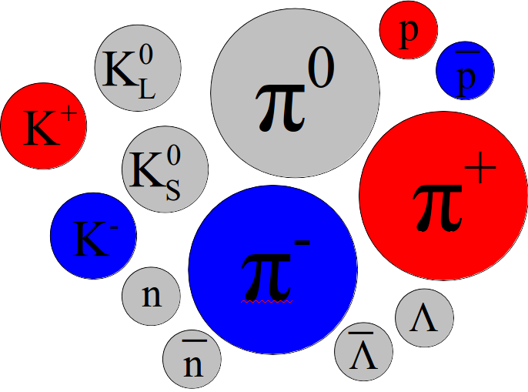
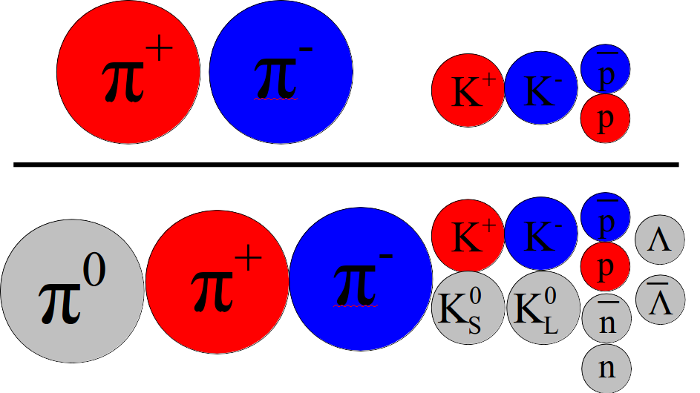
Conclusions
Energy distribution in an event:
NOT 1/3 neutral! ...but hits your detector as ~1/3 neutral
Measurements of E_{T}: tracking only measurements highly accurate!
E_{T} higher than expected at LHC

Slide 36
The End

Slide 37
Comparison of colliders
 | RHIC | LHC
√s_{NN} (GeV) | 9-200 | 2760, 5500 | center of mass energy
dN_{ch}/dη | ~1200 | ~1600 | number of particles
T/T_{c} | 1.9 | 3.0-4.2 | temperature
ε (GeV/fm³) | 5 | ~15 | energy density
τ_{QGP} (fm/c) | 2-4 | >10 | lifetime of QGP
RHIC and LHC:
Cover 2 –3 decades of energy (√s_{NN}= 9 GeV –5.5 TeV) To discover the properties of hot nuclear matter at T ~ 150 –600 MeV

Slide 38
Hybrid method
E_{t}^{had}
E_{t}^{em}
A. Well-measured by TPC
B. Not well measured but included in def.
E. Well-measured by EMCal
π∓,k∓,p`p
n,K⁰_{L},`n
π⁰,e∓, γ, η
F. Not included in def. but occurs as a background
Not included in def. but occurs as a background
Not included in def. but occurs as a background
D. Included in def, but will exclude with DCA and correct for missing energy
C. Not included in def. but occurs as a background
π∓,k∓,p`p
π∓,k∓,p`p
π∓,k∓,p`p
n,K⁰_{L},`n
n,K0L,`n
n,K0L,`n
e∓
K⁰_{S}, Λ`Λ
Stuff the tracking detectors measure well
Stuff the EMCal measures well

Slide 39
Calculation from spectra
Use spectra data and use Blast wave fits to extrapolate to higher and lower p_{T}
Three assumptions E_{T}^{n}=E_{T}^{p} E_{T}^{`n}=E_{T}^{`p} K⁰_{L}=K⁰_{S}
Then, neglecting pseudorapidity dependence and assuming that the correction is the same for 900 GeV, 2.76 TeV, and 7 TeV:
Everything else is negligible

Slide 40
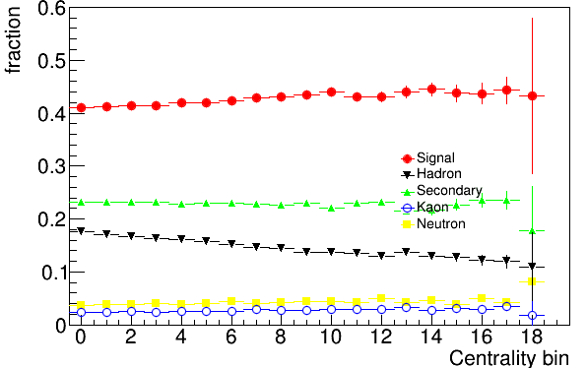
What does the EMCal measure?
Note that this gets the fraction from kaons wrong. The fraction from kaons is actually about 10% of what we measure. Signal is actually ~30%.

Slide 41
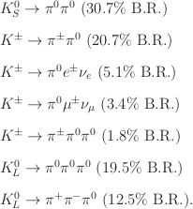
Kaon deposits
There are several kaon decays into pi0's and pi0's decay mostly into photons
These will (mostly) not be matched to tracks
Simulations are unreliable because of how far off simulations are for strange particles

Slide 42
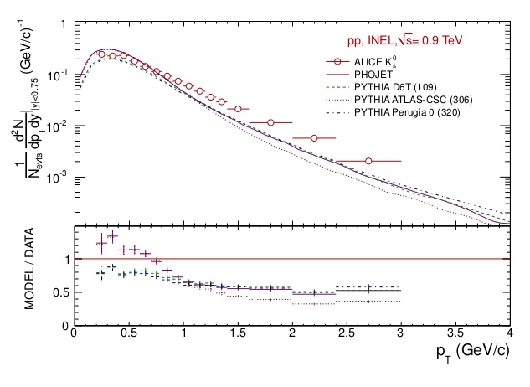
Kaons – measured vs simulation

Slide 43
E_{T}^{em}
Sum over clusters
Geometric acceptance, not including dead channels
Contributions to final E_{T}^{em} systematic error
Correction for minimum energy threshold ~6%
Correction for nonlinearity of detector response ~0.5%
Data driven
All energy deposited by K⁰_{S}, K⁰_{L}, K±, including decays like K⁰_{S}→π⁰π⁰→γγγγ <3%
Correction for other charged hadron deposits in calorimeter ~10-20%
Correction for (anti)neutron deposits in calorimeter ~1.5-5%
Input from data
Correction for deposits by particles from secondary interactions <4 <5%
efficiency x acceptance within geometric acceptance of detector ~1%

Slide 44
E_{T}^{had}
Correction for the geometric acceptance – 1, with acceptance due to sector boundaries, etc. rolled into the track efficiency
Correction for the low p_{T} cut off in the acceptance
Correction for neutral hadrons included in the definition but not measured well: K⁰_{S}, Λ,`Λ, K⁰_{L}, n,`n Not trying to measure K⁰_{S}, Λ,`Λ in TPC – apply DCA cut to eliminate, correct for missing energy
Correction for background not included in definition (e∓) or not measured easily event-by-event (K⁰_{S}, Λ,`Λ)
Correction for π, K, p not identified
Correction for tracking efficiency
Definition of energy to mimic the behavior of a calorimeter

