Slide 1
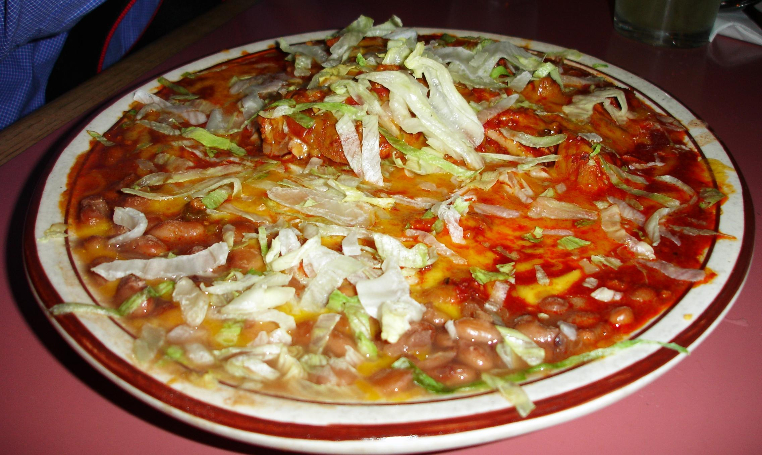
Separating signal from background
Christine Nattrass
University of Tennessee, Knoxville
Partly based on Connors, Nattrass, Reed, & Salur arxiv:1705.01974, accepted in RMP

Slide 2
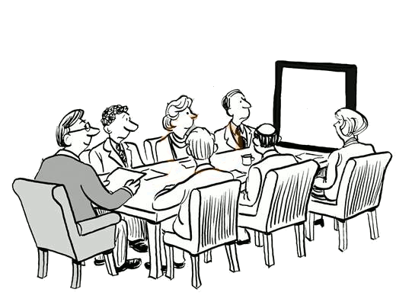
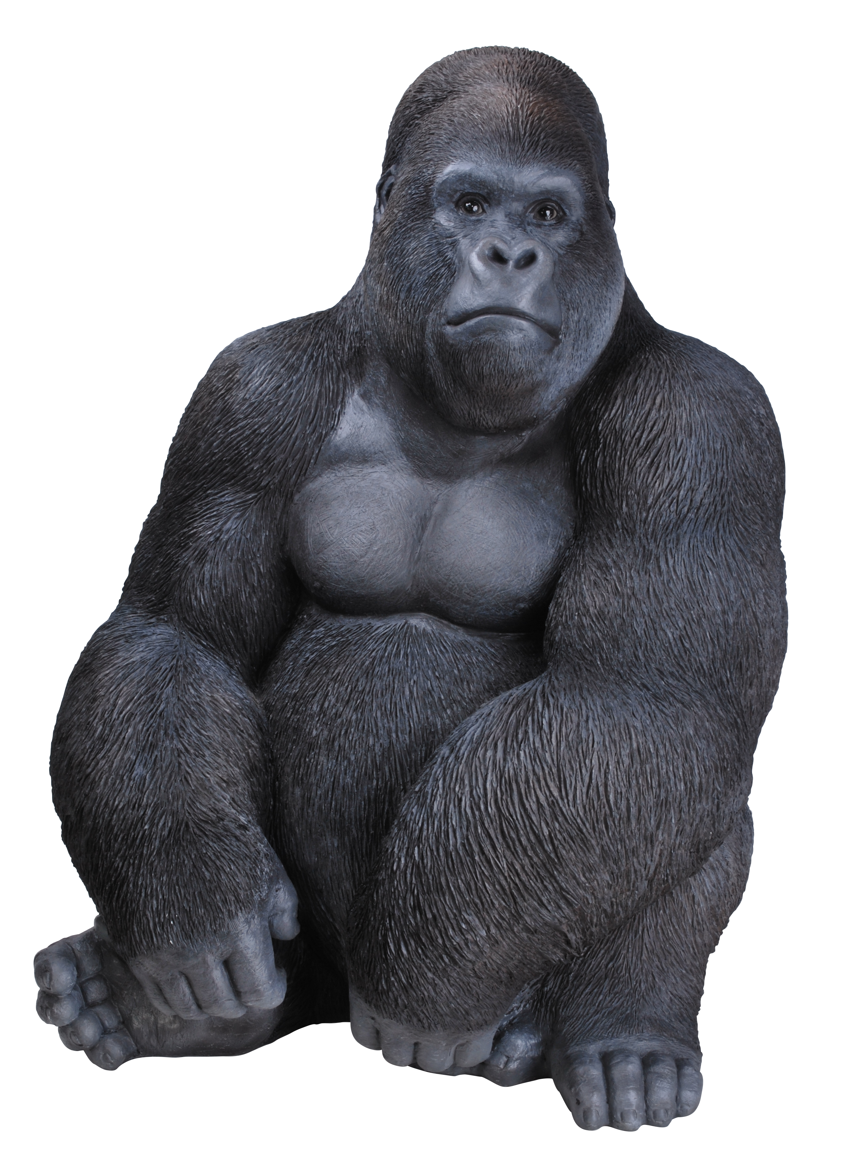
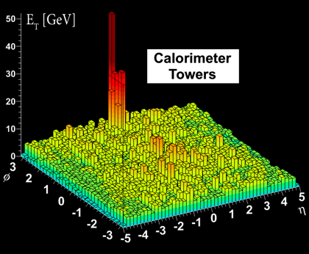

Slide 3
What is a jet?

Slide 4
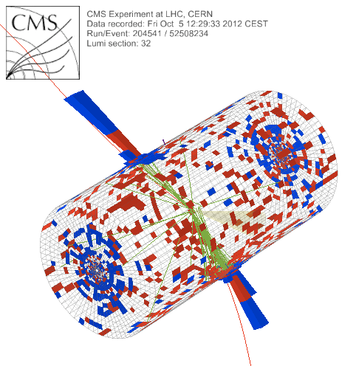
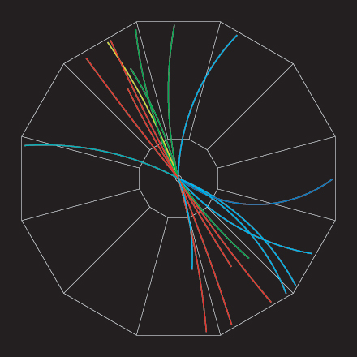
What is a jet?
p+p → dijet
Beam pipe

Slide 5
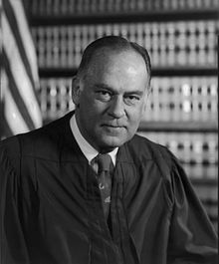
What is a jet?
p+p → dijet
Beam pipe
“I know it when I see it”
US Supreme Court Justice Potter Stewart, Jacobellis v. Ohio

Slide 6
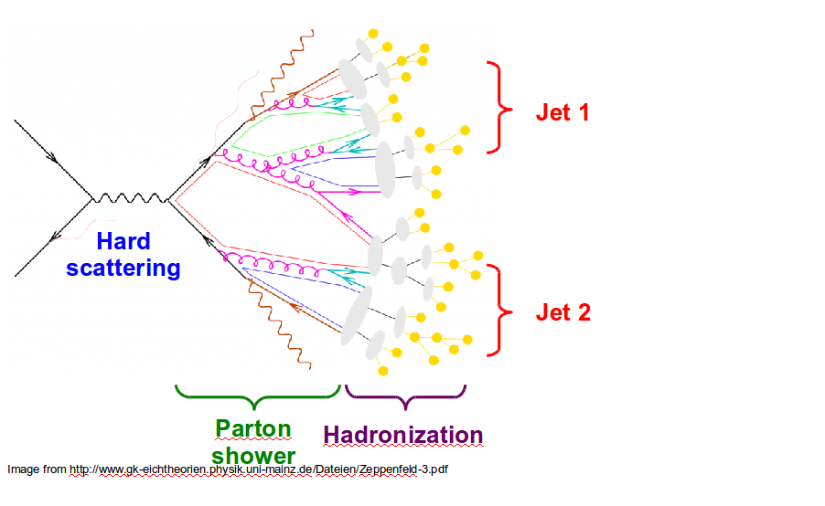
Jet finding
in pp collisions
Jet finder: groups final state particles into jet candidates
  Anti-k_{T} algorithm
  JHEP 0804 (2008) 063 [arXiv:0802.1189]
Depends on hadronization
Ideally
  Infrared safe
  Colinear safe
Snowmass Accord: Theoretical calculations and experimental measurements should use the same jet finding algorithm. Otherwise they will not be comparable.

Slide 7
A jet is what a jet finder finds.

Slide 8
Jet finding
in AA collisions
Jet finder: groups final state particles into jet candidates
  Anti-k_{T} algorithm
  JHEP 0804 (2008) 063 [arXiv:0802.1189]
Combinatorial jet candidates
Energy smearing from background
Large, fluctuating, correlated background
Sensitive to methods to suppress combinatorial jets and correct energy
Focus on narrow/high energy jets

Slide 9
Jet finding
in AA collisions
Jet finder: groups final state particles into jet candidates
  Anti-k_{T} algorithm
  JHEP 0804 (2008) 063 [arXiv:0802.1189]
Combinatorial jet candidates
Energy smearing from background
Large, fluctuating, correlated background
Sensitive to methods to suppress combinatorial jets and correct energy
Focus on narrow/high energy jets
We need an accord on how to treat background

Slide 10
Background is a solved problem.
– Unnamed

Slide 11
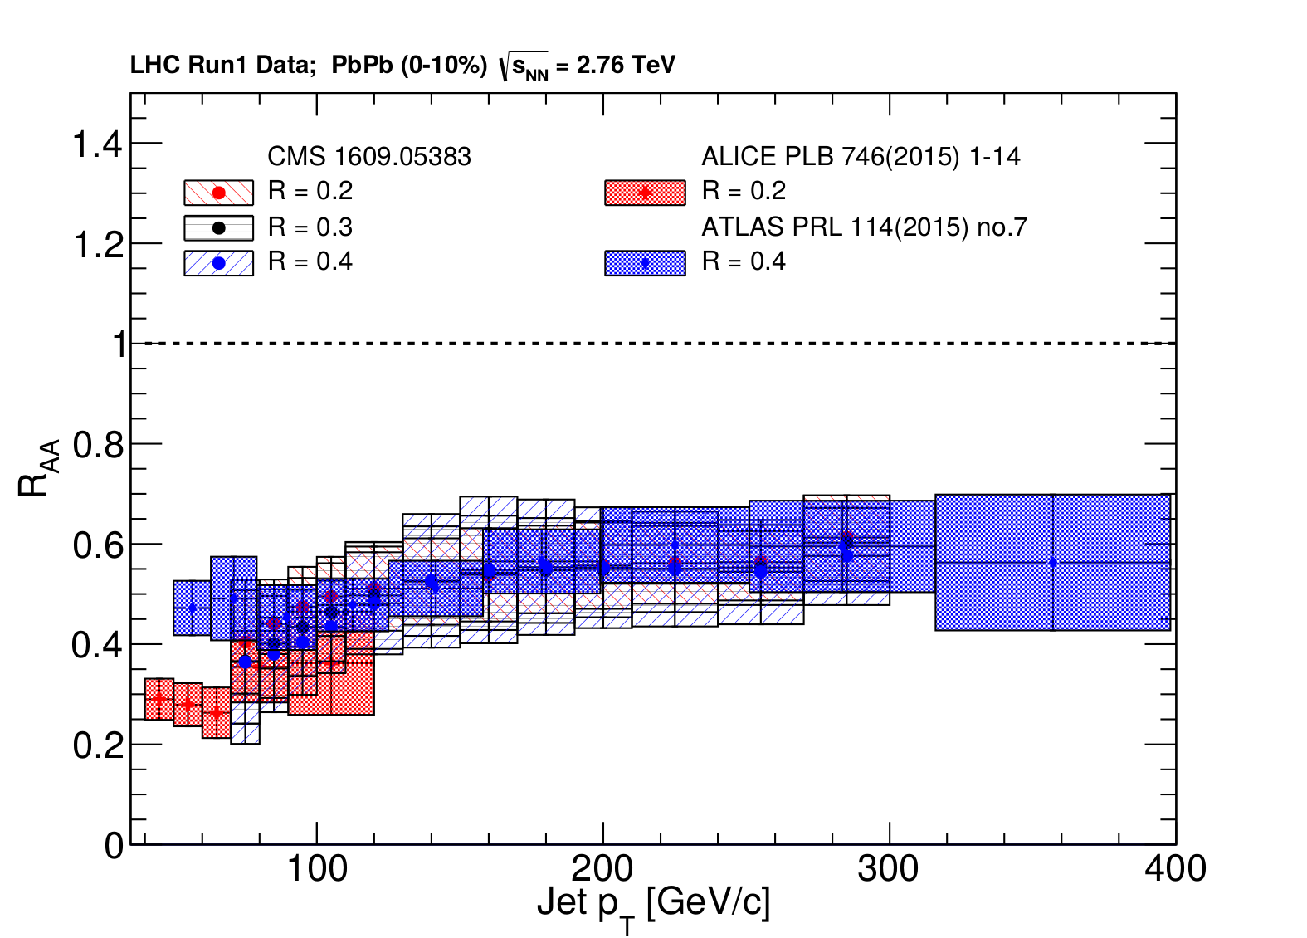
ATLAS
Background subtraction method:
Iterative procedure
  Calorimeter jets: Reconstruct jets with R=0.2. v₂ modulated <Bkgd> estimated by energy in calorimeters excluding jets with at least one tower with
  E_{tower} > <E_{tower}>
  Track jets: Use tracks with p_{T}>4 GeV/c
  Calorimeter jets from above with E>25 GeV and track jets with p_{T}>10 GeV/c used to estimate background again.
Calorimeter tracks matching one track with p_{T}>7 GeV/c or containing a high energy cluster E >7 GeV are used for analysis down to E_{jet} = 20 GeV
arXiv:1705.01974
Constituent biases don't matter that much up here
Phys. Lett. B 719 (2013) 220-241
But they do matter down here!

Slide 12
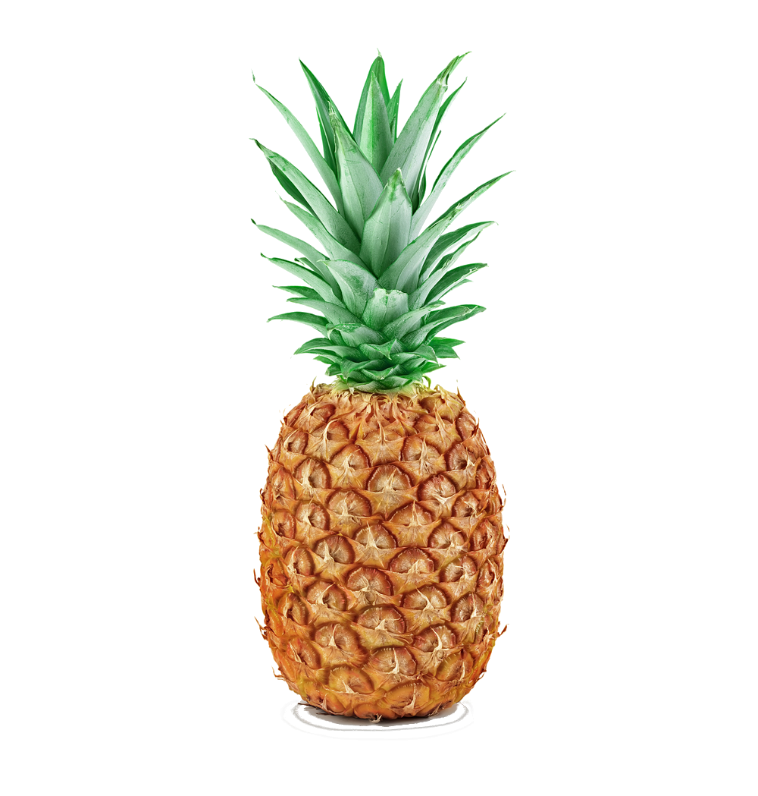

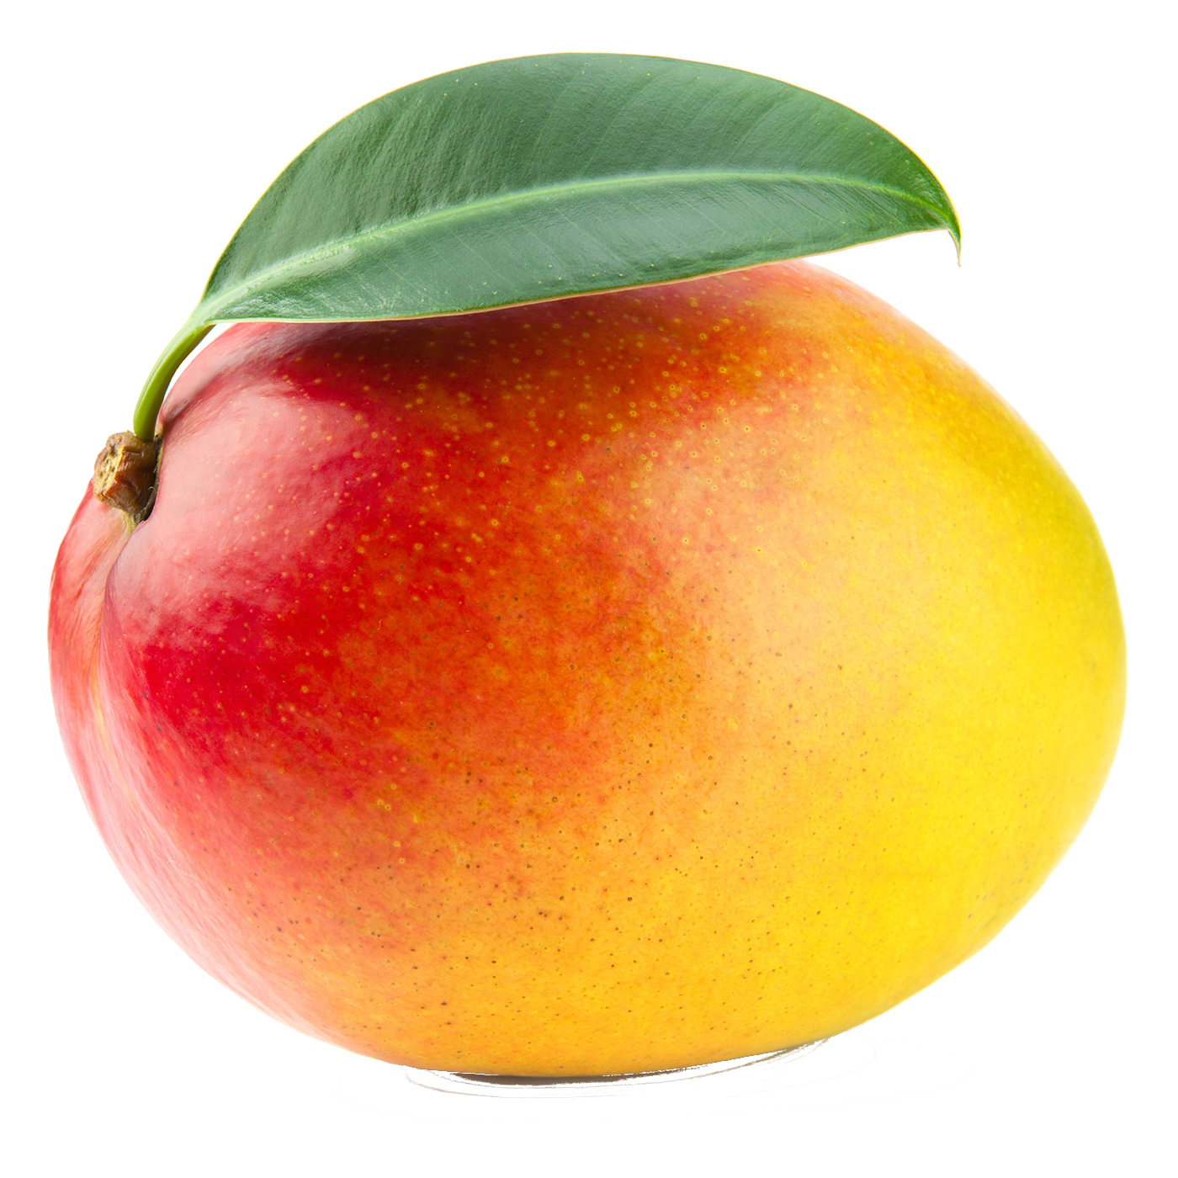
ATLAS
Background subtraction method:
Iterative procedure
  Calorimeter jets: Reconstruct jets with R=0.2. v₂ modulated <Bkgd> estimated by energy in calorimeters excluding jets with at least one tower with
  E_{tower} > <E_{tower}>
  Track jets: Use tracks with p_{T}>4 GeV/c
  Calorimeter jets from above with E>25 GeV and track jets with p_{T}>10 GeV/c used to estimate background again.
Calorimeter tracks matching one track with p_{T}>7 GeV/c or containing a high energy cluster E >7 GeV are used for analysis down to E_{jet} = 20 GeV
arXiv:1705.01974
Constituent biases don't matter that much up here
Phys. Lett. B 719 (2013) 220-241
But they do matter down here!

Slide 13
Different jets are different.
– Rosi Reed

Slide 14
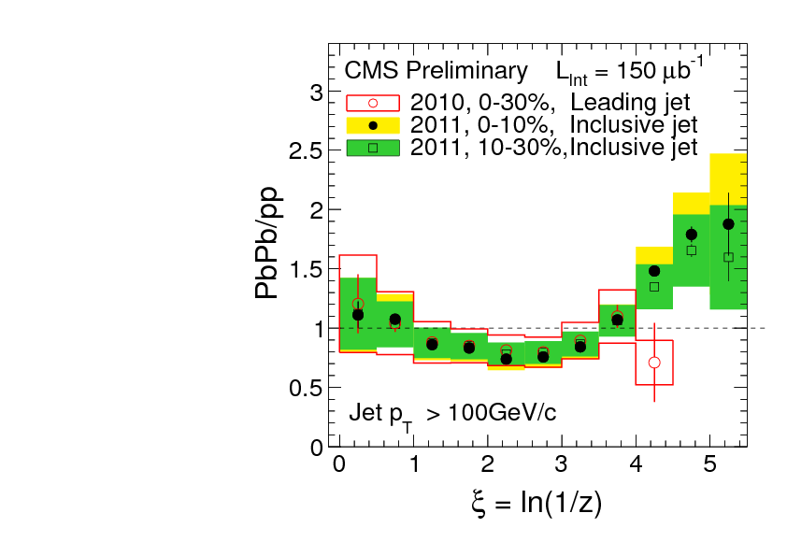
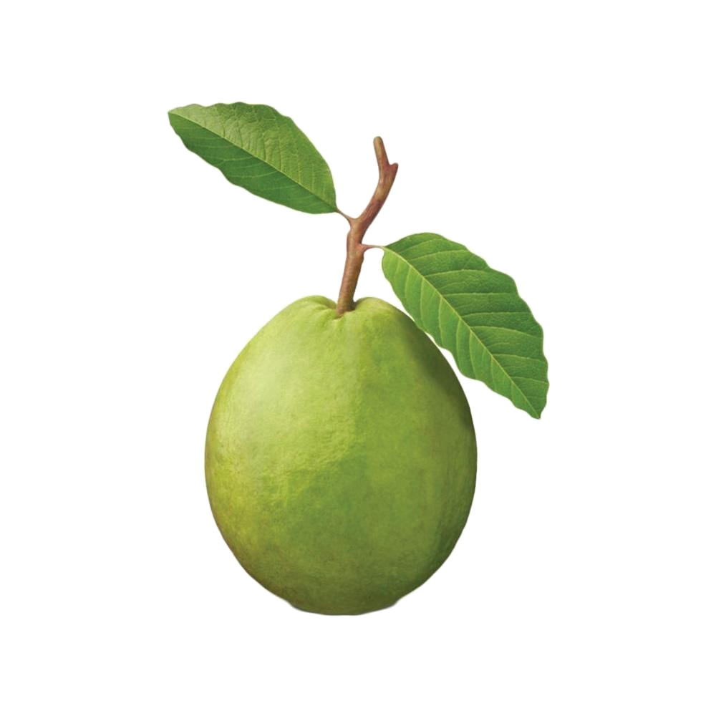
What you see depends on where you look
Phys. Rev. C 90, 024908 (2014)
JHEP10(2012)087
z = p_{T}/E_{jet}
Low p_{T}
High p_{T}
Low p_{T}
Low p_{T}
Low p_{T}
Low p_{T}
High p_{T}
Low p_{T}
High p_{T}
High p_{T}
High p_{T}

Slide 15
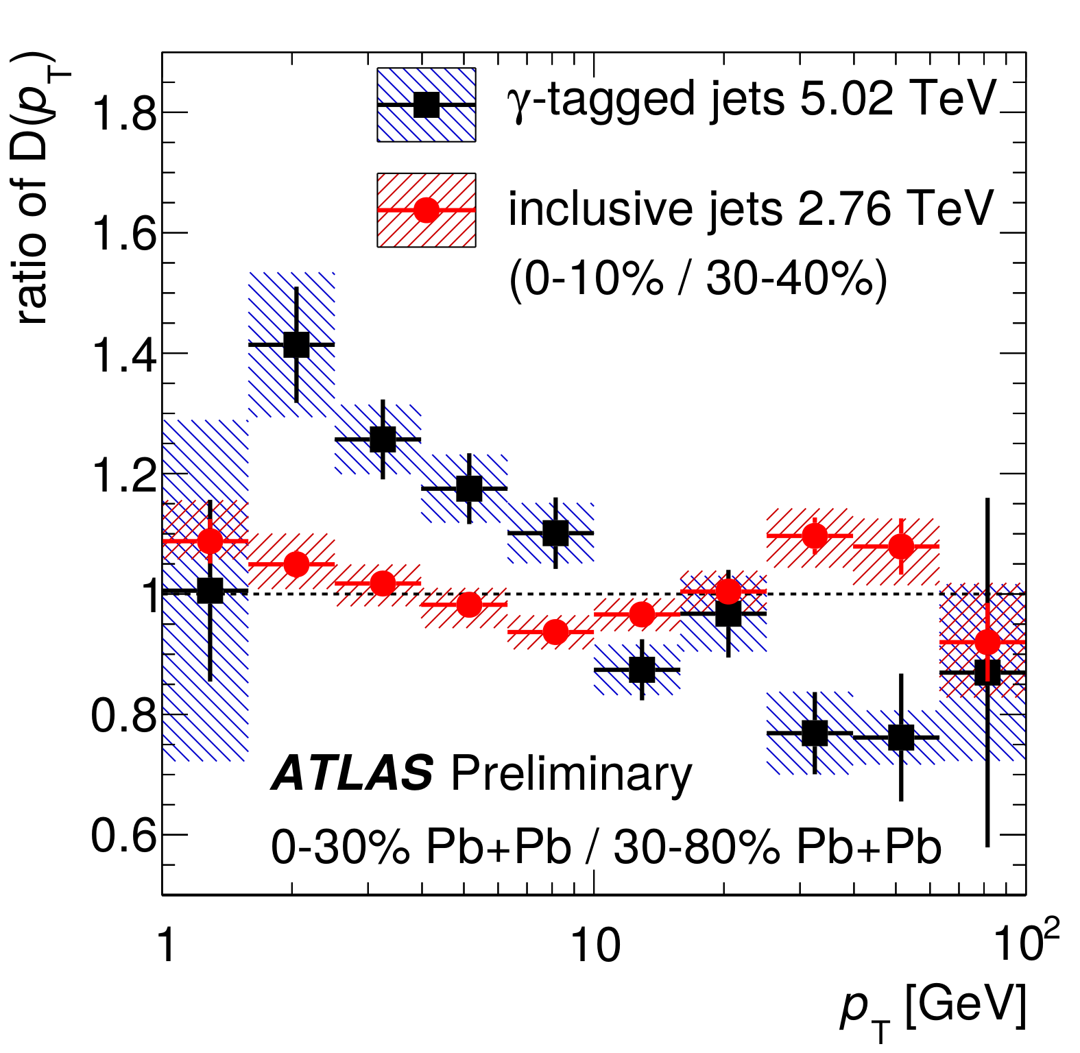
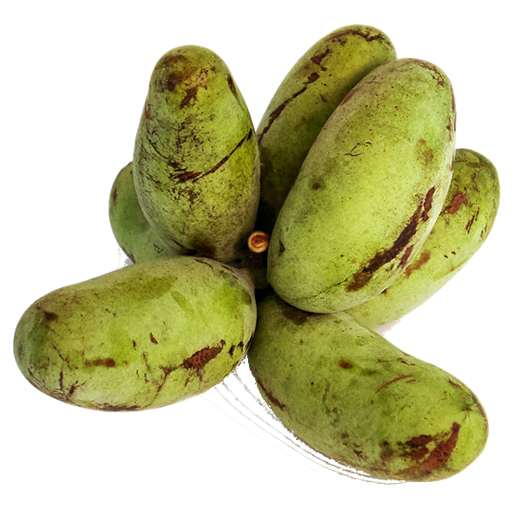
What you see depends on where you look

Slide 16
What should we measure?

Slide 17
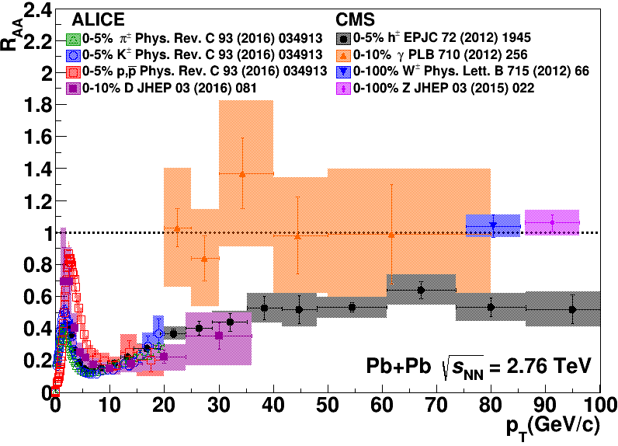
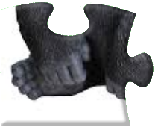
What should we measure?

Slide 18
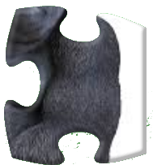
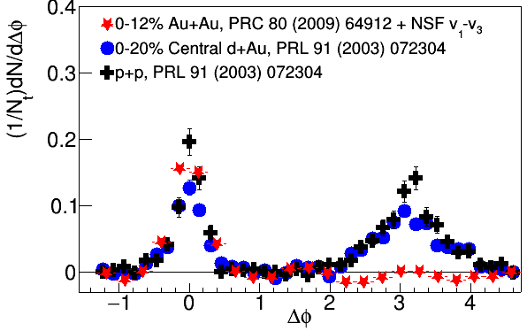
What should we measure?
arXiv:1801.09131

Slide 19
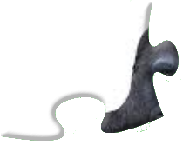
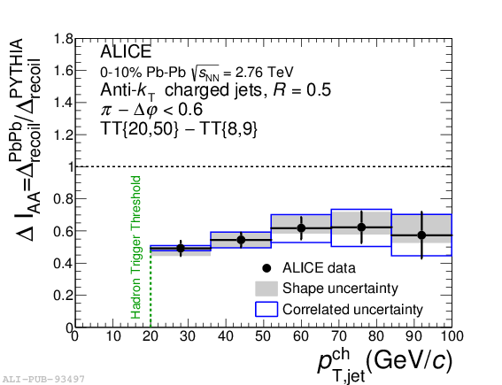
What should we measure?
arXiv:1801.09131

Slide 20
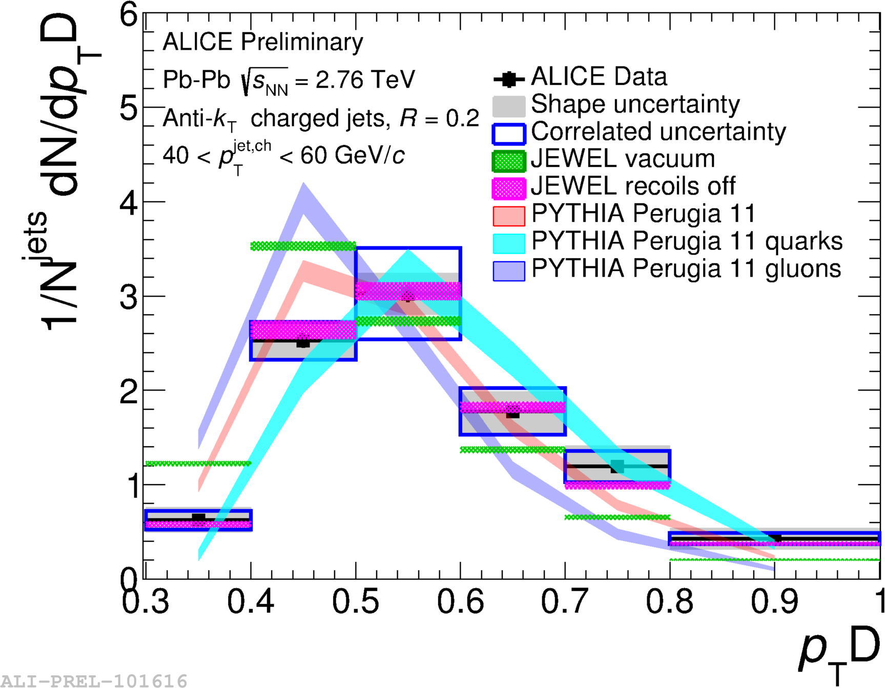
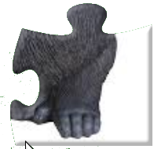
What should we measure?
arXiv:1801.09131

Slide 21
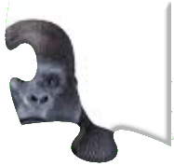
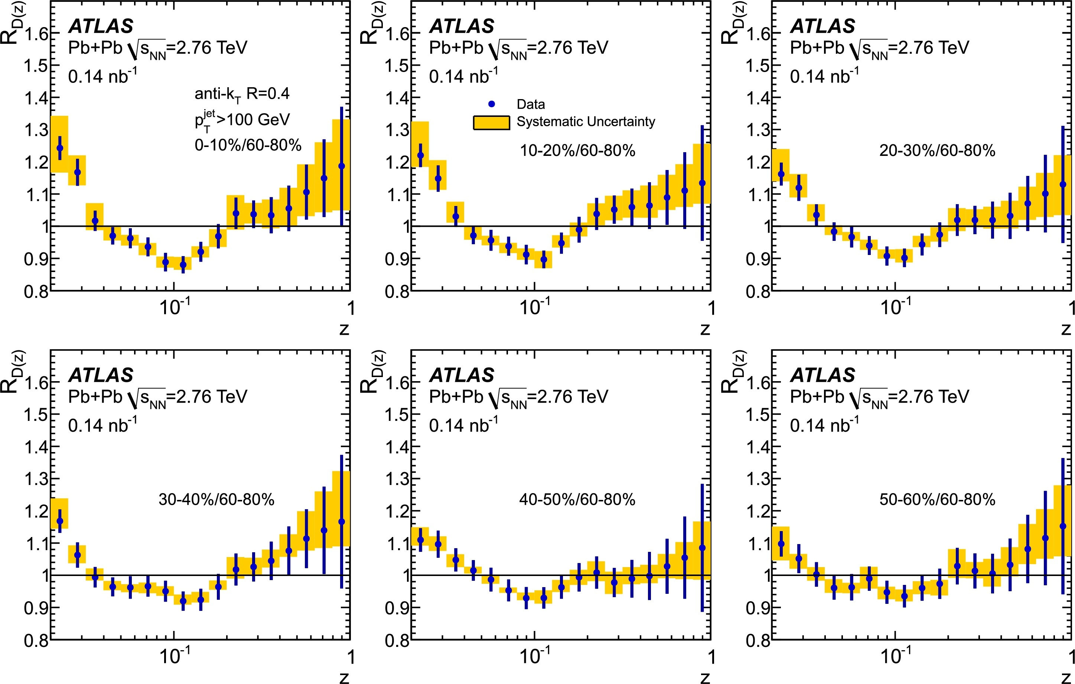
What should we measure?
arXiv:1801.09131

Slide 22
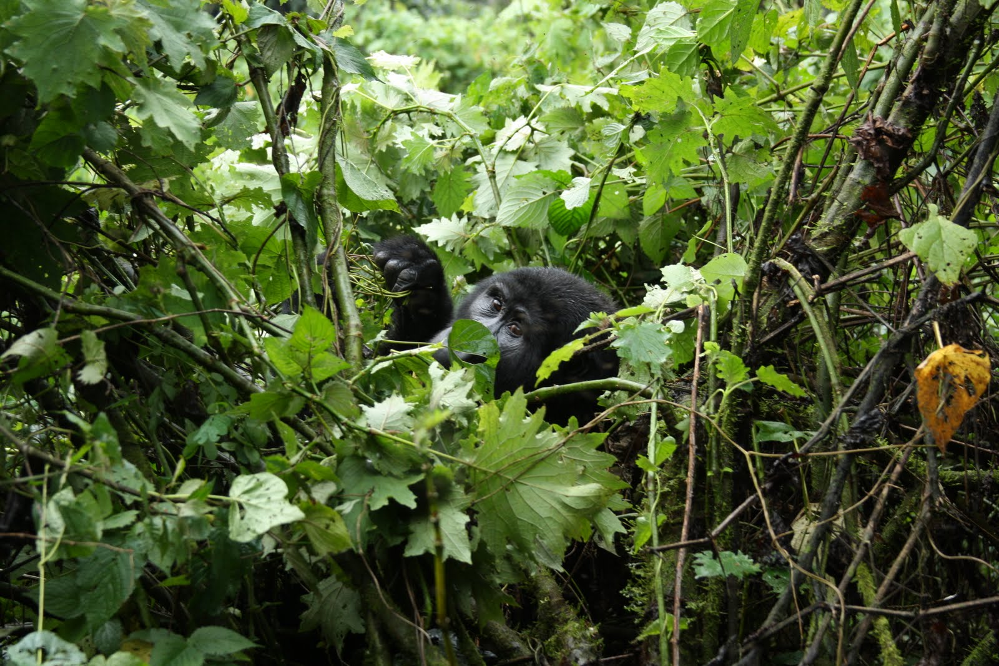

Slide 23
Bias & background
Experimental background subtraction methods: complex, make assumptions, apply biases
Survivor bias: Modified jets probably look more like the medium
Quark/Gluon bias:
  Quark jets are narrower, have fewer tracks, fragment harder [Z Phys C 68, 179-201 (1995), Z Phys C 70, 179-196 (1996), ]
  Gluon jets reconstructed with k_{T} algorithm have more particles than jets reconstructed with anti-k_{T} algorithm [Phys. Rev. D 45, 1448 (1992)]
  Gluon jets fragment into more baryons [EPJC 8, 241-254, 1998]
Fragmentation bias: Experimental measurements explicitly select jets with hard fragments

Slide 24
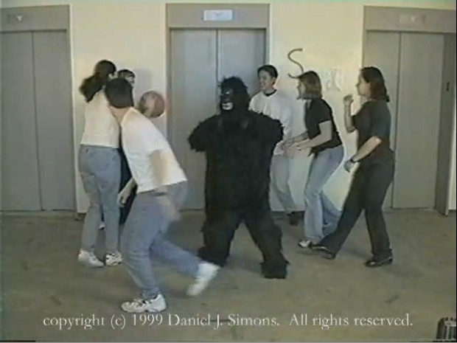
The invisible gorilla
http://www.theinvisiblegorilla.com/

Slide 25



Jet mass
arXiv:1702.00804
Quenching models (JEWEL, Q-PYTHIA) show a larger mass than pp-like PYTHIA jets
Pb-Pb measurement can discriminate among these predictions

Slide 26
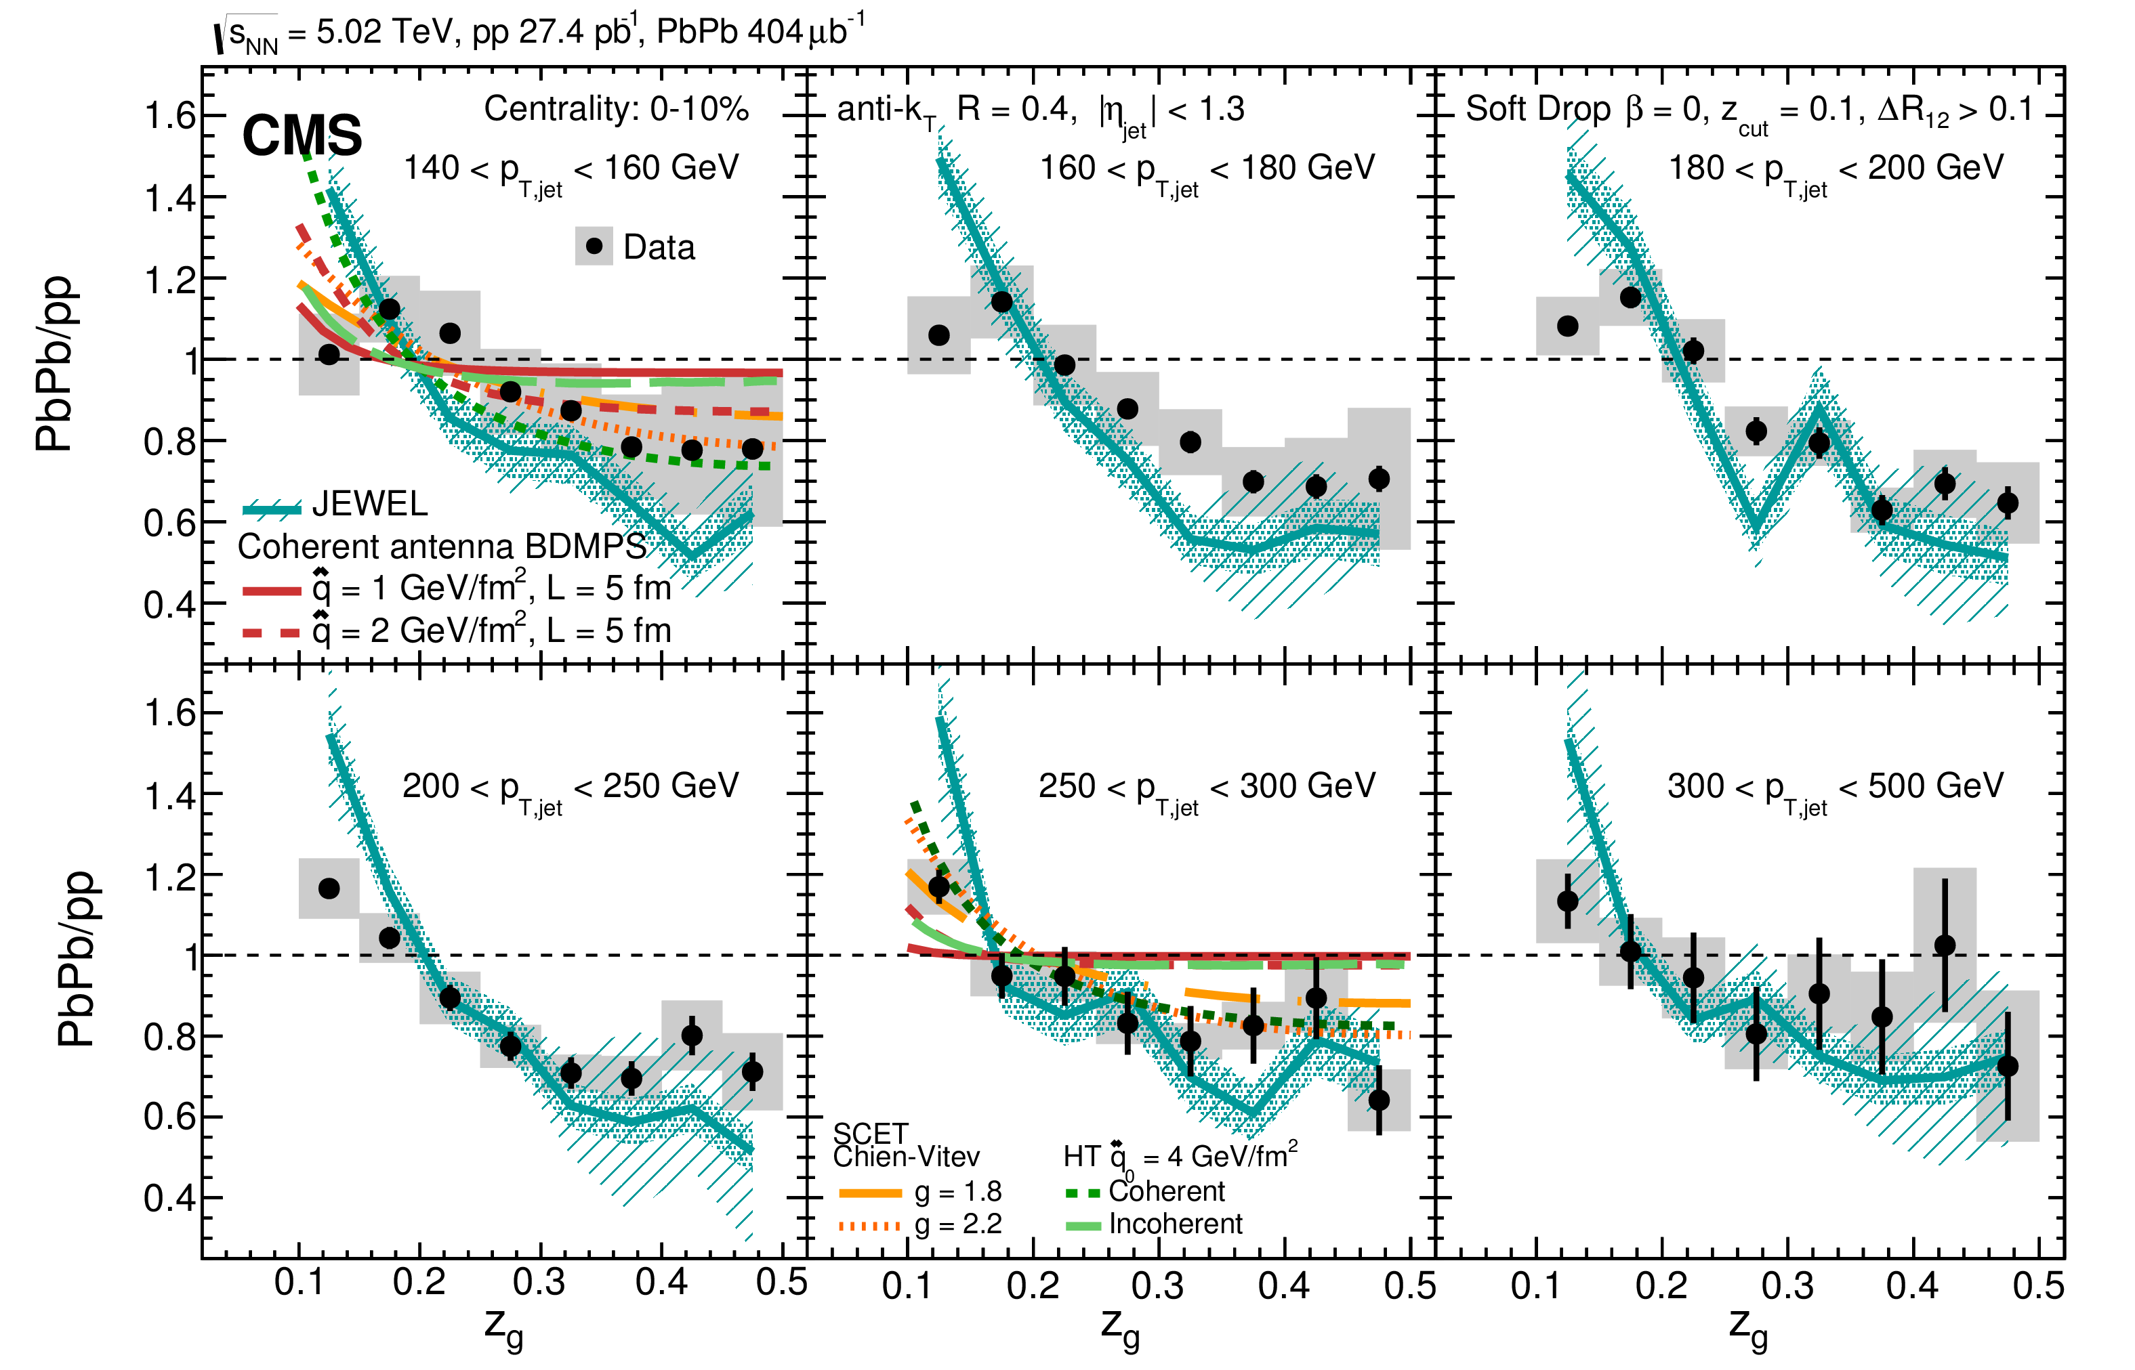
Splitting function

Slide 27
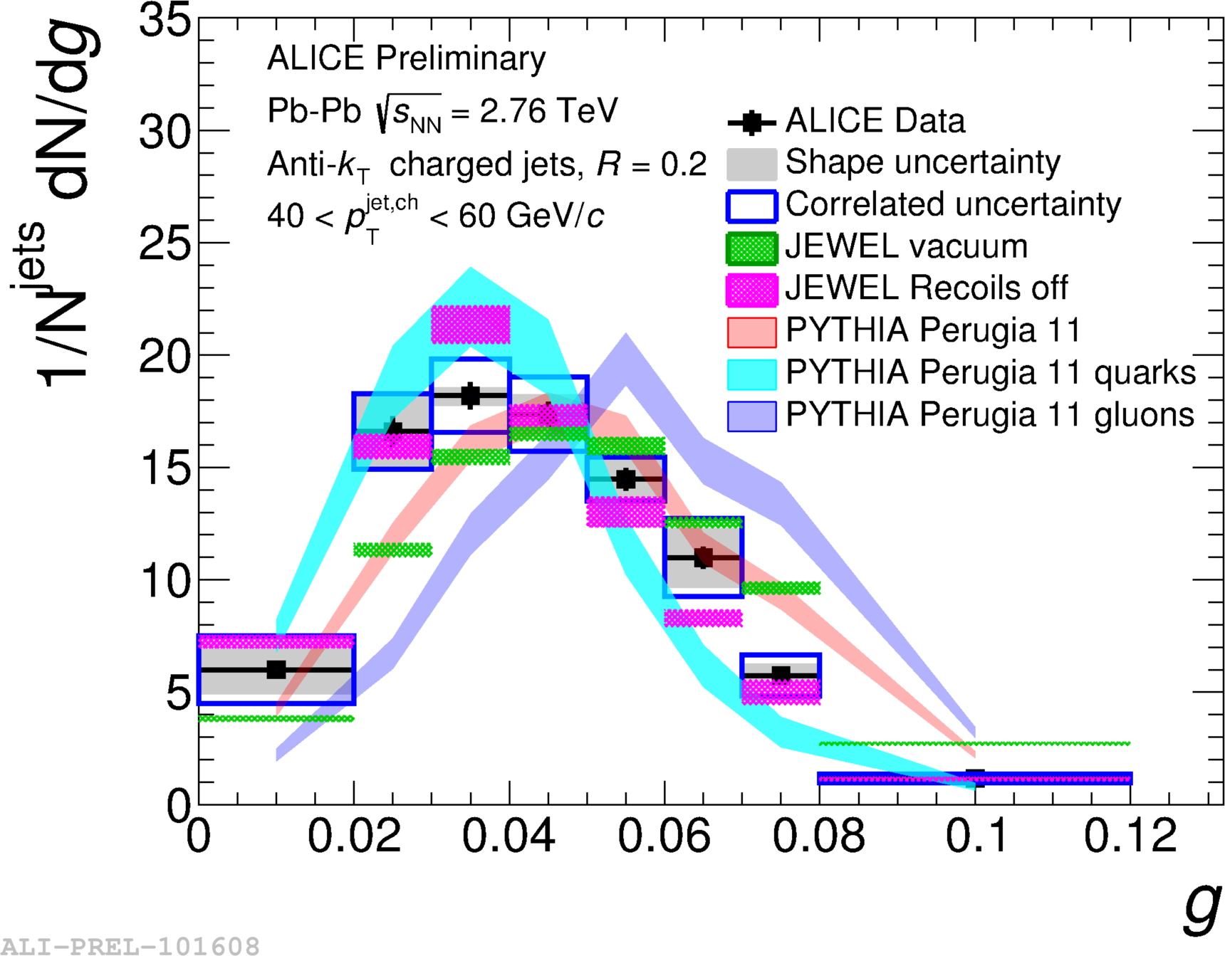
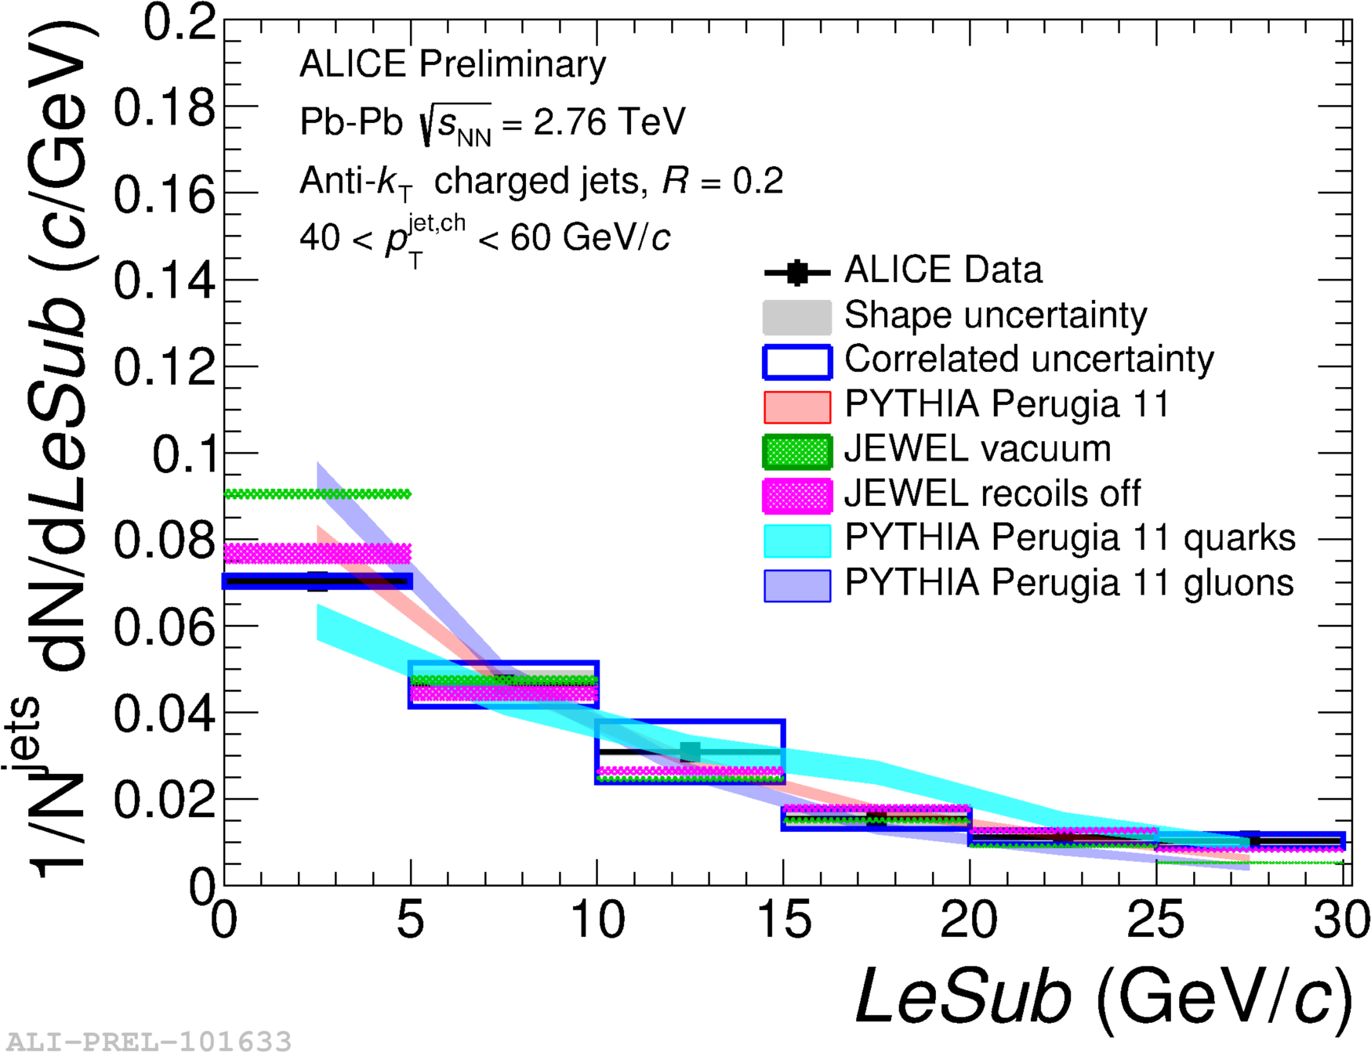
Girth g
Dispersion p_{T}D
LeSub
$g=\sum_{i∈jet}{\frac{p_{T}^{i}}{p_{T}^{jet}}r_{i}}$
$p_{T}D=\frac{\sqrt{\sum_{i∈jet}{{\left(p_{T}^{i}\right)}^{2}}}}{\sum_{i∈jet}{p_{T}^{i}}}$
$LeSub=p_{T}^{leading}−p_{T}^{subleading}$
Jets are slightly more collimated than in pp
Agrees with PYTHIA

Slide 28
Jet measurement madlibs!
[Adjective] [noun] [observable] in [collision system]
Groomed
Unfolded
Event-engineered
Top quark
B-jet
Z-boson
D meson
Correlations
Di-jet asymmetries
v₁, v₂, v₃, v₄...
Proton-lead
Ultra-central collisions

Slide 29
Jet measurement madlibs!
[Adjective] [noun] [observable] in [collision system]
Groomed
Unfolded
Event-engineered
Top quark
B-jet
Z-boson
D meson
Correlations
Di-jet asymmetries
v₁, v₂, v₃, v₄...
Proton-lead
Ultra-central collisions
Groomed top quark di-jet asymmetries in ultracentral collisions

Slide 30
Jet measurement madlibs!
[Adjective] [noun] [observable] in [collision system]
Groomed
Unfolded
Event-engineered
Top quark
B-jet
Z-boson
D meson
Correlations
Di-jet asymmetries
v₁, v₂, v₃, v₄...
Proton-lead
Ultra-central collisions
Groomed top quark di-jet asymmetries in ultracentral collisions
Unfolded Z-boson correlations in proton-lead

Slide 31
Jet measurement madlibs!
[Adjective] [noun] [observable] in [collision system]
Groomed
Unfolded
Event-engineered
Top quark
B-jet
Z-boson
D meson
Correlations
Di-jet asymmetries
v₁, v₂, v₃, v₄...
Proton-lead
Ultra-central collisions
Groomed top quark di-jet asymmetries in ultracentral collisions
Unfolded Z-boson correlations in proton-lead
Groomed top jet v₄ in ultra-central collisions

Slide 32
Jet measurement madlibs!
[Adjective] [noun] [observable] in [collision system]
Groomed
Unfolded
Event-engineered
Top quark
B-jet
Z-boson
D meson
Correlations
Di-jet asymmetries
v₁, v₂, v₃, v₄...
Proton-lead
Ultra-central collisions
Groomed top quark di-jet asymmetries in ultracentral collisions
Unfolded Z-boson correlations in proton-lead
Groomed top jet v₄ in ultra-central collisions
Event-engineered groomed b-jet top quark di-jet asymmetries in ultra-central collisions

Slide 33
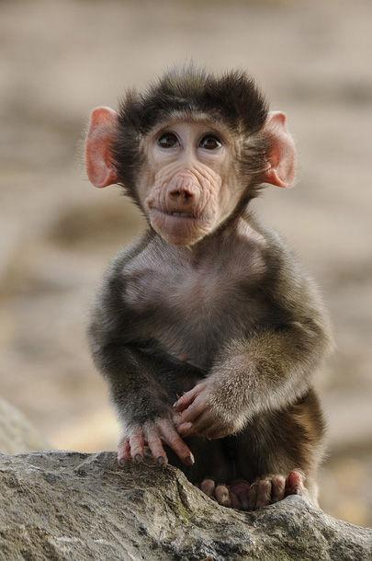
What should we measure?
Jupiter and the Monkey
Jupiter promised a royal reward to the one whose offspring should be deemed the handsomest.
The monkey came with the rest, and presented a flat-nosed, hairless, ill-featured young monkey.
A general laugh saluted her on the presentation of her son.
She resolutely said; "He is at least in the eyes of me, his mother, the dearest, handsomest, and most beautiful of all."
http://aesopsfables.org/F9_Jupiter-and-the-Monkey.html
Abbreviated

Slide 34
I do not care about jets.
Paraphrased from Sevil Salur

Slide 35
I want to learn about the QGP.
Paraphrased from Sevil Salur

Slide 36
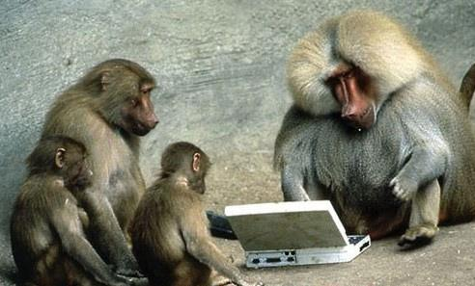
What have we learned?
http://www.pak101.com/funnypictures/Funny/2011/9/20/Funny_Animals_Pictures_mhsqs.jpg

Slide 37
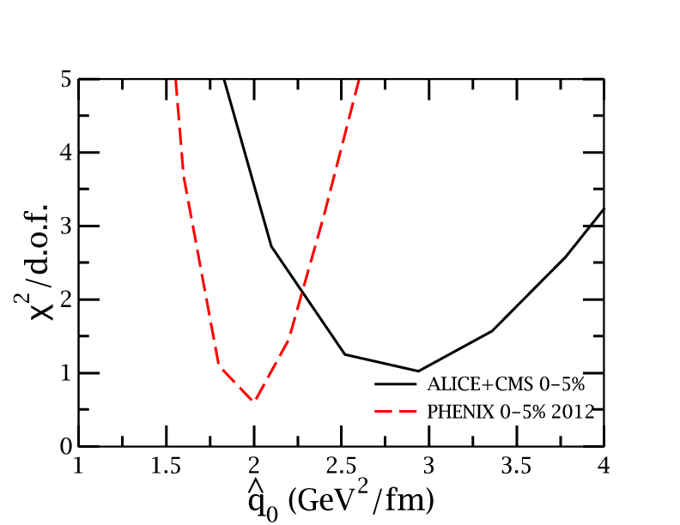
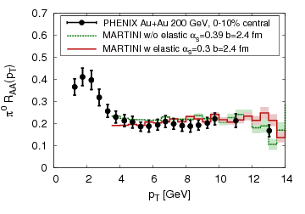
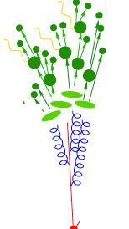
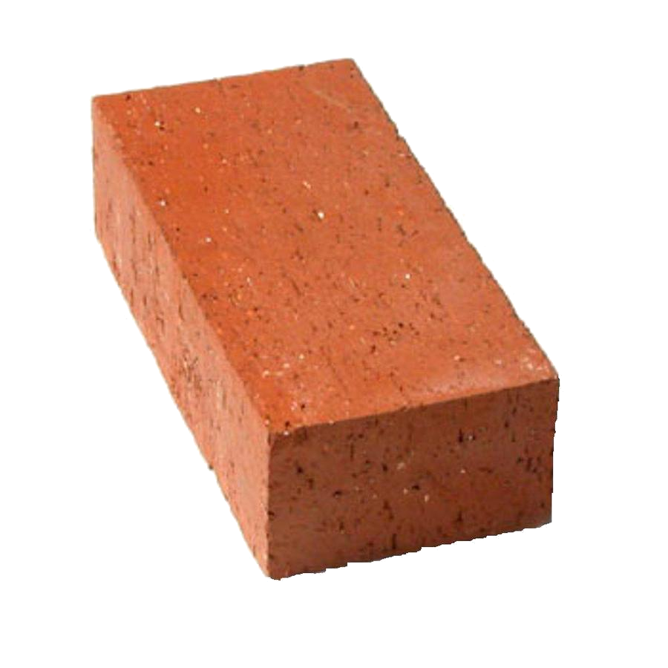
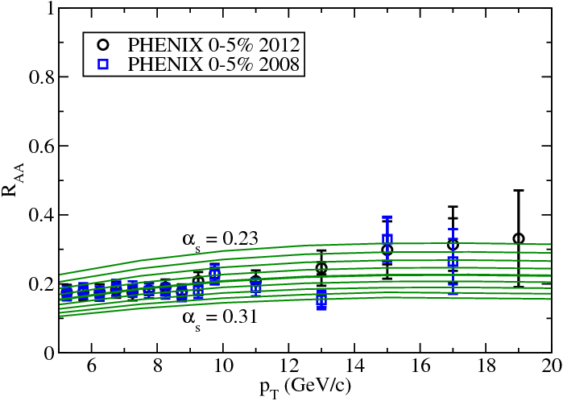
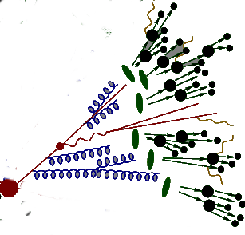
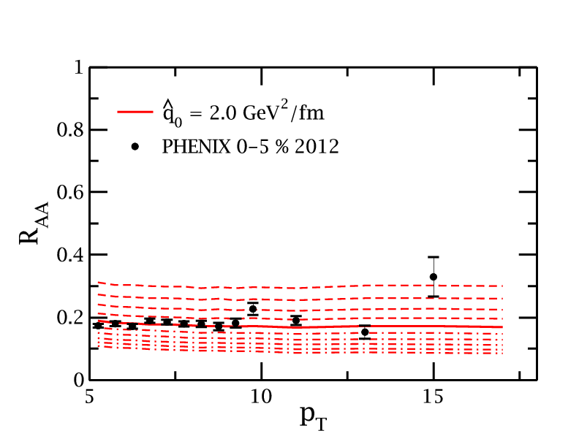
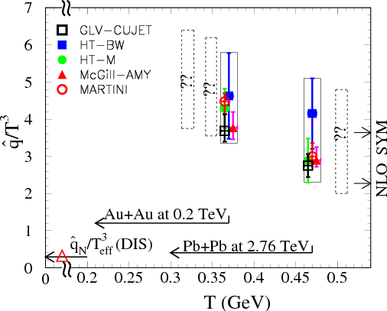
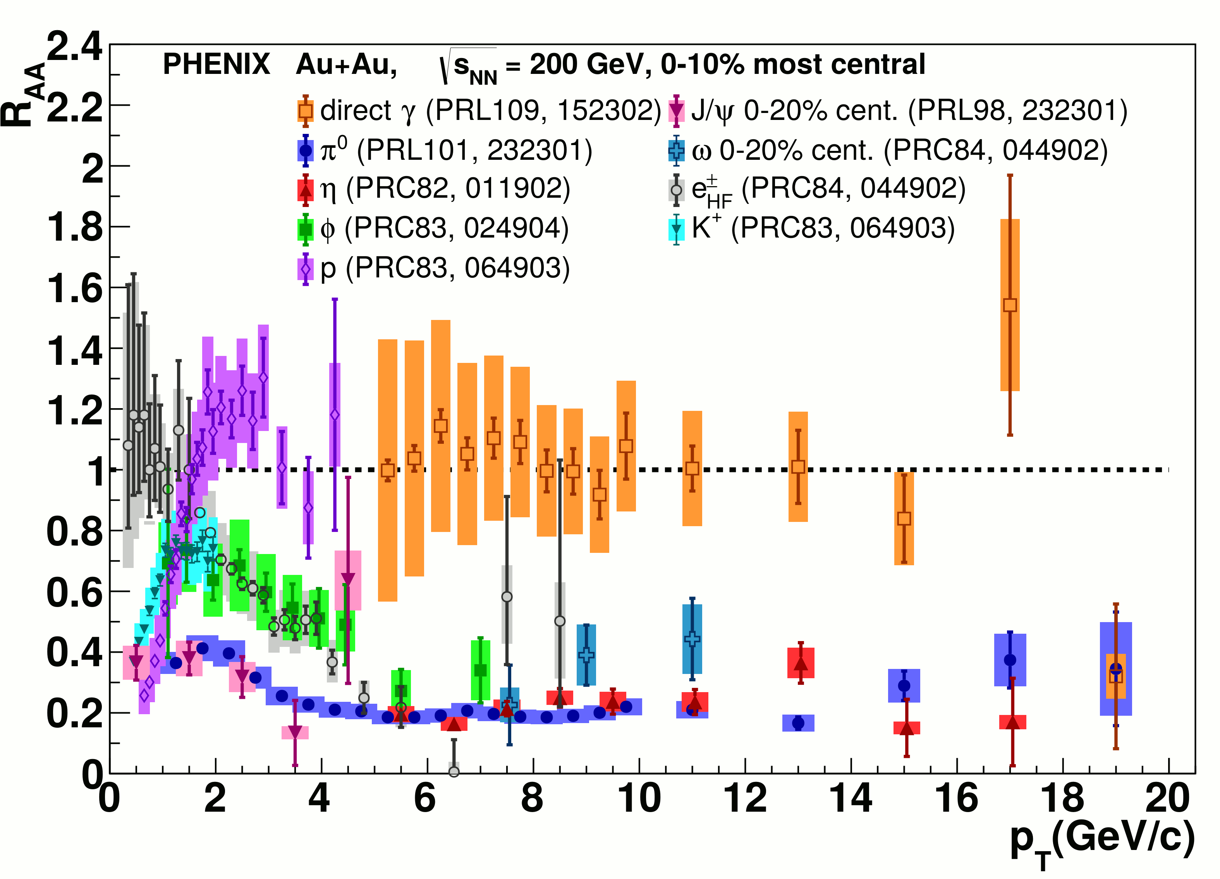
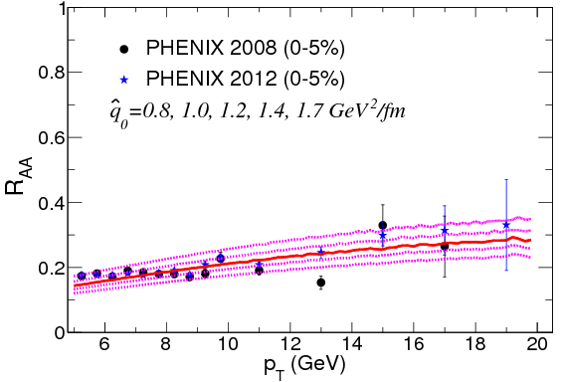
JET collaboration
Phys. Rev. C 90, 014909 (2014)
Martini
McGill
$χ^{2}minimization$
QGP brick + jet
HTM
HTBW
Data
$\hat{q}=1.2±0.3 {GeV}^{2}$
200 GeV Au+Au
$\hat{q}=1.9±0.7 {GeV}^{2}$
2.76 TeV Pb+Pb

Slide 38
It is 2018. What have we learned?

Slide 39
It is 2018. What have we learned?
Qualitative confirmation of our model for partonic energy loss
Reasonable constraints on
  Using mostly hadron spectra
We have not gotten many quantitative constraints out of other observables.
We don't truly know if they are actually sensitive to the physics we want to measure.
Theoretical calculations sensitive to things we might not have under control
$\hat{q}$

Slide 40
It is 2018. What have we learned?
Qualitative confirmation of our model for partonic energy loss
Reasonable constraints on
  Using mostly hadron spectra
We have not gotten many quantitative constraints out of other observables.
We don't truly know if they are actually sensitive to the physics we want to measure.
Theoretical calculations sensitive to things we might not have under control
$\hat{q}$

Slide 41
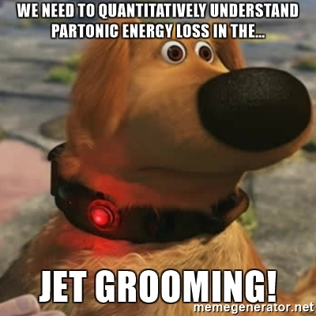
It is 2018. What have we learned?
Qualitative confirmation of our model for partonic energy loss
Reasonable constraints on
  Using mostly hadron spectra
We have not gotten many quantitative constraints out of other observables.
We don't truly know if they are actually sensitive to the physics we want to measure.
Theoretical calculations sensitive to things we might not have under control
$\hat{q}$

Slide 42
It is 2018. What have we learned?
Qualitative confirmation of our model for partonic energy loss
Reasonable constraints on
  Using mostly hadron spectra
We have not gotten many quantitative constraints out of other observables.
We don't truly know if they are actually sensitive to the physics we want to measure.
Theoretical calculations sensitive to things we might not have under control
$\hat{q}$

Slide 43
It is 2018. What have we learned?
Qualitative confirmation of our model for partonic energy loss
Reasonable constraints on
  Using mostly hadron spectra
We have not gotten many quantitative constraints out of other observables.
We don't truly know if they are actually sensitive to the physics we want to measure.
Theoretical calculations sensitive to things we might not have under control.
$\hat{q}$

Slide 44

RBRC Workshop on the Definition of Jets in a Large Background
June 25-27 at BNL
Megan Connors, Guilherme Milhano, Christine Nattrass, Rosi Reed, Sevil Salur

Slide 45
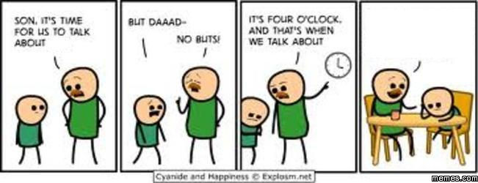
Conclusions
We need to talk about background
We should try to measure the same things
We should report correlations between uncertainties
We should ask whether we’re learning something
We should think about what we’re not seeing
So the thing is, you should do it the way I do it because your way is wrong.
background
background
http://www.memes.com/searchresults/sex/205126

Slide 46
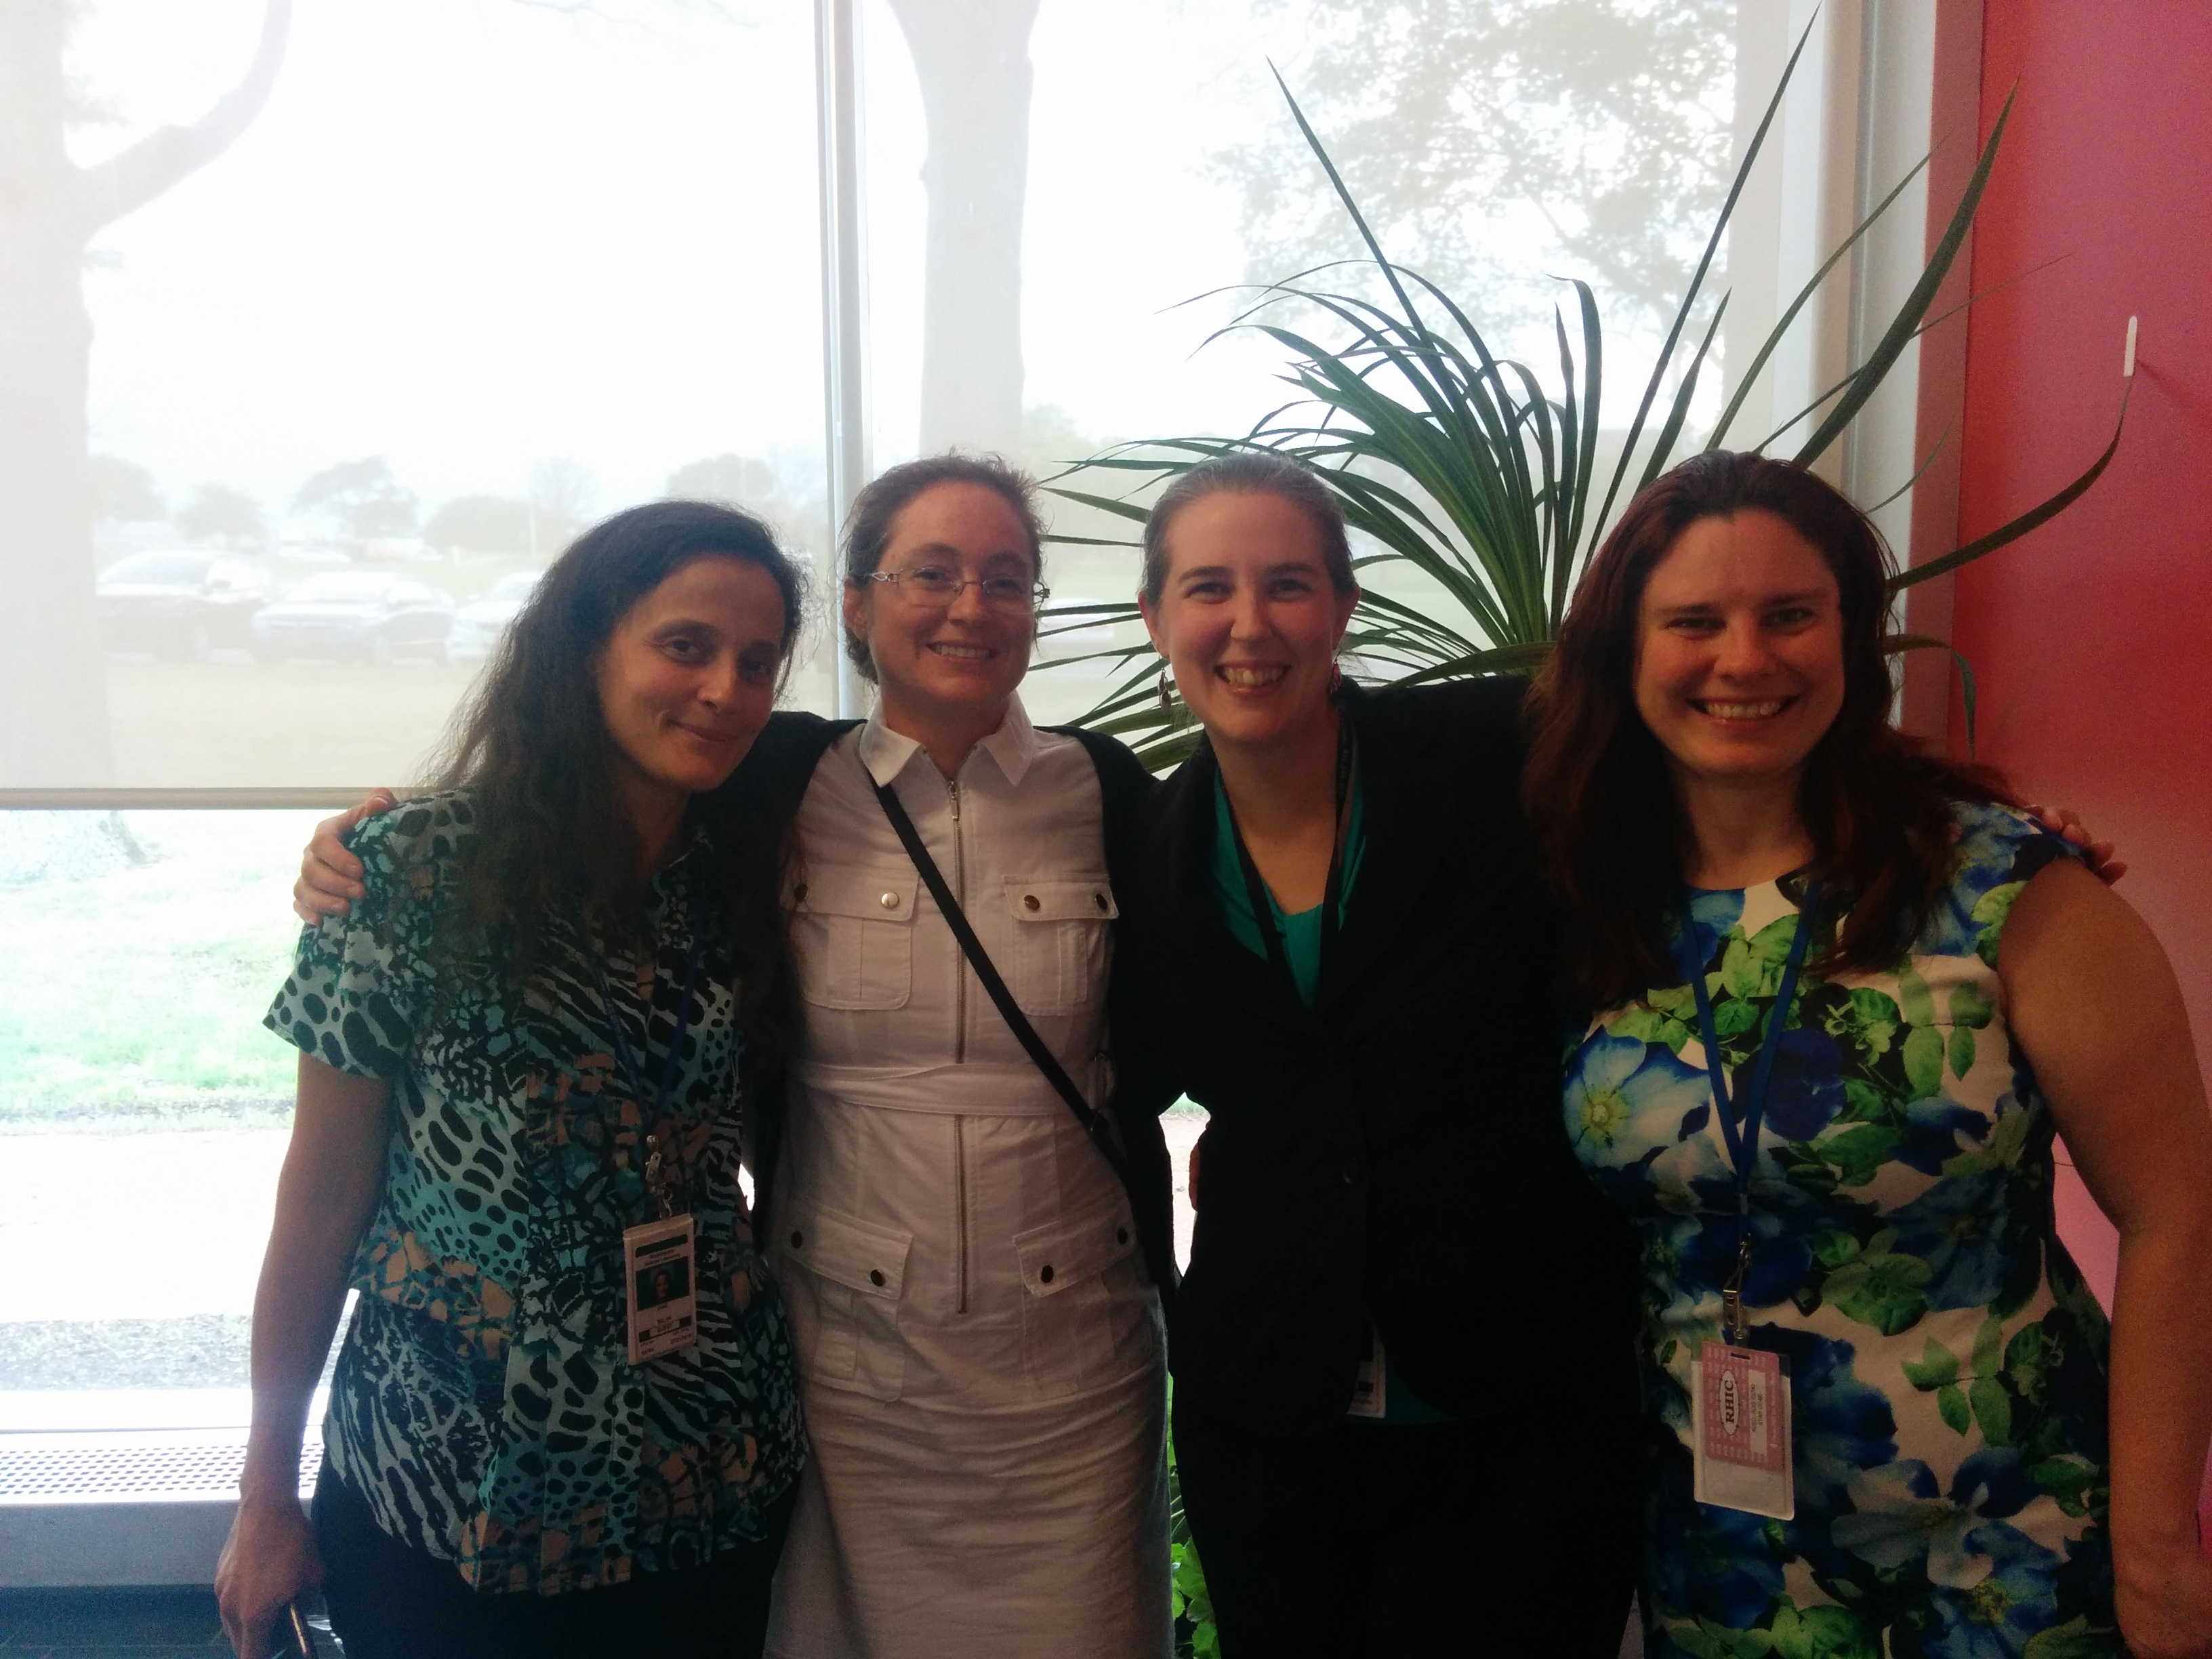
Connors, Nattrass, Reed, & Salur arxiv:1705.01974, , accepted in RMP
Thank you!

Slide 47
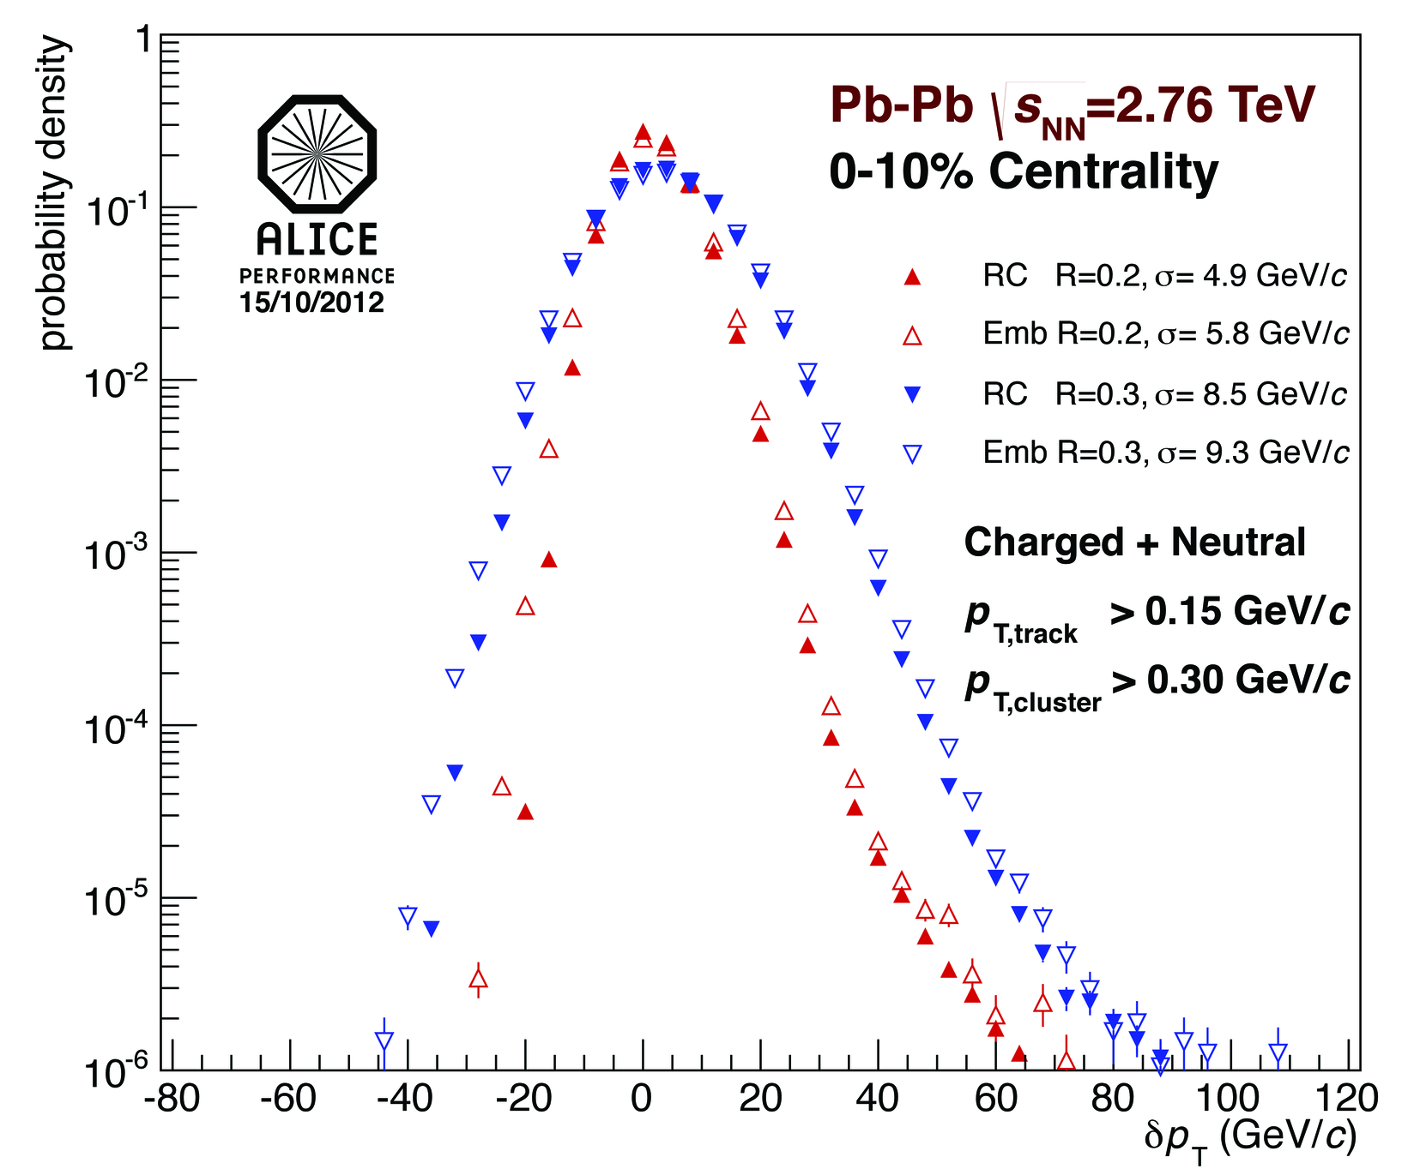
Background Fluctuations
Full Jets √s_{NN} = 2.76 TeV in PbPb
Fluctuations in the background determined via δp_{T}
  Random cones (RC)
  Depends on
    Constituent cut R
    Centrality
    Event plane
    Detector
δp_{T} is used to construct unfolding response matrix
$δp_{T}=p_{T}^{rec}−ρπR^{2}$
δp_{T} is not corrected for detector effects – Experiment specific
Notes:
Random cones – completely random?
Which jet finder
<number>

