Slide 1
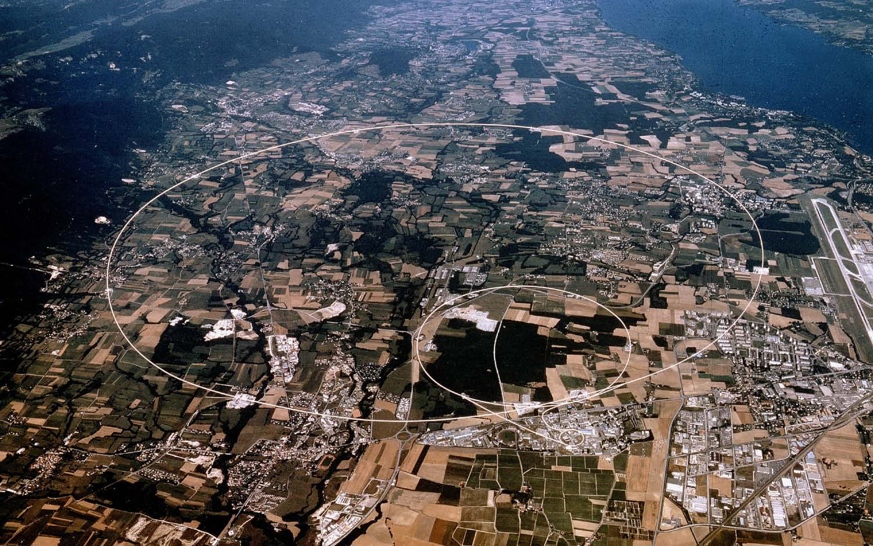

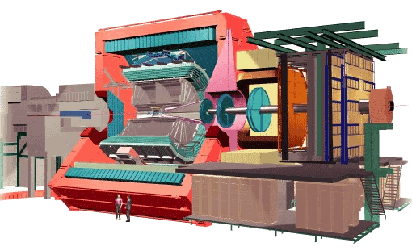
Results from ALICE
Christine Nattrass
University of Tennessee at Knoxville

Slide 2
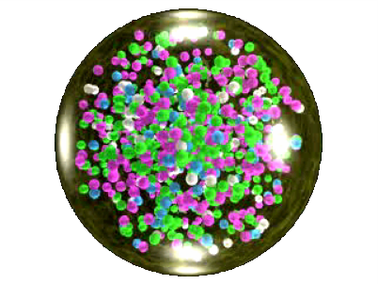
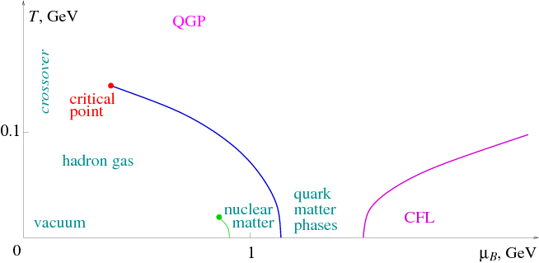
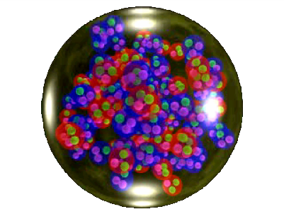
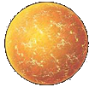
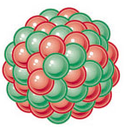
Phase diagram of nuclear matter
Quark Gluon Plasma
Core of neutron stars?
Quark Gluon Plasma – a liquid of quarks and gluons created at temperatures above ~170 MeV (2·10¹²K) – over a million times hotter than the core of the sun
Notes:
But wait – how can we have a liquid of quarks and gluons? Doesn't asymptotic freedom tell us that we can't have free quarks and gluons? How, then, can we have a liquid of quarks and gluons?

Slide 3
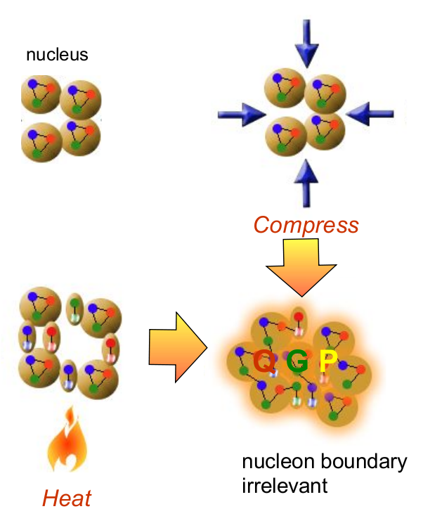
How to make a Quark Gluon Plasma

Slide 4
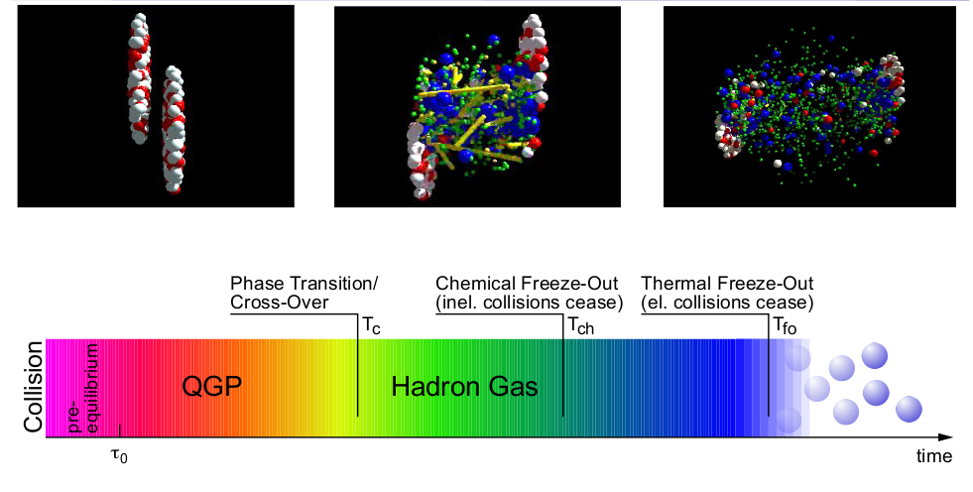
The phase transition in the laboratory

Slide 5
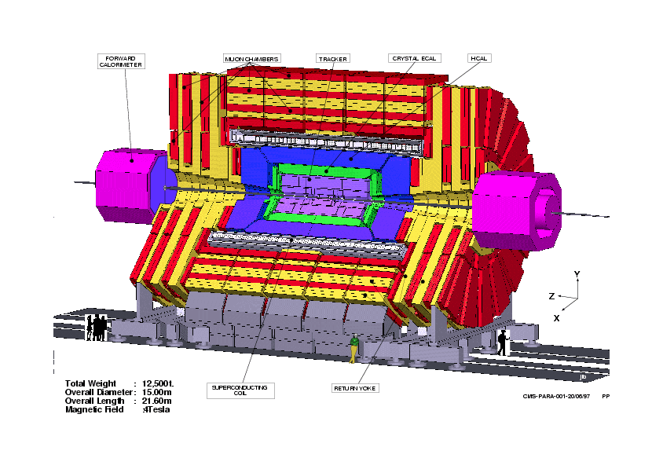
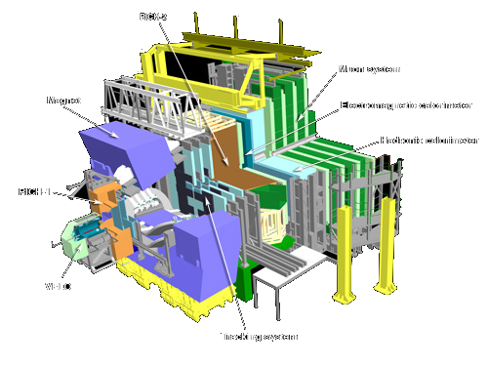
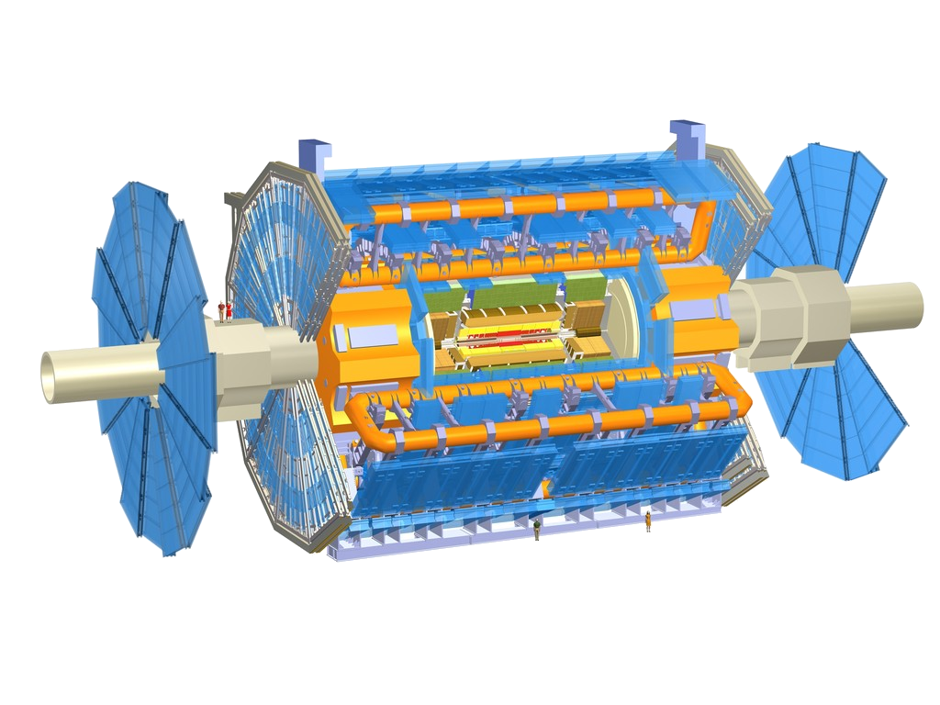
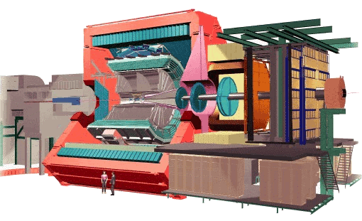
CMS
Large Hadron Collider
Geneva, Switzerland
8.6km diameter
p+p, p+Pb, Pb+Pb
√s_{NN} = 2.76 GeV, 5.5 TeV
LHCb
ATLAS
LHCf
ALICE
Notes:
Mention that RHIC planning began 1983

Slide 6
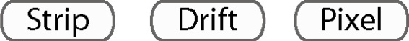



Size: 16 x 26 meters
Weight: 10,000 tons
Detectors: 18
Trigger detectors: When do we have a collision?
Tracking detectors: Where did the particle go?
Identification detectors: What kind of particle is it?
Calorimeters: How much energy does the particle have?
<number>
Notes:
By comparison ATLAS is 25 meters in diameter and 44 meters long – not quite twice as large

Slide 7
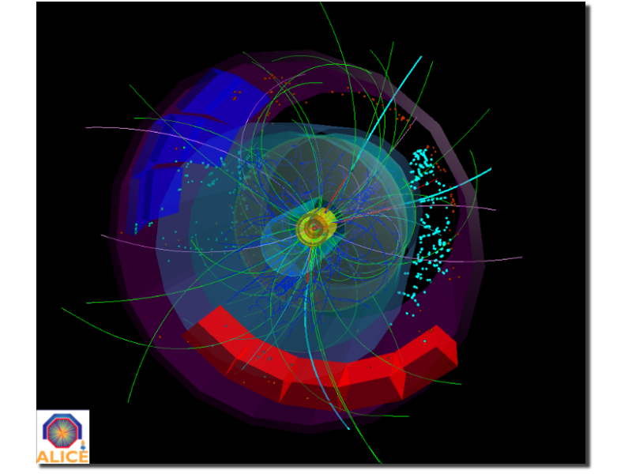
p+p collisions
3D image of each collision

Slide 8
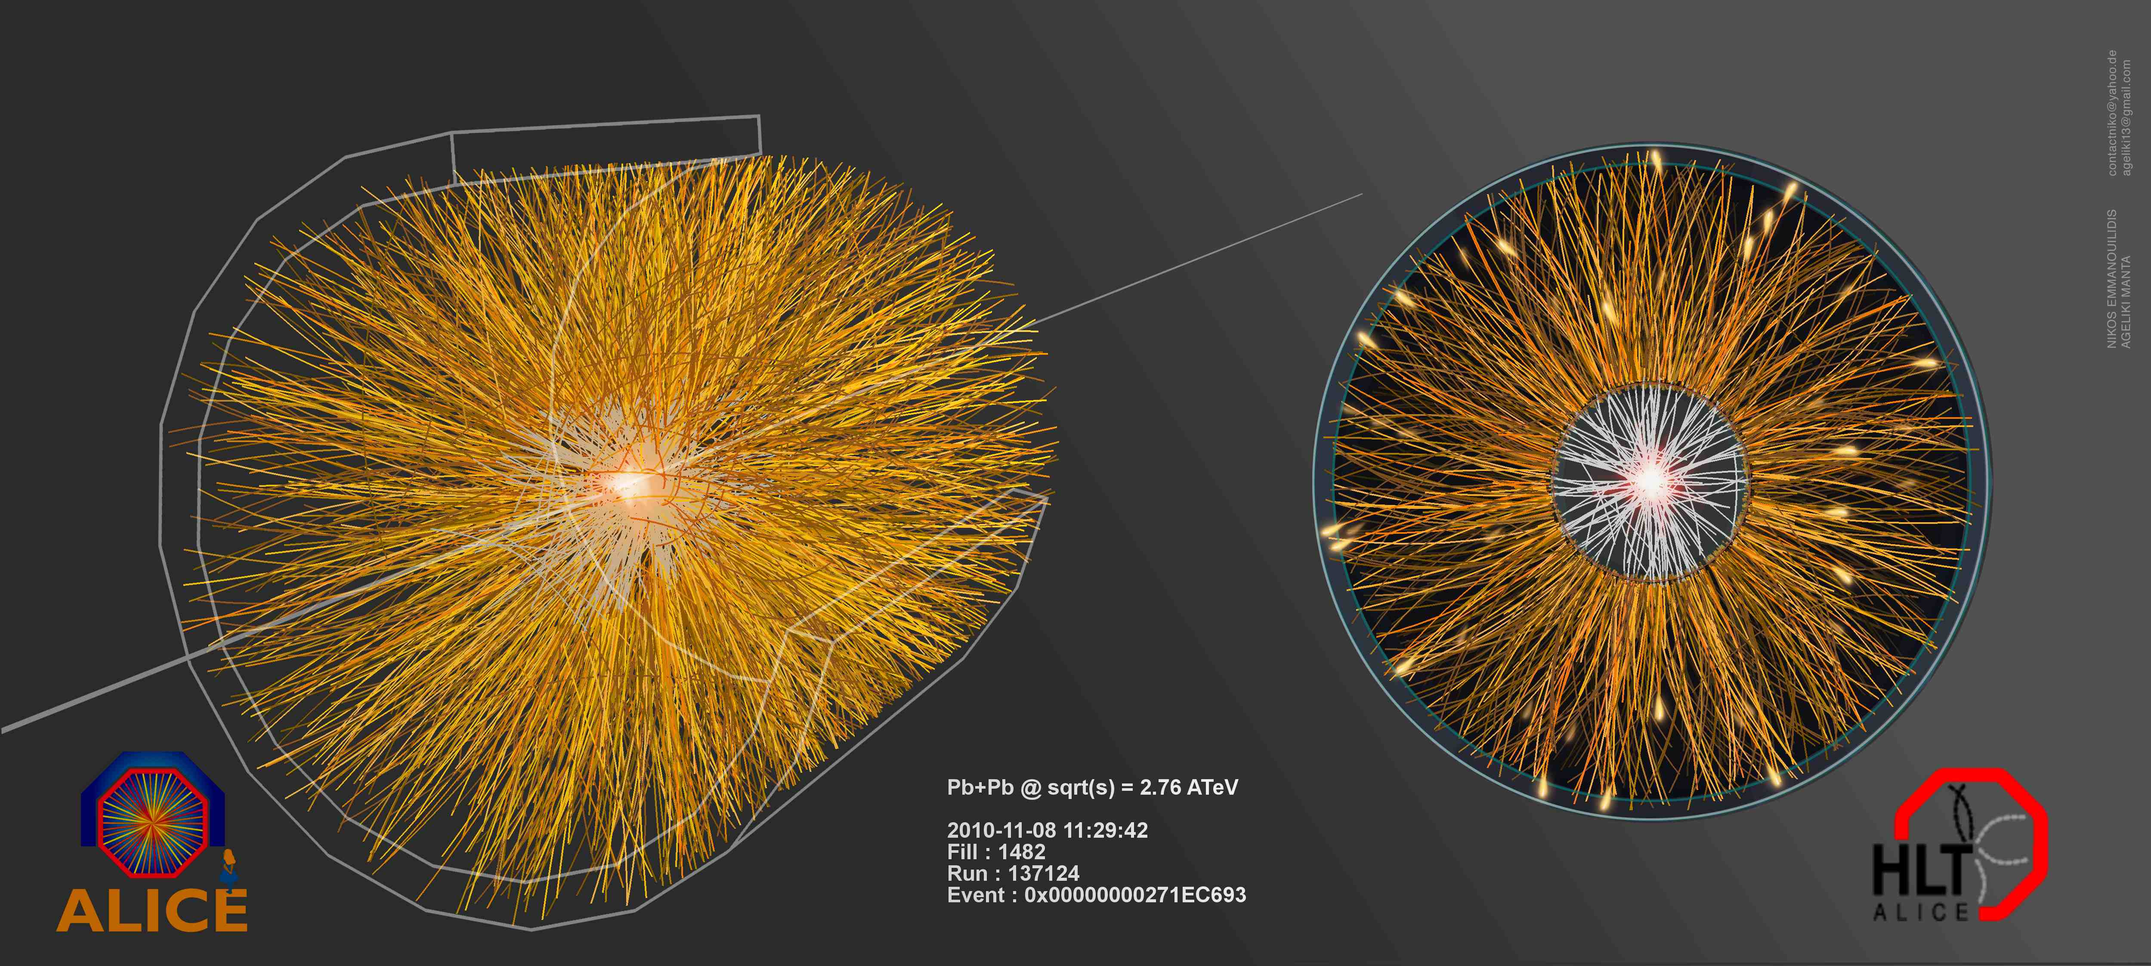
Pb+Pb collisions
5

Slide 9
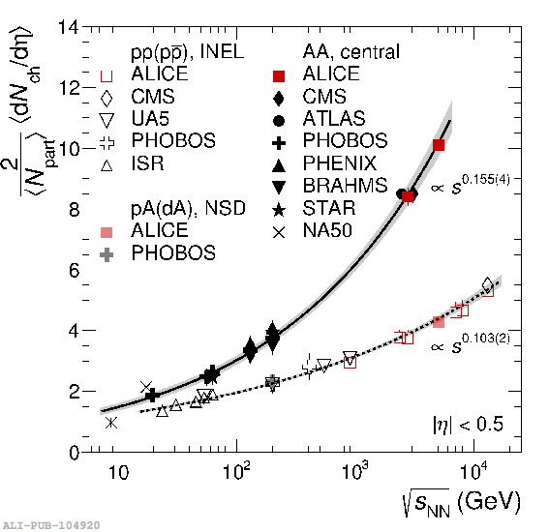
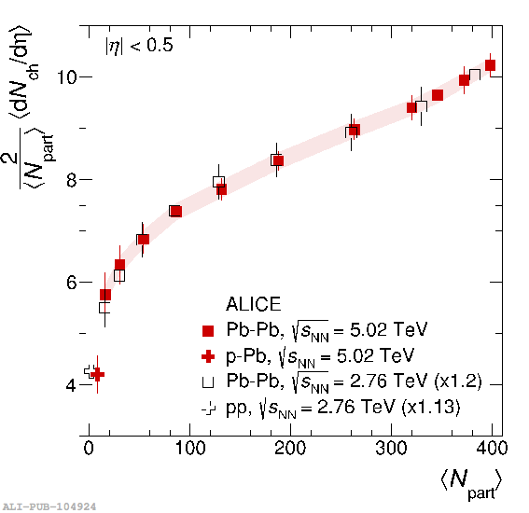
Charged particle multiplicity
ALICE: Pb–Pb at 5.02 TeV — highest energy so far
  For 0–5% most central collisions, confirms trend from lower energies
<dNch/dη> vs. <Npart>: similar evolution with centrality between 5.02 and 2.76 TeV
  ~20% increase going from 2.76 to 5.02 TeV
  Provides further constraints for models

Slide 10
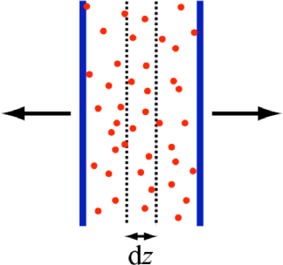
How can we estimate the energy density?
Transverse energy (E_{T})
  sum of particle energies in transverse direction
Volume V = A_{T} τc
τ = formation time
Energy density ε
QGP formation for ε > 0.5 GeV/fm³
A_{T}
= τc

Slide 11
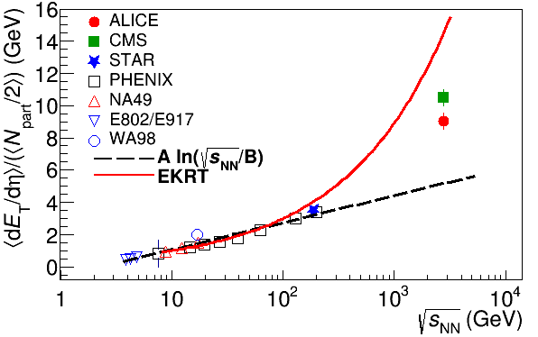
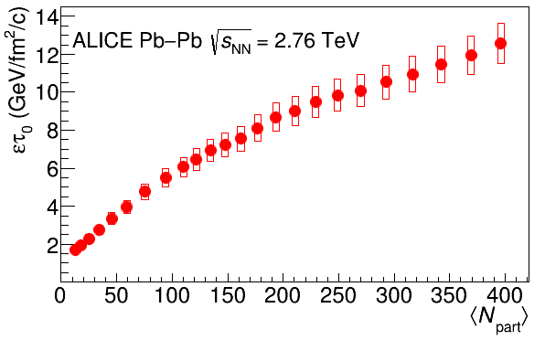
Energy dependence from dE_{T}/dy
RHIC
Standard estimate τ₀ ≈ 1 fm/c
QGP formation
Higher than extrapolations of RHIC data

Slide 12
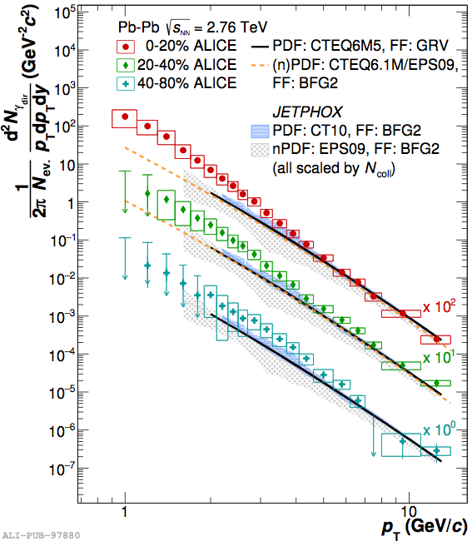
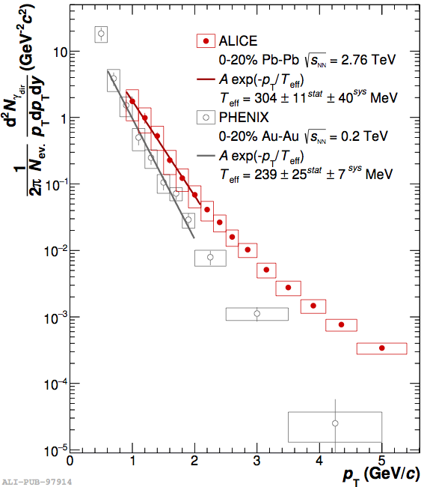
Direct photons in Pb-Pb collisions
Low-p_{T}: 2.6σ excess w. r. t. models in 0–20% central — thermal contribution
T_{eff} = 304 ± 11(stat.) ± 40 (syst.) MeV in central Pb–Pb collisions at 2.76 TeV
30% higher than at RHIC (Au–Au at √s_{NN}=200 GeV)

Slide 13
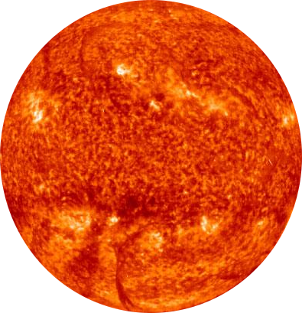
Probes of the Quark Gluon Plasma
nucleus
nucleus
Want a probe which traveled through the medium
QGP is short lived → need a probe created in the collision

Slide 14
Probes of the Quark Gluon Plasma
nucleus
nucleus
Want a probe which traveled through the medium
QGP is short lived → need a probe created in the collision
We expect the medium to be dense → absorb/modify probe

Slide 15
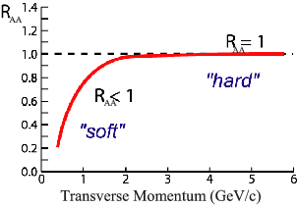
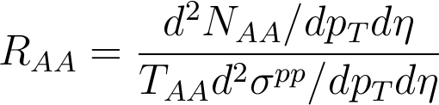
Nuclear modification factor
Measure spectra of probe (jets) and compare to those in p+p collisions or peripheral A+A collisions
If high-p_{T} probes (jets) are suppressed, this is evidence of jet quenching
Enhancement
Suppression

Slide 16
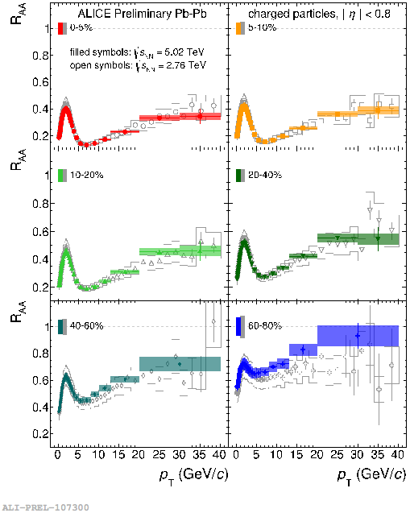
Charged particle R_{AA}
R_{AA}>1: enhancement
R_{AA}<1: suppression
Strong modification of the spectrum shape in most central collisions
Strong centrality dependence
RAA at 5.02 TeV similar to 2.76 TeV

Slide 17
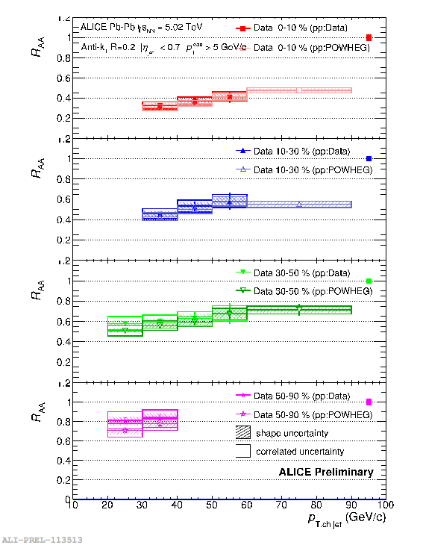
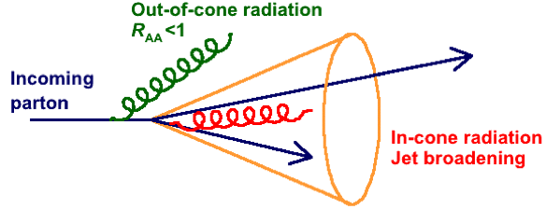
Jet R_{AA}
Out-of-cone radiation: energy loss in jet cone
  Jet yield suppression, di-jet energy imbalance, jet-jet/hadron-jet acoplanarity…
In-cone radiation: medium modified fragmentation
  Jet shape broadening, modification of transverse energy profile…
Consistent with RAA of charged particles and charged-jet RAA at 2.76 TeV

Slide 18
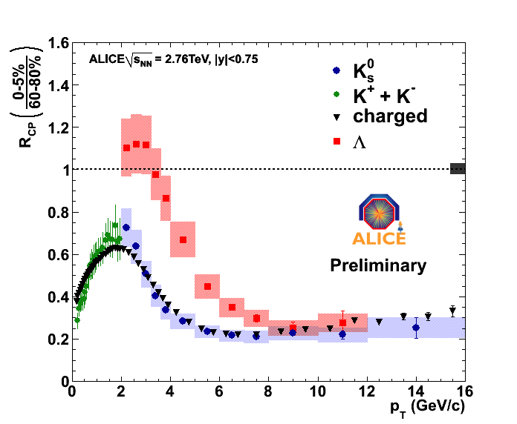
Nuclear modification factor (R_{AA})
Λ
K⁰_{S}
K±
Pb+Pb

Slide 19
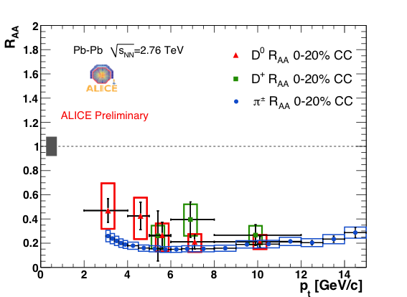
Charm nuclear modification factor
Pb+Pb

Slide 20
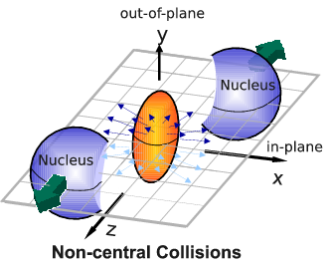
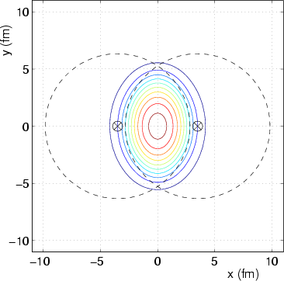
Relativistic fluids
Au+Au √s_{NN} = 200 GeV
b=7 fm
Particles pushed out
Equipotential lines
arXiv:nucl-th/0305084
Initial overlap asymmetric → pressure gradients
Momentum anisotropy → Fourier decomposition:
Notes:
So at this point you're probably wondering how on earth we measure the viscosity of this thing that exists for only a few fermi/c – for less than 10^-24 seconds
When the nuclei collide, they create a droplet of QGP. This droplet of QGP is not symmetric – this shows the incoming nuclei - and there are huge pressure gradients in it. This shows a calculation of the equipotential lines in the QGP.
These pressure gradients push particles out – meaning that particles in this direction are going faster than particles in this direction
What we do is measure the Fourier coefficients of the distribution of particles

Slide 21
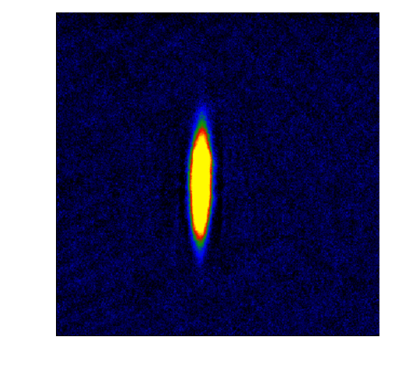
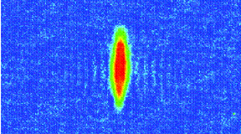
Fluid dynamics
Same phenomena observed in gases of strongly interacting atoms
  K, O’Hara, S. Hemmer, M. Gehm, S. Granade, J. Thomas Science 298 2179 (2002)
High viscosity
Low viscosity

Slide 22
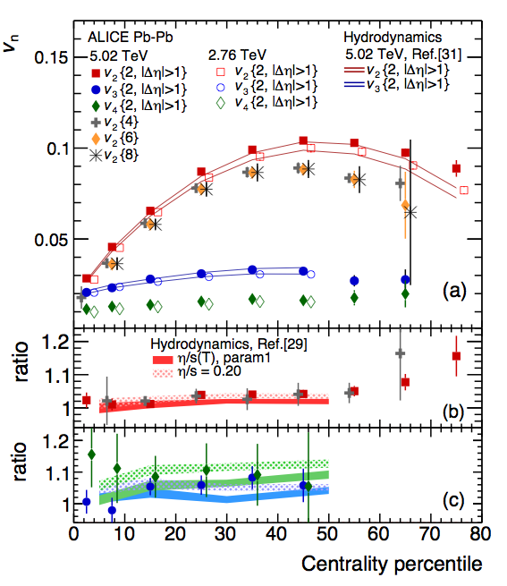
v_{n} at different energies

Slide 23
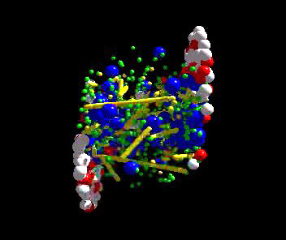
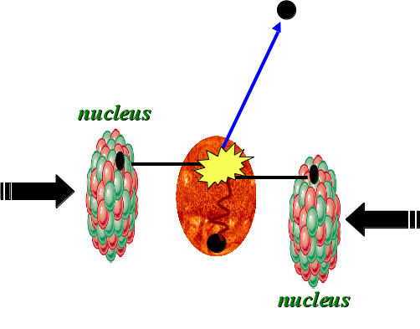
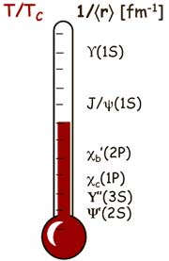
Take home messages
If we get nuclear matter dense enough, we make a new phase of matter, which we produce in high energy heavy ion collisions.
This medium is transparent to colored probes and translucent to electromagnetic probes...
...and an extremely hot and dense...
...perfect liquid.

