Slide 1
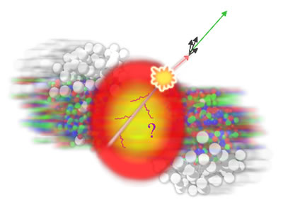
Jets for non-jet people
Christine Nattrass
University of Tennessee, Knoxville

Slide 2
Acknowledgements
The following people contributed ideas and/or slides, but of course I take full responsibility for anything you don’t like:
Rosi Reed, Megan Connors, Sevil Salur
Abhijit Majumder, Raghav Kunnawalkam Elayavalli Marta Verweij, Laura Havener
Austin Schmier, Charles Hughes, Will Witt

Slide 3
What do I want to learn? The cartoon picture

Slide 4
Probing the Quark Gluon Plasma
Medium
Probe
Detector
Want a probe which traveled through the collision
QGP is very short-lived (~1-10 fm/c) →
cannot use an external probe

Slide 5
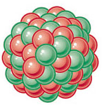
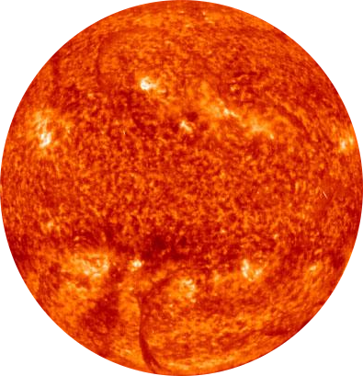
Probes of the Quark Gluon Plasma
Want a probe which traveled through the medium
QGP is short lived → need a probe created in the collision
nucleus
nucleus

Slide 6
Probes of the Quark Gluon Plasma
Want a probe which traveled through the medium
QGP is short lived → need a probe created in the collision We expect the medium to be dense → absorb/modify probe
nucleus
nucleus

Slide 7
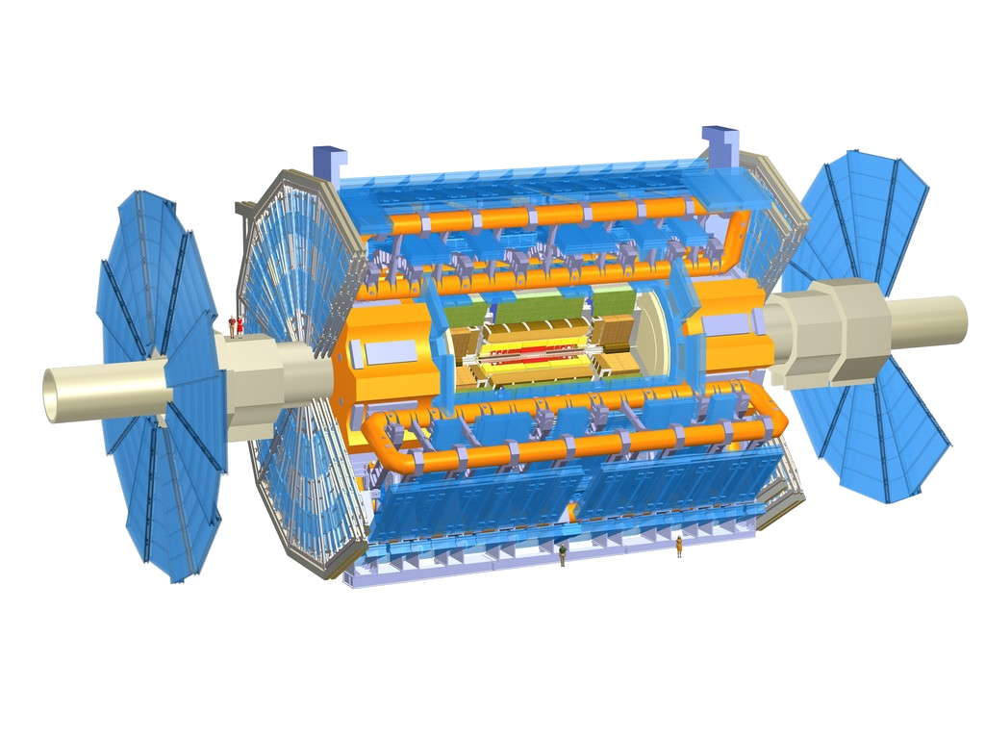
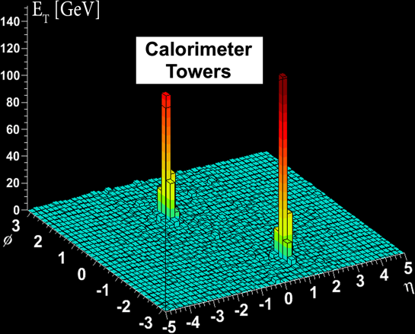
Probes of the Quark Gluon Plasma
ATLAS
nucleus
Phys.Rev.Lett. 105 (2010) 252303
nucleus

Slide 8
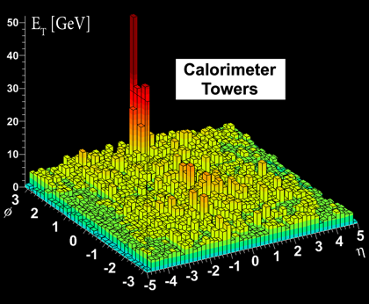
Probes of the Quark Gluon Plasma
ATLAS
Phys.Rev.Lett. 105 (2010) 252303
nucleus
Phys.Rev.Lett. 105 (2010) 252303
nucleus

Slide 9
What am I measuring? Definition of a jet

Slide 10
Theory

Slide 11
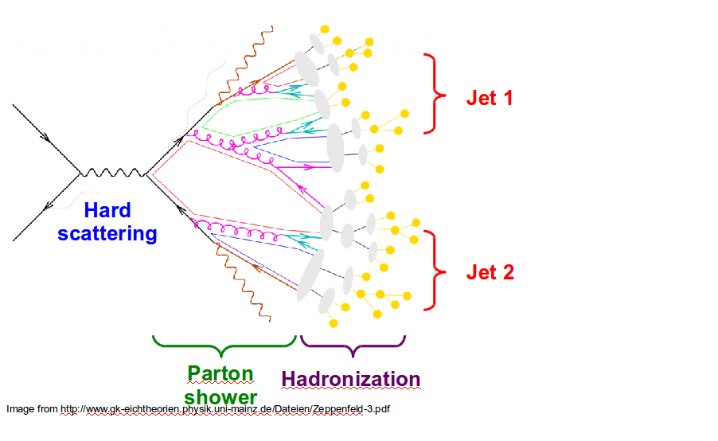
Factorization theorem
perturbative
fragmentation
Assumption: Parton distribution functions, perturbative cross section, fragmentation function factorize
What people really mean by “perturbatively calculable”
D and f are explicitly non-perturbative!
D is for parton c → hadron h Not what is experimentally measured
Most theories for jet quenching modify fragmentation function D
a
b
$\frac{d^{3}σ^{h}}{dyd^{2}p_{T}}=\frac{1}{π}\int{d}x_{a}\int{d}x_{b}f_{a}^{A}\left(x_{a}\right)f_{b}^{B}\left(x_{b}\right)\frac{dσ_{ab→cX}}{d\hat{t}}\frac{D_{c}^{h}\left(z\right)}{z}$

Slide 12
Jet finders

Slide 13
What is a jet?

Slide 14
What is a jet?
A measurement of a jet is a measurement of a parton.

Slide 15
What is a jet?
A measurement of a jet is a measurement of a parton.

Slide 16
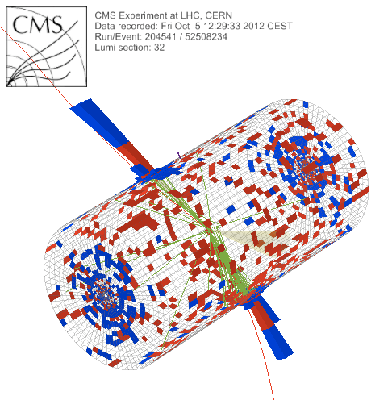
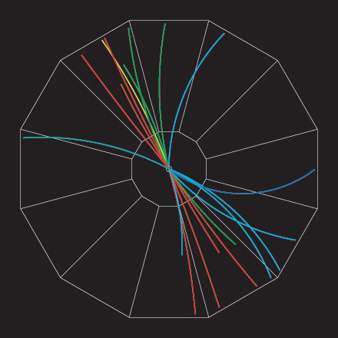
What is a jet?
p+p dijet
Beam pipe

Slide 17
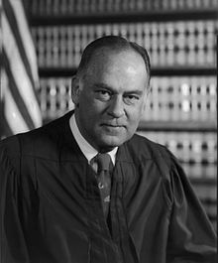
What is a jet?
p+p dijet
Beam pipe
“I know it when I see it”
US Supreme Court Justice Potter Stewart, Jacobellis v. Ohio

Slide 18
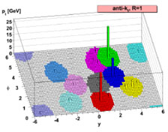
Jet finding algorithms
Tracks
Jet finding algorithm
Jet candidates
Clusters
Particles
Any list of objects works as input
Use the same algorithm on theory & experiment
Output only as good as input
M. Cacciari, G. P. Salam, G.Soyez, JHEP 0804:063,2008

Slide 19
in pp collisions
Jet finding
Jet finder: groups final state particles into jet candidates
Anti-k_{T} algorithm JHEP 0804 (2008) 063 [arXiv:0802.1189]
Depends on hadronization
Ideally
Infrared safe
Colinear safe
Snowmass Accord: Theoretical calculations and experimental measurements should use the same jet finding algorithm. Otherwise they will not be comparable.

Slide 20
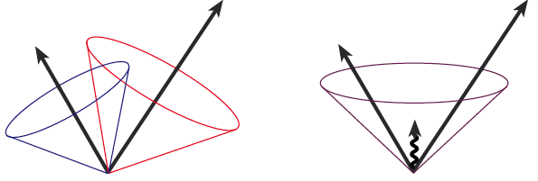
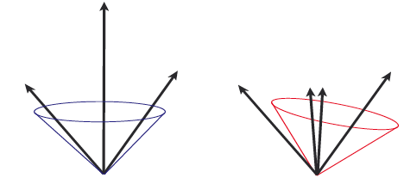
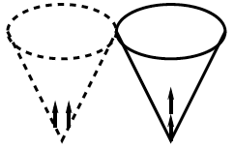
Jets in principle
Jet measures partons
Hadronic degrees of freedom are integrated out
Algorithms are infrared and colinear safe
OK
BAD: 2 jets are merged in one

Slide 21
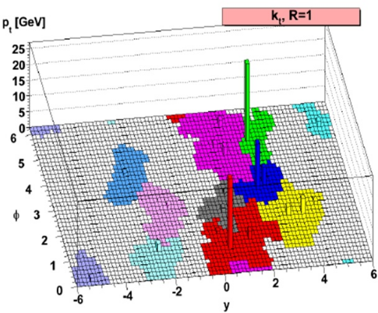
k_{T} jet finding algorithm
Particles, clusters
k_{T} algorithm
$k_{T}=p_{T},ΔR_{ij}=\sqrt{{\left(η_{i}−η_{j}\right)}^{2}+{\left(ϕ_{i}−ϕ_{j}\right)}^{2}}$
For all i,j calculate:
Combine smallest d_{ij}. If d_{iB} smallest, d_{iB}→ jet
Repeat until no particles left
$d_{ij}=min\left(p_{T,i}^{2},p_{T,j}^{2}\right)\frac{ΔR_{ij}^{2}}{R^{2}}$
$d_{iB}=p_{T,i}^{2}$
Jet candidates

Slide 22
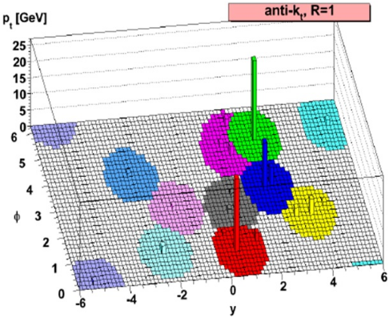
anti-k_{T} jet finding algorithm
Particles, clusters
k_{T} algorithm
$k_{T}=p_{T},ΔR_{ij}=\sqrt{{\left(η_{i}−η_{j}\right)}^{2}+{\left(ϕ_{i}−ϕ_{j}\right)}^{2}}$
For all i,j calculate:
Combine smallest d_{ij}. If d_{iB} smallest, d_{iB}→ jet
Repeat until no particles left
$d_{ij}=min\left(p_{T,i}^{−2},p_{T,j}^{−2}\right)\frac{ΔR_{ij}^{2}}{R^{2}}$
$d_{iB}=p_{T,i}^{−2}$
Jet candidates

Slide 23
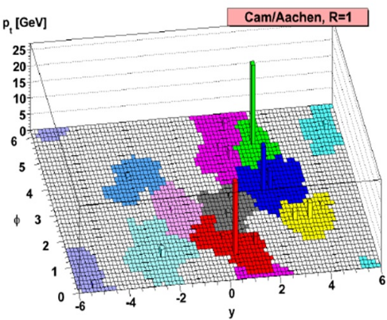
Cambridge/Aachen jet finding algorithm
Particles, clusters
k_{T} algorithm
$k_{T}=p_{T},ΔR_{ij}=\sqrt{{\left(η_{i}−η_{j}\right)}^{2}+{\left(ϕ_{i}−ϕ_{j}\right)}^{2}}$
For all i,j calculate:
Combine smallest d_{ij}. If d_{iB} smallest, d_{iB}→ jet
Repeat until no particles left
$d_{ij}=\frac{ΔR_{ij}^{2}}{R^{2}}$
$d_{iB}=1$
Jet candidates

Slide 24
A jet is what a jet finder finds.

Slide 25
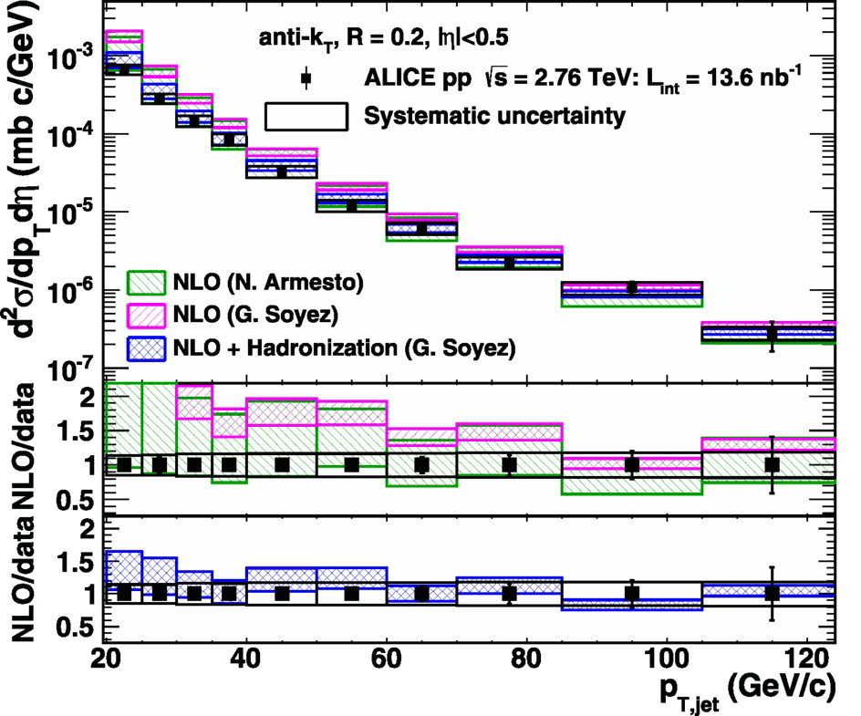
<footer>
Jet cross-section in pp √s = 2.76 TeV, R = 0.2 Inclusive
arXiv:1301.3475
PLB: 10.1016/j.physletb.2013.04.026
Green and magenta bands: NLO on Parton level
Blue band: NLO + hadronization
Hadronization calculations necessary to describe data
Notes:
----- Meeting Notes (6/24/13 16:47) -----
PRB -> PLB
Mention lack of bias
Make Large figure
<number>

Slide 26
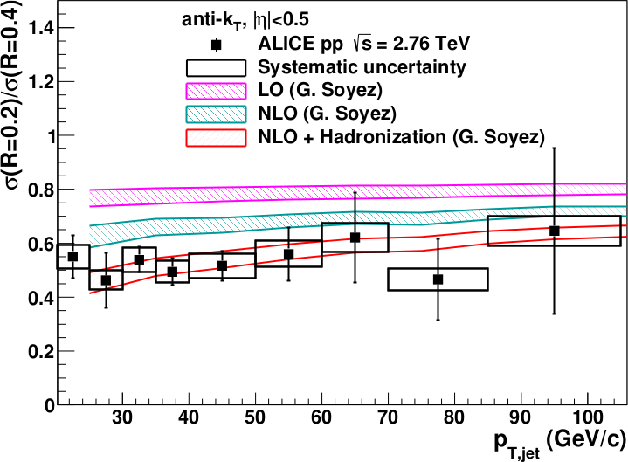
<footer>
Jet ratios in pp √s = 2.76 TeV, R = 0.2, 0.4 Inclusive
arXiv:1301.3475
PLB: 10.1016/j.physletb.2013.04.026
Data and NLO+ hadronization calculations agree well
Notes:
----- Meeting Notes (6/24/13 16:47) -----
PRB -> PLB
mention ratio
<number>

Slide 27
Mini-summary
Tracks
Jet finding algorithm
Jet candidates
Clusters
Particles
Jets are not partons
Good jet finders:
Infrared and colinear safe
k_{T}, anti-k_{T}, Cambridge/Aachen, SISCone
Jet is defined by jet finder, its parameters
PDFs, fragmentation functions non-perturbative → all jet measurements sensitive to somewhat non-perturbative effects
Good agreement between theory and experiment

Slide 28
Jets in A+A collisions What assumptions am I making?

Slide 29
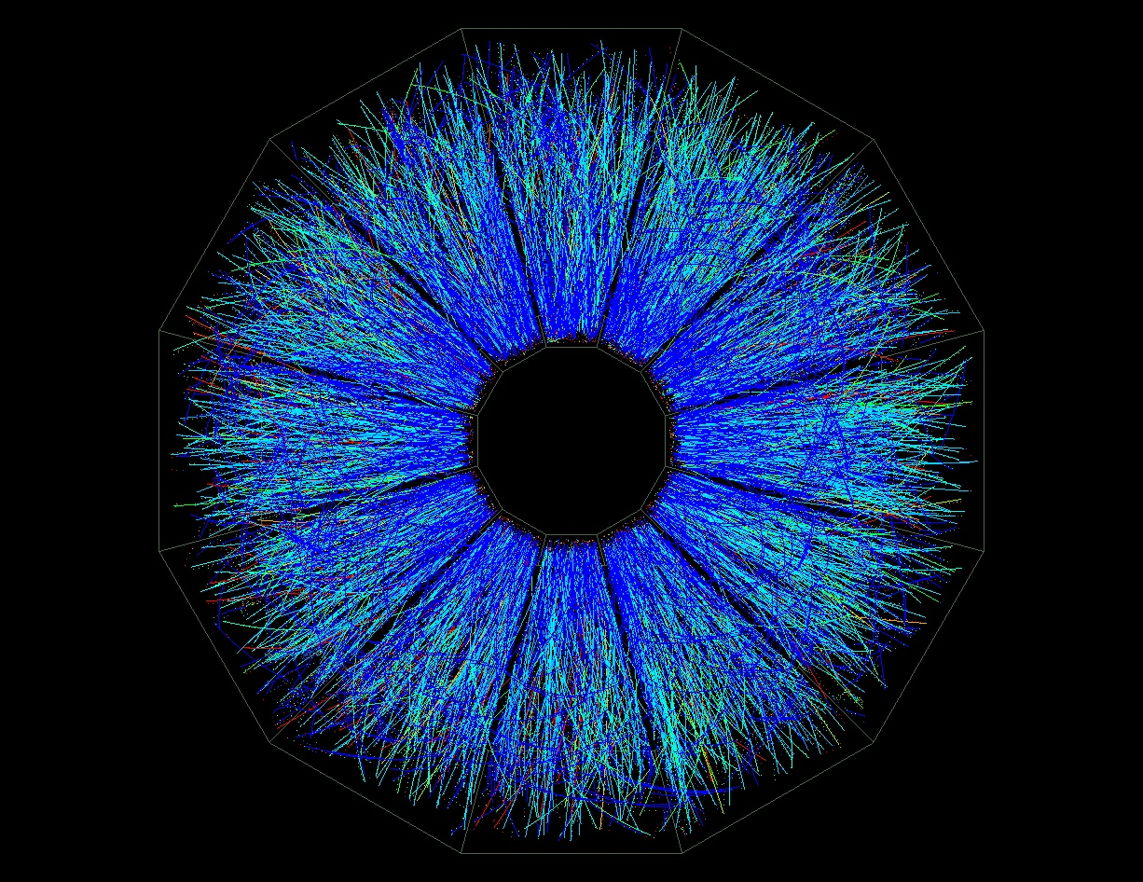
p+p vs A+A
p+p di-jet event in STAR
Central Au+Au collision in STAR

Slide 30
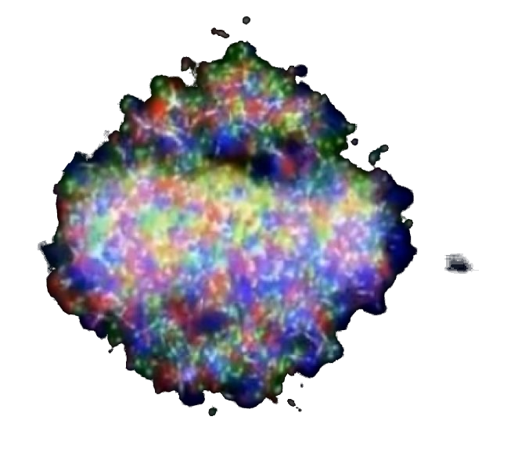
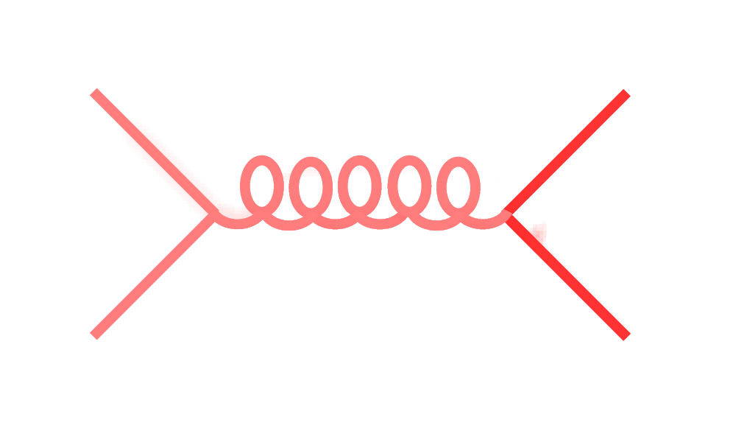
Signal vs Background: The standard paradigm
Background
Signal

Slide 31
Signal vs Background: The standard paradigm
Background
Combinatorial jets
Signal

Slide 32
Signal vs Background: The standard paradigm
Background
Combinatorial jets
Signal
= “fake” jets

Slide 33
Signal vs Background: The standard paradigm
Background
Combinatorial jets
Signal
*Some gray areas

Slide 34
in AA collisions
Jet finding
Jet finder: groups final state particles into jet candidates
Anti-k_{T} algorithm JHEP 0804 (2008) 063 [arXiv:0802.1189]
Combinatorial jet candidates
Energy smearing from background
Sensitive to methods to suppress combinatorial jets and correct energy
Focus on narrow/high energy jets

Slide 35
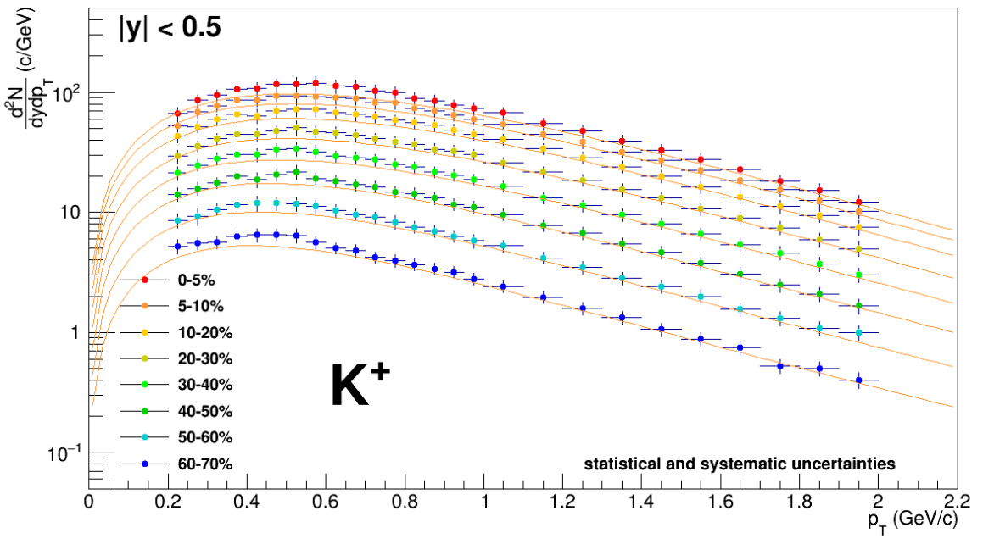
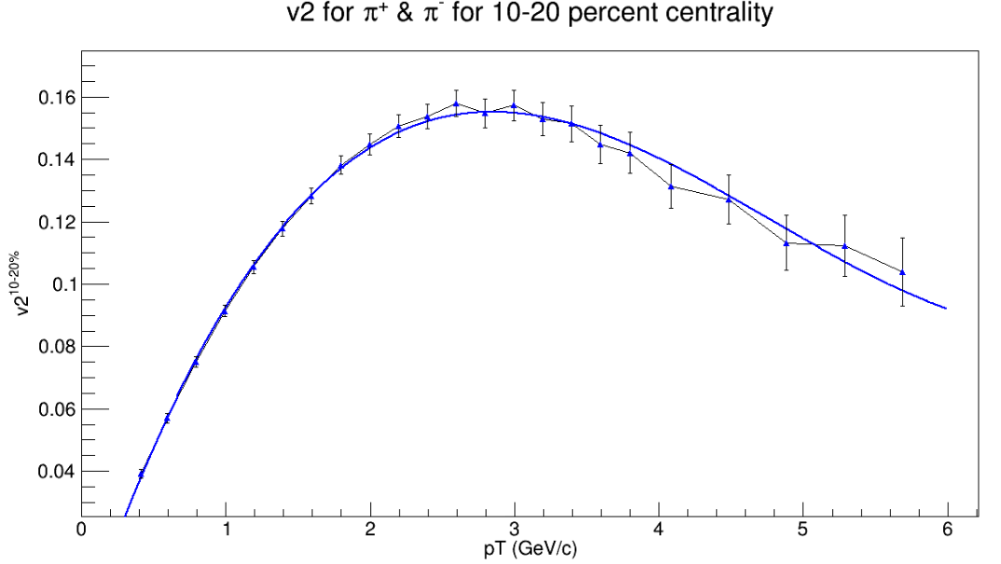
TennGen background generator
Event properties
Track properties
ε₁
ε₃
Momentum spectra
Blast Wave Fit
dN/dy
Random p_{T}
ε₂, ε₄, ε₆
ALICE PLB720 (2013) 52-62
ε₅
p_{T}
Even event planes fixed at Ψ=0
Odd planes at random φ
Multiplies from ALICE PRC88 (2013) 044910
Polynomial Fit
v_{n}
v_{n}
ALICE JHEP 1609 (2016) 164
Azimuthal asymmetries
Random φ
No jets! No resonances
Emulates hydro correlations
p_{T}

Slide 36
PYTHIA Angantyr
JHEP (2018) 2018: 134
Based on PYTHIA 8 Sjöstrand, Mrenna & Skands, JHEP05 (2006) 026 Comput. Phys. Comm. 178 (2008) 852.
Based on Fritiof & wounded nucleons
N-N collisions w/fluctuating radii → fluctuating σ
Lots of jets! And resonances!
No hydrodynamics, no jet quenching

Slide 37
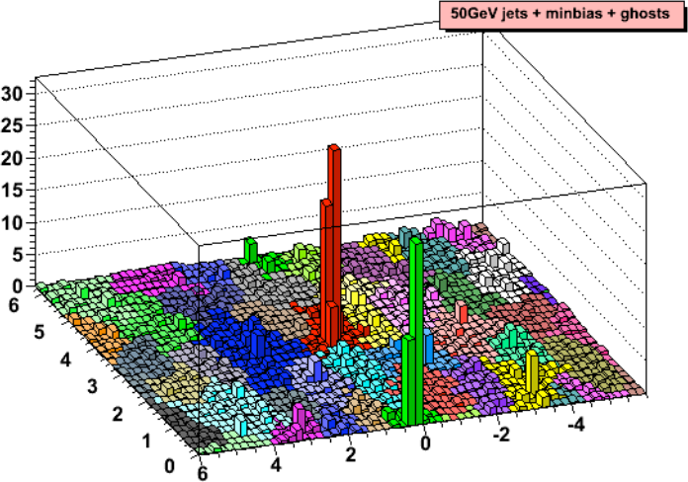
Area-based background subtraction
Cacciari & Salam, PLB659:119–126,2008
Particles, clusters
k_{T} algorithm
Cacciari DIS 2006
$k_{T}=p_{T},ΔR_{ij}=\sqrt{{\left(η_{i}−η_{j}\right)}^{2}+{\left(ϕ_{i}−ϕ_{j}\right)}^{2}}$
For all i,j calculate:
Combine smallest d_{ij}. If d_{iB} smallest, d_{iB}→ jet
Repeat until no particles left
$d_{ij}=min\left(p_{T,i}^{2},p_{T,j}^{2}\right)ΔR_{ij}^{2}$
Energy (arb. units)
$d_{iB}=p_{T,i}$
Cacciari & Salam Phys.Lett.B641:57-61,2006
Jet candidates
$ϕ$
Median ρ=p_{T}/A
$η$
$p_{T}^{jet}=p_{T}^{reco}−ρ_{median}A^{jet}$

Slide 38
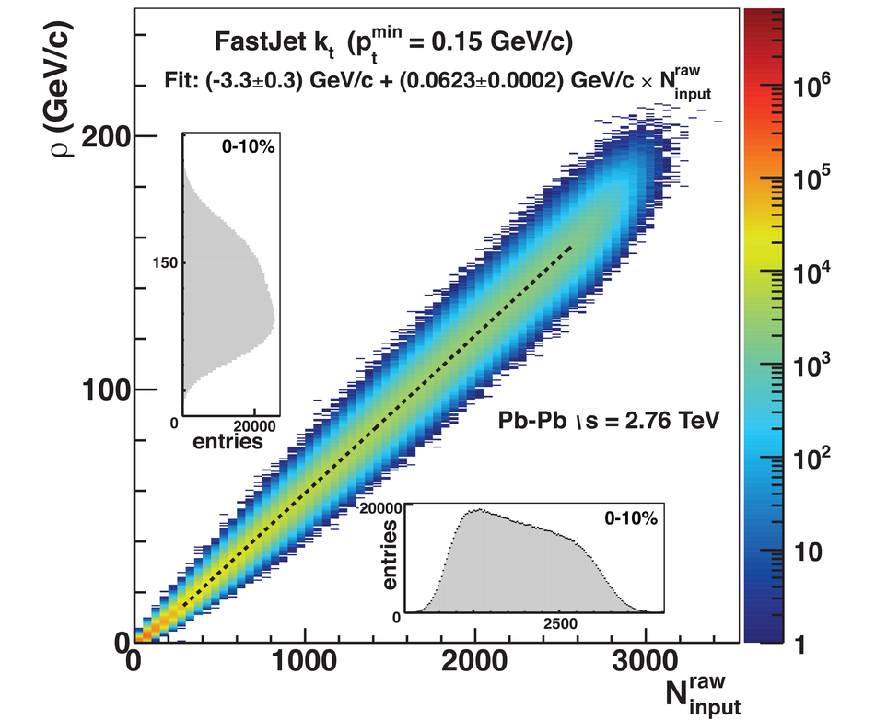
Background density ρ
`
ALICE
arXiv:2005.02320

Slide 39
Random cones
X
Excluded
$ϕ$
R=0.4
Real jets
Excluded
$η$

Slide 40
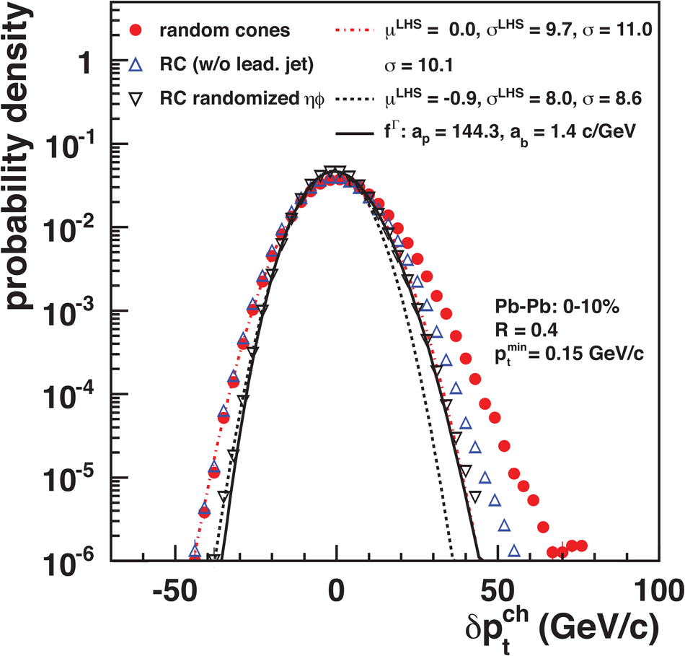
Random cones in ALICE
Estimate ρ
k_{T} jet finder→jet candidates
ρ = Median(p_{T}/A)
Draw Random cone
JHEP 03 (2012) 053
$δp_{T}=p_{T}^{reco}−ρA$

Slide 41
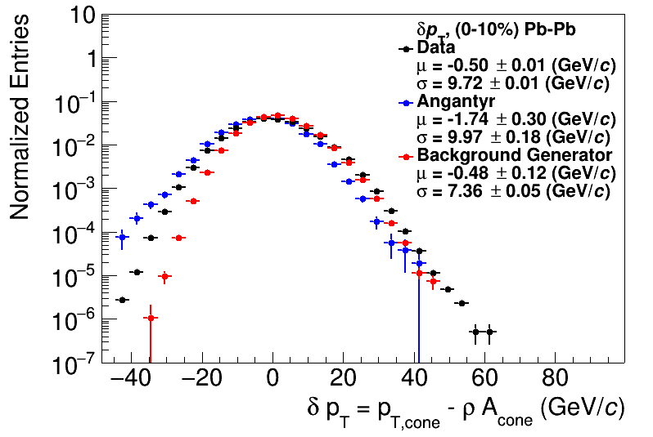
Random cones
JHEP 03 (2012) 053
ALICE
arXiv:2005.02320

Slide 42
Shape of width of the distribution
Single particle spectra
$f_{Γ}\left(p_{T},p,b\right)=\frac{b}{Γ\left(p\right)}{\left(bp_{T}\right)}^{p−1}e^{−bx}$
Σp_{T} of N particles→N-fold convolution:
$\frac{{dpT}^{total}}{dy}∝f_{N}\left(p_{T},Np,b\right)$
$f_{N}\left(p_{T},p,b\right)=f_{Γ}\left(p_{T},Np,b\right)$
$\frac{dN}{dy}∝f_{Γ}\left(p_{T},2,b\right)=b^{2}p_{T}e^{−kp_{T}}$
$N=\frac{N_{total}}{A_{total}}πR^{2}$
$μ_{total}=\frac{Np}{b}=Nμ_{p_{T}},σ_{total}=\frac{\sqrt{Np}}{b}=\sqrt{N}σ_{p_{T}}$
$μ_{p_{T}}=\frac{p}{b},σ_{p_{T}}=\frac{\sqrt{p}}{b}$
Tannenbaum, PLB(498),1–2,Pg.29-34(2001)
Add Poissonian fluctuations in N:
$σ_{total}=\sqrt{Nσ_{p_{T}}^{2}+Nμ_{p_{T}}^{2}}$
Add non-Poissonian fluctuations in N due to flow
$σ_{total}=\sqrt{Nσ_{p_{T}}^{2}+\left(N+2\sum{v_{n}^{2}}\right)μ_{p_{T}}^{2}}$

Slide 43
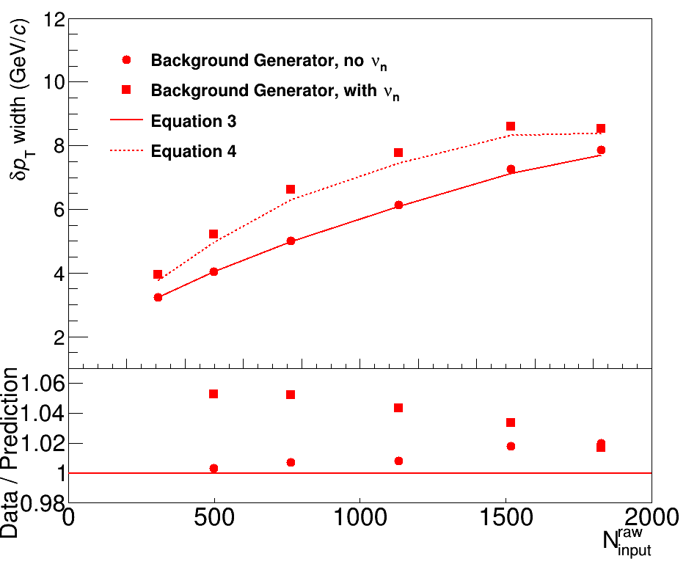
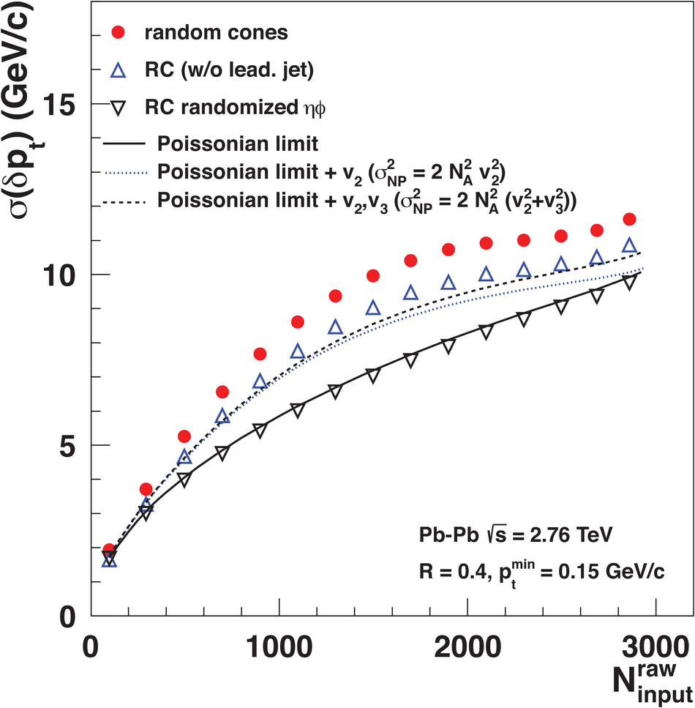
Width vs multiplicity
TennGen
ALICE
Small deviations

Slide 44
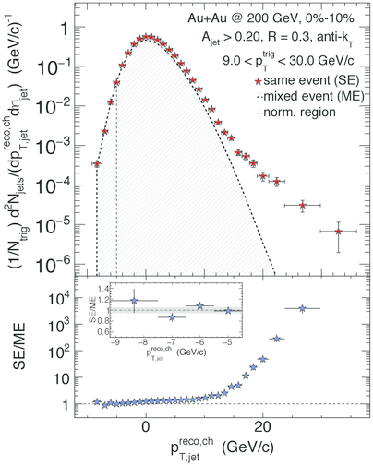
Mixed events
Gets background up to a normalization factor
Good agreement with the data… but 20% discrepancies still within uncertainties
In measurement with background suppressed (h-jet correlations)
Did not see such agreement at the LHC
STAR Phys. Rev. C 96 (2017) 24905

Slide 45
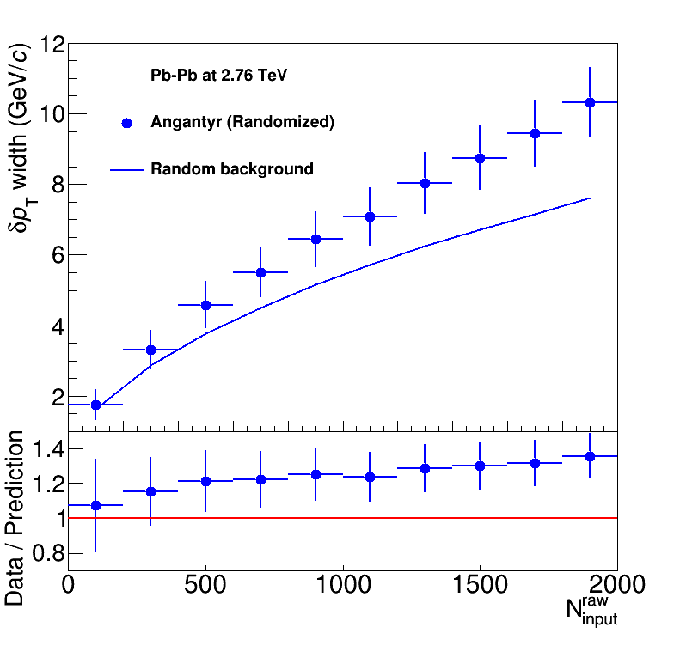
Width vs multiplicity
Angantyr
ALICE
Doesn’t go away with random track orientation!

Slide 46
Shape of width of the distribution
Single particle spectra
$f_{Γ}\left(p_{T},p,b\right)=\frac{b}{Γ\left(p\right)}{\left(bp_{T}\right)}^{p−1}e^{−bx}$
Σp_{T} of N particles→N-fold convolution:
$\frac{{dpT}^{total}}{dy}∝f_{N}\left(p_{T},Np,b\right)$
$f_{N}\left(p_{T},p,b\right)=f_{Γ}\left(p_{T},Np,b\right)$
$\frac{dN}{dy}∝f_{Γ}\left(p_{T},2,b\right)=b^{2}p_{T}e^{−kp_{T}}$
$N=\frac{N_{total}}{A_{total}}πR^{2}$
$μ_{total}=\frac{Np}{b}=Nμ_{p_{T}},σ_{total}=\frac{\sqrt{Np}}{b}=\sqrt{N}σ_{p_{T}}$
$μ_{p_{T}}=\frac{p}{b},σ_{p_{T}}=\frac{\sqrt{p}}{b}$
Tannenbaum, PLB(498),1–2,Pg.29-34(2001)
Add Poissonian fluctuations in N:
$σ_{total}=\sqrt{Nσ_{p_{T}}^{2}+Nμ_{p_{T}}^{2}}$
Assumes shape
Add non-Poissonian fluctuations in N due to flow
Assumes uncorrelated number fluctuations
$σ_{total}=\sqrt{Nσ_{p_{T}}^{2}+\left(N+2\sum{v_{n}^{2}}\right)μ_{p_{T}}^{2}}$

Slide 47
Mini-summary
Jet finders put all input clusters, tracks in a jet candidate
Background is dominated by random particles
But 5% effects from flow
Models have background too!
And it doesn’t agree with data!
Sensitive to multiplicity, shape of spectrum
Cacciari DIS 2006
Energy (arb. units)
Cacciari & Salam Phys.Lett.B641:57-61,2006
$ϕ$
$η$

Slide 48
Jets in A+A collisions: Dealing with background

Slide 49
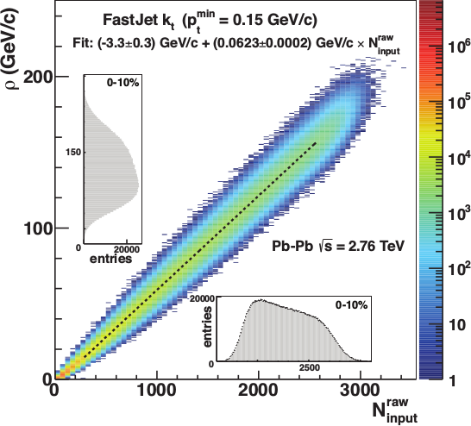
Focus on smaller angles
Pros
Background is smaller
Background fluctuations smaller
Cons:
Modifications expected at higher R
Biases sample towards quarks
JHEP 03 (2012) 053
Aside: “quark” and “gluon” jet only defined at leading order.

Slide 50
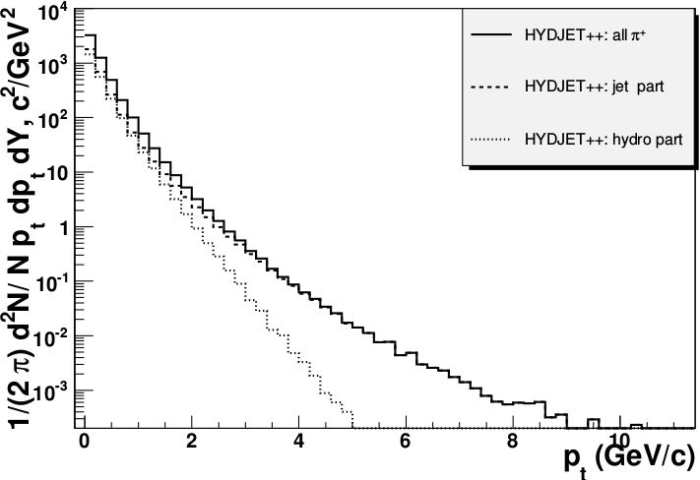
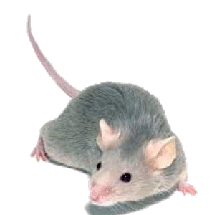
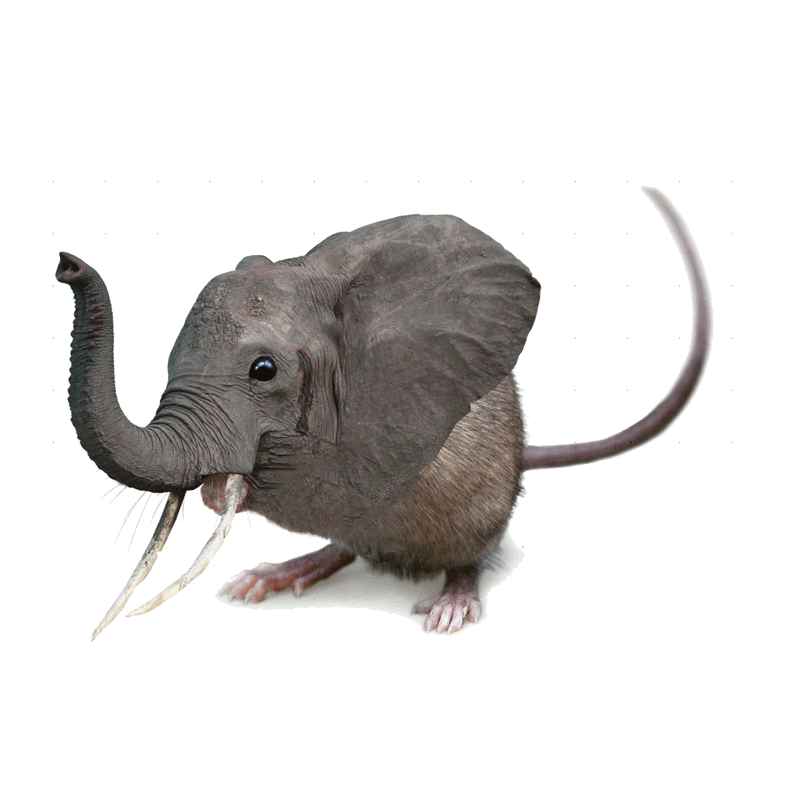
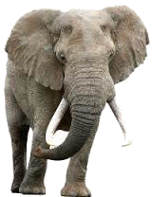
Focus on high p_{T}
Pros:
Reduces combinatorial background
Cons:
Cuts signal where we expect modifications
Could bias towards partons which have not interacted
Biases sample towards quark jets
PoS High-pTphysics09:023,2009
“Quark” and “gluon” jets only defined at leading order!

Slide 51
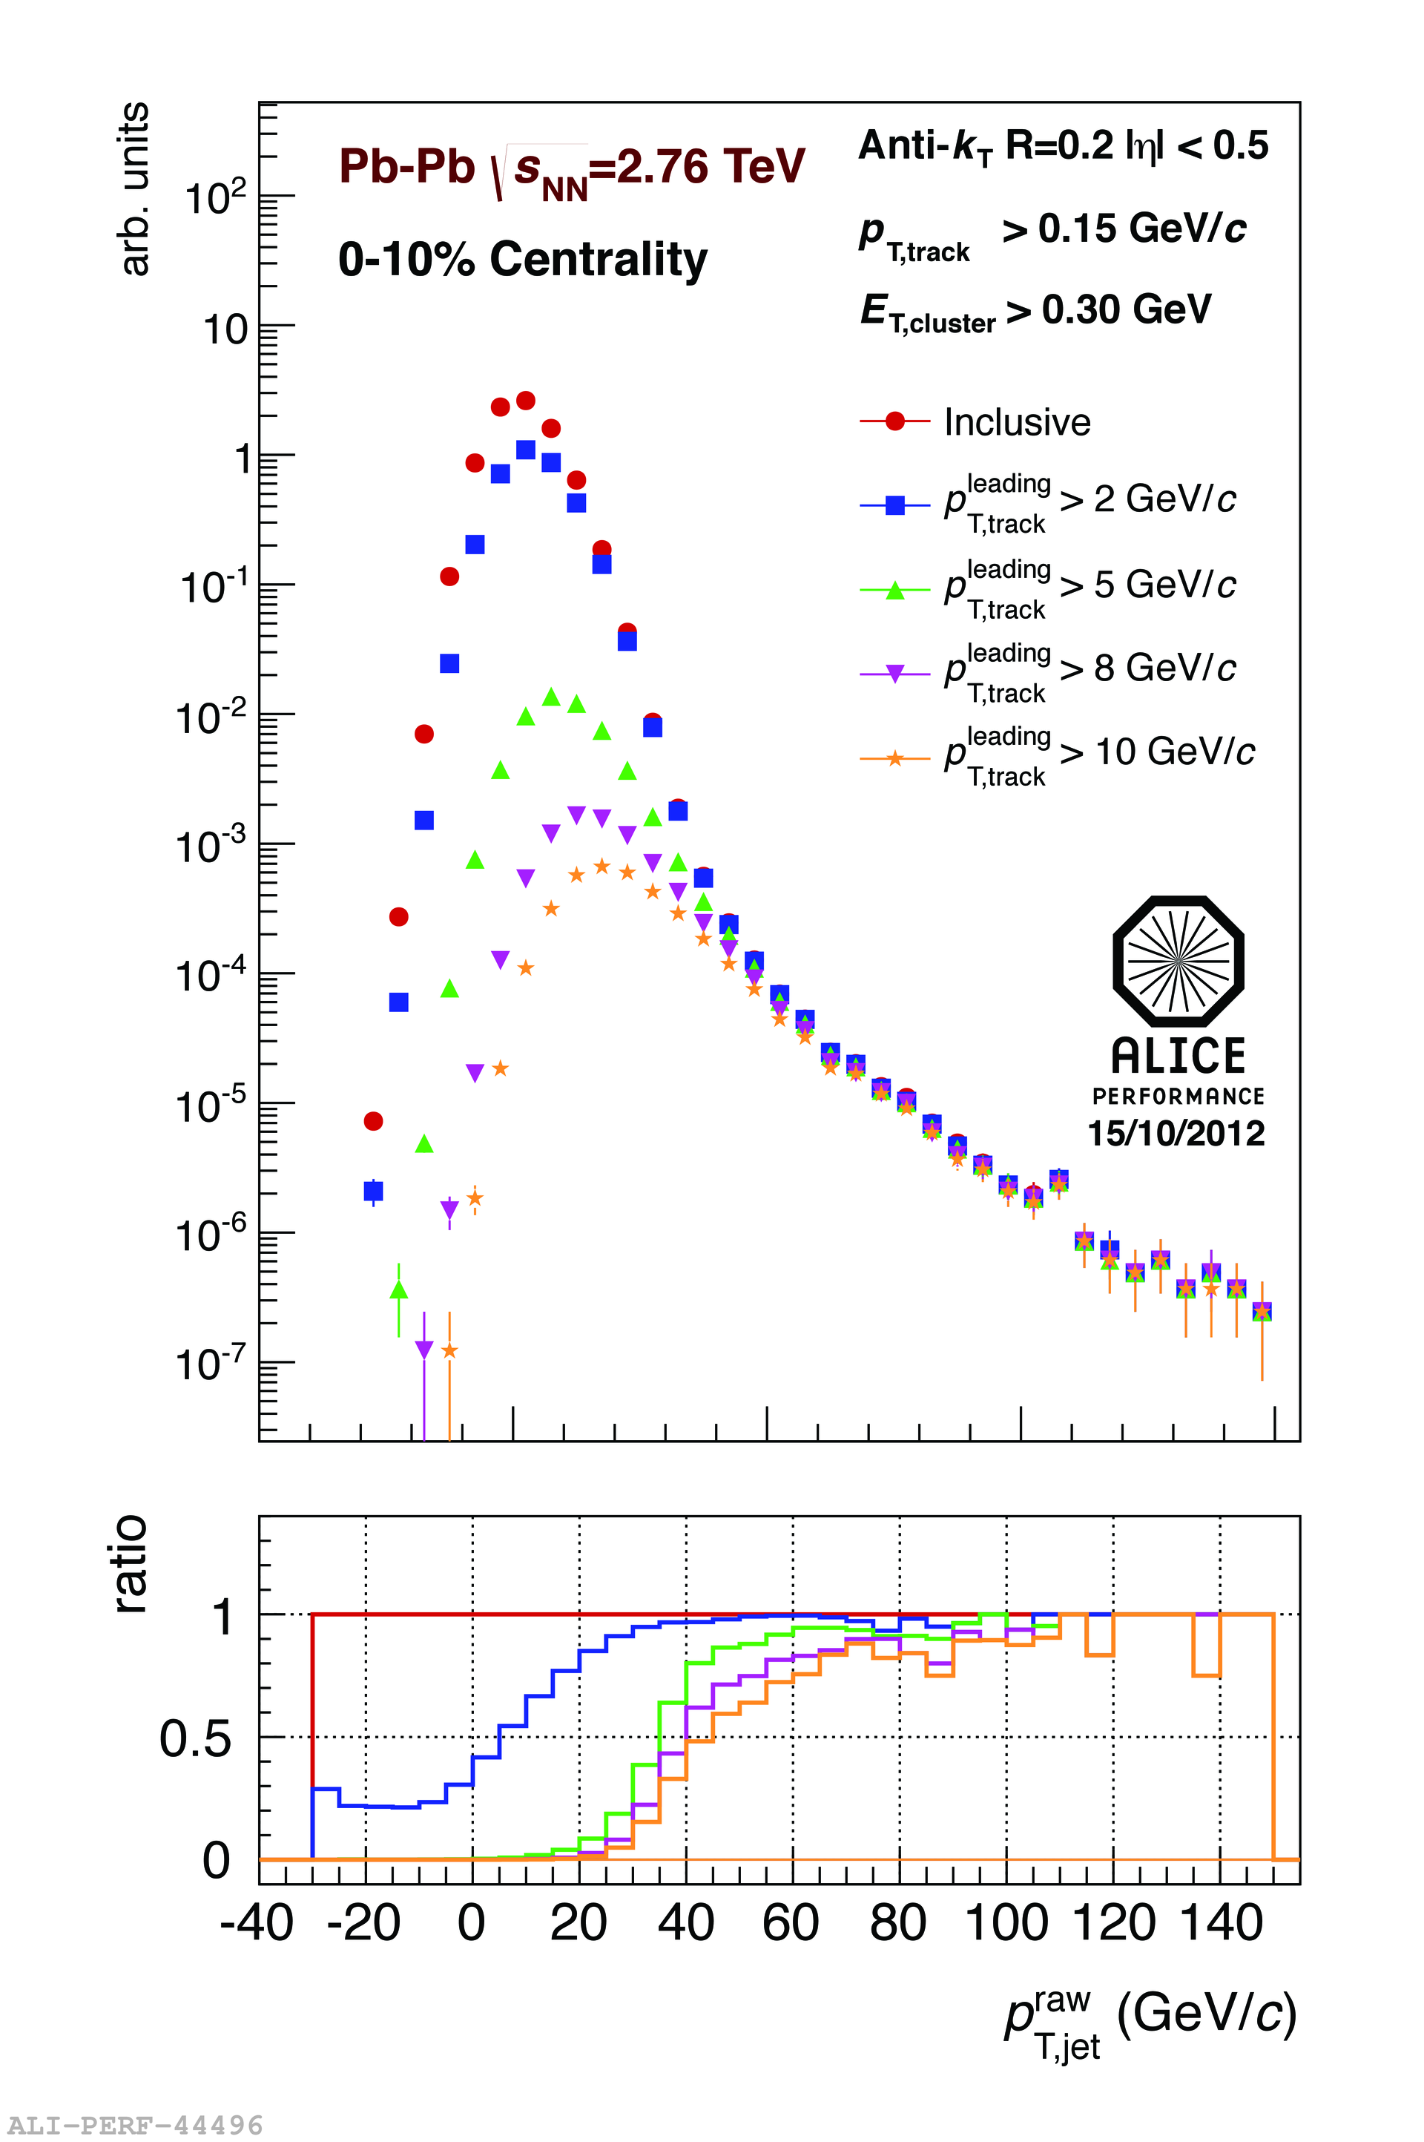
<footer>
Area-based subtraction
ALICE/STAR
Require leading track p_{T} > 5 GeV/c
Suppresses combinatorial “jets”
Biases fragmentation
No threshold on constituents
Limited to small R
Combinatorial “jets”
Notes:
<number>

Slide 52
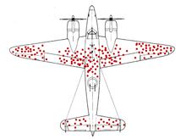
Survivor bias
WWII Example: holes planes returning indicate where it’s safer to get hit
We’re looking at the jets which remain

Slide 53
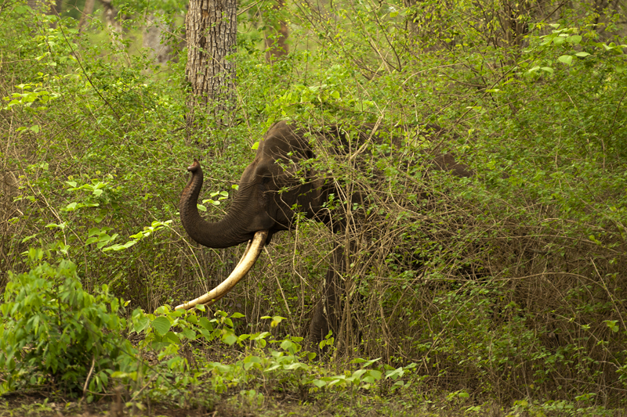
http://walkthewilderness.net/animals-of-india-72-asiatic-elephant/

Slide 54
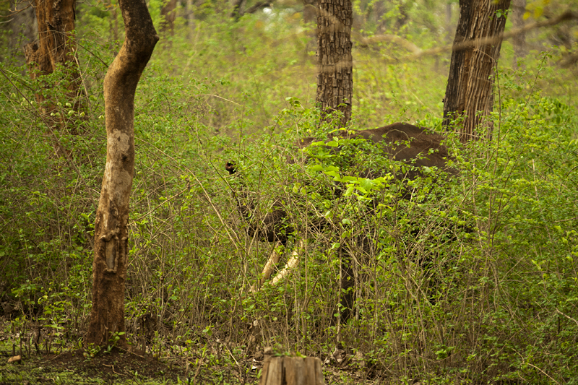
http://walkthewilderness.net/animals-of-india-72-asiatic-elephant/

Slide 55
http://walkthewilderness.net/animals-of-india-72-asiatic-elephant/

Slide 56
Bias & background
Experimental background subtraction methods: complex, make assumptions, apply biases
Survivor bias: Modified jets probably look more like the medium
Quark/Gluon bias:
Quark jets are narrower, have fewer tracks, fragment harder [Z Phys C 68, 179-201 (1995), Z Phys C 70, 179-196 (1996), ]
Gluon jets reconstructed with k_{T} algorithm have more particles than jets reconstructed with anti-k_{T} algorithm [Phys. Rev. D 45, 1448 (1992)]
Gluon jets fragment into more baryons [EPJC 8, 241-254, 1998]
Fragmentation bias: Experimental measurements explicitly select jets with hard fragments

Slide 57
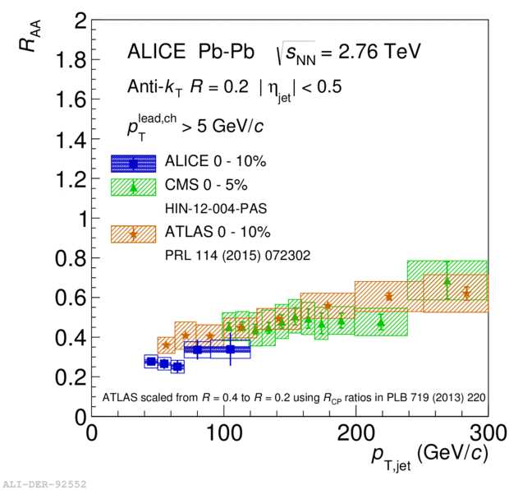
Iterative procedure
Constituent biases don't matter that much up here
Used by ATLAS & CMS
ATLAS
Calorimeter jets: Reconstruct jets with R=0.2. v₂ modulated <Bkgd> estimated by energy in calorimeters excluding jets with at least one tower with E_{tower} > <E_{tower}> Track jets: Use tracks with p_{T}>4 GeV/c
Calorimeter jets from above with E>25 GeV and track jets with p_{T}>10 GeV/c used to estimate background again.
Calorimeter tracks matching one track with p_{T}>7 GeV/c or containing a high energy cluster E >7 GeV are used for analysis down to E_{jet} = 20 GeV
But they do matter down here!
Phys. Lett. B 719 (2013) 220-241

Slide 58
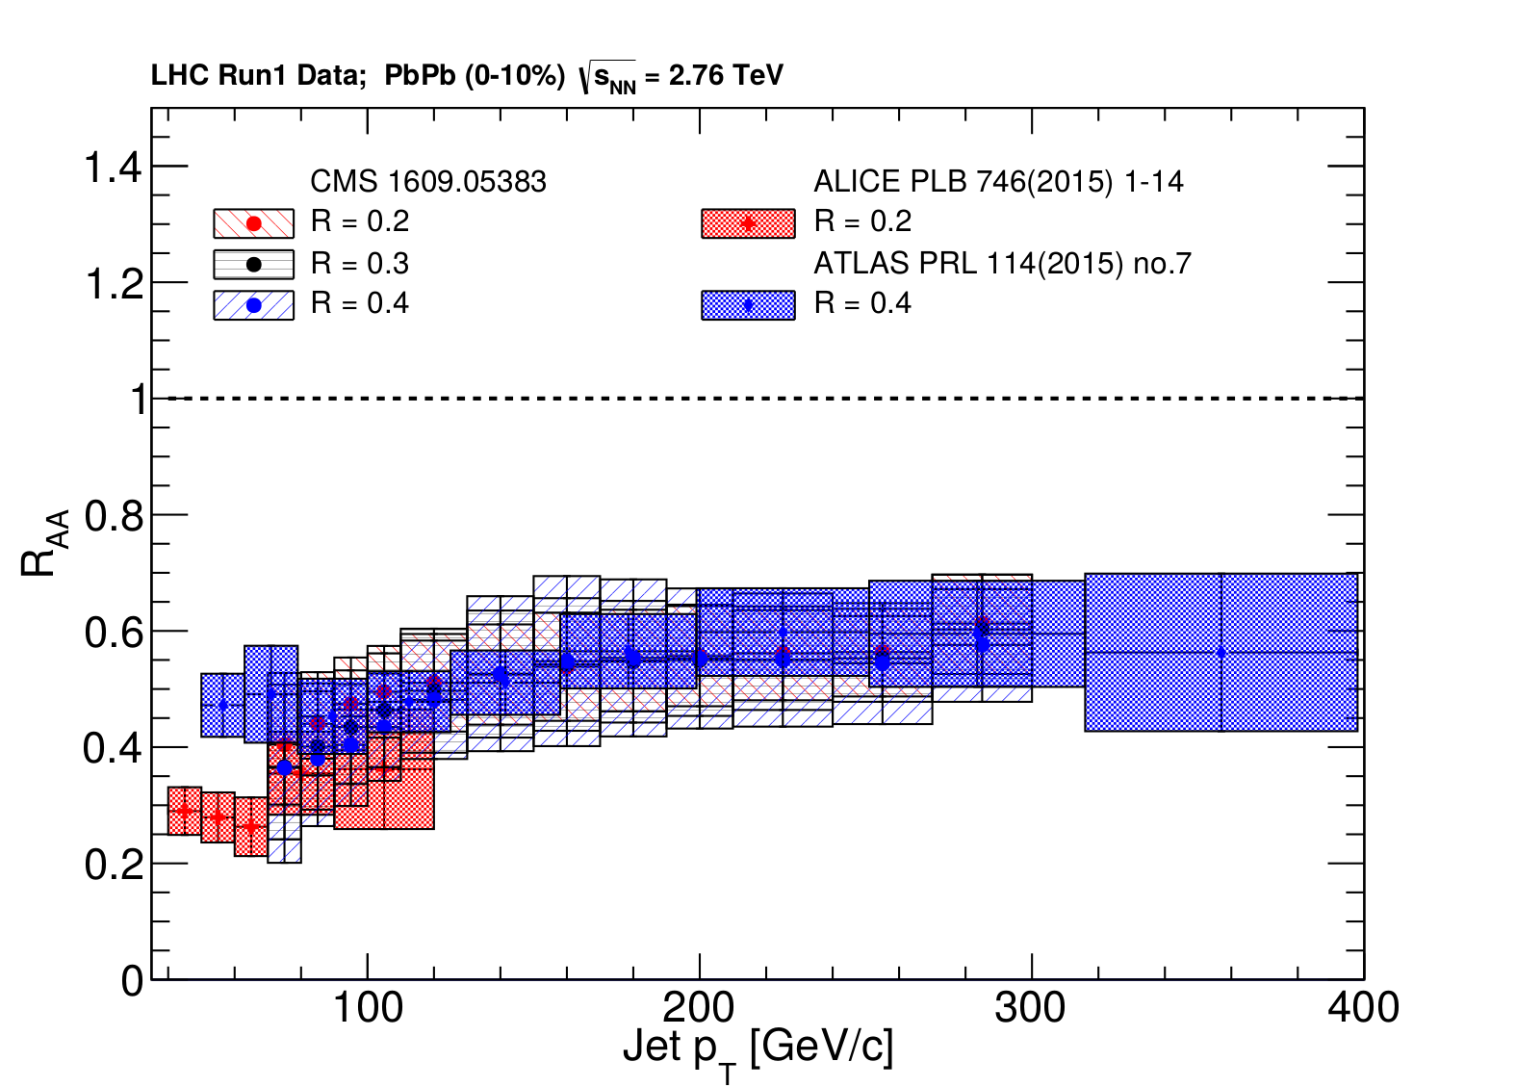
Jet R_{AA}
arXiv:1705.01974

Slide 59
Jet R_{AA}
arXiv:1705.01974
Tension between ATLAS & ALICE/CMS

Slide 60
ATLAS
Background subtraction method:
Iterative procedure
Calorimeter jets: Reconstruct jets with R=0.2. v₂ modulated <Bkgd> estimated by energy in calorimeters excluding jets with at least one tower with E_{tower} > <E_{tower}> Track jets: Use tracks with p_{T}>4 GeV/c
Calorimeter jets from above with E>25 GeV and track jets with p_{T}>10 GeV/c used to estimate background again.
Calorimeter tracks matching one track with p_{T}>7 GeV/c or containing a high energy cluster E >7 GeV are used for analysis down to E_{jet} = 20 GeV
Constituent biases don't matter that much up here
Phys. Lett. B 719 (2013) 220-241
But they do matter down here!

Slide 61
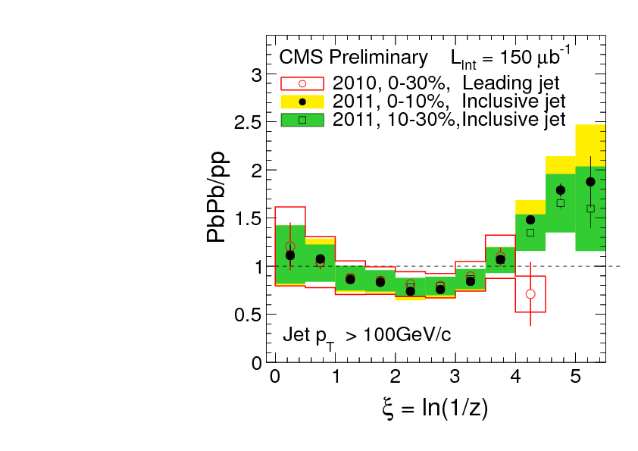
What you see depends on where you look
?
Phys. Rev. C 90, 024908 (2014) JHEP10(2012)087
High p_{T}
z = p_{T}/E_{jet}
Low p_{T}
Low p_{T}
Low p_{T}
Low p_{T}
Low p_{T}
High p_{T}
Low p_{T}
High p_{T}
High p_{T}
High p_{T}

Slide 62
Mini-summary
Most studies do one or more of the following:
Explicitly apply a (non-purturbative) bias
Implicitly apply a (non-purturbative) bias
Focus on small R
Focus on high pT
May also → survivor bias
Background subtraction should be part of definition of algorithm

Slide 63
Jets in A+A collisions: How to compare to models

Slide 64
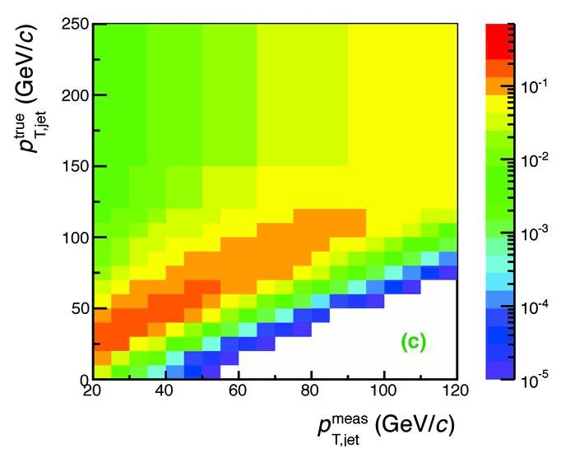
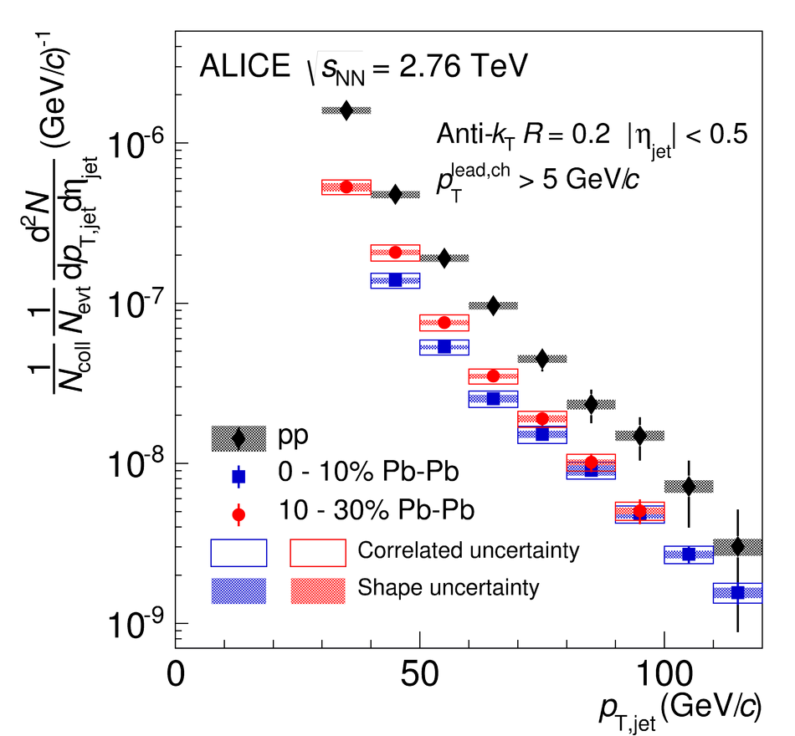
Analysis steps
Tracks
Jet finding algorithm
Jet candidates
Background subtraction
Clusters
Jet spectrum smeared by energy resolution, background fluctuations
Unfolding – corrects for single track reco ε, E resolution, background fluctuations
Corrected spectra

Slide 65
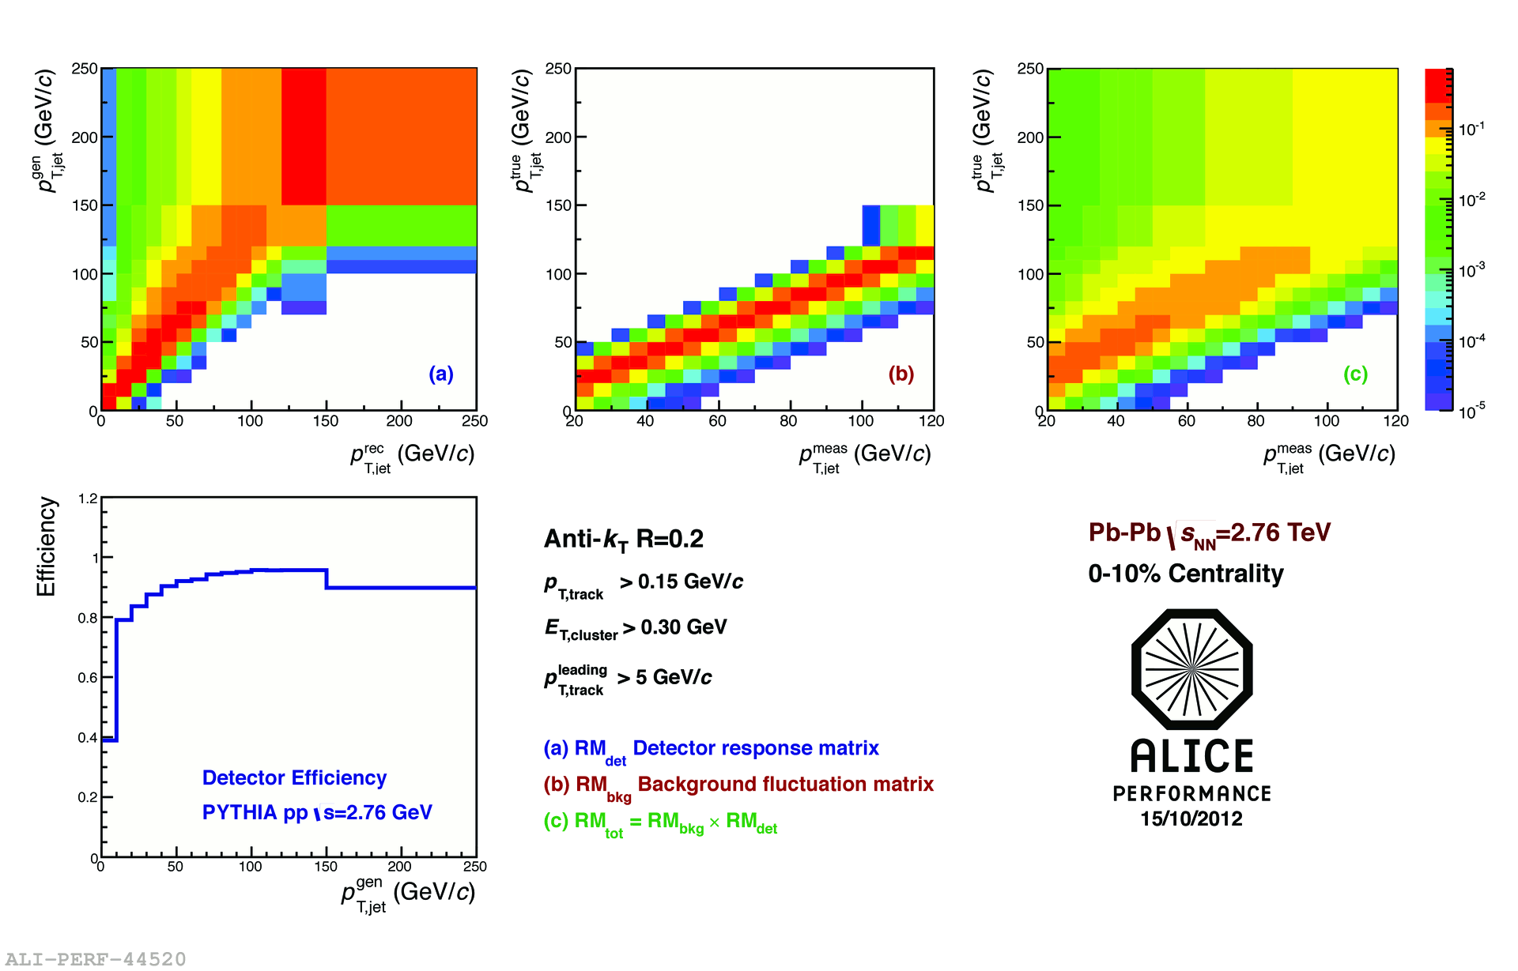
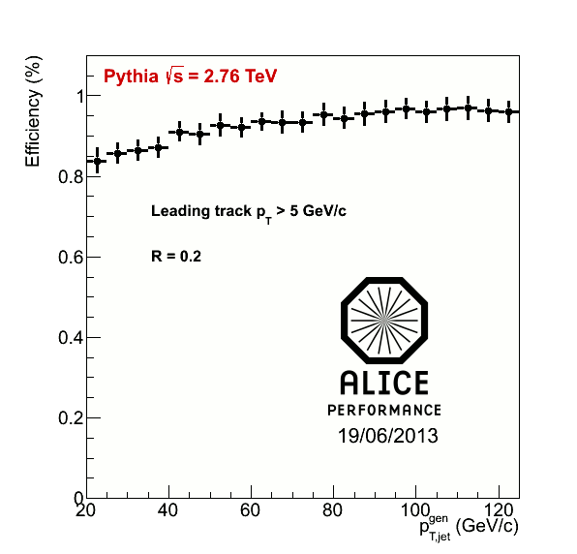
<footer>
Jets in ALICE: Response Matrix Construction
RMdet X RMbkg = RM
RM_{bkg} and RM_{det} are approximately factorizable
Notes:
----- Meeting Notes (6/24/13 16:47) -----
Put Large Labels on
b) change pT true -> pT rec so consistence
c) change gT true ->pT gen
<number>

Slide 66
<footer>
Jets in ALICE: Response Matrix Construction
RMdet X RMbkg = RM
DETECTOR EFFECT
RM_{bkg} and RM_{det} are approximately factorizable
Notes:
----- Meeting Notes (6/24/13 16:47) -----
Put Large Labels on
b) change pT true -> pT rec so consistence
c) change gT true ->pT gen
<number>

Slide 67
<footer>
Jets in ALICE: Response Matrix Construction
RMdet X RMbkg = RM
NOT A DETECTOR EFFECT!!
DETECTOR EFFECT
RM_{bkg} and RM_{det} are approximately factorizable
Notes:
----- Meeting Notes (6/24/13 16:47) -----
Put Large Labels on
b) change pT true -> pT rec so consistence
c) change gT true ->pT gen
<number>

Slide 68
Snowmass Accord: Forget the idea of a parton. Apply the same algorithm to data and your model. Then the measurement and the calculation are the same.

Slide 69
Rivet: Apply the same algorithm to data and your model. Then the measurement and the calculation are the same.

Slide 70
What is Rivet?

Slide 71
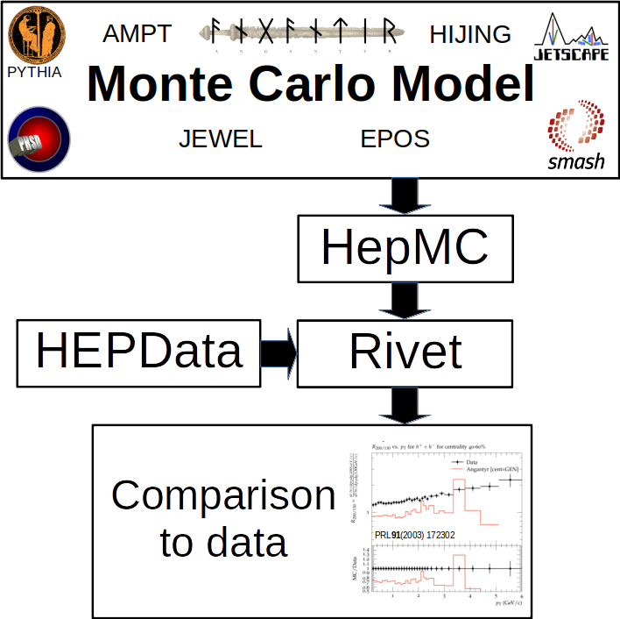

Slide 72
Why use Rivet?
Facilitates comparisons between Monte Carlos and data
It’s not that hard
It preserves analysis details

Slide 73
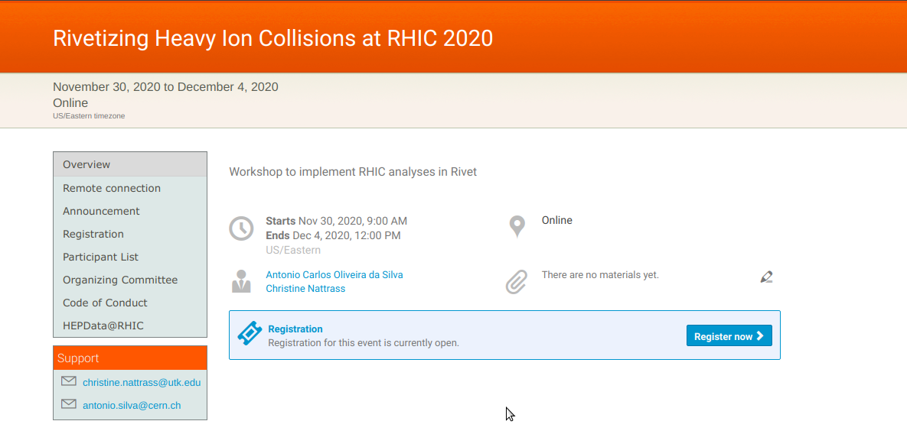

Slide 74
<footer>
Jets in ALICE: Response Matrix Construction
RMdet X RMbkg = RM
NOT A DETECTOR EFFECT!!
DETECTOR EFFECT
RM_{bkg} and RM_{det} are approximately factorizable
Notes:
----- Meeting Notes (6/24/13 16:47) -----
Put Large Labels on
b) change pT true -> pT rec so consistence
c) change gT true ->pT gen
<number>

Slide 75
Analysis steps: Full Monte Carlo
Jet finding algorithm
Jet candidates
Background subtraction
Particles
Unfolding – corrects for background fluctuations
Jet spectrum smeared by energy resolution
Corrected spectra

Slide 76
Comparison to data
HepMC
Rivet
Unfold to correct for fluctuations
HEPData
HepMC
Rivet
arXiv:2005.02320 [hep-ph]
Comparison to data
See poster by Nattrass et al
PRL91(2003) 172302
Unfold to correct for fluctuations
Comparison to data
PRL91(2003) 172302

Slide 77
Mini-summary
Experimental techniques can bias measurement in subtle ways
Background subtraction
Kinematic cuts
Choice of jet finder, R
Centrality determination
Technique for finding reaction plane
Unclear how these influence the measurement
Safest to do the same analysis on data and model
But unfolding is necessary in a full Monte Carlo model!

Slide 78
Summary
Jets are defined by a jet finder and its parameters
All jet measurements are somewhat sensitive to non-perturbative effects
Background for jets in heavy ion collisions dominated by random combinations of particles
Other effects ~5%
Not described well by theory
Measurements may have a biased selection of jets
Conservative approach: Treat models like data → Rivet!

