Slide 3
I do not care about jets.
Paraphrased from Sevil Salur

Slide 4
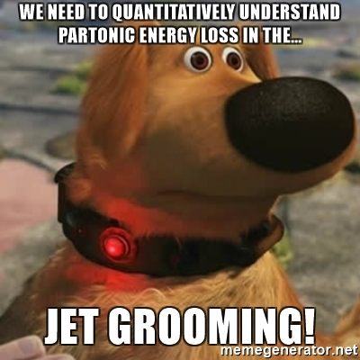
I want to learn about the QGP.
First part paraphrased from Sevil Salur. The cartoon is my fault.

Slide 5
What should we measure?

Slide 6
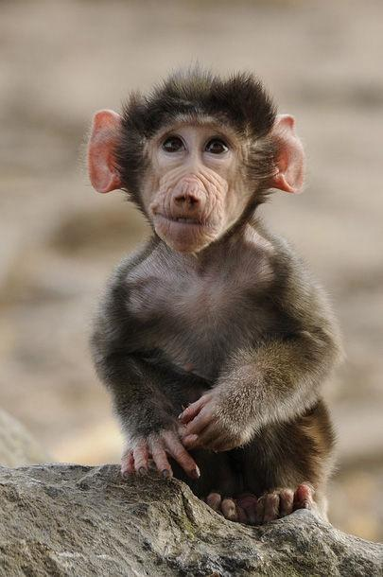
What should we measure?
Jupiter and the Monkey
Jupiter promised a royal reward to the one whose offspring should be deemed the handsomest.
The monkey came with the rest, and presented a flat-nosed, hairless, ill-featured young monkey.
A general laugh saluted her on the presentation of her son.
She resolutely said; "He is at least in the eyes of me, his mother, the dearest, handsomest, and most beautiful of all."
http://aesopsfables.org/F9_Jupiter-and-the-Monkey.html Abbreviated

Slide 7
Jet measurement madlibs!
[Adjective] [noun] [observable] in [collision system]
Groomed
Unfolded
Event-engineered
Top quark
B-jet
Z-boson
D meson
Correlations
Di-jet asymmetries
v₁, v₂, v₃, v₄...
Proton-lead
Ultra-central collisions

Slide 8
Jet measurement madlibs!
[Adjective] [noun] [observable] in [collision system]
Groomed
Unfolded
Event-engineered
Top quark
B-jet
Z-boson
D meson
Correlations
Di-jet asymmetries
v₁, v₂, v₃, v₄...
Proton-lead
Ultra-central collisions
Groomed top quark di-jet asymmetries in ultracentral collisions

Slide 9
Jet measurement madlibs!
[Adjective] [noun] [observable] in [collision system]
Groomed
Unfolded
Event-engineered
Top quark
B-jet
Z-boson
D meson
Correlations
Di-jet asymmetries
v₁, v₂, v₃, v₄...
Proton-lead
Ultra-central collisions
Groomed top quark di-jet asymmetries in ultracentral collisions
Unfolded Z-boson correlations in proton-lead

Slide 10
Jet measurement madlibs!
[Adjective] [noun] [observable] in [collision system]
Groomed
Unfolded
Event-engineered
Top quark
B-jet
Z-boson
D meson
Correlations
Di-jet asymmetries
v₁, v₂, v₃, v₄...
Proton-lead
Ultra-central collisions
Groomed top quark di-jet asymmetries in ultracentral collisions
Unfolded Z-boson correlations in proton-lead
Groomed top jet v₄ in ultra-central collisions

Slide 11
Jet measurement madlibs!
[Adjective] [noun] [observable] in [collision system]
Groomed
Unfolded
Event-engineered
Top quark
B-jet
Z-boson
D meson
Correlations
Di-jet asymmetries
v₁, v₂, v₃, v₄...
Proton-lead
Ultra-central collisions
Groomed top quark di-jet asymmetries in ultracentral collisions
Unfolded Z-boson correlations in proton-lead
Groomed top jet v₄ in ultra-central collisions
Event-engineered groomed b-jet top quark di-jet asymmetries in ultra-central collisions

Slide 12
Error bars matter
Simple measurements with small error bars may offer stronger constraints than better/more intuitive/more clever observables with large error bars
Sometimes it’s surprising which measurements provide greatest constraints
Examples:
Single particle spectra with small error bars constrain uncertainty on properties of the medium well Phys.Rev. C89 (2014) no.3, 034917
Relatively low Q, large x DIS and Drell-Yan data provide comparable constraints on Higgs production to LHC jet measurements PoS DIS2018 (2018) 024
Correlations between uncertainties are also important. Experiments should publish them.

Slide 13
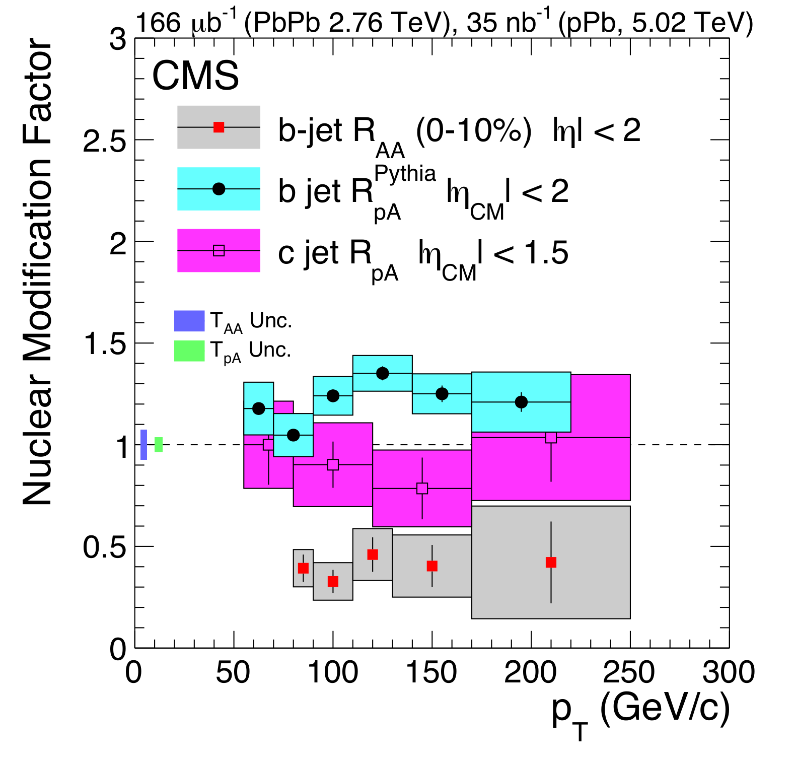
Do we really learn anything from this?*
HUGE error bars!
*I really do like this measurement. It’s nothing personal. I ask the same thing about the measurements I’m working on.

Slide 14
Available data
RHIC: High-p_{T} hadron correlations 52%, reconstructed jets 3%
LHC: High-p_{T} hadron correlations 23%, reconstructed jets 40%
Analysis about 1 year old, some may disagree with classifications, but the gist holds

Slide 15
What should we measure?

Slide 16
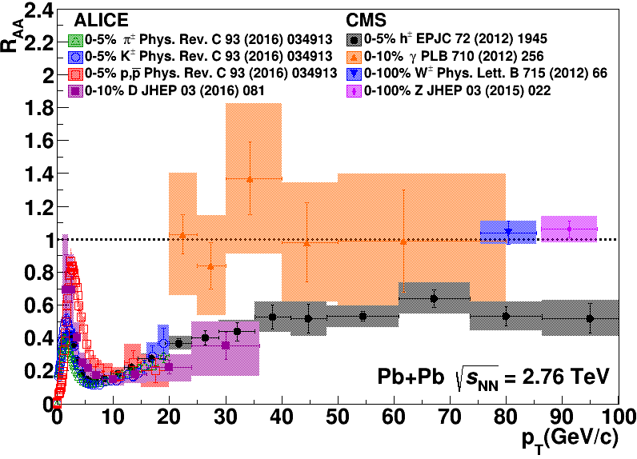
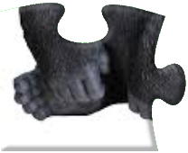
What should we measure?

Slide 17
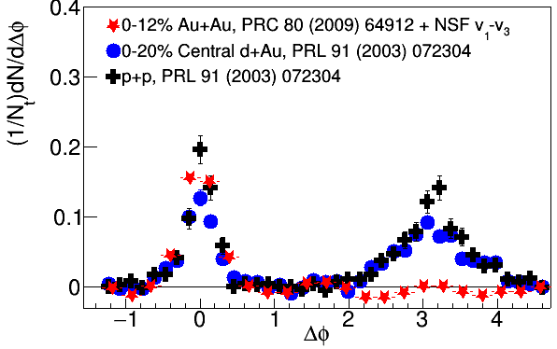
What should we measure?
arXiv:1801.09131

Slide 18
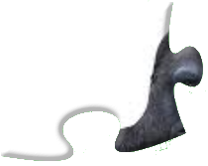
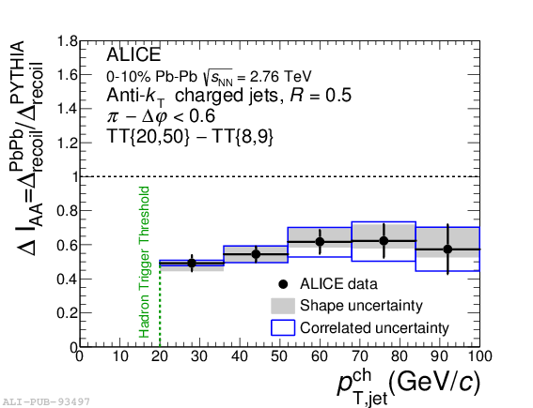
What should we measure?
arXiv:1801.09131

Slide 19
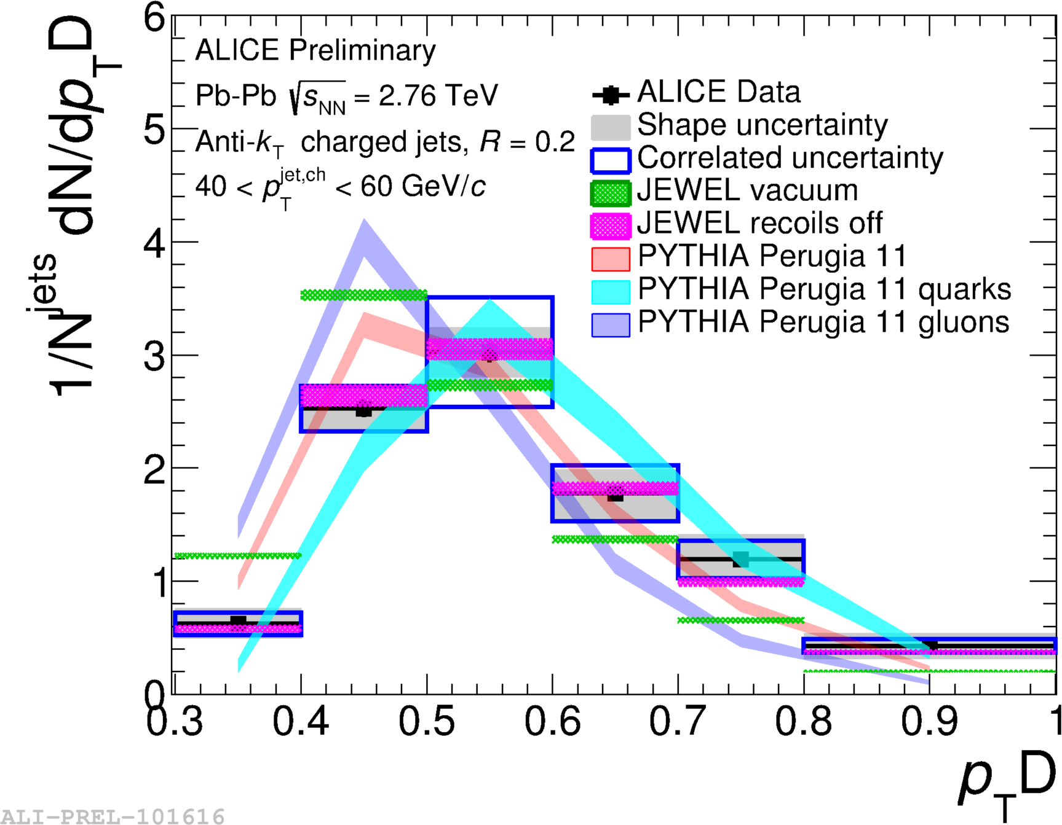
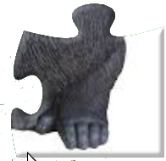
What should we measure?
arXiv:1801.09131

Slide 20
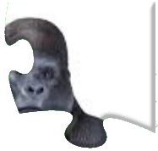
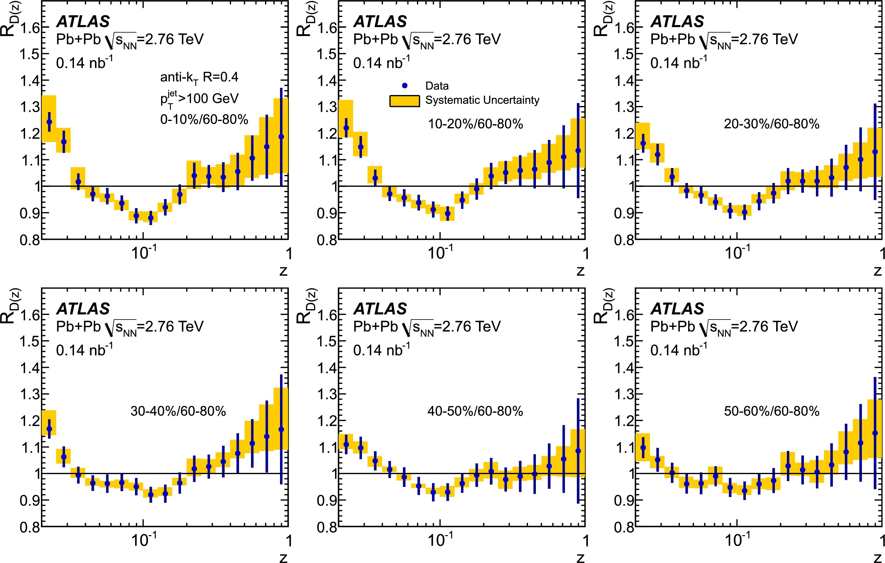
What should we measure?
arXiv:1801.09131

Slide 21
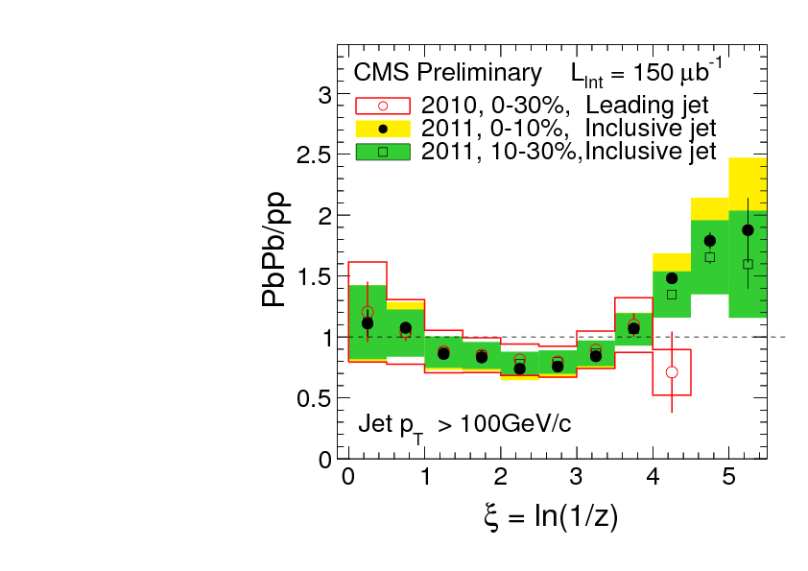
What you don’t see matters
Phys. Rev. C 90, 024908 (2014) JHEP10(2012)087
z = p_{T}/E_{jet}
Low p_{T}
High p_{T}
Low p_{T}
Low p_{T}
Low p_{T}
Low p_{T}
High p_{T}
Low p_{T}
High p_{T}
High p_{T}
High p_{T}

Slide 22
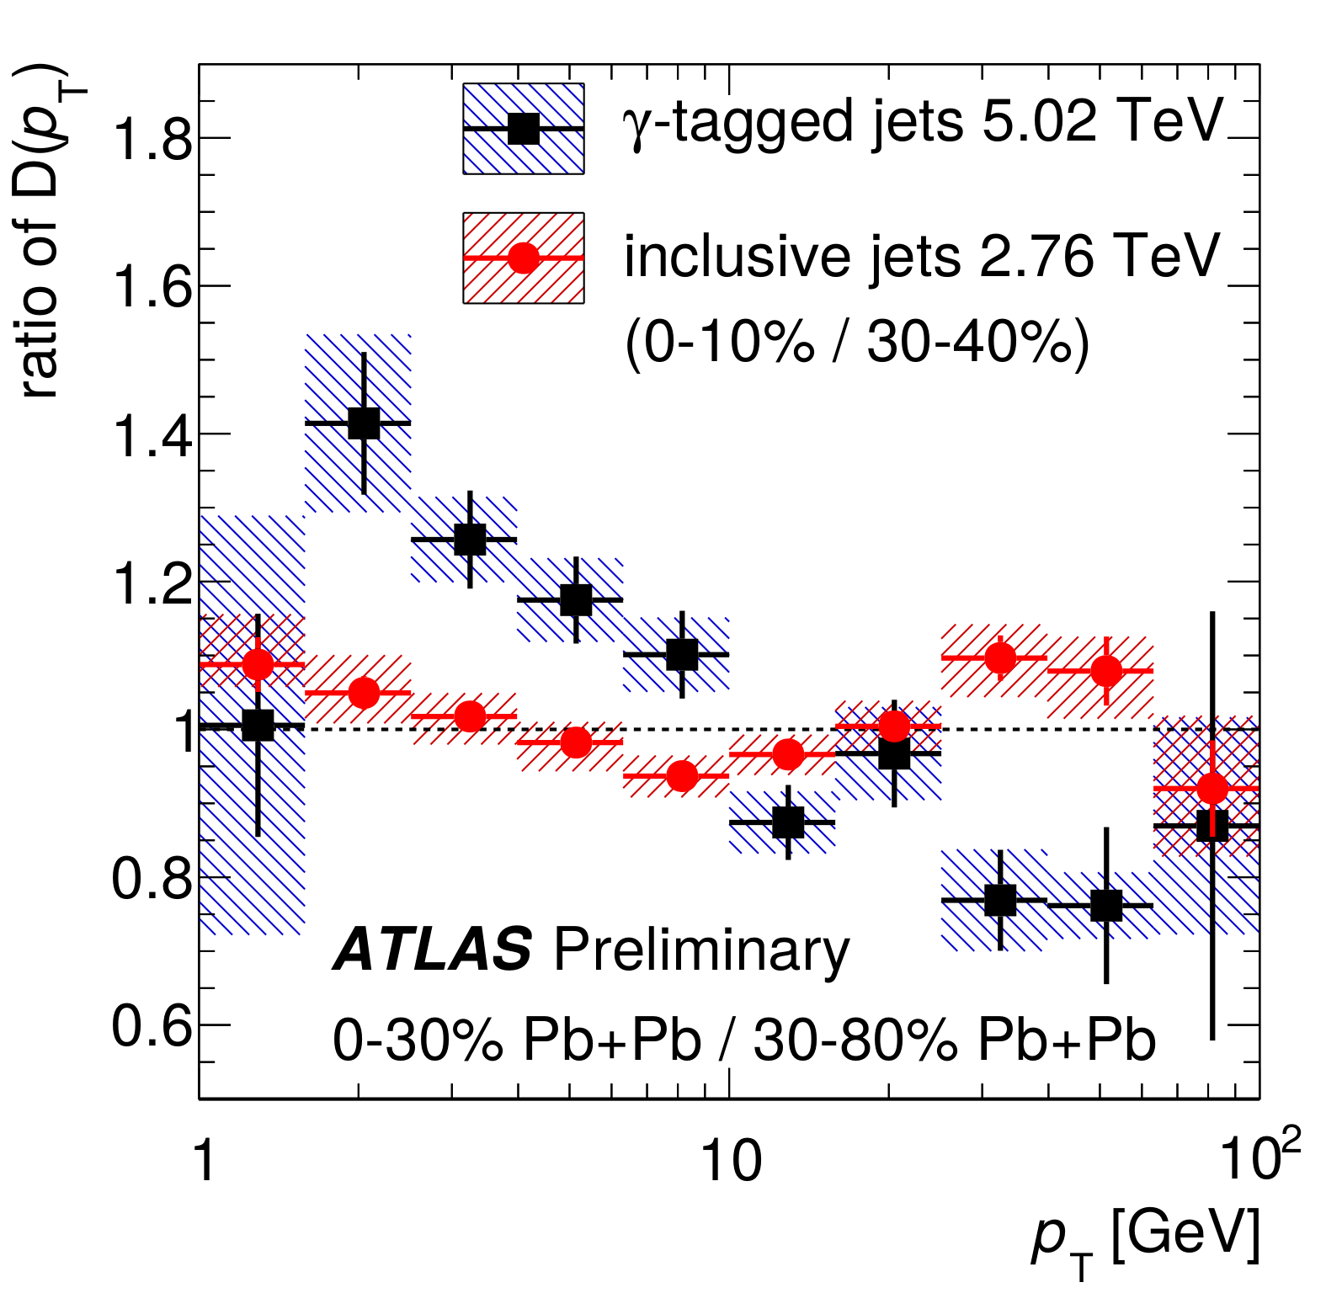
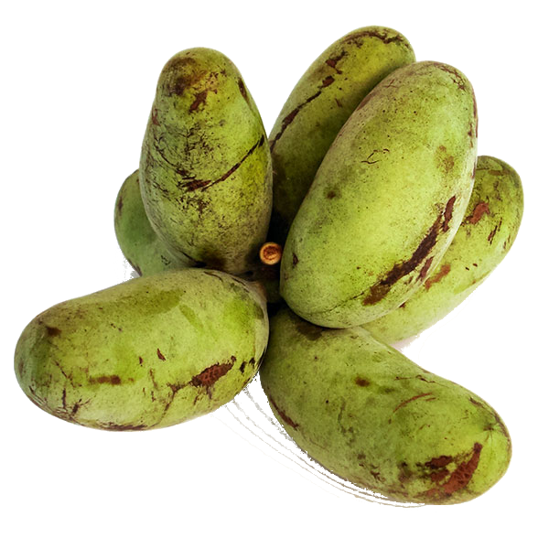
What you don’t see matters

Slide 23
What should we measure? Some of my answers
Everything!
Martin Spousta: But we can’t measure everything! We should focus!
Yen-jie Lee: We should measure things which are sensitive to different properties of the medium and which are human understandable.
“Simple” measurements with small error bars
Beware complicated measurements and black boxes.
Have an open mind – your (my!) pet observable may not be the best

Slide 24
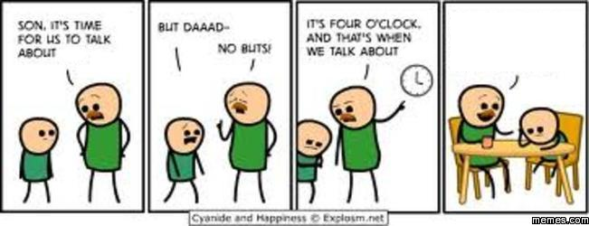
Background
So the thing is, you should do it the way I do it because your way is wrong.
background
background
http://www.memes.com/searchresults/sex/205126

Slide 25
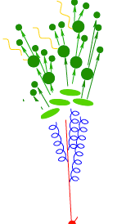
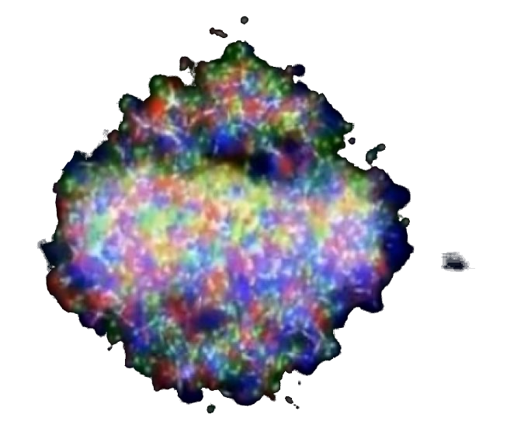
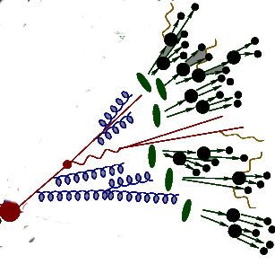
Discussion of analysis technique in a typical jet paper/talk
Jet finder
Background subtraction
Signal + background
Jet candidates
Real jets

Slide 26
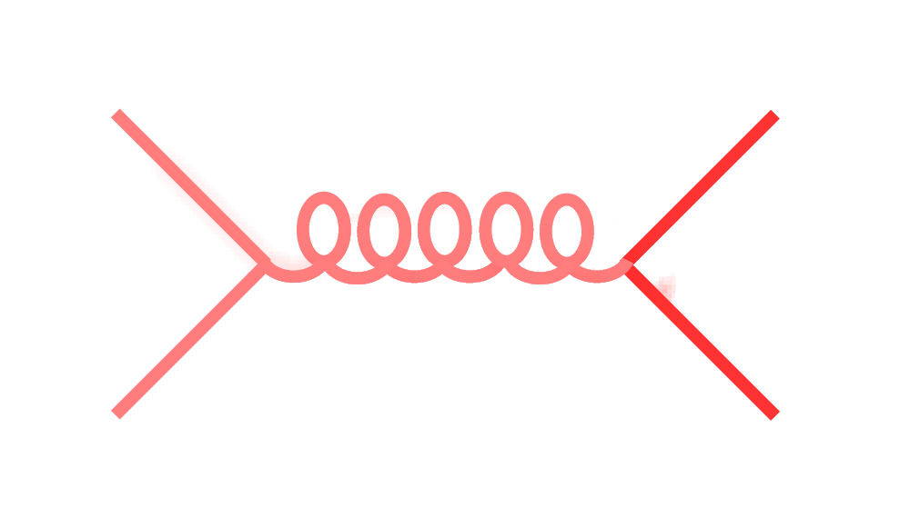
Signal vs Background
Background
Signal
??

Slide 27
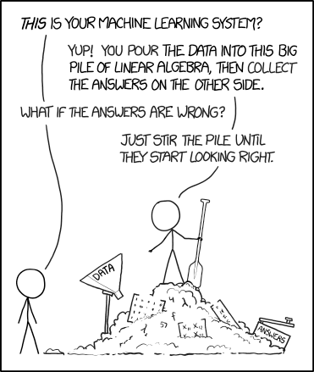
Beware black boxes!
https://xkcd.com/1838/

Slide 28
Beware black boxes!
BACKGROUND SUBTRACTION ALGORITHM?
OF CODE
https://xkcd.com/1838/

Slide 29
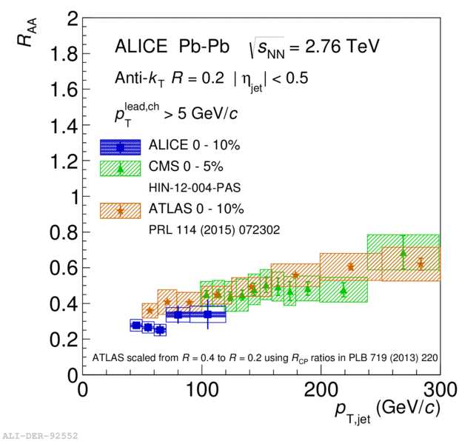
ATLAS
Constituent biases don't matter that much up here
Background subtraction method:
Iterative procedure
Calorimeter jets: Reconstruct jets with R=0.2. v₂ modulated <Bkgd> estimated by energy in calorimeters excluding jets with at least one tower with E_{tower} > <E_{tower}> Track jets: Use tracks with p_{T}>4 GeV/c
Calorimeter jets from above with E>25 GeV and track jets with p_{T}>10 GeV/c used to estimate background again.
Calorimeter tracks matching one track with p_{T}>7 GeV/c or containing a high energy cluster E >7 GeV are used for analysis down to E_{jet} = 40 GeV
But they do matter down here!
→ Background subtraction in use by experiments is not benign!
Phys. Lett. B 719 (2013) 220-241

Slide 30
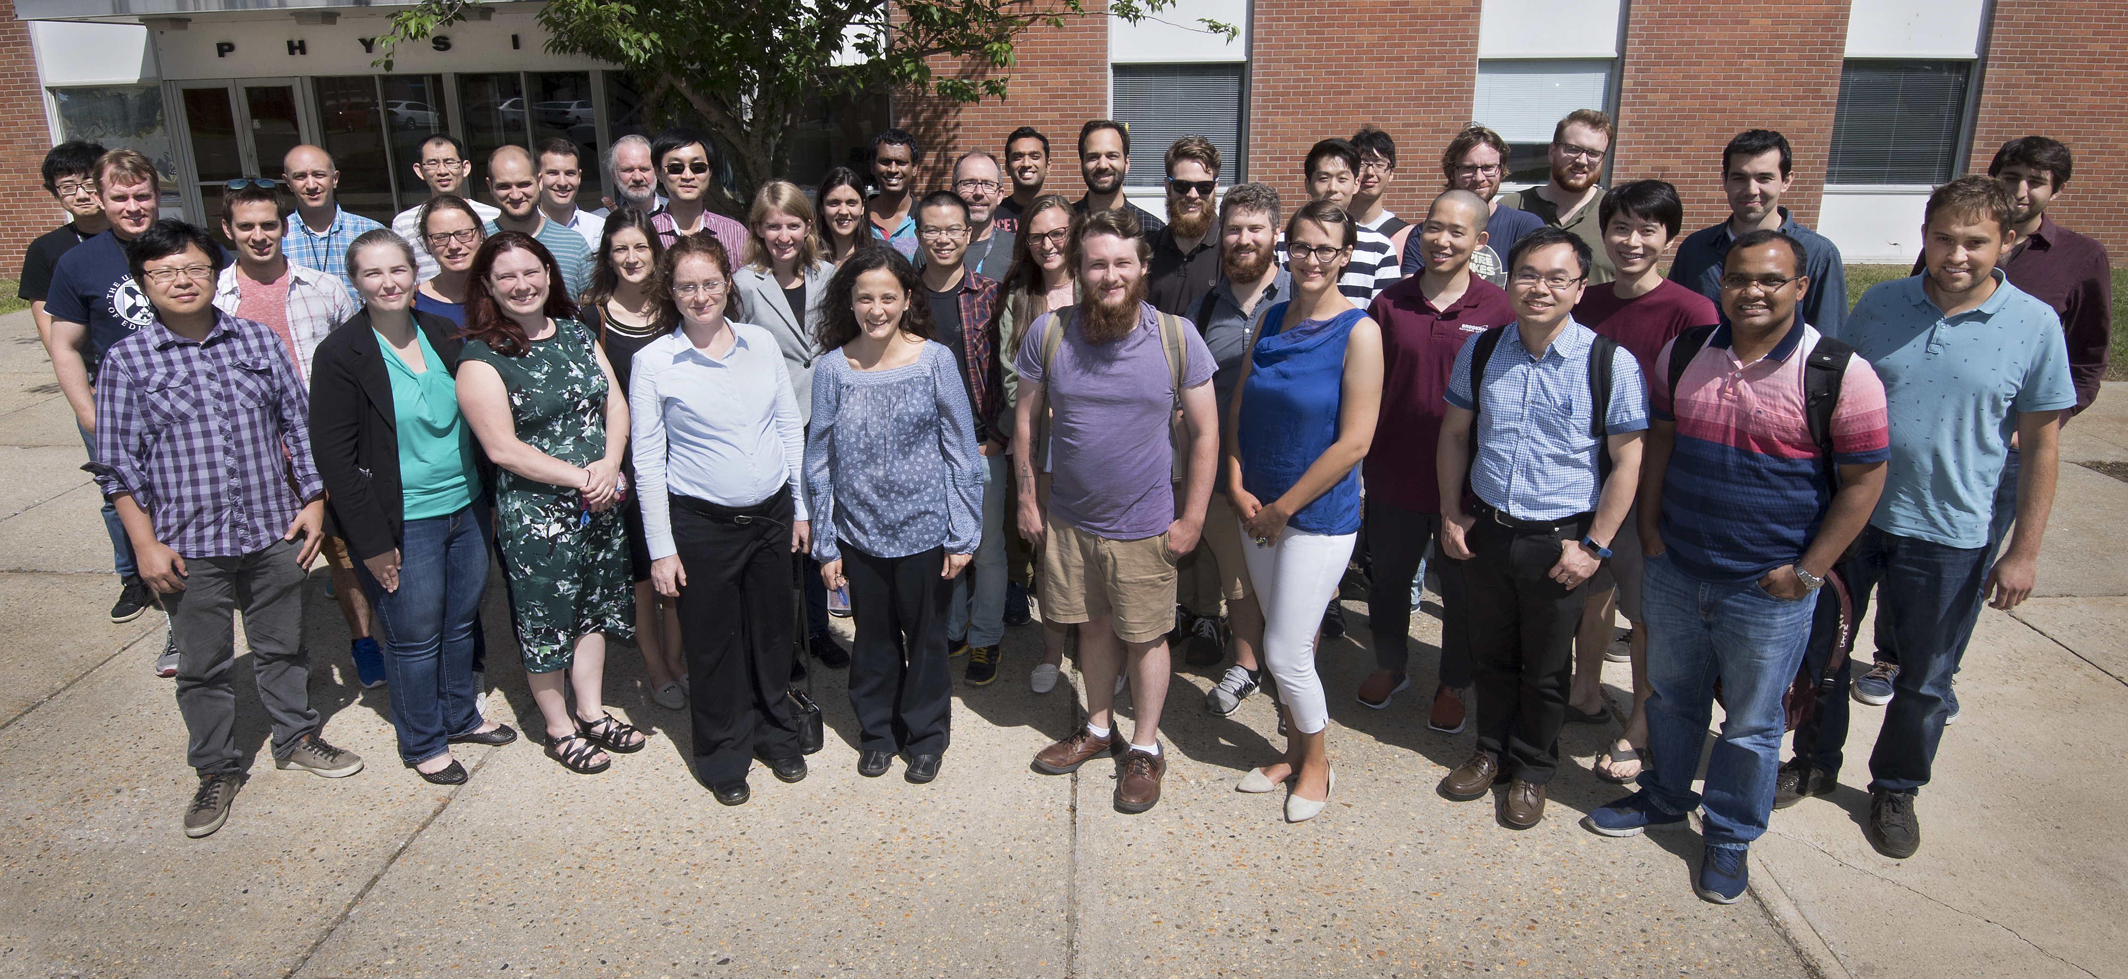
Definition of Jets in a Large Background
Organizers: M. Connors, G. Milhano, C. Nattrass, R. Reed, S. Salur
Spectra conveners: R. Kunnawalkam Elayavalli, Y. Mehtar-Tani (R. Bertens)
Correlation conveners: J. Noronha-Hostler, J. Huang
Substructure conveners: Y. Lee, Y. Chien
Extensively discussed the interplay between experimental techniques and theoretical calculations with the aim of reaching an agreement* on the way forward for extracting jet measurements from large background events such as those in heavy ion collisions and high luminosity p-p or electron-ion collisions.
*Consensus on some points
62 Registered but due to various visa & travel complications: 45 + several BNL employees attended.

Slide 31
Recommendations
Korinna Zapp
Include anything correlated in definition of jet
Provide enough details to make comparisons between data and models
Reconsider role of collinear safety
Discuss and put effort into the problem

Slide 32
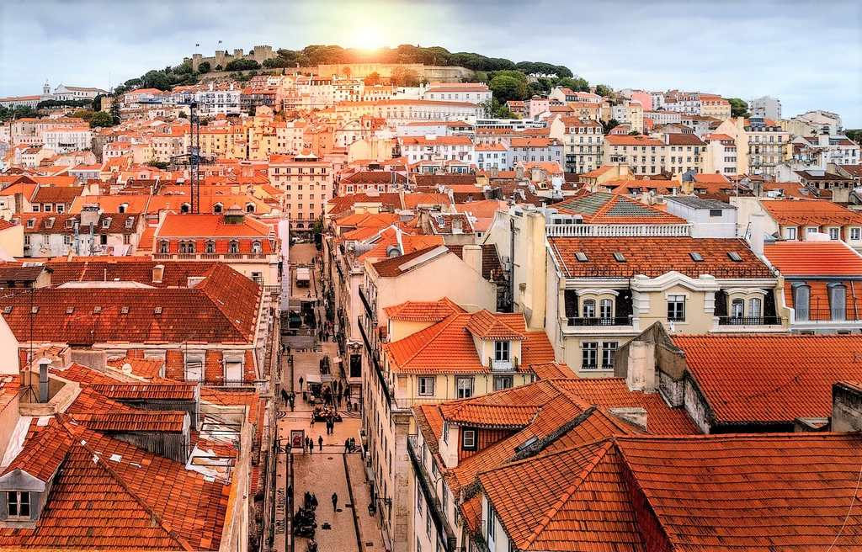
The Lisbon Accord
Lisbon Accord proposed that heavy ion analyses adopt RIVET in July 2014
Workshop position paper will second this recommendation
https://www.aworldtotravel.com/things-lisbon-is-famous-for/

Slide 33
Problems with RIVET
RIVET 2.7
Not all heavy ion functionality exists
Very few heavy ion analyses exist
Only takes in HEPMC 2.0 input
No way to deal with fluctuations
No option to fit functions
Cannot run in batch mode
Use undergraduates!
Write a converter

Slide 34
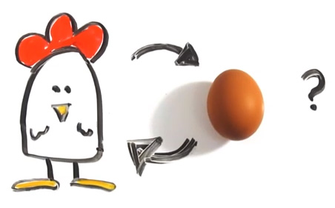
Few heavy ion analyses in RIVET
RIVET isn’t useful for heavy ion analyses
http://iterated-reality.com/en/2015/03/17/the-chicken-or-the-egg-causality-dilemma-solved-by-unity-consciousness/

Slide 35
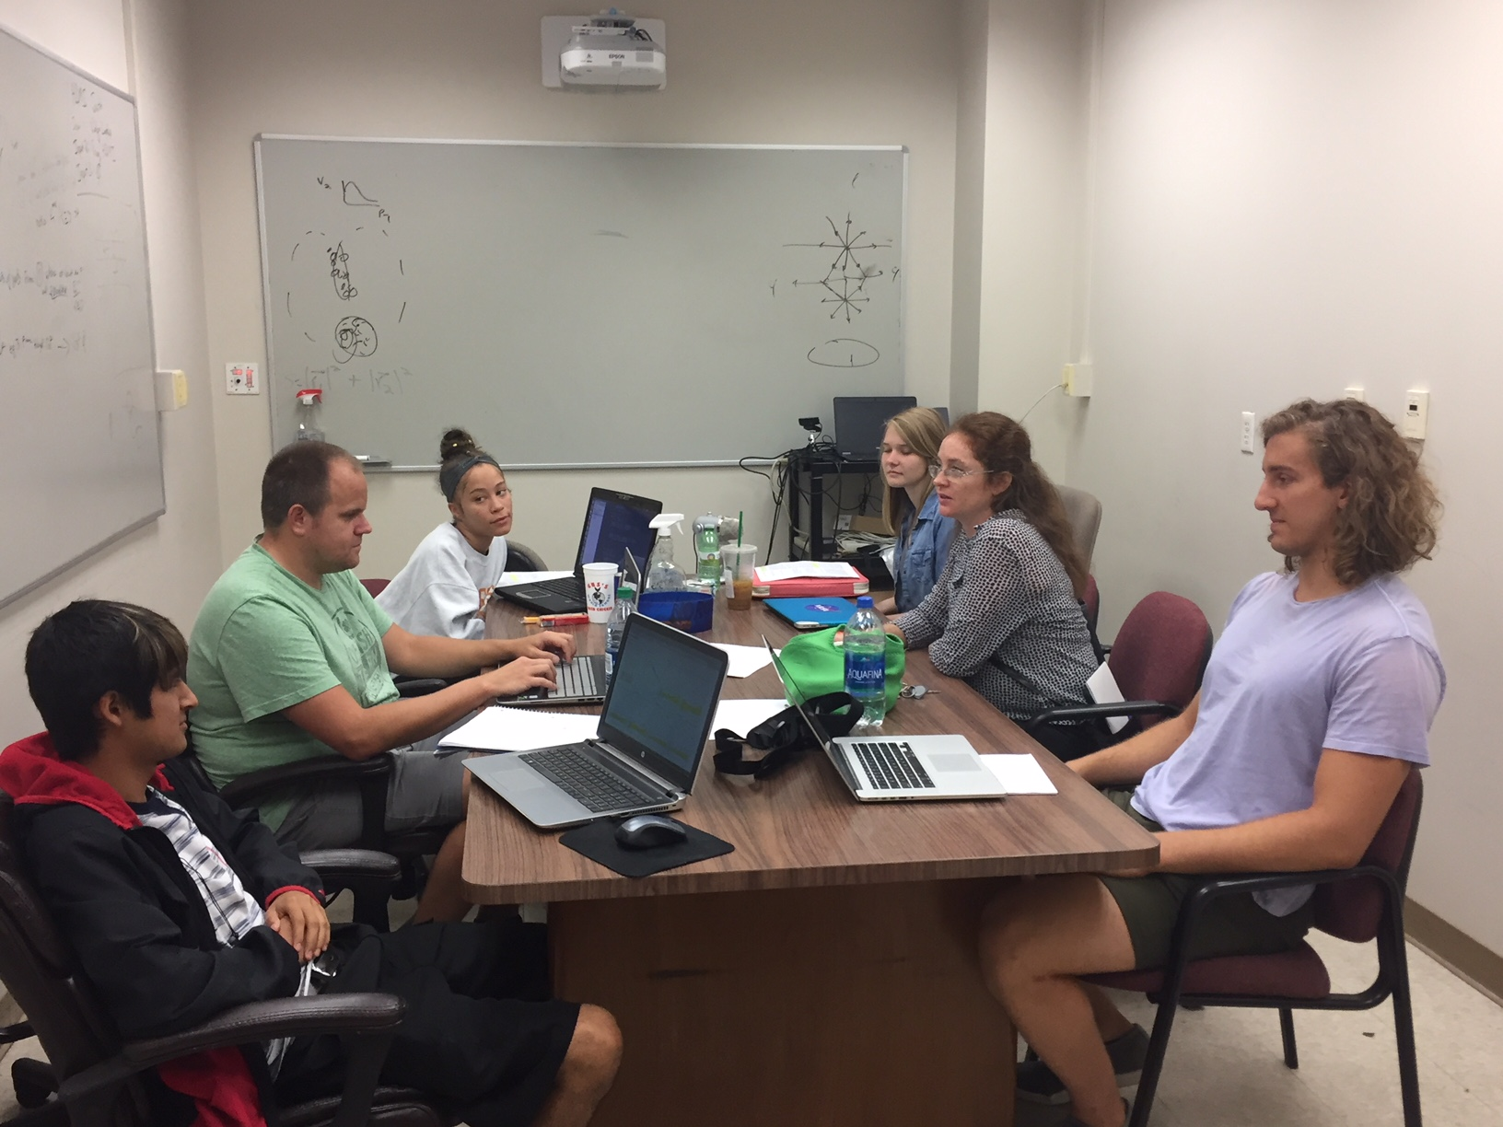
Undergraduates!*
JETSCAPE REU
Left to right: Ricardo Santos (Berea), James Neuhaus, Jerrica Wilson, Mariah McCreary, Christine Nattrass, Austin Schmier (UTK)
*And one beginning graduate student with no programming experience. We acknowledge substantial support from the US NSF and the JETSCAPE Collaboration

Slide 36
Course-based undergraduate research experience

Slide 37
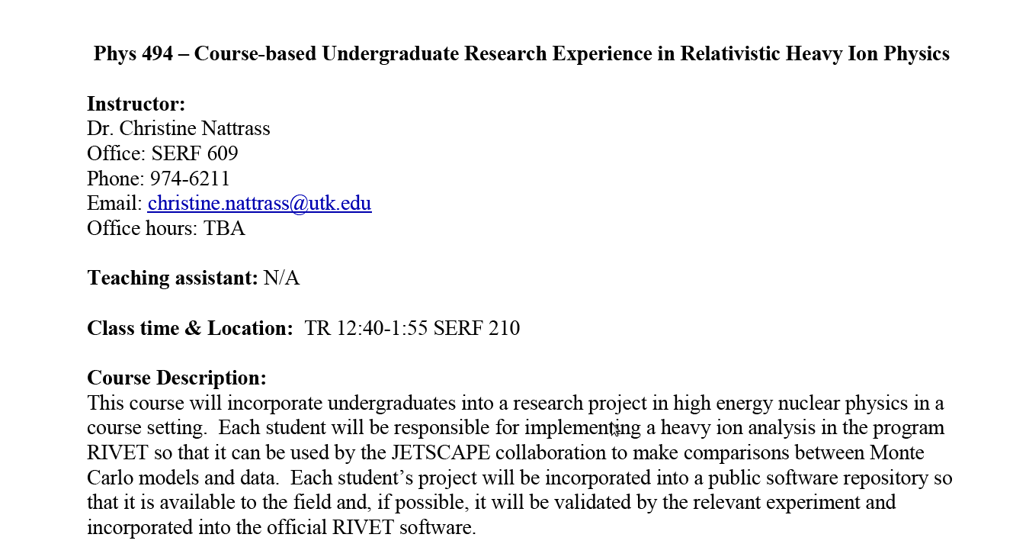

Slide 38
https://i.ytimg.com/vi/mZnv6LXD9qs/maxresdefault.jpg

Slide 39
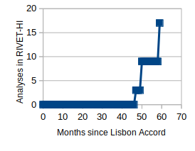
Analyses (almost) implemented in UTK copy of RIVET
Spring 2019 UTK research class, RHIC dihadron and gamma hadron analyses
2018 UTK summer students, reconstructed jet analyses
ALICE implementations
https://github.com/cnattras/rivet-hi
Need to be finalized! Hold me to it!

Slide 40
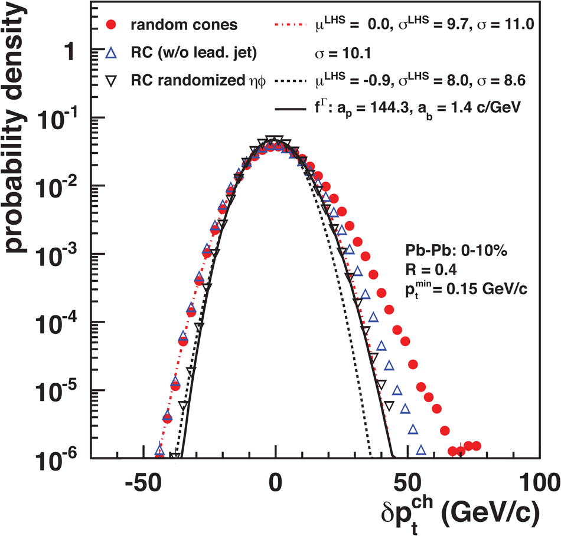
Problem: The background fluctuates
Background
Signal
JHEP 03 (2012) 053
...even in Monte Carlo!

Slide 41
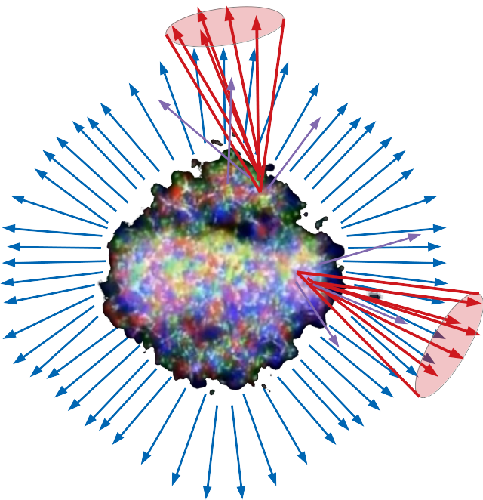
How to address fluctuations?
Tag final state hadrons as part of signal or background and only put these into jet finder
May work OK but conceptually suboptimal
Compare to data which have not been corrected for fluctuations in the background
Technically feasible but jet measurements would not be physically meaningful, would be sensitive to our understanding of soft physics
Unfold Monte Carlo results
Treating MC just like data
Unfolding is highly non-trivial

Slide 42
Conclusions
We need to be humble
Focus on reduced uncertainties
Publish correlations between uncertainties!
Treat MC like data
Implement analyses in RIVET!
Warning: fluctuations in full MC
Beware black boxes

Slide 44
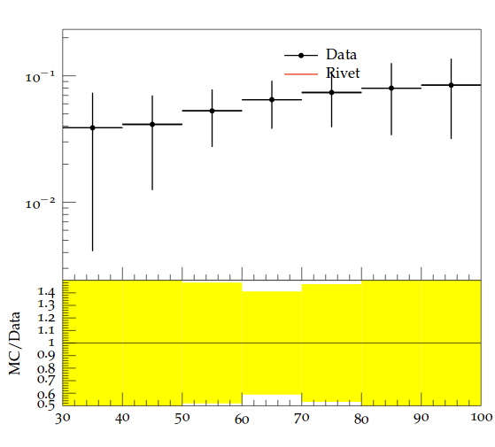
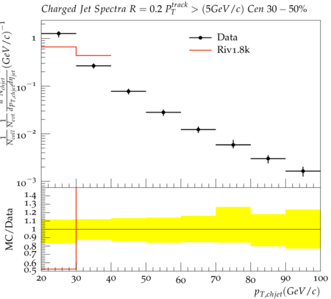
Progress
Charged jet v₂
Mariah McCreary
0-5% collision centrality
100 Pythia PbPb events
Ricardo Santos
1800 Pythia PbPb events
Phys.Lett. B753 (2016) 511-525
p_{T}^{Jet,ch}
JHEP 30 (2014) 013
WARNING: Very small sample size, highly biased results, need to coordinate with Przemyslaw, Jochen, & Jan Fiete to ensure code can eventually be committed. Fluctuations in combinatorial background not subtracted.
Undergraduates Mariah McCreary (UTK), James Neuhaus (UTK), Jerrica Wilson (UTK), Ricardo Santos (Berea); Graduate student Austin Schmier (UTK); Post doc Redmer Bertens (UTK)
Mariah and Ricardo implementing ALICE analyses, James and Redmer providing key support.
Funding from JETSCAPE, Berea, and the UTK physics department.

Slide 45
Summary of existing heavy ion analyses
STAR
6 analyses but none of them instantiated by STAR, some validated but none heavy ion
I am an “author” on one and I have no recollection of this whatsoever so I’m not sure how official they are
2 implemented in my class this semester, 2 in progress
PHENIX
4 implemented in my class this semester
ALICE
10 pp analyses
3 heavy ion analyses in RIVET-HI (multiplicity, charged spectra, dihadron correlations)
2 jet spectra analyses and one jet v2 analysis in UTK copy of RIVET-HI, still require management of fluctuations
ATLAS - 0
1 jet spectra analysis in UTK copy of RIVET-HI, one in jet spectra analysis and one jet v2 analysis in progress, still require management of fluctuations
CMS - 0
1 jet fragmentation function analysis in UTK copy of RIVET-HI, jet fragmentation function analysis and jet spectra analysis in progress, still require management of fluctuations
LHCb - 0

