Slide 1
Rivet
Christine Nattrass
University of Tennessee, Knoxville

Slide 2
What is Rivet?
Robust Independent Validation of Experiment and Theory

Slide 3
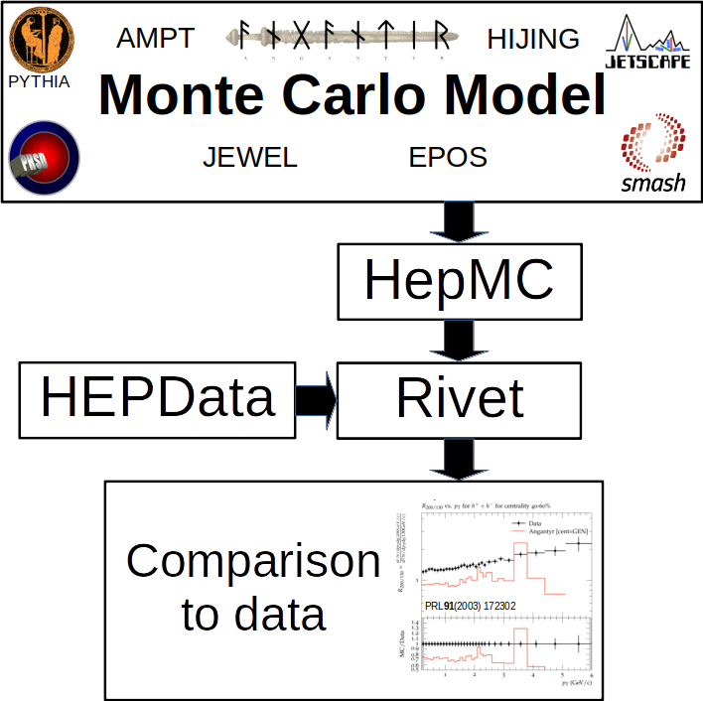

Slide 4
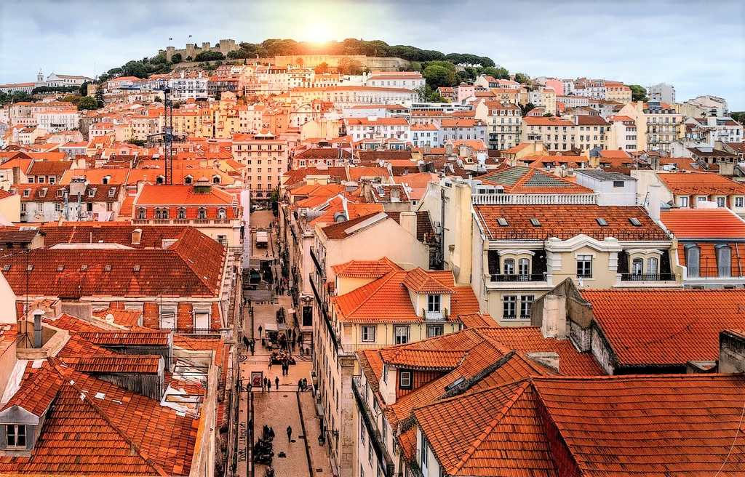
The Lisbon Accord
Lisbon Accord proposed that heavy ion experiments adopt Rivet in July 2014
Fully heavy ion capable with June 2019 release of Rivet 3.0
https://www.aworldtotravel.com/things-lisbon-is-famous-for/

Slide 5
Why use Rivet?
Facilitates comparisons between Monte Carlos and data
It’s not that hard
It preserves analysis details
You can treat Monte Carlo like data

Slide 6
Steps
Format data for HEPData or fix issues with Rivet compatibility of HEPData Short tutorial Long tutorial
Install Rivet or load it on an existing farm
Follow a Rivet tutorial
Slides and recordings from Rivetizing Heavy Ion Collisions at RHIC

Slide 7
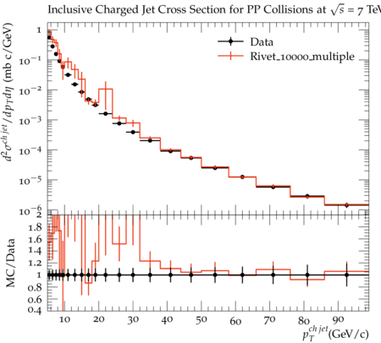
Jet spectra in 7 TeV pp collisions
Charged jets in ALICE
Phys. Rev. D 99, 012016 (2018).
Justin Piel – Undergraduate at Stetson
First learned about jets this summer
Learned how to run JETSCAPE at this school
Implemented analysis
Other undergrads working with me on Rivet this summer: Ralph Davenport, Kip Hunt, Jason Spriggs, Taylor Sussmane, Adam Tilley

Slide 8
What does it take to get everyone doing this?
Experiments need to have a validation procedure
Manage issues with heavy ion Monte Carlo models
Define “primary particles” in Rivet
Deal with background in models
Get a critical mass of heavy ion analyses

Slide 9
Status of heavy ion Monte Carlos

Slide 10
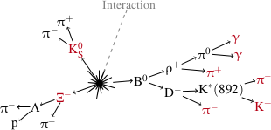
Compatibility with HEPMC/Rivet
HIJING - unknown
HIJING++ - Compatible, code should be public soon.
EPOS – Mostly compatible. Treatment of decays may need improvement.
PHSD – Mostly compatible. Treatment of decays may need improvement.
SMASH – Mostly compatible. Treatment of decays may need improvement.
JETSCAPE – Treatment of decays needs improvement. Only contains final state particles.
AMPT - Converter to HEPMC available internally in ALICE. Working on making this publicly available
In JETSCAPE HEPMC
Status of beams: may need to run with options to ignore beams
Draft from HEPMC in Heavy Ion Collisions workshop

Slide 11
Primary Particles

Slide 12
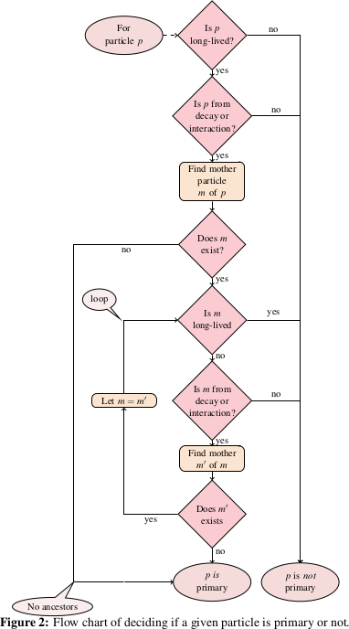
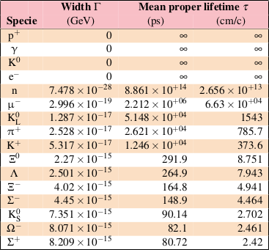
Primary Particles
Experimental definition: Looks like it comes from the interaction vertex, cτ> 1 cm Slight variations by experiment
Definition for each experiment
Needs particle decays in MC
Theoretical definition in Rivet projection - ALICE public note Christian Holmes Christiansen (cholm@nbi.dk)
Needs experiment approval

Slide 13
Background for jet analyses

Slide 14
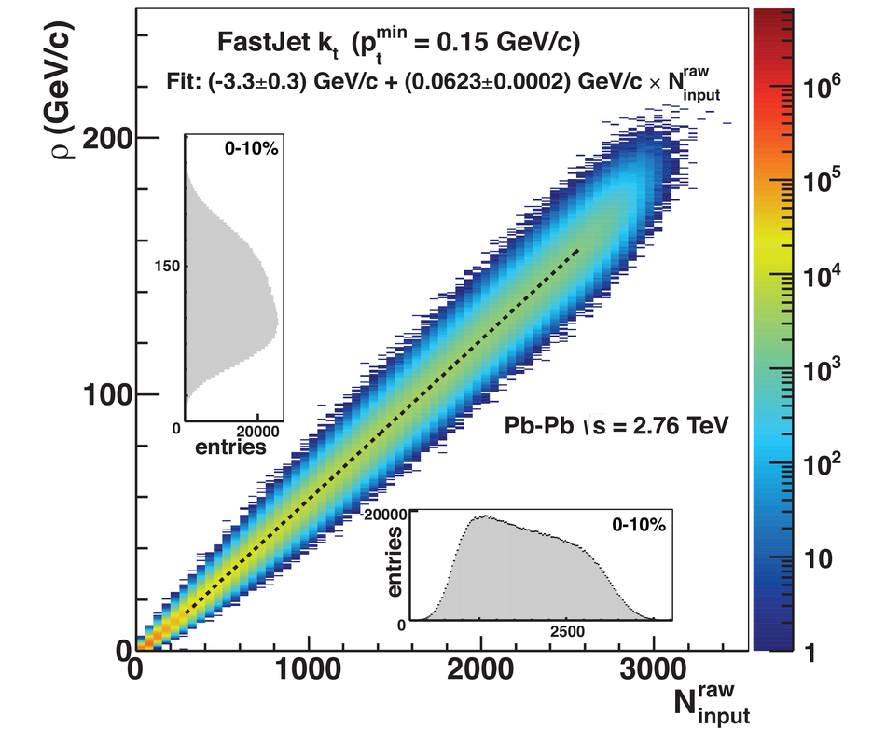
Background density ρ
`
ALICE
arXiv:2005.02320

Slide 15
Snowmass Accord: Apply the same algorithm to data and your model. Then the measurement and the calculation are comparable.

Slide 16
Rivet: Apply the same algorithm to data and your model. Then the measurement and the calculation are comparable.

Slide 17
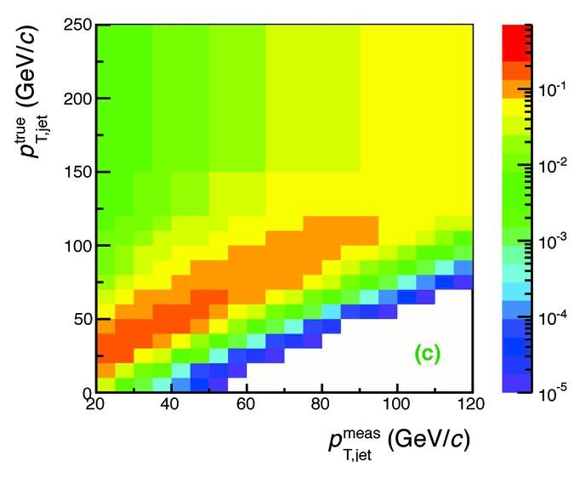
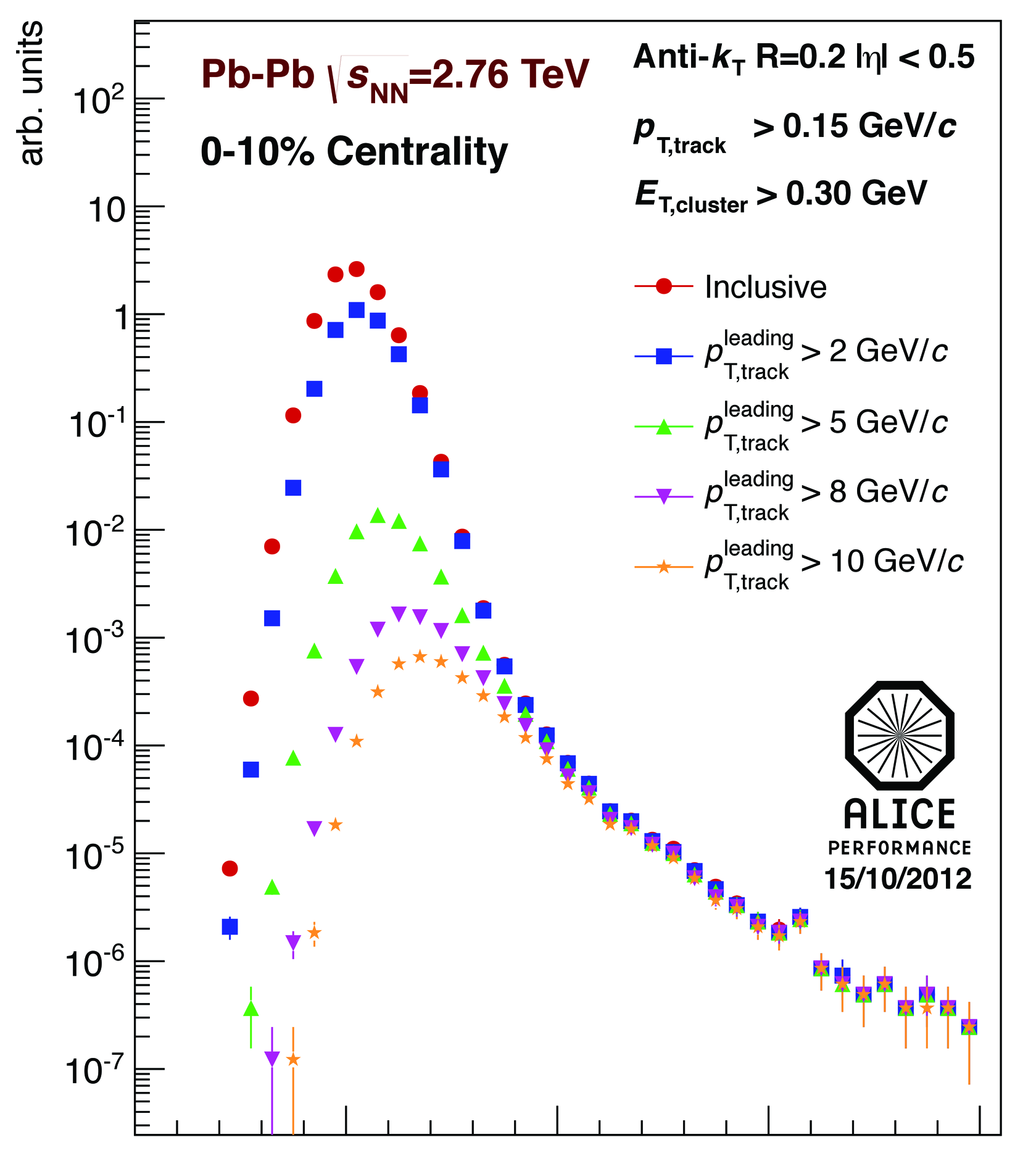
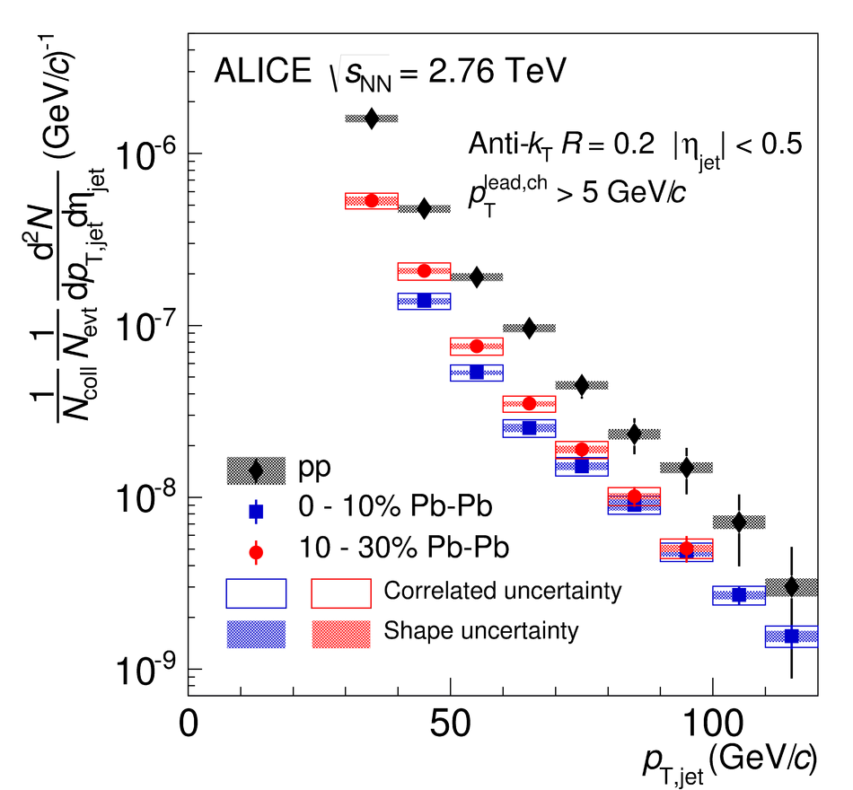
Analysis steps
Tracks
Jet finding algorithm
Jet candidates
Background subtraction
Clusters
Jet spectrum smeared by energy resolution, background fluctuations
Unfolding – corrects for single track reco ε, E resolution, background fluctuations
Corrected spectra

Slide 18
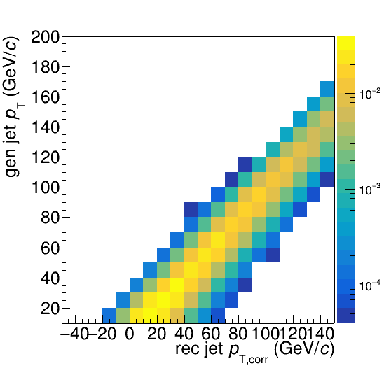
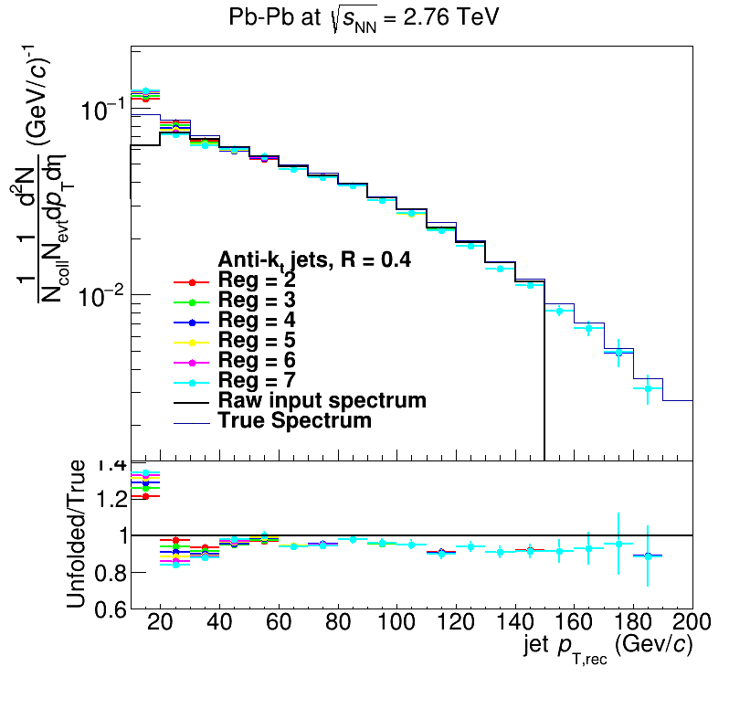
Analysis steps: Full Monte Carlo
Jet finding algorithm
Jet candidates
Background subtraction
Particles
Unfolding – corrects for background fluctuations and other effects
Jet spectrum smeared by energy resolution
Corrected spectra

Slide 19
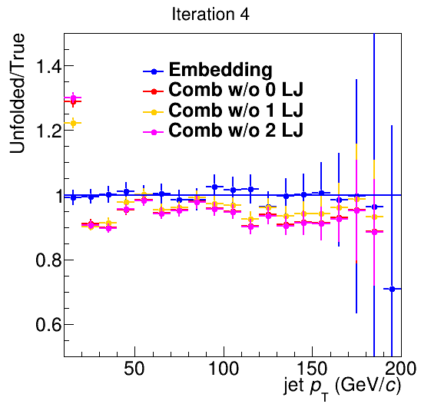
Closure
Methods
Use δp_{T} method to measure width of fluctuations with varying numbers of leading jets (LJ) discarded
Embed PYTHIA event into heavy ion event
Only embedding leads to full closure

Slide 20
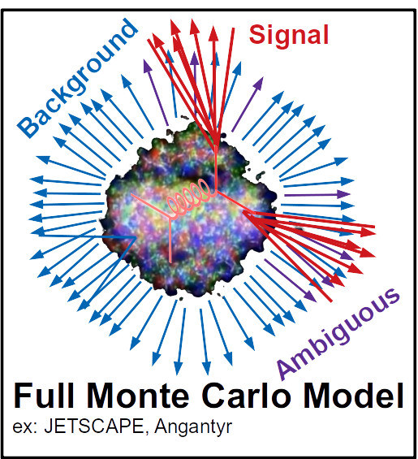
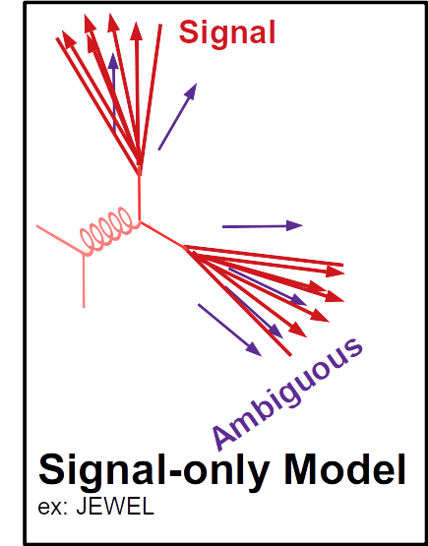
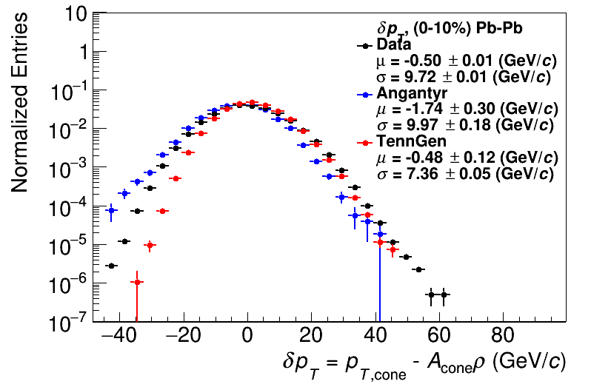
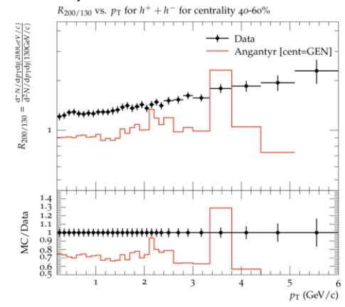
Comparison to data
HepMC
Rivet
Unfold to correct for fluctuations
HEPData
HepMC
Rivet
arXiv:2005.02320 [hep-ph]
Comparison to data
See poster by Nattrass et al
PRL91(2003) 172302
Unfold to correct for fluctuations
Comparison to data
PRL91(2003) 172302

Slide 21
How do you get a lot of Rivet analyses done?

Slide 22
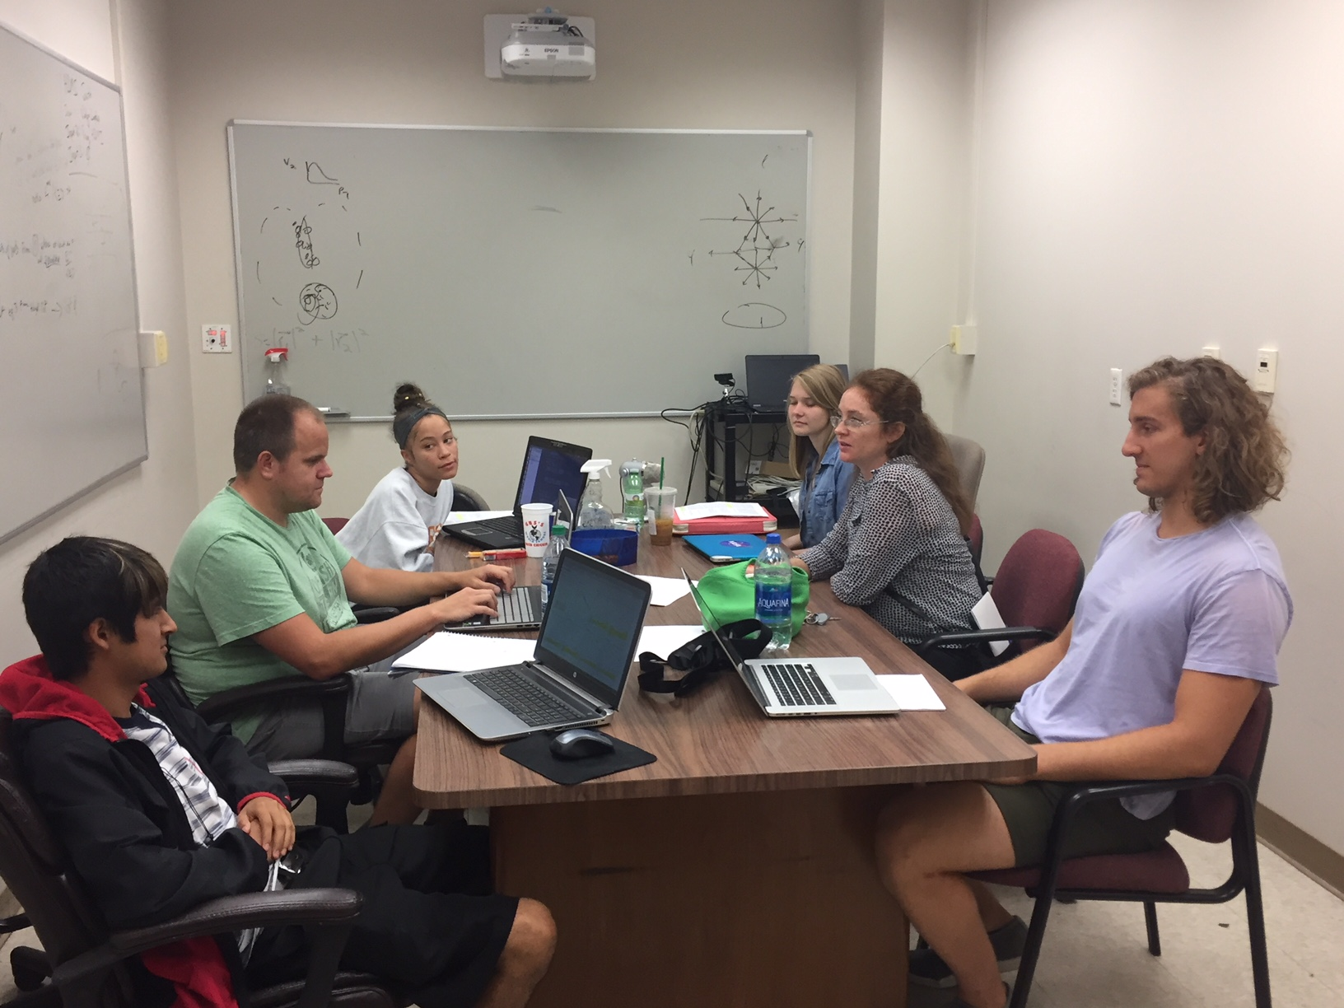
Undergraduates!*
Left to right: Ricardo Santos (Berea), James Neuhaus, Jerrica Wilson, Mariah McCreary, Christine Nattrass, Austin Schmier (UTK)
*And one beginning graduate student with no programming experience

Slide 23
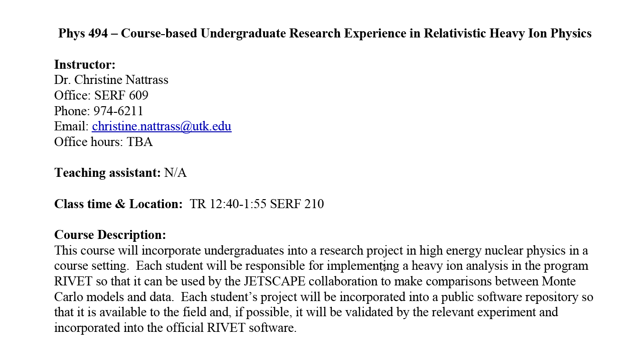
Course-based undergraduate research experience Ask me if you want more info!
4 semesters
17 students
8 women
4 minorities
3 non-traditional
All Rivet students
28 students
12 women
9 minorities
5 non-traditional

Slide 24
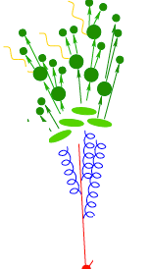
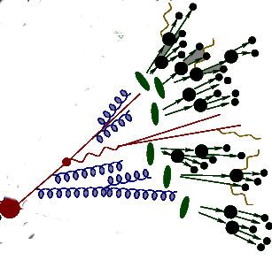
Since Summer 2019:
- 32% of UTK ugrad
- 42% of female UTK ugrads
- 50% of non-white UTK ugrads
worked on Rivet
https://i.ytimg.com/vi/mZnv6LXD9qs/maxresdefault.jpg

Slide 25
Resources
Output - github
Unvalidated, work in progress
About 45 analyses, mostly R_{AA} & dihadron correlations
May have issues with some models (see #5)
May need primary particle, centrality definition approval (see #3)
Course-based undergraduate research experience
Designed for ~135 hours of effort by undergraduate students with one intro computing class and no previous Linux experience
Flipped pedagogy → extensive out-of-class activities, interactive class sessions
Possible alternative for diploma students?
Syllabus
Schedule with links to resources
Tutorial slides Part 1 UTK-specific Part 2 Universal
Workshop
Slides
Recordings
Contact me!

Slide 26
Conclusions
Rivet
Is easy straightforward
Allows comparisons to multiple models
Lots of resources available!

Slide 27
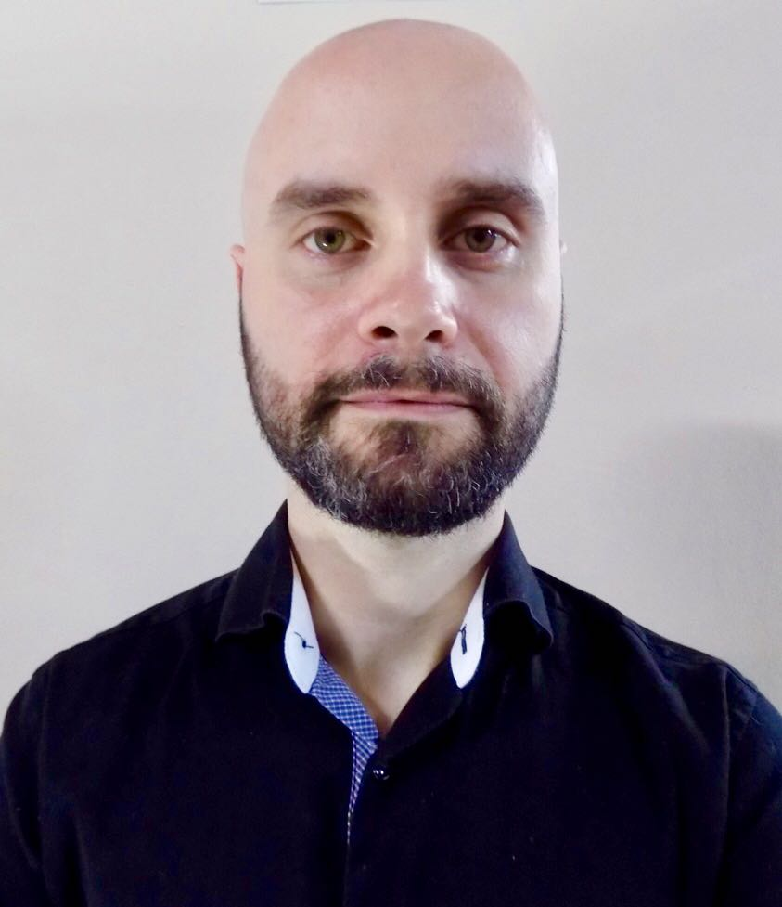
Acknowledgements
Antonio Da Silva
Christal Martin
Undergrads working with me on Rivet this summer: Ralph Davenport, Kip Hunt, Justin Piel, Jason Spriggs, Taylor Sussmane, Adam Tilley

Slide 28
Acknowledgements
Antonio Da Silva
Christal Martin
Undergrads working with me on Rivet this summer: Ralph Davenport, Kip Hunt, Justin Piel, Jason Spriggs, Taylor Sussmane, Adam Tilley

