Slide 1
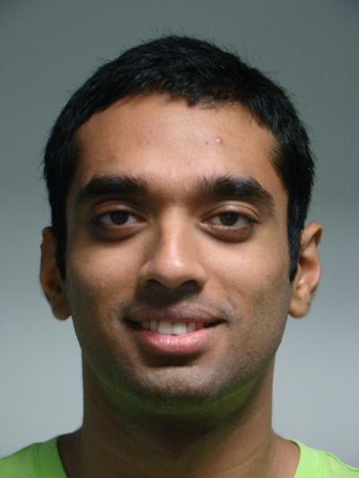
Implementation RHIC analyses in Rivet
Antonio Da Silva
University of Tennessee, Knoxville
Raghav Kunnawalkam Elayavalli
Yale University
Christine Nattrass
University of Tennessee, Knoxville

Slide 2
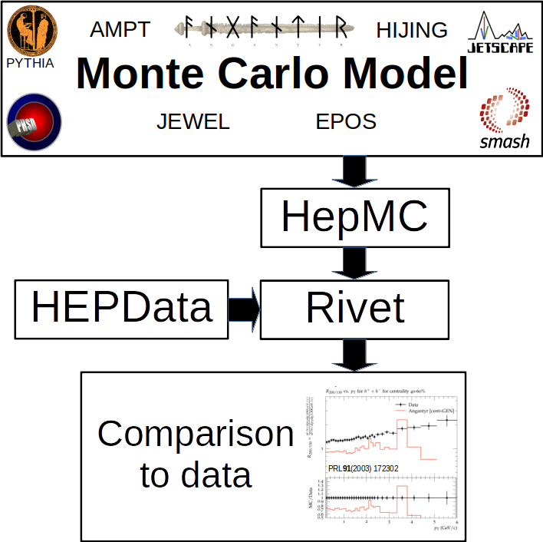
Challenges
5. Not all generators 100% Rivet-compatible
1. Data not in HEPData
2. Need to write code
3. Need “primary particle” definition
Labor
4. Need validation
Technical
Political

Slide 3
Technical – Mostly non-issues
Measurement reported vs N_{part} or N_{coll}
Use centrality on the x-axis instead
Multiple options for centrality determination
Can “undo” Glauber model scaling of R_{AA} as well
Rivet (mostly) requires bins on x-axis
Have to be reconstructed
Can be done when formatting HEPData

Slide 4
1. Labor – HEPData – Status
Required for new publications since early 2020
190/284 (67%) papers*
Option for shifts in 2020
Required for new publications since August 2020
47/223 (21%) papers*
RHIC
248/781
32%
2/152 (1%) papers*
No process for uploads
Spokesperson: Wit Busza
9/122 (7%) papers*
In progress
*As of April 4, 2021. Denominator from InspireHep.net requiring published papers

Slide 5
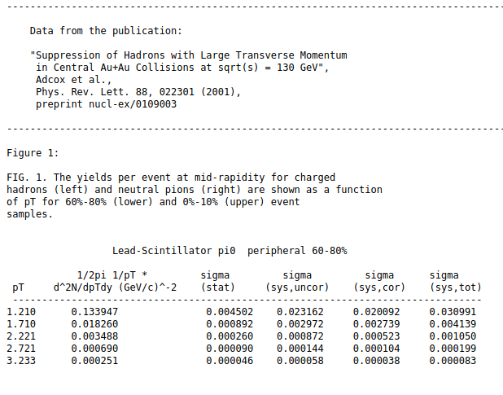
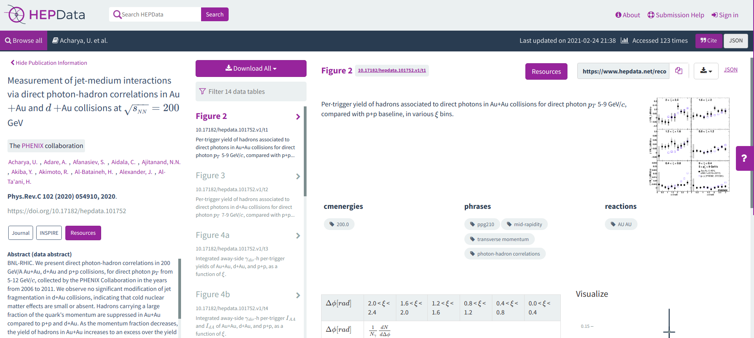
1. Labor – HEPData – Semi-automated
Text files from collaboration websites
YAML_Maker
HEPData
Moderate manipulation
Moderate formatting
Inconsistent format
Sometimes messy, unclear
Requires human input
Easy to install & used
On github
13 minute Tutorial
Or try https://gitlab.com/cholmcc/hepdata
Needs header file, proof-reading
Some additional requirements for experimental approval, rivet compatibility
2-20 hours/paper

Slide 6
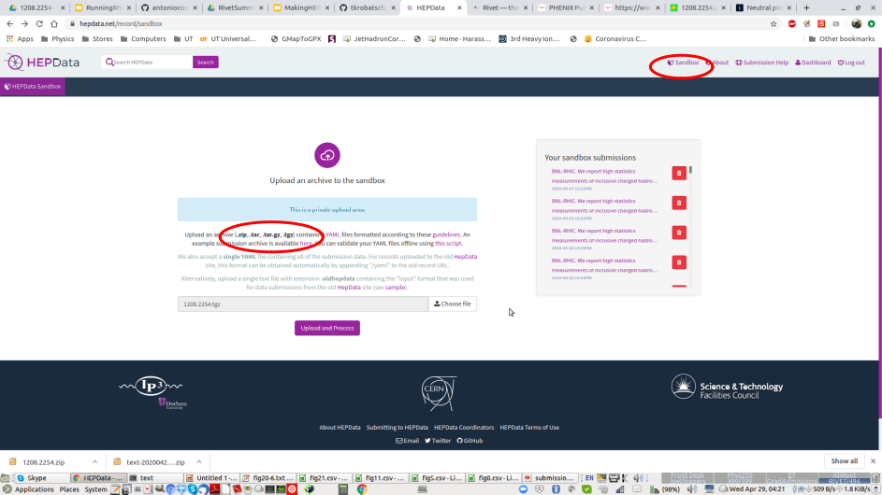
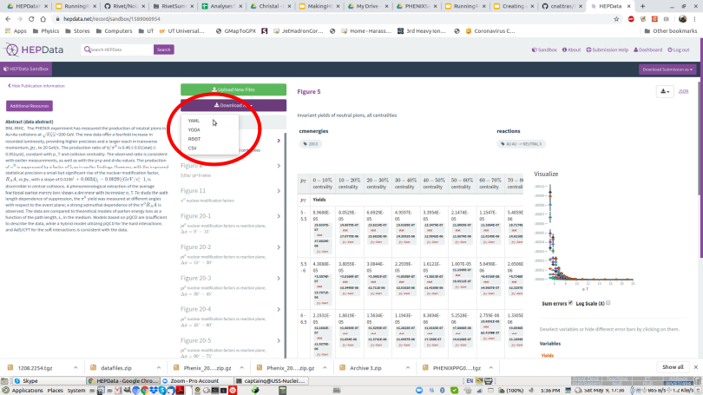
1. Labor – HEPData – What you can do
If you need data from a paper for Rivet
Format for HEPData
Use the HEPData sandbox to get Yoda file
Contact experiment to get it submitted to HEPData STAR: Frank Geurts (geurts@rice.edu) PHENIX: Maxim Potekhin (potekhin@bnl.gov) BRAHMS: Christian Holmes Christiansen (cholm@nbi.dk)
Feel free to contact me for help! Christine.nattrass@utk.edu
HEPData sandbox
Download as Yoda File

Slide 7
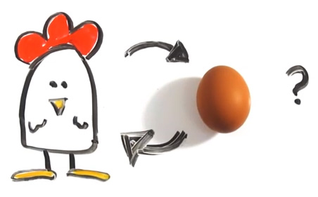
2. Labor – The dilemma
Few heavy ion analyses in Rivet
Theorists don’t use Rivet
http://iterated-reality.com/en/2015/03/17/the-chicken-or-the-egg-causality-dilemma-solved-by-unity-consciousness/

Slide 8
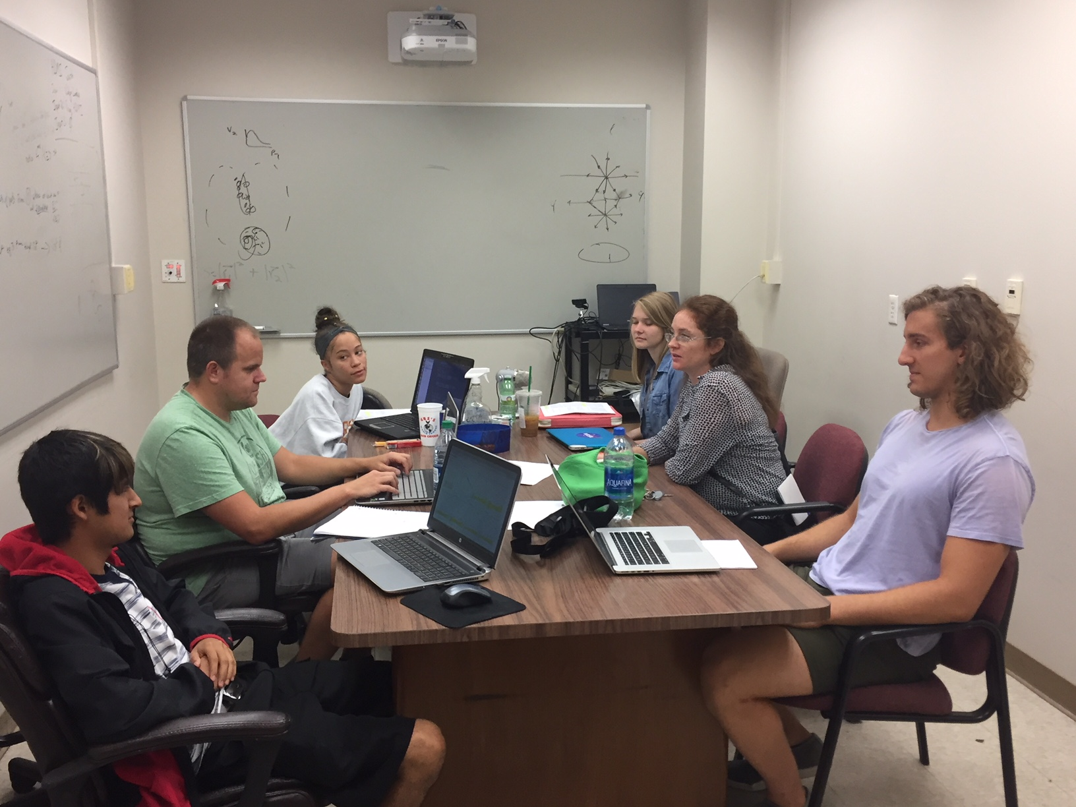
2. Labor – The solutions
Undergraduates!*
Left to right: Ricardo Santos (Berea), James Neuhaus, Jerrica Wilson, Mariah McCreary, Christine Nattrass, Austin Schmier (UTK)
*And one beginning graduate student with no programming experience

Slide 9
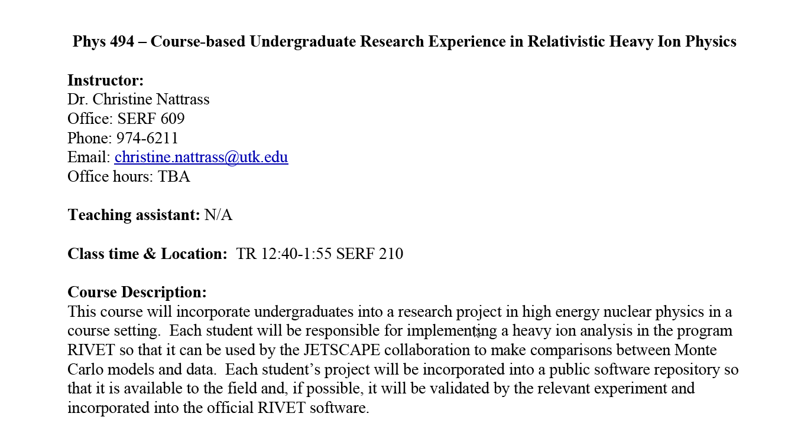
2. Labor – The solutions
Course-based undergraduate research experience Ask me if you want more info!
4 semesters
17 students
8 women
4 minorities
3 non-traditional
All Rivet students
26 students
12 women
8 minorities
4 non-traditional

Slide 10
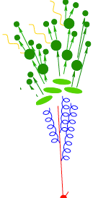
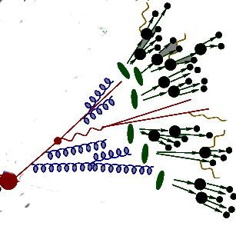
2. Labor – The solutions
https://i.ytimg.com/vi/mZnv6LXD9qs/maxresdefault.jpg

Slide 11
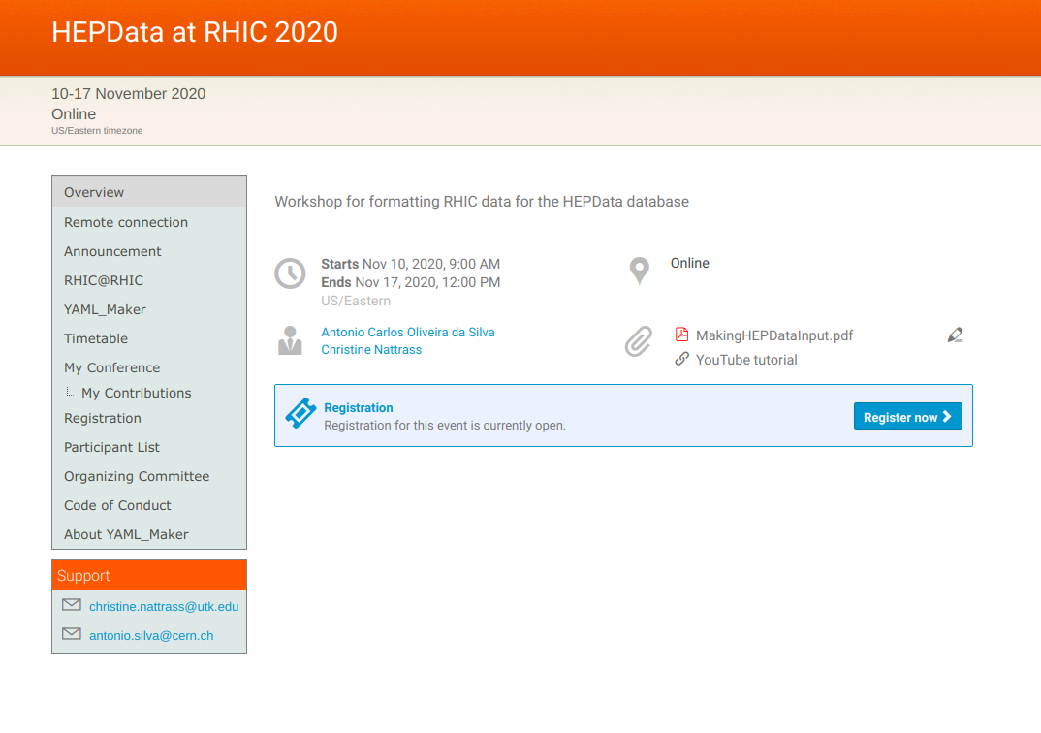
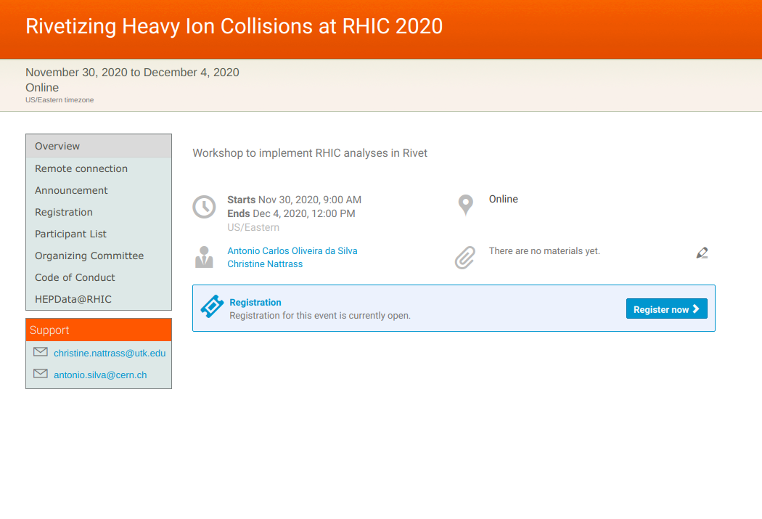
2. Labor – The solutions
Targeted workshops
https://indico.bnl.gov/event/8843/
https://indico.bnl.gov/event/8840

Slide 12
2. Labor – Rivet – Efforts in STAR
Developing PYTHIA 8 tune for pp with Rivet, Professor
About 6 analyses to be released soon
pp collisions only
Heavy ion analyses in development, need validation (see #4)
https://professor.hepforge.org/

Slide 13
2. Labor – Resources
Output - github
Unvalidated, work in progress
About 45 analyses, mostly R_{AA} & dihadron correlations
May have issues with some models (see #5)
May need primary particle, centrality definition approval (see #3)
Course-based undergraduate research experience
Designed for ~135 hours of effort by undergraduate students with one intro computing class and no previous Linux experience
Flipped pedagogy → extensive out-of-class activities, interactive class sessions
Possible alternative for diploma students?
Syllabus
Schedule with links to resources
Tutorial slides Part 1 UTK-specific Part 2 Universal
Workshop
Slides
Recordings
Contact me!

Slide 14
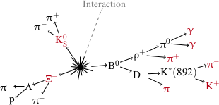
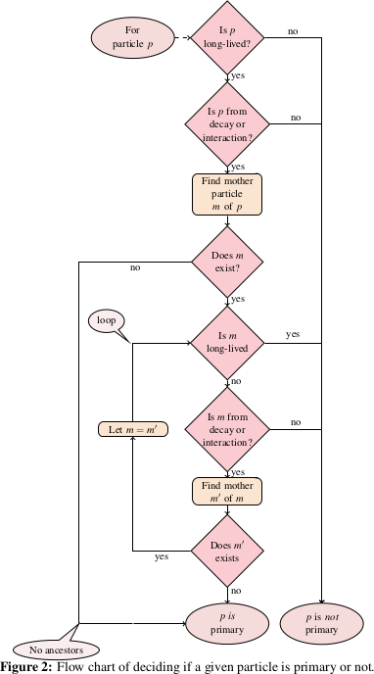
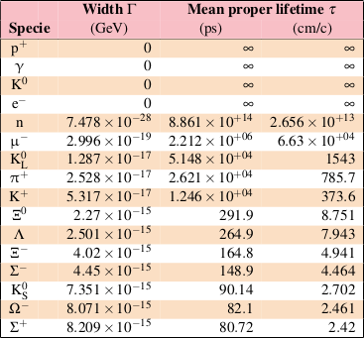
3. Technical/Political – Primary Particles
Experimental definition: Looks like it comes from the interaction vertex, cτ> 1 cm Slight variations by experiment
Technical: Definition for each experiment
Technical: Needs particle decays in MC
Theoretical definition in Rivet projection - ALICE public note Christian Holmes Christiansen (cholm@nbi.dk)
Political: Needs experiment approval

Slide 15
4. Political – Analysis validation
ALICE procedure:
Compare to sufficiently large MC sample
New analysis – w/ paper approval
Already published analysis – reproduce MC comparisons from published paper. Analogous to paper approval
How large is large enough?
What if there aren’t any? Or it’s hard to reproduce?
What about analyses produced outside the collaboration?
What about ambiguities in the analysis?

Slide 16
5. Technical – Rivet compatibility of MC
Does selection of beam particles work? Some methods depend on beam particle being in the HEPMC output.
No spin-aware MC
Are particles decayed?
Are unstable particles kept in the output? Is their parentage recorded? Are daughters kept too?
Do projections (e.g. PromptParticles) work with MC output? Some depend on record of parentage.

Slide 17
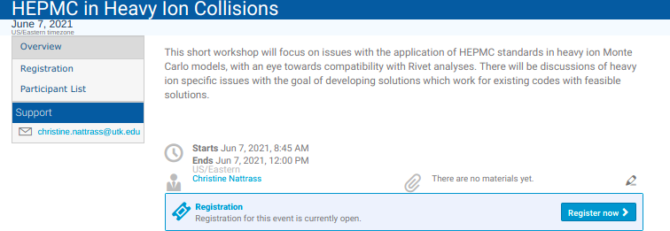
5. Technical – Rivet compatibility of MC
3 hour workshop to discuss HEPMC output of heavy ion models

Slide 18
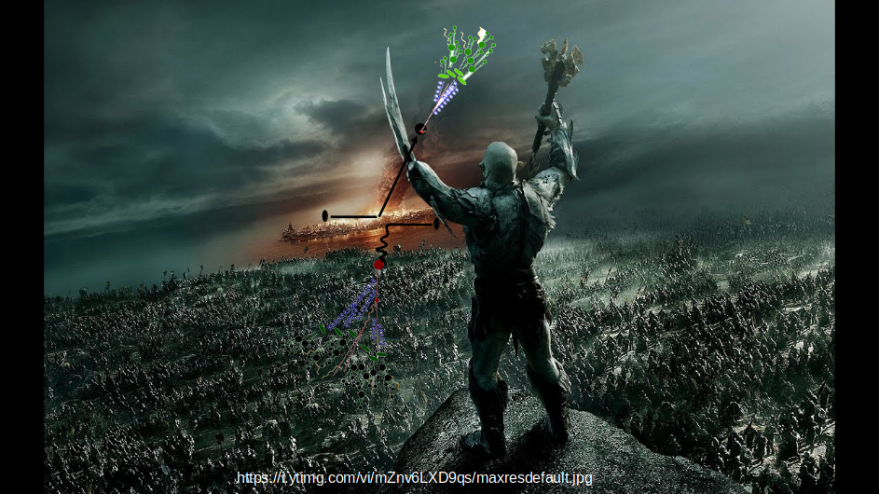
Summary
3. Primary particle definition
1. Data getting into HEPData
2. Build your own undergraduate army
4. Validation Procedure
5. HEPMC output may have some issues
https://indico.bnl.gov/event/10966/

