Slide 1
Jets – principle vs practice

Slide 2
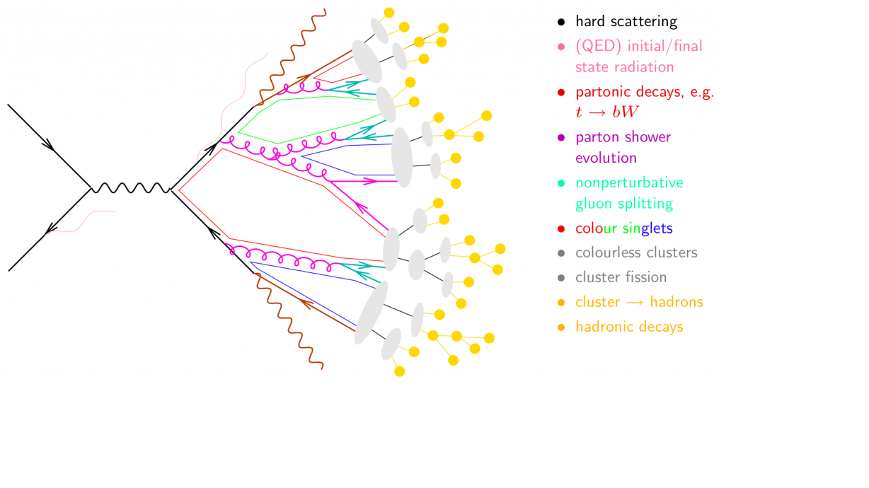
Jet formation in a vacuum
Hard scattering
Parton shower
Hadronization
Image from http://www.gk-eichtheorien.physik.uni-mainz.de/Dateien/Zeppenfeld-3.pdf

Slide 3
Jet formation in a vacuum
Jet 1
Hard scattering
Jet 2
Parton shower
Hadronization
Image from http://www.gk-eichtheorien.physik.uni-mainz.de/Dateien/Zeppenfeld-3.pdf

Slide 4
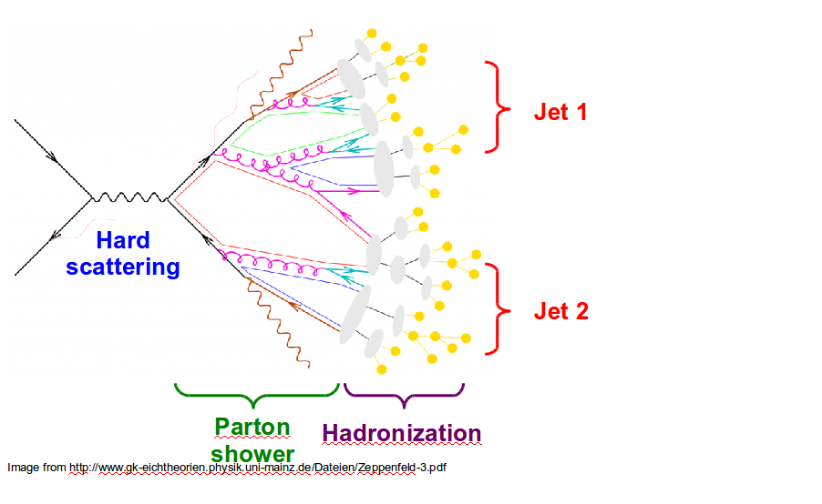
Jets in principle
Jet measures partons
Hadronic degrees of freedom are integrated out
Algorithms are infrared and colinear safe

Slide 5
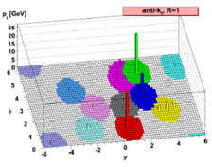
Jet finding algorithms
Tracks
Jet finding algorithm
Jet candidates
Clusters
Particles
Any list of objects works as input
Output only as good as input
M. Cacciari, G. P. Salam, G.Soyez, JHEP 0804:063,2008

Slide 6
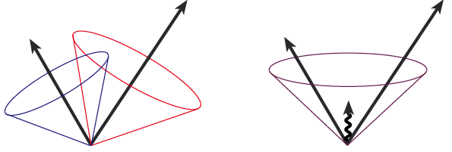
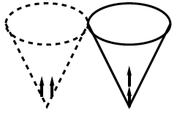
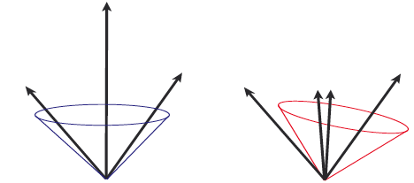
Jet finding algorithms
Required THEORETICAL features in a jet finding algorithm:
  Collinear safety: the algorithm should be insensitive to any collinear radiation.
      Example A: if the energy is split among soft particles, and each tower is under a threshold, the jet is lost
  Infrared safety: the algorithm should not be sensitive to soft radiation
OK
BAD: 2 jets are merged in one
      Example B: if the energy of a parton is split in two towers, and the algorithm starts with the particles with highest E, a different jet may be found
Recommended resource on jet finding algorithms: Eur.Phys.J.C67:637-686,2010
Experimental measurement and theoretical calculation should use same algorithm

Slide 7
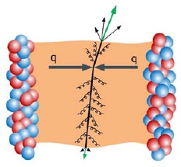
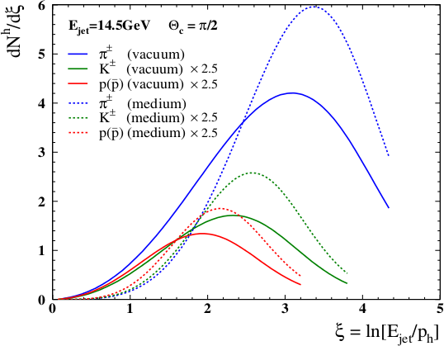
Jet modifications
Jet quenching mechanisms
  Gluon Bremsstrahlung
  Collisional energy loss
Broadens jets
Softens fragmentation function
Modified hadronization in-medium?
  Quenching and modified hadronization might look the same experimentally
Eur.Phys.J.C55:293-302,2008

Slide 8
Hadronization is important.

Slide 9
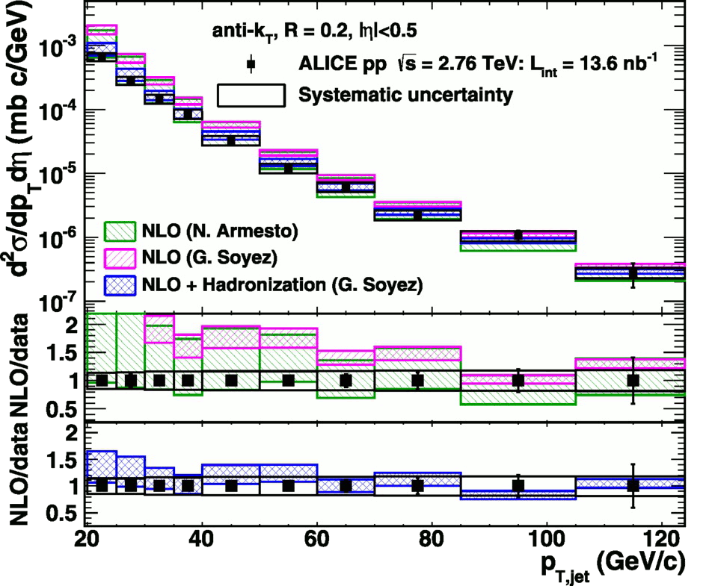
<footer>
Full jet cross-section in pp
√s = 2.76 TeV, R = 0.2 Inclusive
arXiv:1301.3475
PLB: 10.1016/j.physletb.2013.04.026
f_{hadcor} = 100%,
p_{T} > 150 MeV/c
E_{T} > 300 MeV
Green and magenta bands: NLO on Parton level
Blue band: NLO + hadronization
Hadronization calculations necessary to describe data
Notes:
----- Meeting Notes (6/24/13 16:47) -----
PRB -> PLB
Mention lack of bias
Make Large figure
<number>

Slide 10
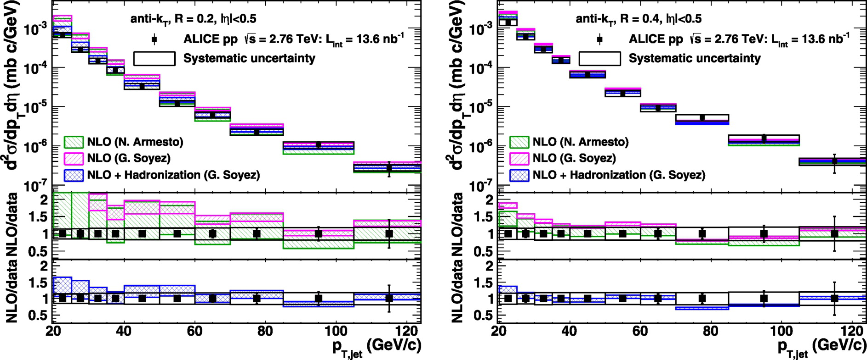
<footer>
Full jet cross-section in pp
√s = 2.76 TeV, R = 0.2, 0.4 Inclusive
arXiv:1301.3475
PLB: 10.1016/j.physletb.2013.04.026
Data and NLO+ hadronization calculations agree well
for both R = 0.2 and 0.4
Notes:
----- Meeting Notes (6/24/13 16:47) -----
PRB -> PLB
mention ratio
<number>

Slide 11
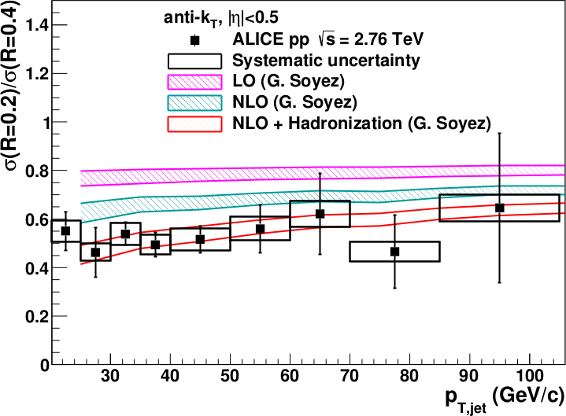
<footer>
Full jet ratios in pp
√s = 2.76 TeV, R = 0.2, 0.4 Inclusive
arXiv:1301.3475
PLB: 10.1016/j.physletb.2013.04.026
Data and NLO+ hadronization calculations agree well
Notes:
----- Meeting Notes (6/24/13 16:47) -----
PRB -> PLB
mention ratio
<number>

Slide 12
Experiments can't measure all particles

Slide 13
How is energy distributed among final state particles?
p
_{L}
π⁰
K⁰
‾p
K⁺
_{S}
π⁺
K⁰
K⁻
π⁻
n
Λ
‾n
‾Λ
Size of circles proportional to the fraction of energy in that particle
Scale: diameter in inches = √fraction * 5

Slide 14
How does it hit a detector?
γ
γ
π⁺
π⁻
γ
_{S}
γ
K⁰
π⁰
π⁰
γ
γ
γ
‾Λ
K⁺
π⁰
γ
Λ
γ
γ
24% as a γ
K⁻
p
‾p
n
‾Λ
Λ
n
_{L}
58% in primary hadrons
K⁰
n
‾n
π⁻
π⁺
p
π⁻
‾p
π⁺
_{S}
Λ
‾Λ
K⁰
11% as a neutral hadron
7% in secondary hadrons
Scale: diameter in inches = √fraction * 5

Slide 15
What can ALICE see?
γ
γ
π⁺
π⁻
γ
_{S}
γ
K⁰
π⁰
π⁰
γ
γ
γ
‾Λ
K⁺
π⁰
γ
Λ
γ
γ
24% as a γ
K⁻
p
‾p
n
‾Λ
Λ
n
_{L}
58% in primary hadrons
<90% efficiency
K⁰
n
‾n
11% as a neutral hadron
π⁺
π⁻
p
π⁻
‾p
π⁺
_{S}
Λ
‾Λ
K⁰
7% in secondary hadrons
Low efficiency
Scale: diameter in inches = √fraction * 5

Slide 16
Hadronic calorimeters (ATLAS, CMS)
What a calorimeter measures:
Nucleons
Anti-nucleons
Everything else
Theoretical jet
Corrections are determined by Monte Carlo
Some corrections are MC dependent
Hadronic calorimeter deposits impacted by magnetic field
3.8T magnetic field in CMS, 2T in ATLAS and limits what particles can even reach these detectors
  0.1-0.2 GeV for ATLAS
Particles in magnetic field

Slide 17
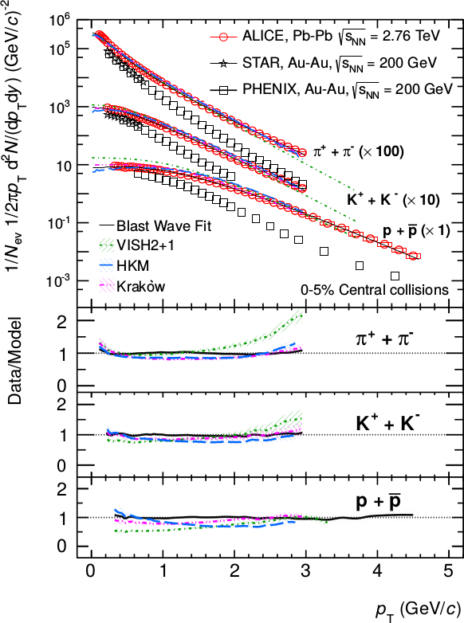
Lower momentum thresholds
Example: CMS
Tracks: p_{T}>900 MeV/c
Clusters: limited by B, usually E>500 MeV
→ ~62% of inclusive E_{T} measured
Example: ALICE
Tracks: p_{T}>150 MeV/c
EMCal Clusters: E>300 MeV
→ ~50% of inclusive E_{T} measured
Fraction of energy measured in jets is higher, but...
Phys. Rev. Lett. 109, 252301 (2012)
<p_{T}> ~ 700 MeV/c
Phys. Lett. B 727 (2013) 371-380

Slide 18
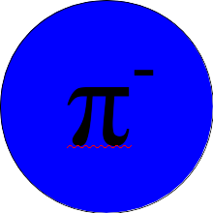
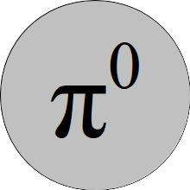
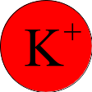


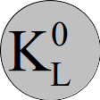


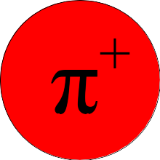
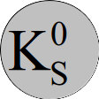



Theoretical jet
Schematic only
Diameter of circle proportional to energy carried by particle

Slide 19
What ALICE sees
Lost due to momentum/energy cuts
Lost due to tracking inefficiency
Detector is blind to these particles
Schematic only
Diameter of circle proportional to energy carried by particle

Slide 20
What ALTAS/CMS sees
Lost due to momentum/energy cuts

Slide 21
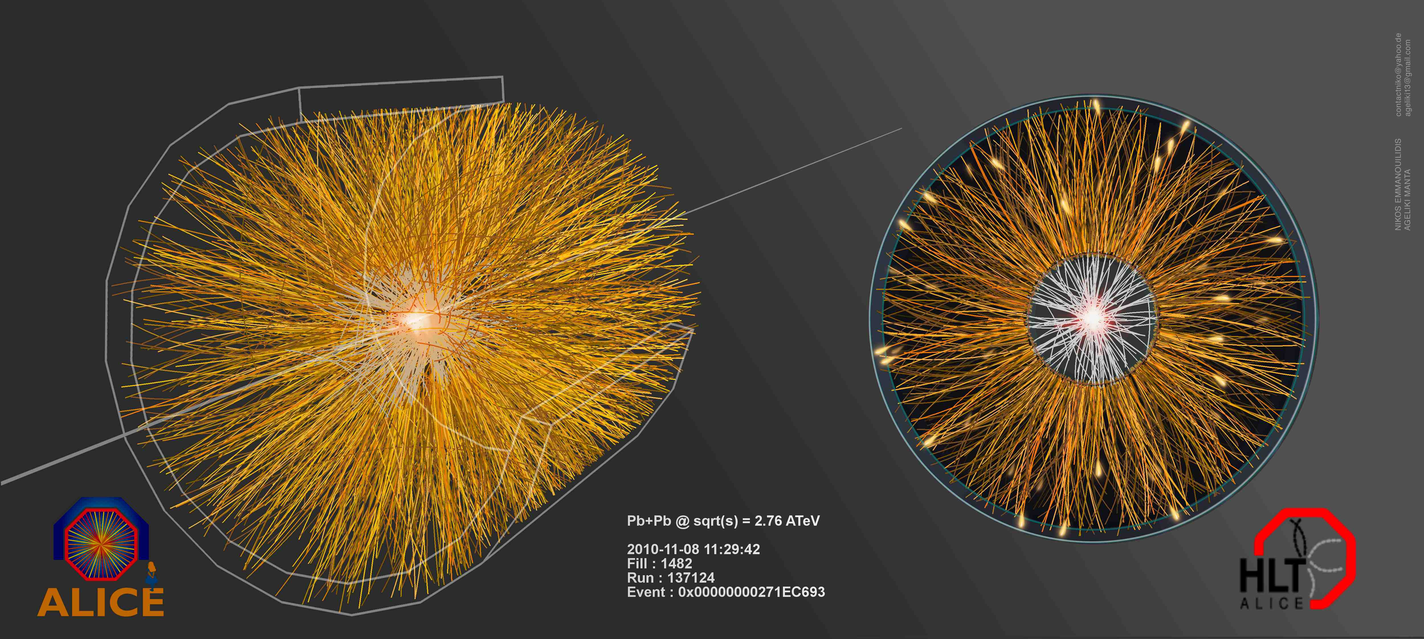
About that pesky background...

Slide 22
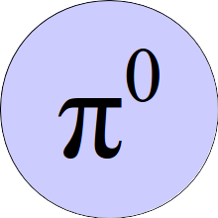
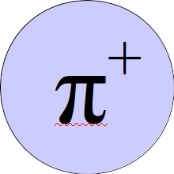

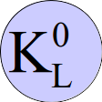
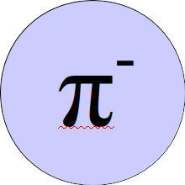

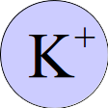
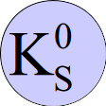
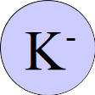




Background

Slide 23
Background +Jet

Slide 24
Background +Modified Jet

Slide 25
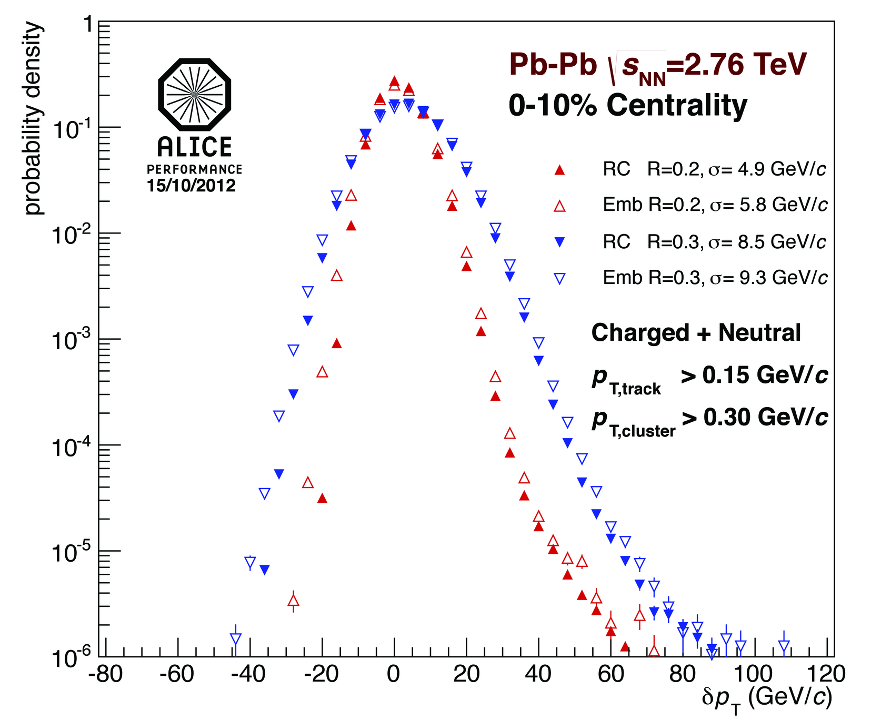
Combinatorial jets
Full Jets in Pb-Pb √s_{NN} = 2.76 TeV
Fluctuations in the background determined via δp_{T}
  Random cones (RC)
  Depends on
    Constituent cut R
    Centrality
    Event plane
    Detector
δp_{T} is used to construct unfolding response matrix
δp_{T} is not corrected for detector effects – Experiment specific
Notes:
Random cones – completely random?
Which jet finder
<number>

Slide 26
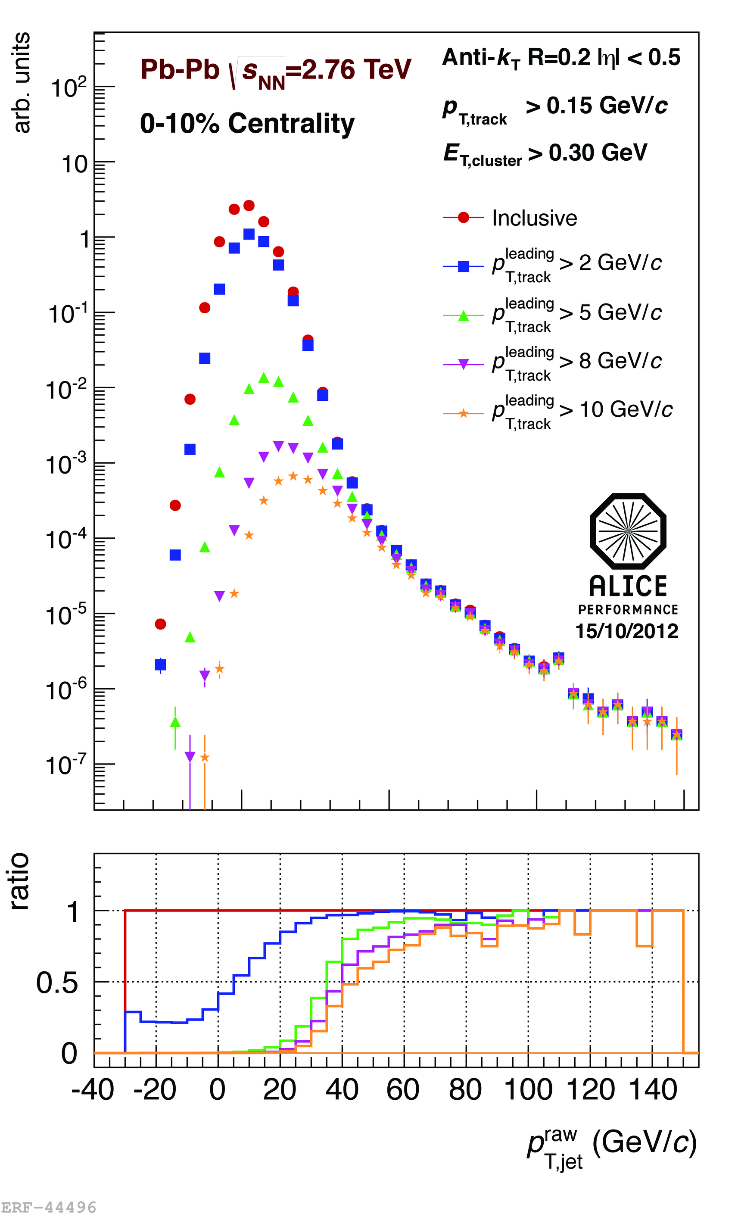
<footer>
Leading track jet bias
√s_{NN} = 2.76 TeV Pb-Pb, R=0.2
Combinatorial “jets”
Combinatorial jets a challenge in HI collisions
  Require leading track p_{T} > 5 GeV/c
  Suppresses combinatorial “jets”
  Biases fragmentation
Measured spectra:
Full jets
Where
comes from FastJet anti-k_{T} algorithm
Notes:
<number>

Slide 27
Combinatorial jets
Full Jets in Pb-Pb √s_{NN} = 2.76 TeV
How to suppress:
  Reduce R
  Increase constituent cut
    No longer colinear safe
  Require high p_{T} track
    No longer colinear safe
  Focus on higher p_{T} jets
Notes:
Random cones – completely random?
Which jet finder
<number>

Slide 28
Questions you should ask
How do the analysis cuts impact the jets used in the analysis?
  Small R → eliminates out of cone radiation
  High jet p_{T}/E biases towards unmodified jets
  Requirement of high pT track/cluster biases towards unmodified jets
  High minimum constituent cut could make the analysis blind to medium modifications
Is this analysis sensitive to medium modifications?

Slide 29
“Different jets are different.”
-- Rosi Reed

Slide 30
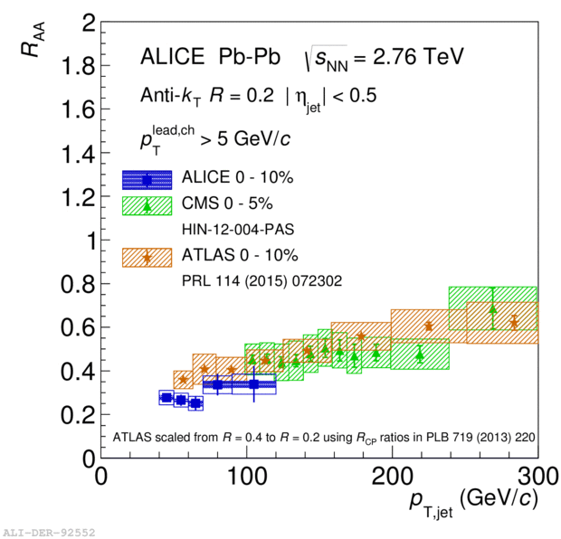
Jet R_{AA}
√s_{NN} = 2.76 TeV, R = 0.2 Inclusive
ALICE: tracks >150 MeV/c, clusters > 300 MeV, 5 GeV/c track bias
CMS: tracks > 500 MeV/c, hadronic calorimeter clusters
ATLAS: Calorimeter jets (primary)
Track jets with tracks> 4 GeV/c & 7 or 8 GeV/c constituent bias
Scaled down from R=0.4 to R=0.2
Constituent biases don't matter that much up here
But they do matter down here!
The fact that these results are consistent is telling us something about the medium!

Slide 31
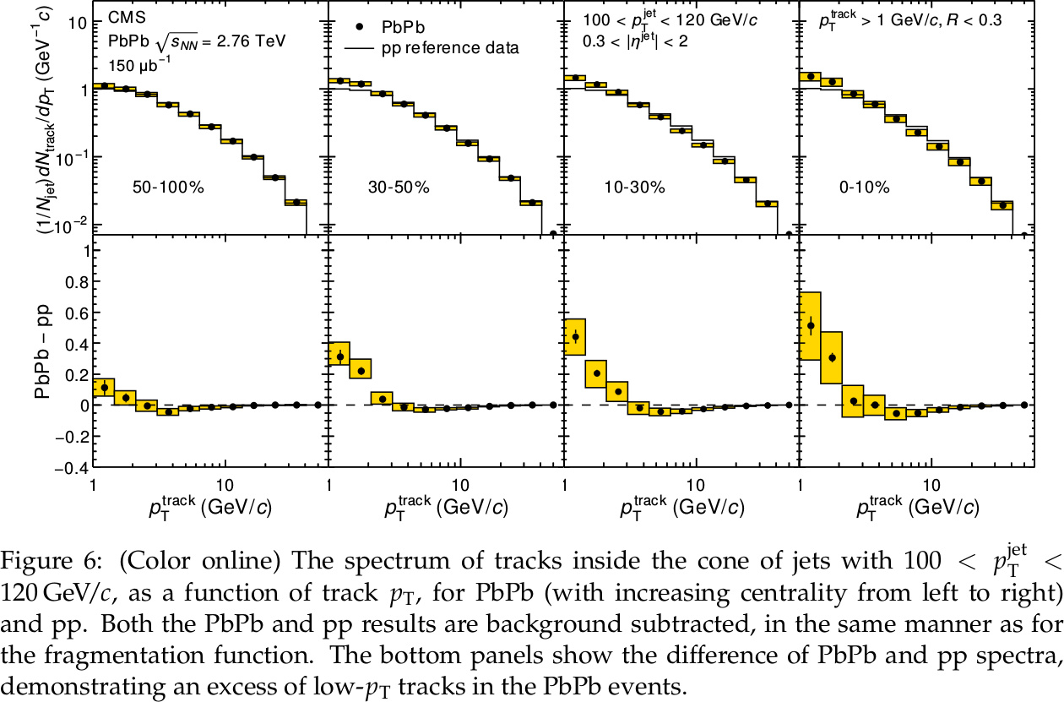
CMS fragmentation functions
R = 0.3
Tracks + calorimeter towers
Tracks > 0.9 GeV/c
How biased is this measurement towards unmodified jets?

Slide 32
Conclusions
Jet measures partons jets measure some fraction of partonic energy, but this fraction depends on the measurement techniques
Hadronic degrees of freedom are integrated out hadronization is really important!
Algorithms are infrared and colinear safe measurements are not colinear safe!
Analysis cuts lead to biases in jet selection
  The bias can be a tool but it should influence interpretation of results

Slide 33
Backup

Slide 34
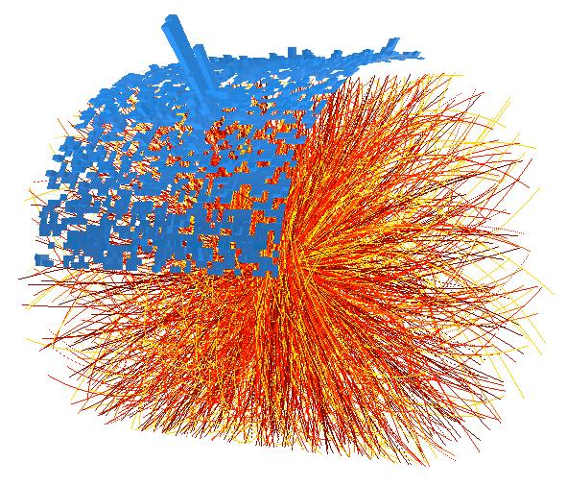
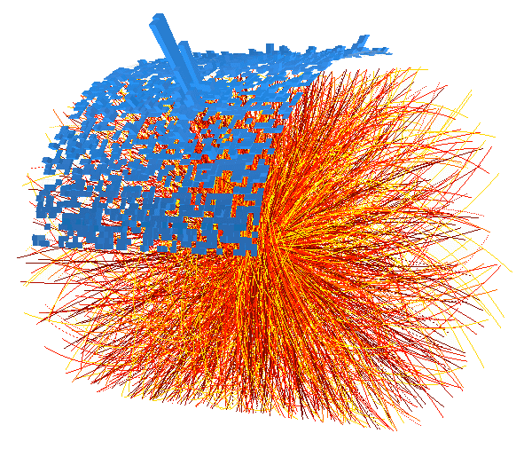
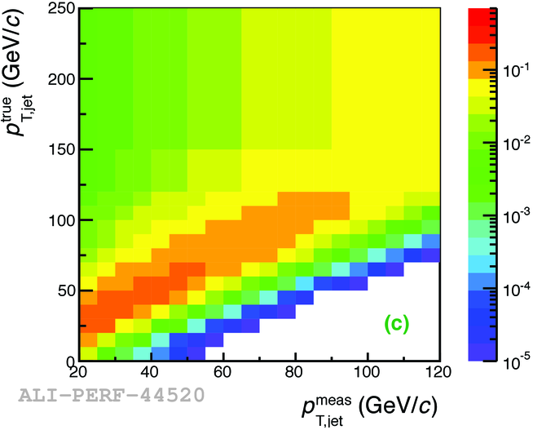
Method
1. Find jet candidates
2. Subtract background
Background
3. Correct for resolution

Slide 35
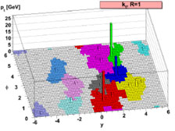

Jet Reconstruction
Jets reconstructed using FastJet package
  R = 0.2 - 0.4
  Anti-k_{T} – Used for signal determination
  k_{T} – Used for background determination
Correct for detector effects using unfolding
  Momentum resolution
  Energy resolution
  Track Matching
M. Cacciari, G. P. Salam, G.Soyez, JHEP 0804:063,2008
Notes:
----- Meeting Notes (6/24/13 16:47) -----
anti-kT used for our signal for consistency
Use as subbullets
Keep things together
<number>

Slide 36
<footer>
<number>
Full Jet Selection Requirements
EMCal fiducial acceptance cut
  R away from EMCal boundaries
  R=0.2:
    |η_{jet}| < 0.5
    1.60 < φ_{jet} < 2.94
Jets with leading track p_{T} > 100 GeV/c are rejected due to limitations of tracking beyond 100 GeV/c
Jet at edge of acceptance
Notes:
----- Meeting Notes (6/24/13 16:47) -----
eta_jet and phi_jet
put edges of calorimeter - R
<number>

Slide 37
<footer>
Jets in Heavy Ion Collisions
Experimental Challenges
Need to remove underlying event (UE) contribution
  A = Jet area, ρ = median UE momentum density
  p_{T, Jet} = Jet p_{T} from jet finder
  We can only remove the average background
  contribution
B_{σ} from UE fluctuations
Combinatorial (fake) jets can be reconstructed from UE
Detector effect corrections depend on fragmentation
Both background and detector effects are corrected in unfolding
  Corrects spectra for the B_{σ} term
  Quantified in Response Matrix (RM)
Background
Notes:
----- Meeting Notes (6/24/13 16:47) -----
mention that the last term is corrected via unfolding - put in last bullet
<number>

Slide 38
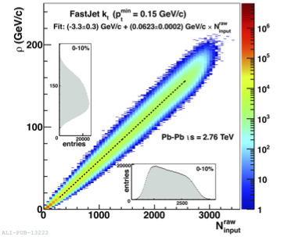
<footer>
HI Background Determination
Charged Jets √s_{NN} = 2.76 TeV
ρ_{ch} : median of
  2 leading jets removed
  May be sensitive to jet fragments outside k_{T} jet cone
  Determined event-by-event
ρ_{ch} is not corrected for detector effects or missing energy
Subtracted from signal jets on a jet-by-jet basis
JHEP 1203:053, 2012
(arxiv:1201.2423)
Notes:
----- Meeting Notes (6/24/13 16:47) -----
More time on the plot
move "sensitive" bullet to 2 leading jets bullet
make point about median (bold)
<number>

Slide 39
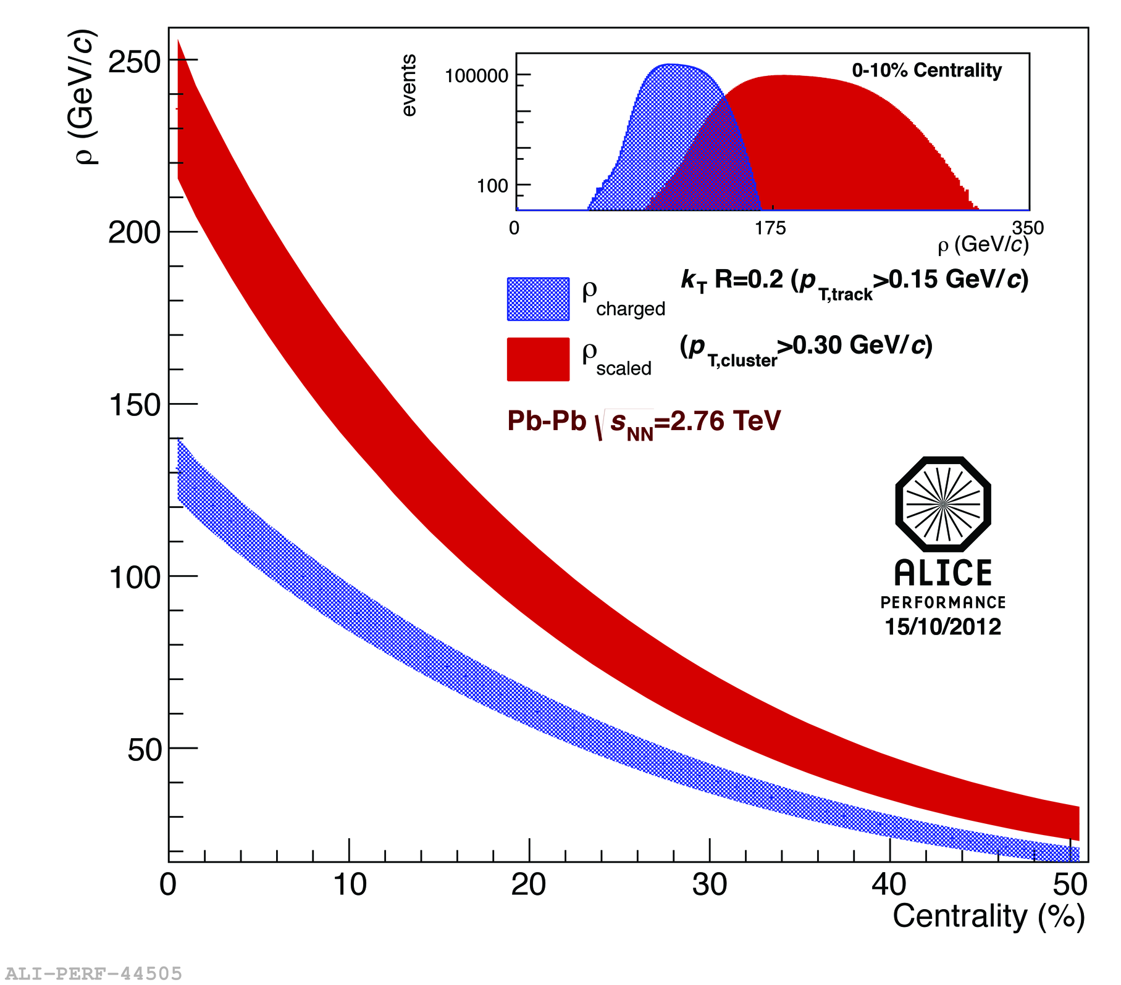
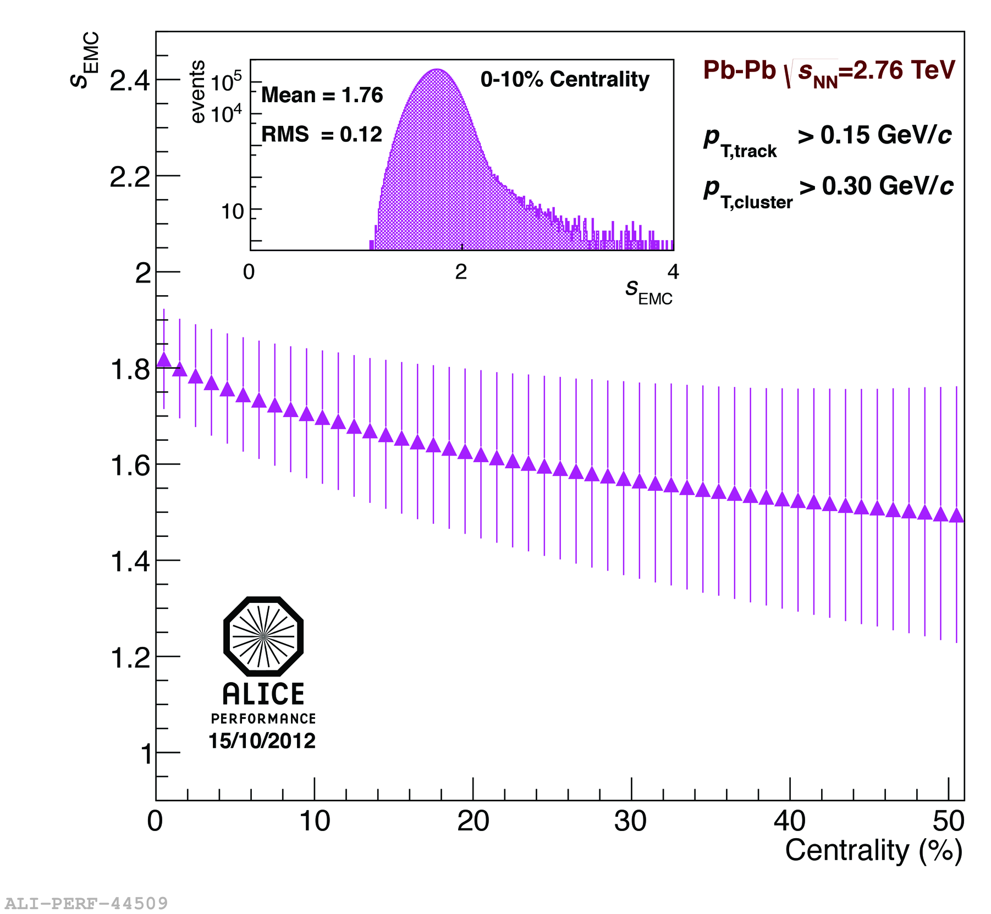
HI Background Determination
Full Jets √s_{NN} = 2.76 TeV
Centrality dependent scale factor accounts for neutral energy
ρ_{scaled} = ρ_{ch} × ρ_{EMC}
Notes:
----- Meeting Notes (6/24/13 16:47) -----
make pretty
use performance plots
mention RMS scale factor
Remove 1st bullet and move up second
make colors for equations
As of today "full jets are jets"
<number>

Slide 40
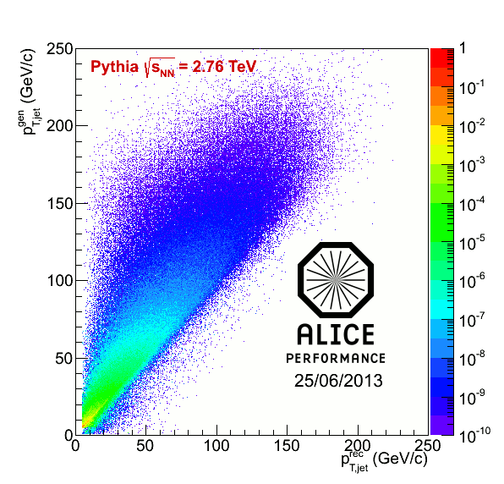
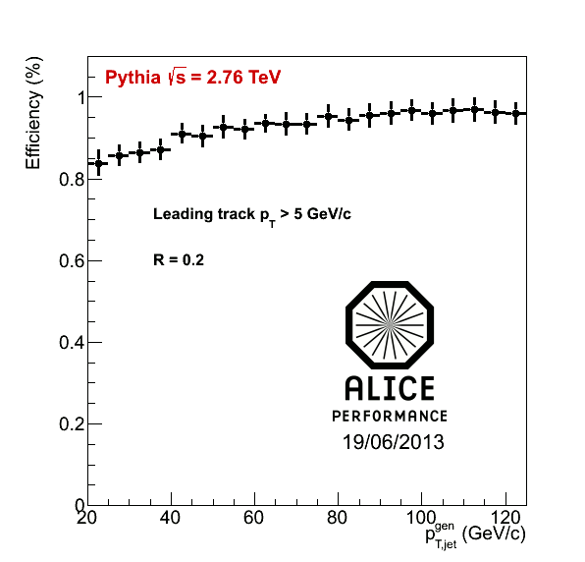
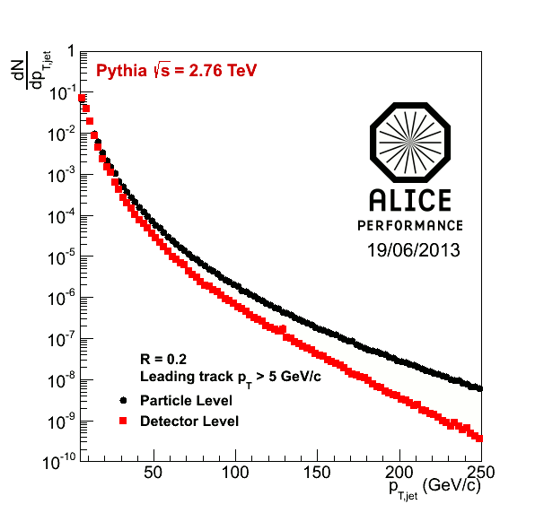
Response matrix RM_{det}
RM_{det} quantifies detector response to jets
  “Particle” level jets – defined by jet finder on MC particles
  Pythia with Pb-Pb tracking efficiency
  “Detector” level jets – defined by jet finder after event reconstruction through GEANT
  Particle level jets are geometrically matched to detector level jets
  Matrix has a dependence on spectral shape and fragmentation
Jet-finding efficiency is probability of a matched particle level jet
Notes:
----- Meeting Notes (6/24/13 16:47) -----
Say "matched jets" instead of 2 jets -> so people don't get confused with dijets
<number>

Slide 41
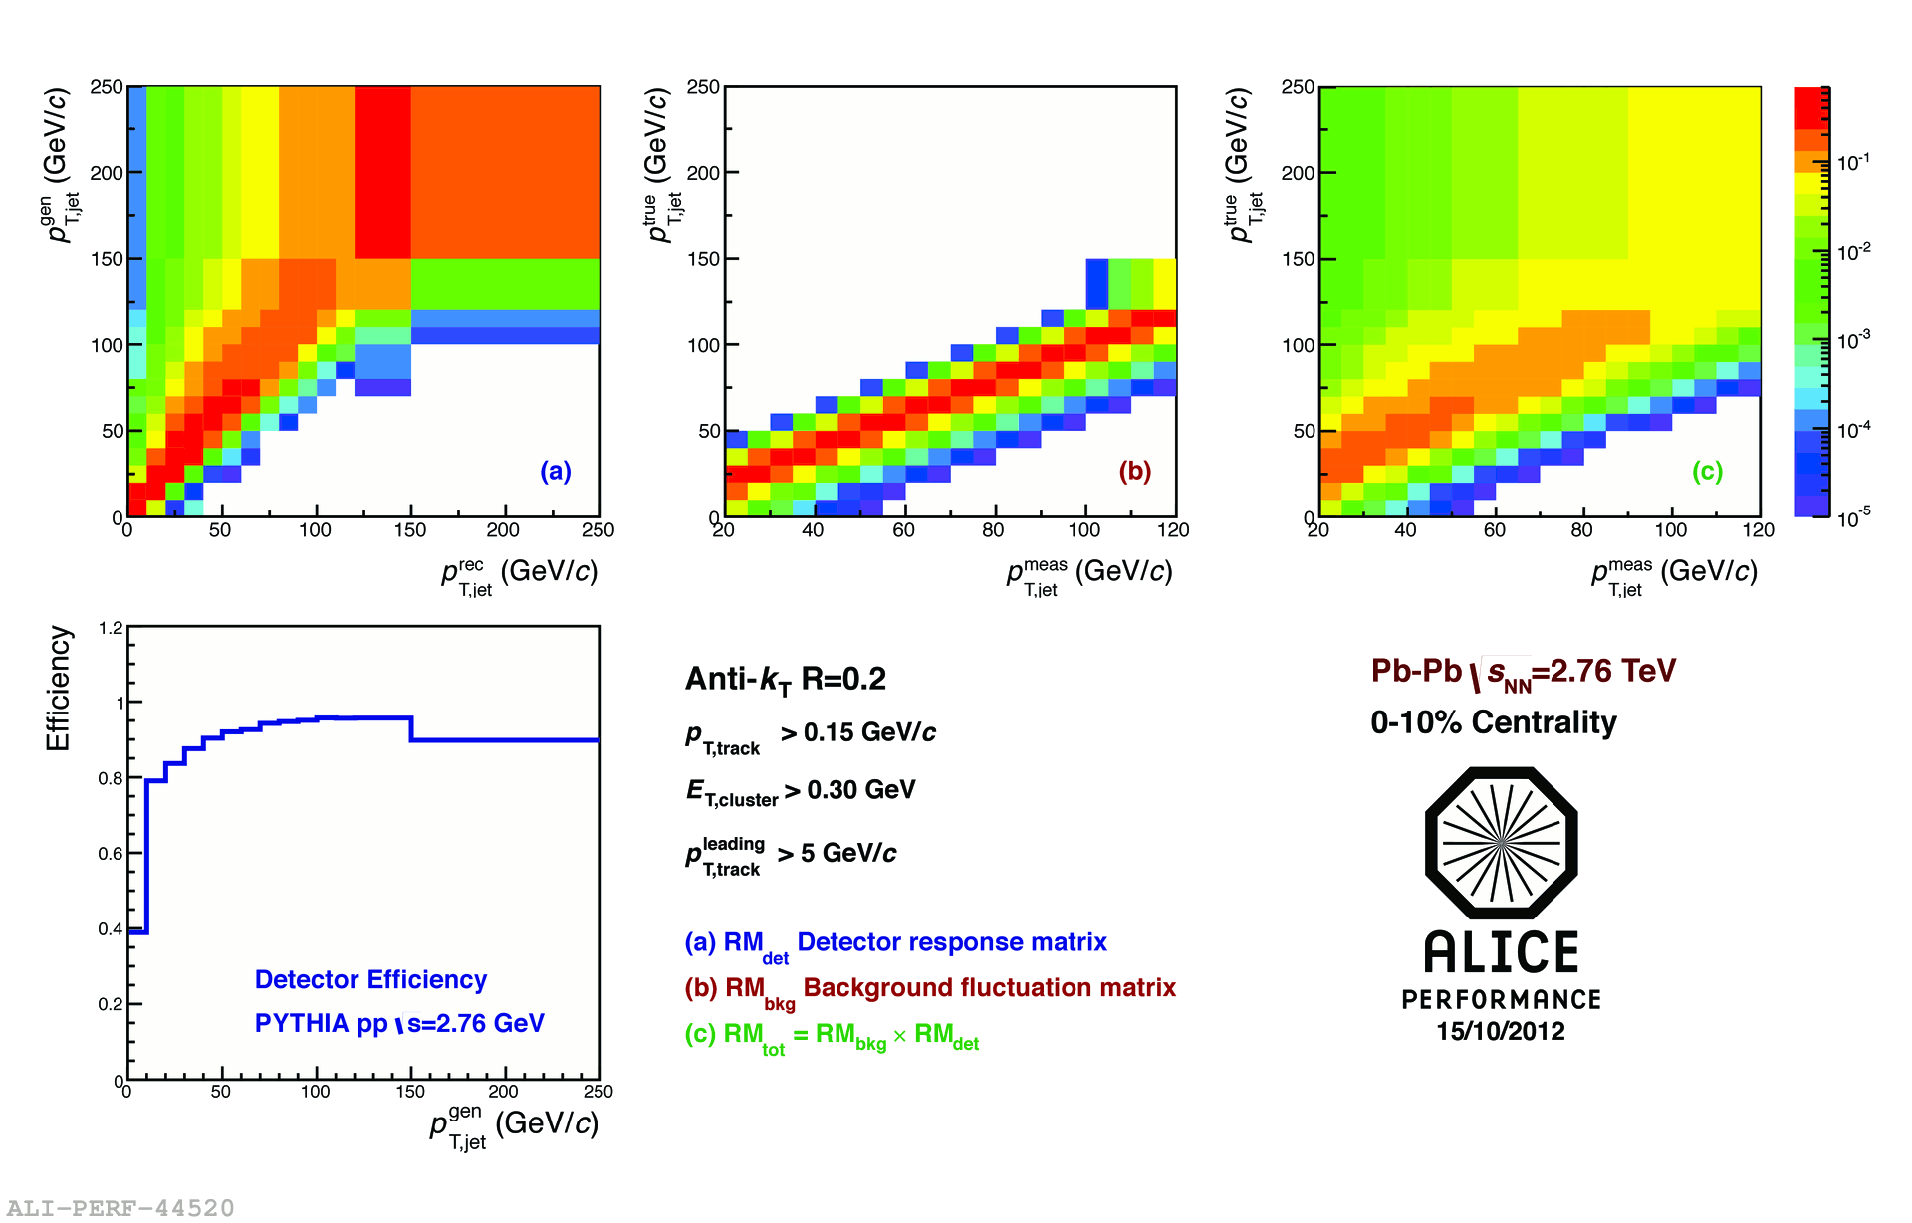
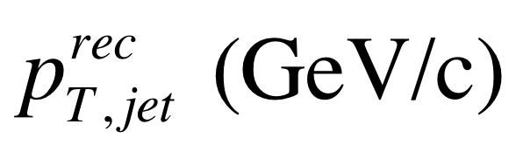
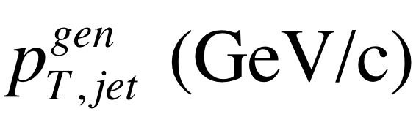
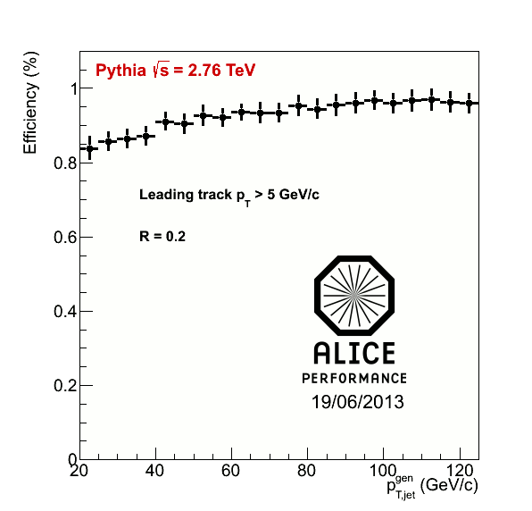
<footer>
Response Matrix Construction
RMdet X RMbkg = RM
RM_{bkg} and RM_{det} are approximately factorizable
Notes:
----- Meeting Notes (6/24/13 16:47) -----
Put Large Labels on
b) change pT true -> pT rec so consistence
c) change gT true ->pT gen
<number>

Slide 42
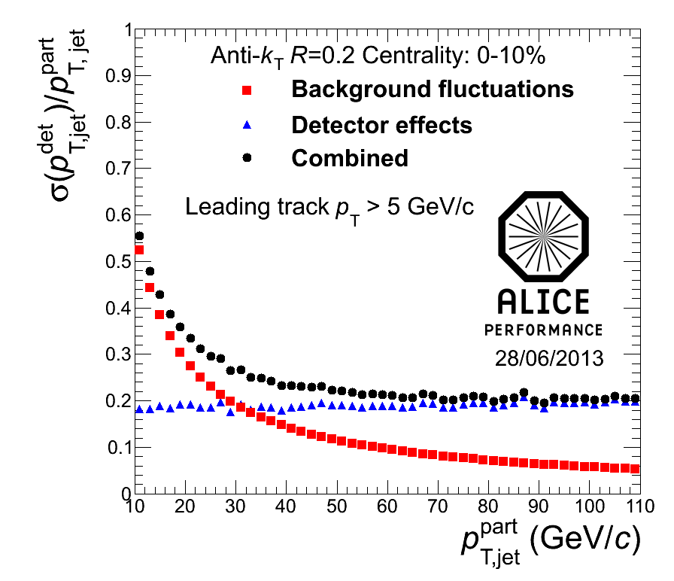
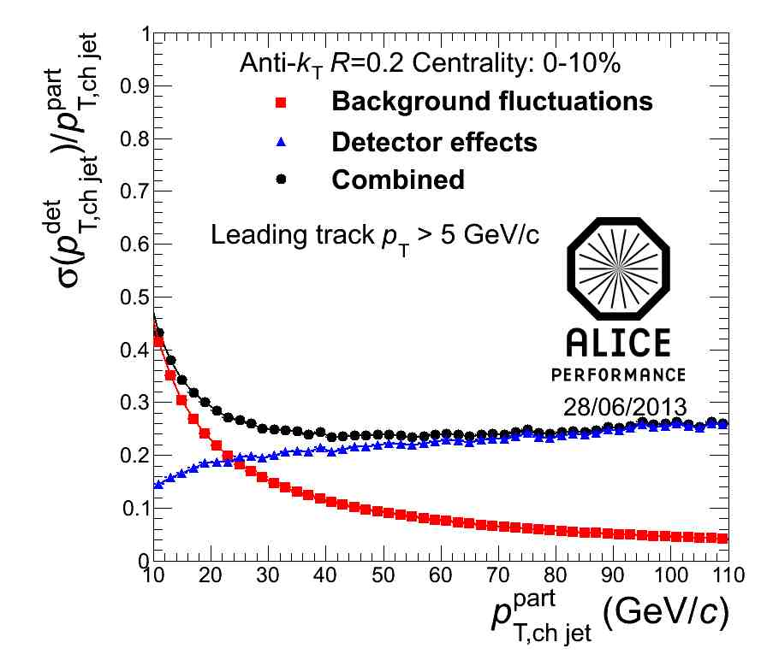
<footer>
Jet Resolution
Full
Charged
Jet resolution
  Dominated by background fluctuations at low momentum
  Dominated by detector effects at high momentum
Notes:
----- Meeting Notes (6/24/13 16:47) -----
Ask Marta for R = 0.2 plots for this
make sure performance
increase label size
<number>

Slide 43
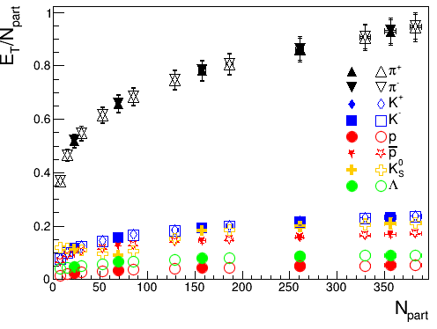
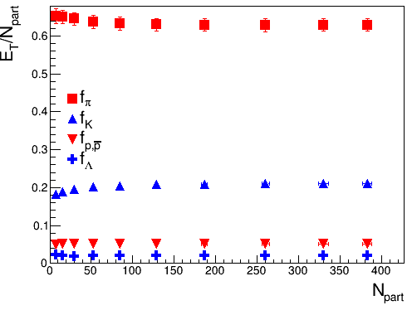
Calculations from spectra
The distribution of energy is surprisingly centrality independent.

Slide 44
Building blocks
Size of circles proportional to the fraction of energy in that particle
Scale: diameter in inches = √fraction * 5

