Slide 1
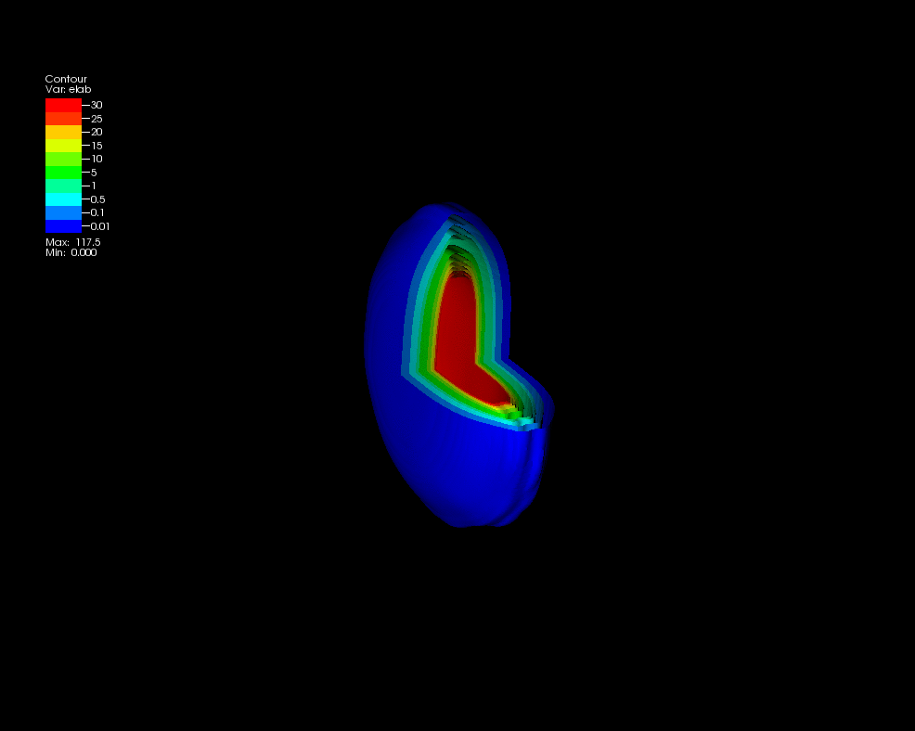
Melting Nuclei
Christine Nattrass
University of Tennessee at Knoxville
Calculations done on the Titan supercomputer by the CJet collaboration https://sites.google.com/site/cjetsite/

Slide 2
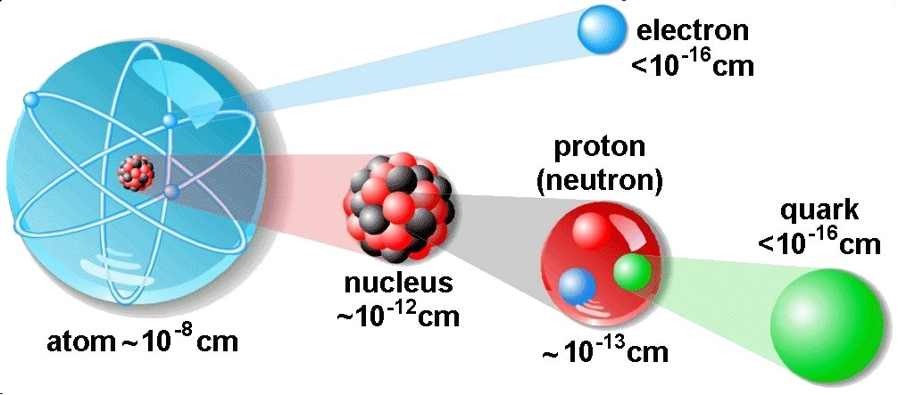
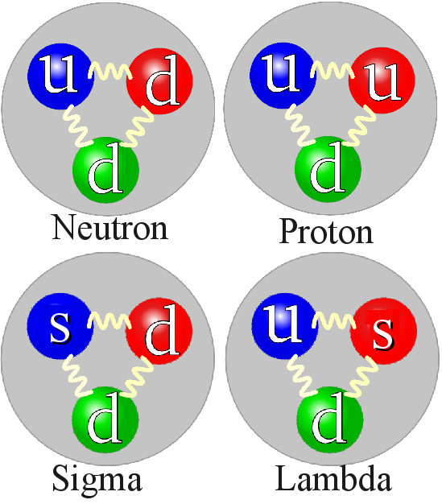
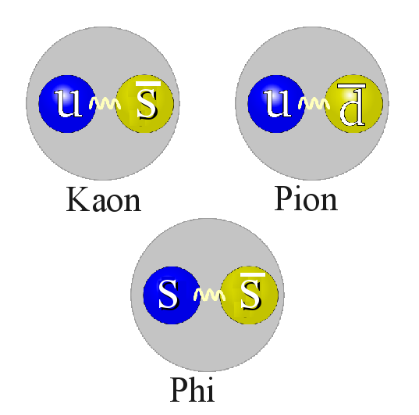
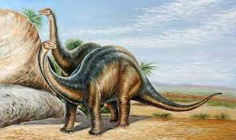
Structure of matter
Hadrons
Baryons
Standard model
Mesons
125000
Higgs

Slide 3
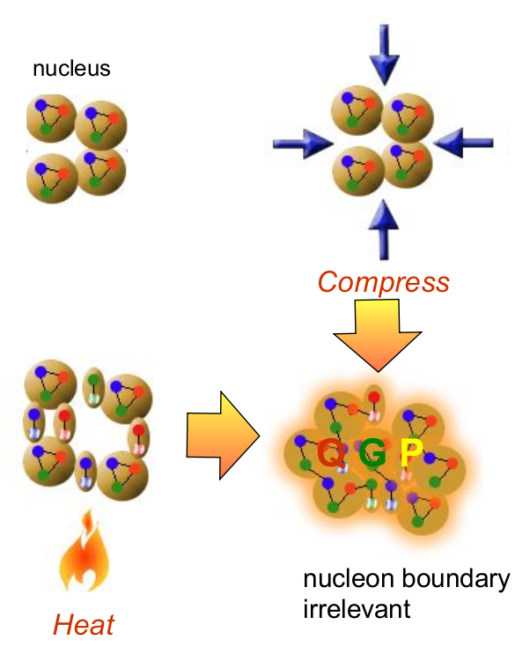
How to make a Quark Gluon Plasma

Slide 4
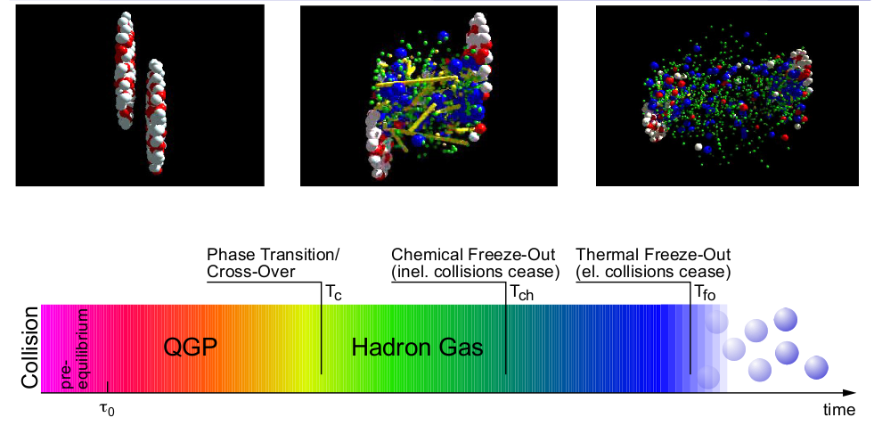
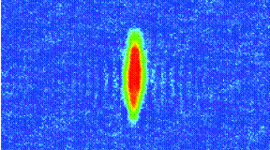
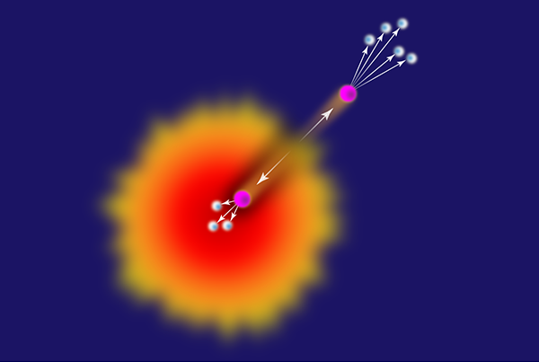
The phase transition in the laboratory
Initial State
QGP
Freeze-out
K, O’Hara, S. Hemmer, M. Gehm, S. Granade, J. Thomas Science 298 2179 (2002)
Hydrodynamical flow
Jet quenching
https://physics.aps.org/articles/v7/97

Slide 5
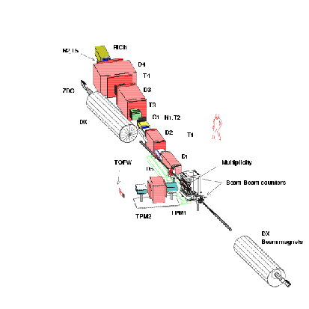
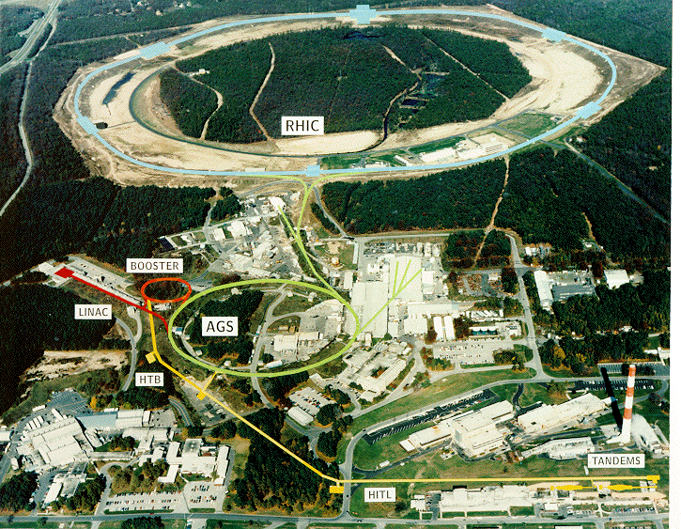
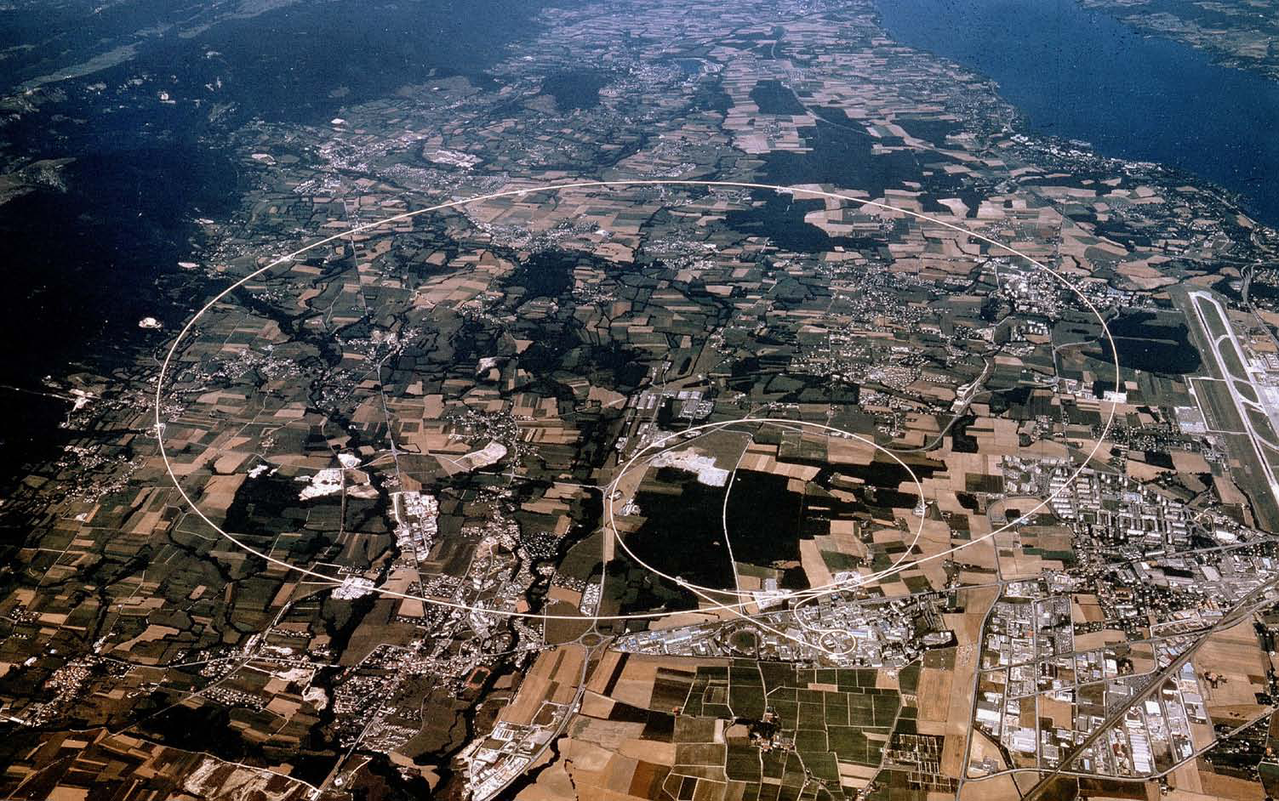
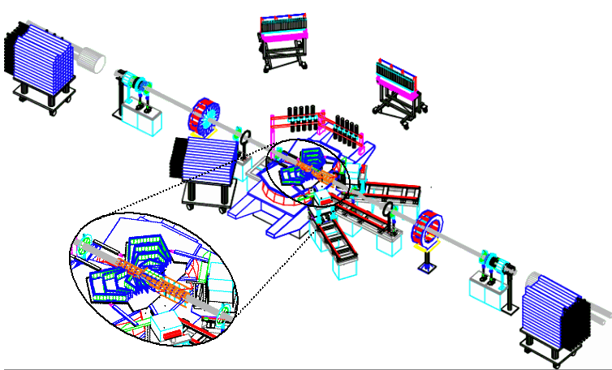
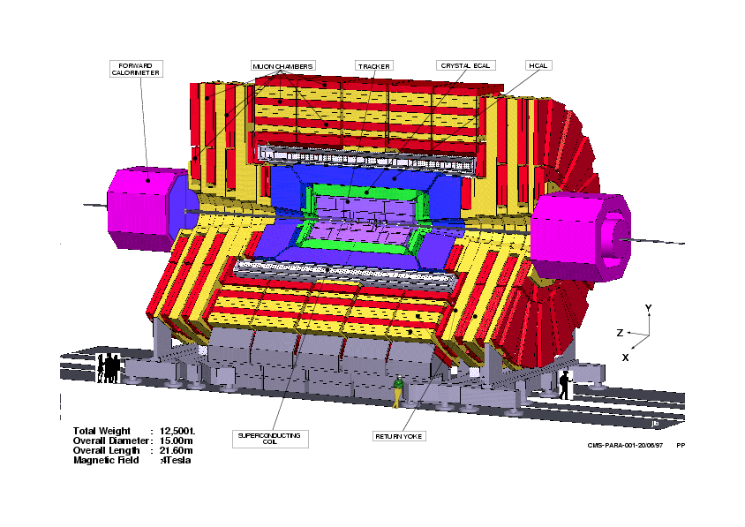
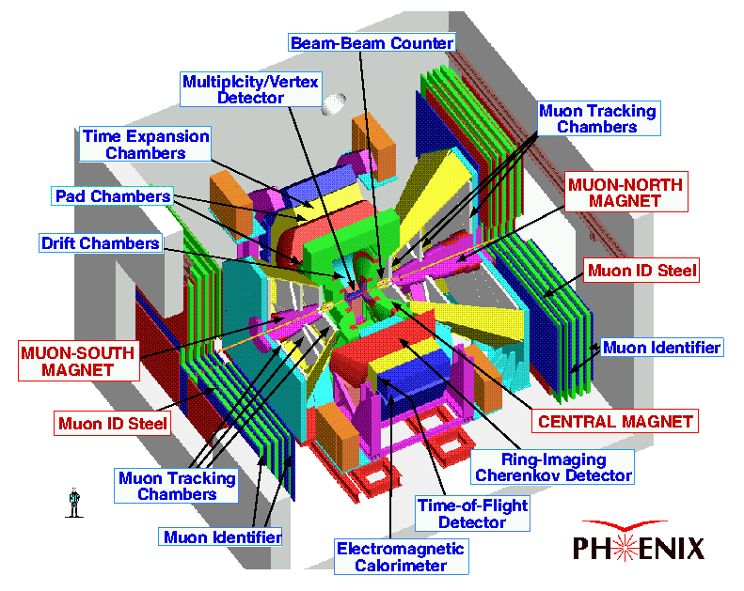
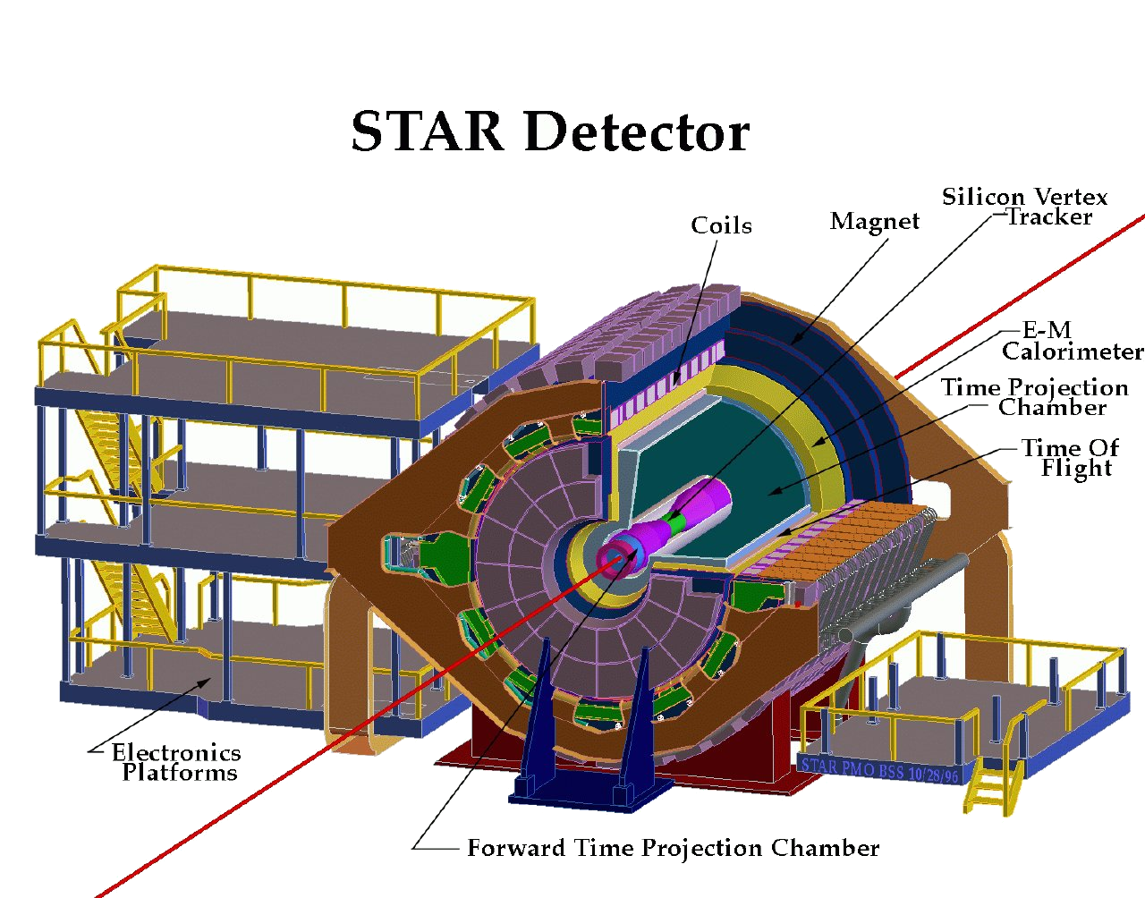
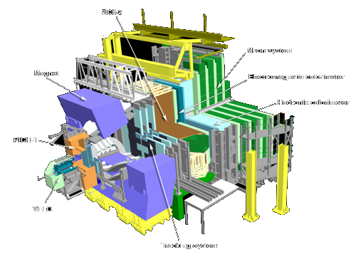
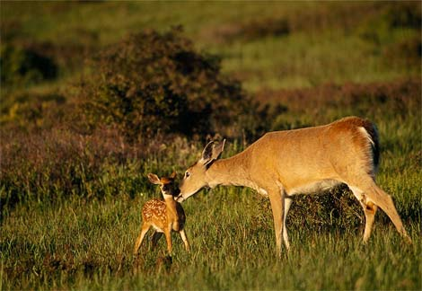
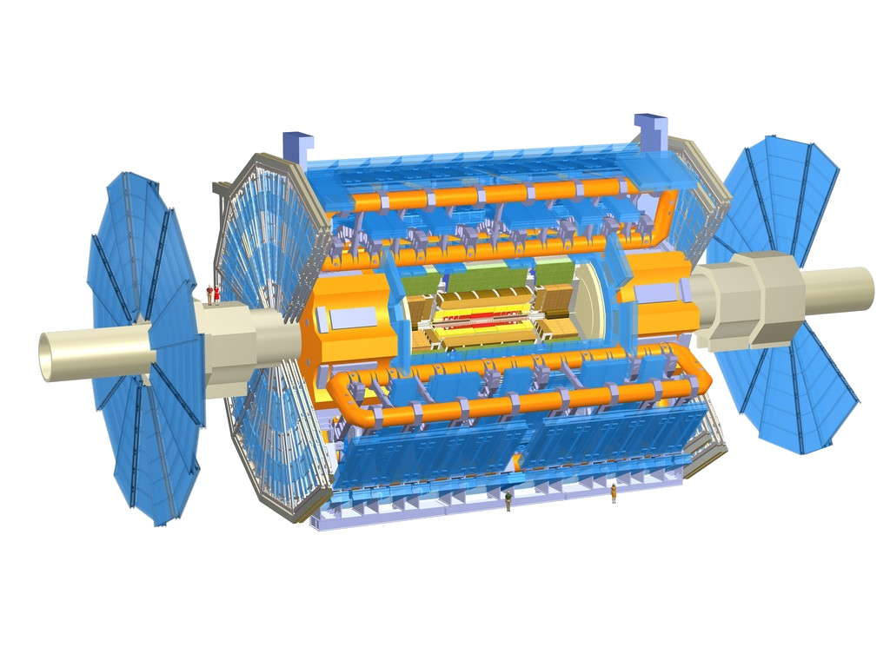
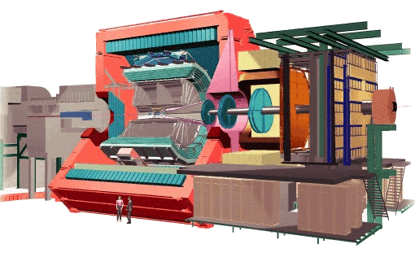
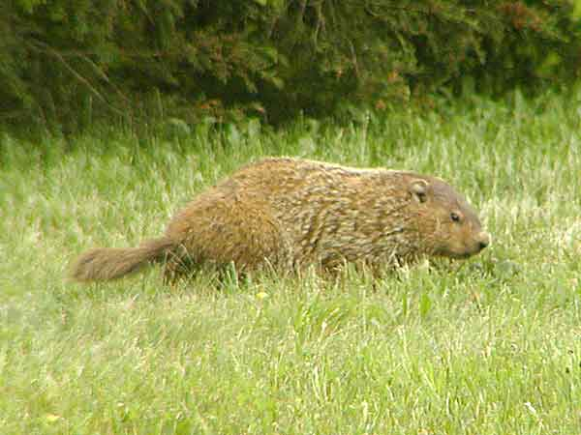
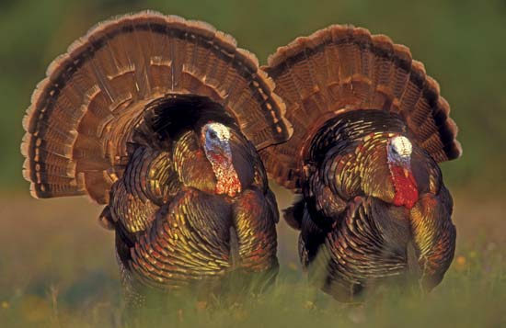
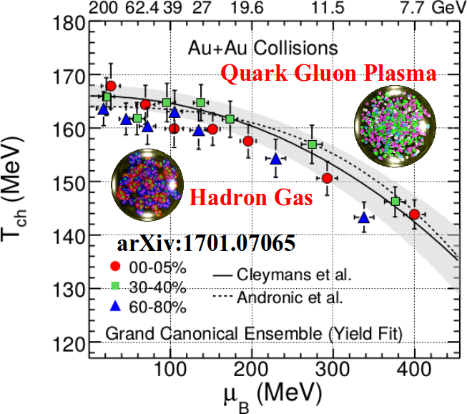
Relativistic Heavy Ion Collider
Large Hadron Collider
PHOBOS
BRAHMS
CMS
PHENIX
STAR
RHIC
LHCb
ALICE
ATLAS LHCf
LHC
Upton, NY
1.2km diameter
p+p, d+Au, Cu+Cu, Au+Au, U+U
√s_{NN} = 9 - 200 GeV
Geneva, Switzerland
8.6km diameter
p+p, p+Pb, Pb+Pb
√s_{NN} = 2.76 GeV, 5.5 TeV
RHIC
Notes:
Mention that RHIC planning began 1983

Slide 6
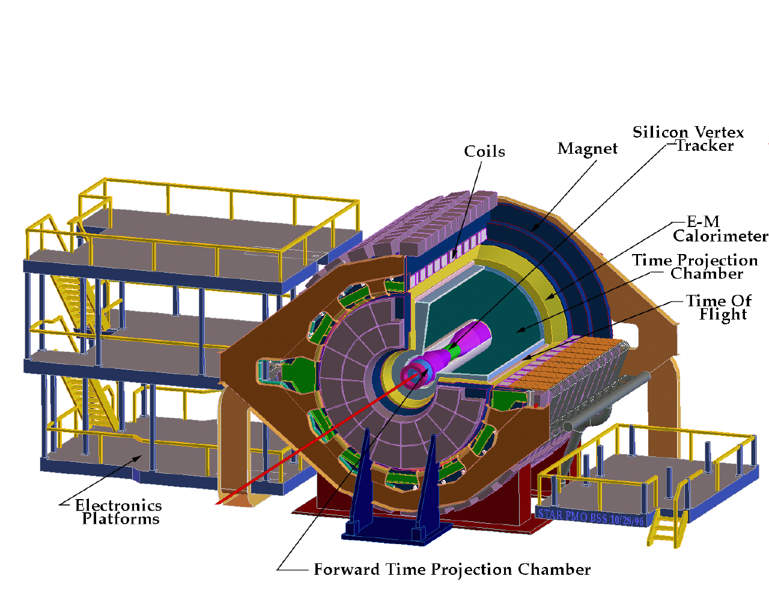
ALICE
ATLAS
CMS
STAR
PHENIX
Notes:
Mention that RHIC planning began 1983

Slide 7
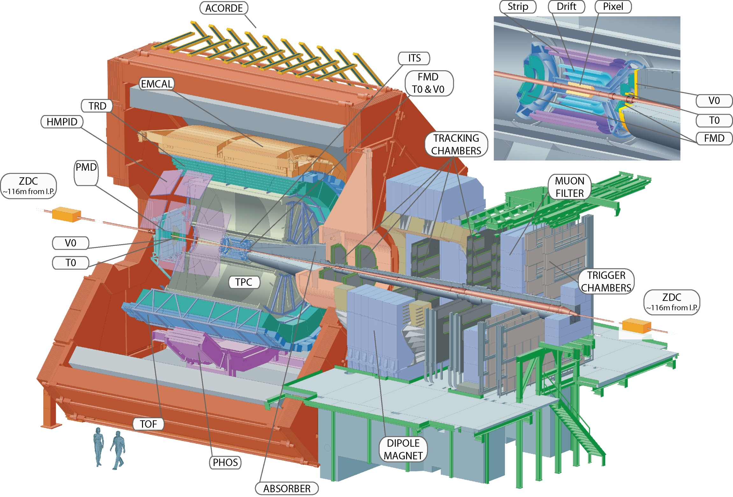
Size: 16 x 26 meters
Weight: 10,000 tons
Detectors: 18
Trigger detectors: When do we have a collision?
Tracking detectors: Where did the particle go?
Identification detectors: What kind of particle is it?
Calorimeters: How much energy does the particle have?
<number>
Notes:
By comparison ATLAS is 25 meters in diameter and 44 meters long – not quite twice as large

Slide 8
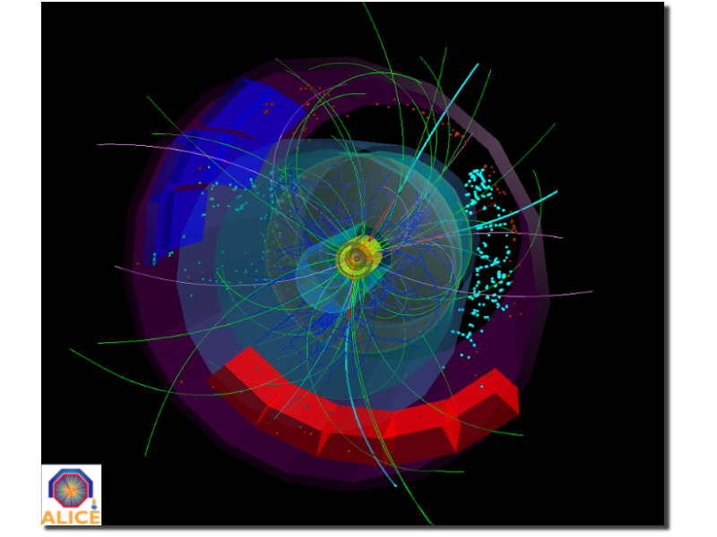
p+p collisions
3D image of each collision

Slide 9
Pb+Pb collisions
5

Slide 10
QGP Spectroscopy

Slide 11
Probing the Quark Gluon Plasma
Medium
Probe
Detector
Want a probe which traveled through the collision
QGP is very short-lived (~1-10 fm/c) →
cannot use an external probe

Slide 12
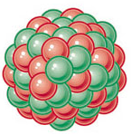
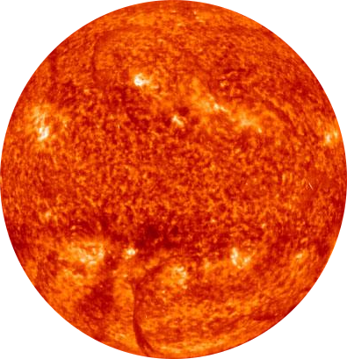
Probes of the Quark Gluon Plasma
nucleus
nucleus
Want a probe which traveled through the medium
QGP is short lived → need a probe created in the collision

Slide 13
Probes of the Quark Gluon Plasma
nucleus
nucleus
Want a probe which traveled through the medium
QGP is short lived → need a probe created in the collision We expect the medium to be dense → absorb/modify probe

Slide 14
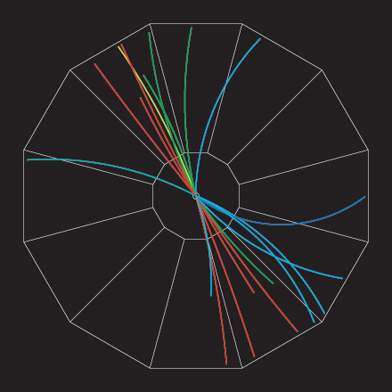
Jets
p+p → dijet
D
c, x_{c}
p
a, x_{a}
b, x_{b}
p
σ_{ab}
Beam pipe
d, x_{d}
D
Jets – hard parton scattering leads to back-to-back quarks or gluons, which then fragment as a columnated spray of particles

Slide 15
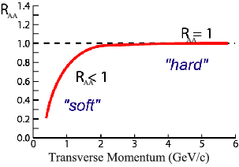
Nuclear modification factor
Measure spectra of probe (jets) and compare to those in p+p collisions or peripheral A+A collisions
If high-p_{T} probes (jets) are suppressed, this is evidence of jet quenching
Enhancement
Suppression

Slide 16
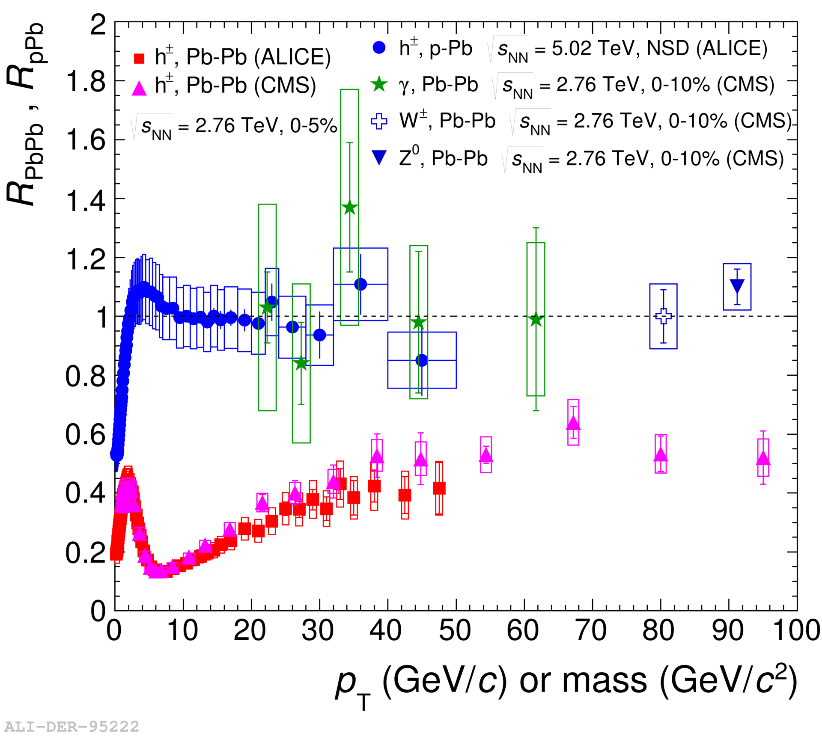
Nuclear modification factor
LHCb-PAPER-2017-015
Control
Control
Probe
Charged hadrons (colored probes) suppressed in Pb—Pb
Charged hadrons not suppressed in p—Pb at midrapidity
Electroweak probes not suppressed in Pb—Pb

Slide 17
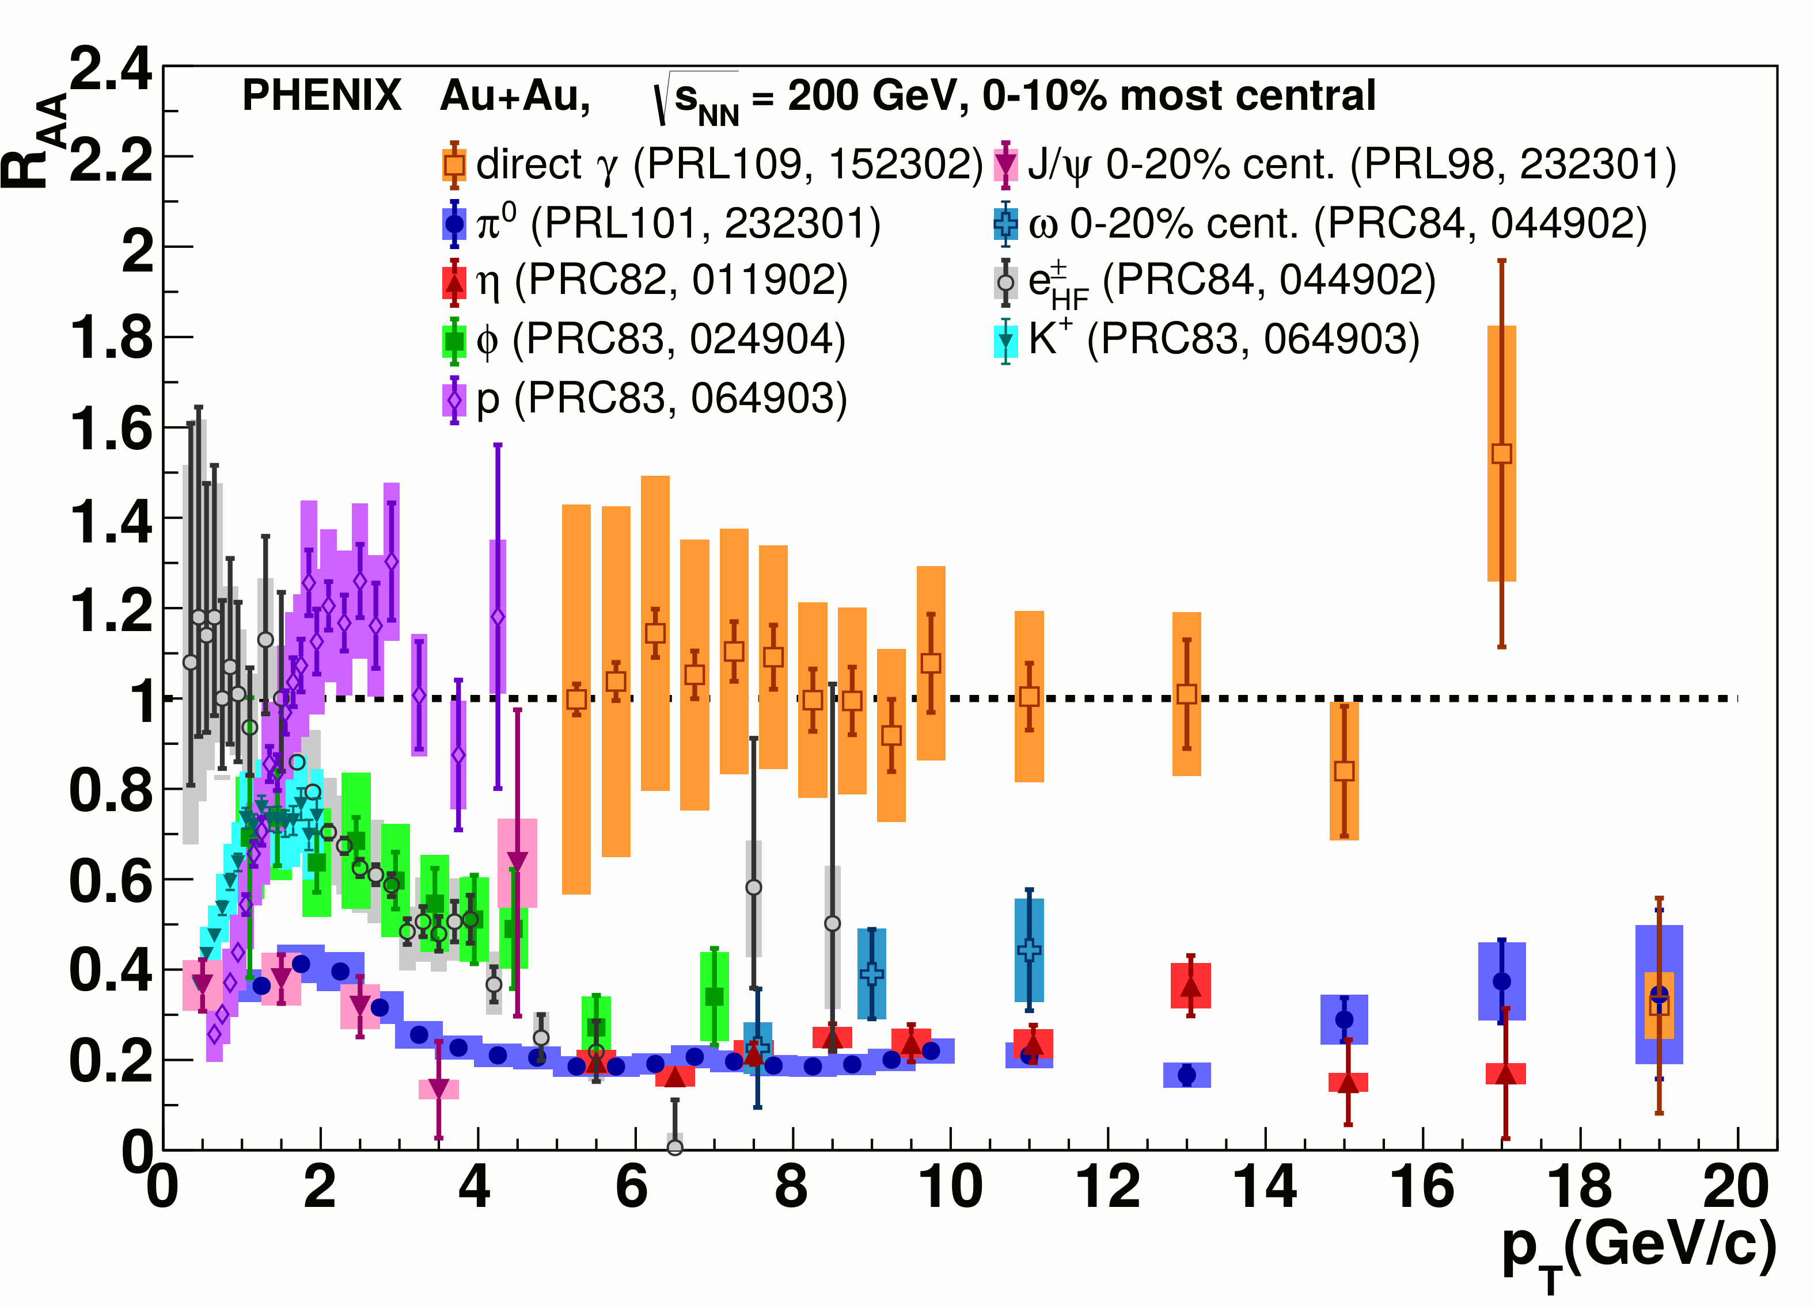
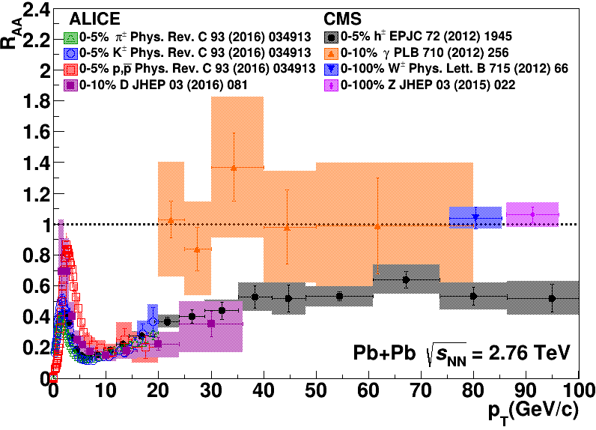
Nuclear modification factor R_{AA}
RHIC
LHC
Connors, Nattrass, Reed, SalurarXiv:1705.01974 [nucl-ex]
Electromagnetic probes – consistent with no modification – medium is transparent to them
Strong probes – significant suppression – medium is opaque to them - even heavy quarks!

Slide 18
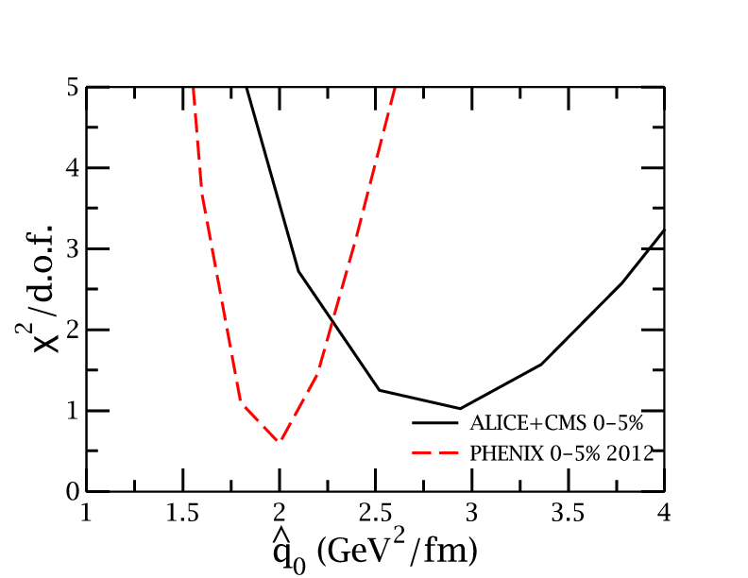
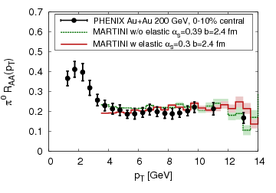
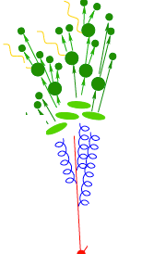
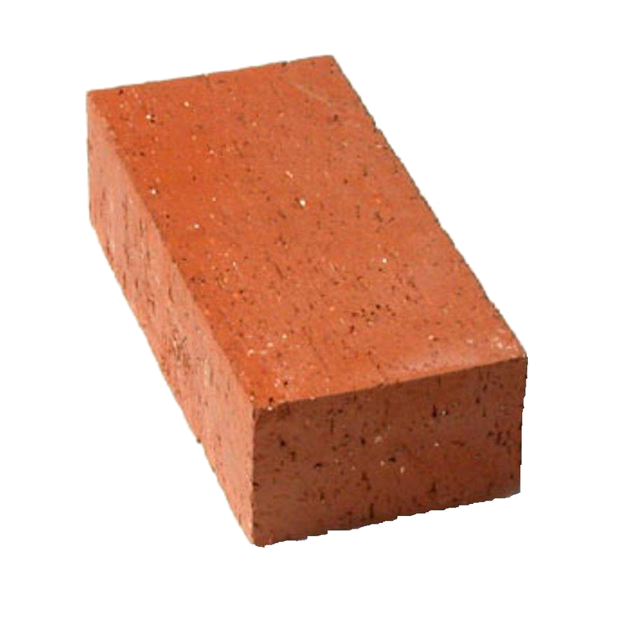
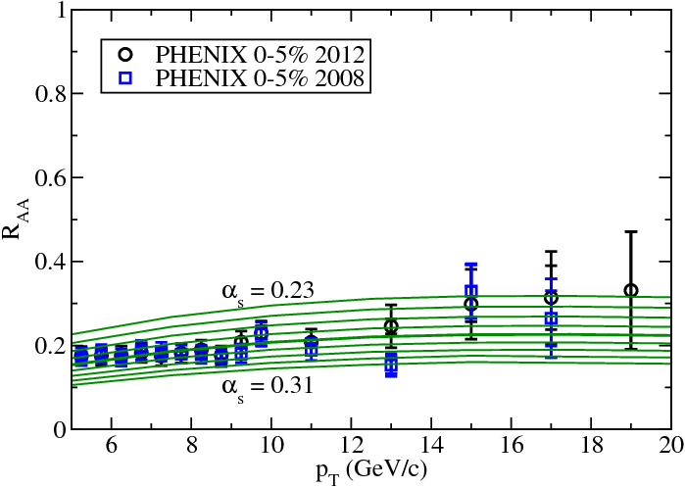
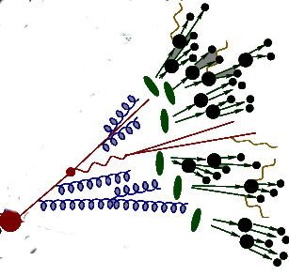
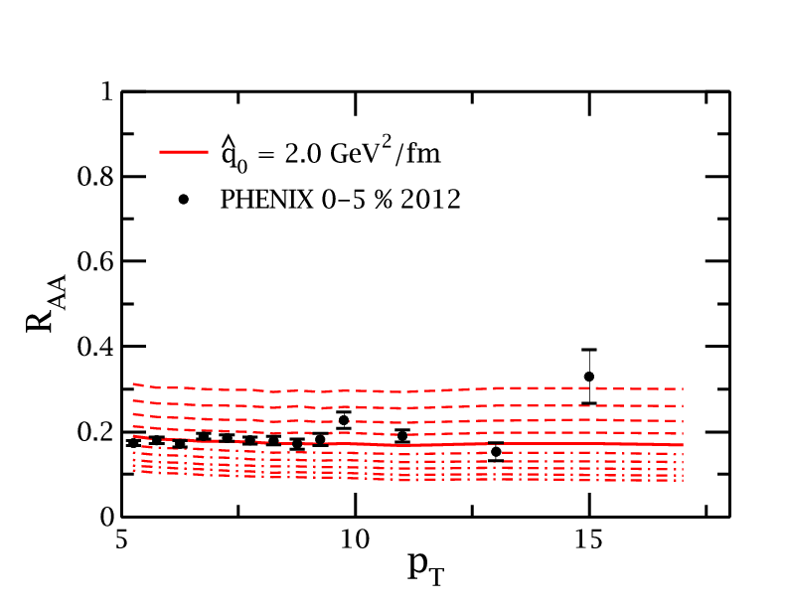
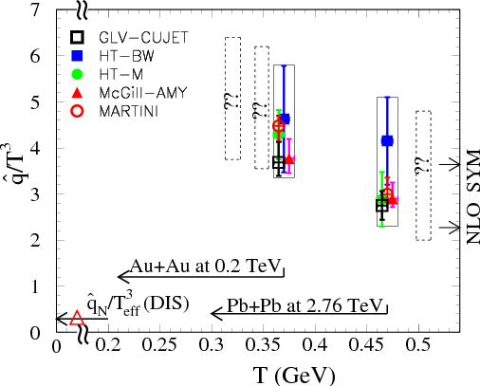
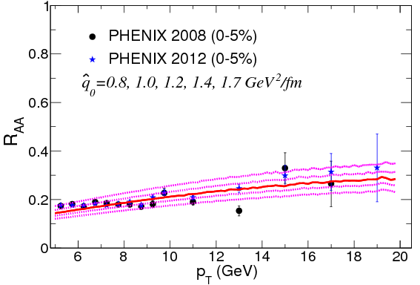
JET collaboration Phys. Rev. C 90, 014909 (2014)
Martini
McGill
$χ^{2}minimization$
QGP brick + jet
HTM
HTBW
Data
$\hat{q}=1.2±0.3 {GeV}^{2}$
200 GeV Au+Au
$\hat{q}=1.9±0.7 {GeV}^{2}$
2.76 TeV Pb+Pb

Slide 19
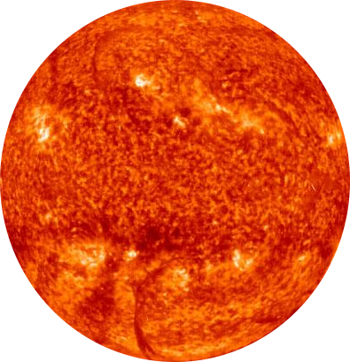
Di-hadron correlations
p+p → dijet
Trigger
nucleus
Associated
Phys.Rev.Lett.93:252301,2004
nucleus

Slide 20
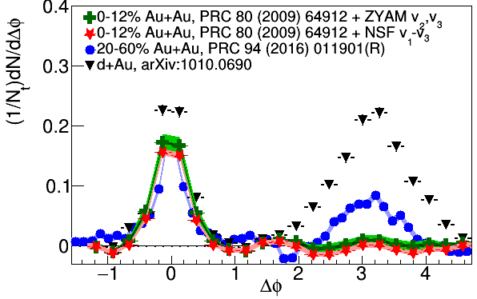
Di-hadron correlations
p+p → dijet
Trigger
nucleus
Associated
nucleus
Updated to include latest information about background

Slide 21
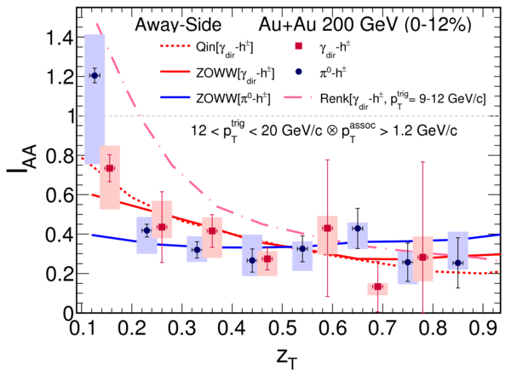
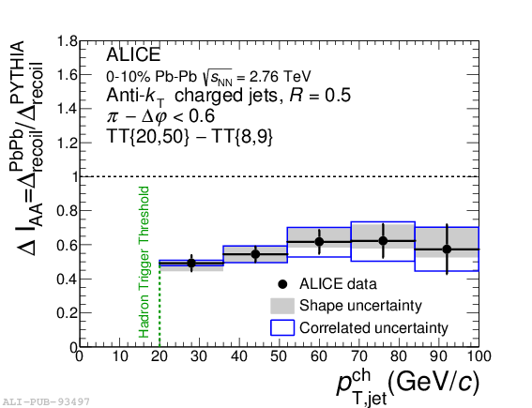
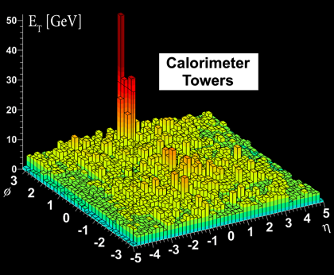
suppression
suppression
Jet v₂
[Phys.Lett. B 753 (2016) 511-525,
Phys. Rev. Lett.111 152301 (2013)]
Di-hadron correlations
[Too many to list]
γ-hadron correlations
[Phys.Rev.C80:024908,2009, Phys.Rev.D82:072001,2010, Phys.Rev.C82:034909,2010 Physics Letters B 760 (2016)]
γ-jet correlations
[Phys. Lett. B 718 (2013) 773]
High-p_{T}
hadron v₂
[too many to list]
suppression
Dijet asymmetry
[Phys.Rev.C84:024906,2011, Phys. Lett. B 712 (2012) 176, Phys.Rev.Lett.105:252303,2010, Phys. Rev. Lett. 119, 062301 (2017)]
Hadron-jet correlations
[JHEP 09 (2015) 170, Phys. Rev. C 96, 024905 (2017)]

Slide 22
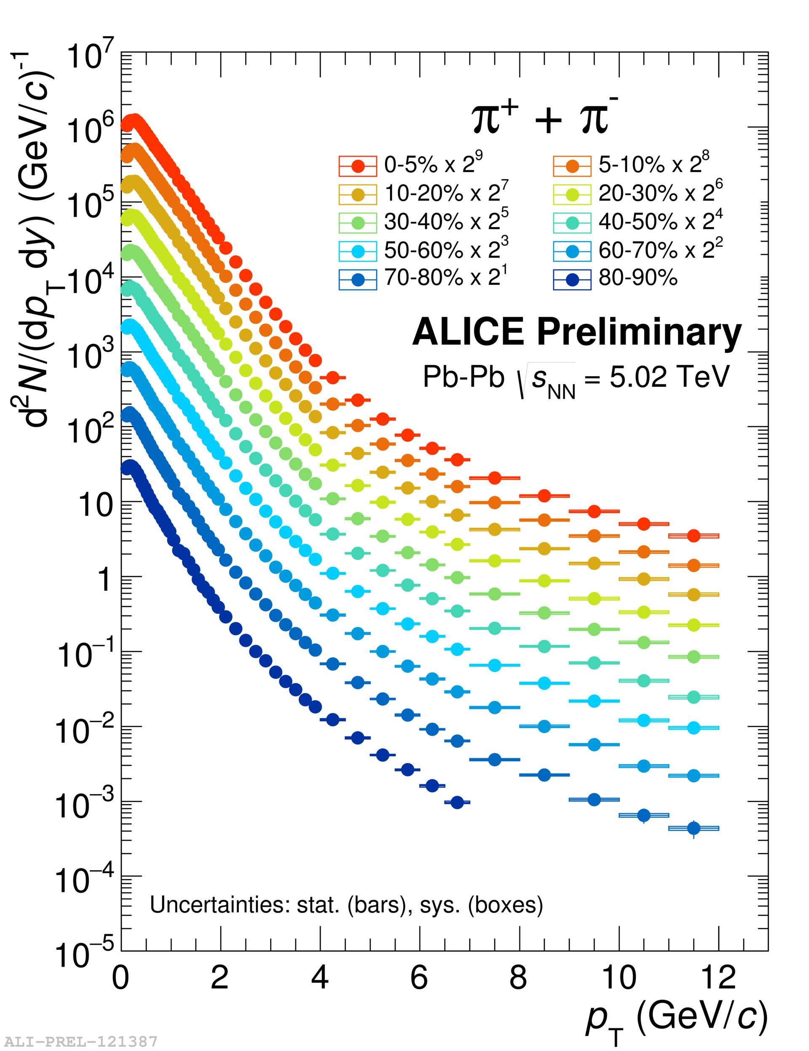
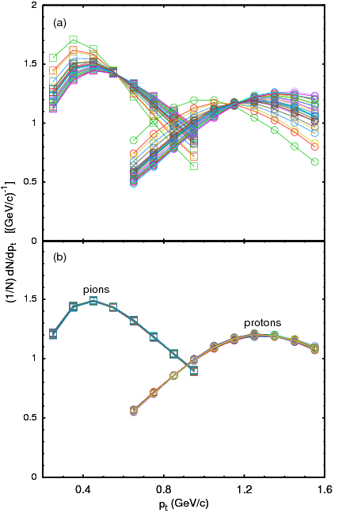
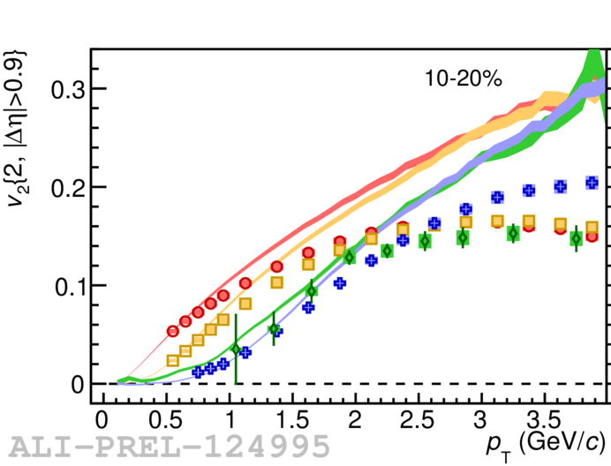
Bayesian Statistical Analysis Models and Data Analysis Initiative http://madai.us
Prior
Data
Posterior
Optimization
Monte Carlo
models
Model emulation
Run full model ~1000 times
MCMC parameter search uses emulator (interpolator) in lieu of full model
Constraint of QGP properties Novak et al, Phys.Rev. C89 (2014) no.3, 034917

Slide 23
JETSCAPE Event generator Jet Energy-loss Tomography with a Statistically and Computationally Advanced Program Envelope http://jetscape.wayne.edu/
Realistic medium
Realistic
theoretical
calculations
Experimental
techniques
Realistic Monte Carlo Model
Realistic jets

Slide 24
Event Generator + Bayesian Statistical analysis
Realistic theoretical calculations
Data
Bayesian Statistical Analysis
Constraint of QGP properties

Slide 25
RIVET Robust Independent Validation of Experiment and Theory
Realistic
theoretical
calculations
Experimental
techniques
Realistic Monte Carlo Model
Works here

Slide 26
UTK JETSCAPE Group
James Neuhaus
Jerrica Wilson
Mariah McCreary
Ricardo Santos (Berea)
Austin Schmier
4 undergrads + 1 beginning grad student
Redmer Bertens (post doc)
Before: 3 heavy ion analyses implemented
After: 9 heavy ion analyses, 2 more in progress

Slide 27
Take home messages
If we get nuclear matter dense enough, we make a new phase of matter, which we produce in high energy heavy ion collisions.
This medium is extremely hot and dense...
...and opaque to colored probes and translucent to electromagnetic probes.

Slide 28
About me
BS, Colorado State University, 2003
PhD, Yale University, 2009
Postdoc, University of Tennessee, Knoxville, 2009-2012
Assistant prof, University of Tennessee, Knoxville 2012 –
Active on issues related to women in physics and working on being a more effective ally for people of color
Parent
Brew beer & wine, keep bees, avid cook, cyclist

Slide 29
Careers in high energy physics
You should consider high energy physics if...
You like programming and working with computers
You're a people person – and don't mind working with 1000 people
You like to travel around the world – and work
You enjoy giving talks
Common career options for people with a Ph.D. in high energy physics
Academia – research and teaching universities
Research at a National Laboratory
National security
Finance
Computer programming

Slide 30
What I spend my time doing
Programming (c++) - analyzing data
Writing and giving talks – 3 research talks, 1 seminar, 2 posters, 1 software tutorial, and lots of talks (>30) at internal meetings in 2010
Hardware work: assembling & testing the detector
Outreach: blogging for ALICE, giving tours of PHENIX to the public...
Writing papers and conference proceedings
Reviewing the work of my collaborators
Reading papers
Taking shifts – including being on call 24/7
Teaching, advising students (undergrad & grad)
Committee work

Slide 31
Resources
US LHC blog and Facebook page
Experiments
Relativistic Heavy Ion Collider: STAR PHENIX
Large Hadron Collider: ALICE ATLAS CMS LHCb TOTEM
Event displays and pretty pictures from ALICE
Really cool ATLAS event animation
Links to articles in the press on PHENIX
Scientific American article

Slide 32
US Universities with graduate programs in experimental heavy ion physics
Relativistic Heavy Ion Collider
STAR
University of California at Davis
University of California Los Angelos
University of Houston
University of Illinois at Chicago
Creighton University (masters only)
Kent State University
Michigan State University
Ohio State University
Purdue University
Texas A&M University
University of Texas Austin
University of Washington
Wayne State University
Yale University
PHENIX
University of California Riverside
University of Colorado Boulder
Columbia University
Florida State University
Georgia State University
Iowa State University
Ohio University
State University of New York (Chemistry & Physics departments)
University of Tennessee at Knoxville
Vanderbilt University

Slide 33
US Universities with graduate programs in experimental heavy ion physics
Large Hadron Collider
ALICE
University of Texas Austin
Chicago State University
Ohio State University
Wayne State University
University of Texas Houston
University of Tennessee Knoxville
Yale University
Creighton University (masters only)
Purdue University
CMS
University of California Davis
University of Illinois Chicago
University of Kansas
University of Maryland
University of Iowa
Rutgers University
Massachusetts Institute of Technology
Vanderbilt University
ATLAS
Columbia University

Slide 34
Quantifying
$\hat{q}$
Phys. Rev. C 90, 014909 (2014)
Jet Collaboration: For a 10 GeV quark traveling 4 fm
≈1.2±0.3 GeV²/fm at τ₀=0.6 fm/c in Au+Au at √s_{NN}=200 GeV →loses 2.2 Gev
≈1.9±0.7 GeV²/fm in Pb+Pb collisions at √s_{NN}=2.76 TeV →loses 2.8 Gev
$\hat{q}$
$\hat{q}$
$\hat{q}={Q^{2}}/L$
Q = Momentum transfer from parton to medium
L = path length

Slide 35
QGP Chemistry

Slide 36
Chemistry - equilibrium
T~170 MeV
arXiv:1701.07065
Nuclear Physics A Volume 757, 102-183
Ratios of particles expected from a model
Even strange quarks are at equilibrium!

Slide 37
QCD Phase Diagram
Quark Gluon Plasma
Hadron Gas
arXiv:1701.07065
Notes:
But wait – how can we have a liquid of quarks and gluons? Doesn't asymptotic freedom tell us that we can't have free quarks and gluons? How, then, can we have a liquid of quarks and gluons?

Slide 38
trajectory of system
arXiv:1701.07065

Slide 39
QGP Thermometers

Slide 40
Measuring temperature

Slide 41
Thermal photons
Phys.Rev.Lett.104:132301,2010
Thermal photons
QCD processes
ALICE collaboration:
Pb+Pb collisions at √s_{NN}=2.76 TeV
Inverse slope: T = 304 +/-51
PHENIX collaboration: Au+Au collisions at √s_{NN}=200 GeV
Inverse slope: T = 221 +/- 19 (stat) +/- 19 (syst) MeV

Slide 42
Building a quarkonium-thermometer
CMS-PAS HIN-11-011
N_{part}
Clear hierarchy in R_{AA} of different quarkonium states
c
c
b
b

Slide 43
Building a quarkonium-thermometer
Note: 6.5<p_{T}<30 GeV for J/ψ and ψ(2s)
CMS-PAS HIN-11-011
N_{part}
Clear hierarchy in R_{AA} of different quarkonium states
Expected in terms of binding energy
CMS-PAS HIN-12-014, HIN-12-007

Slide 44
~600
trajectory of system
arXiv:1701.07065

Slide 45
QGP Energy Density

Slide 46
How can we estimate the energy density?
Transverse energy (E_{T})
sum of particle energies in transverse direction
Volume V = A_{T} τc
τ = formation time
Energy density ε
QGP formation for ε > 0.5 GeV/fm³
A_{T}
= τc
$ϵ=\frac{1}{V}\frac{{dE}_{T}}{dy}=\frac{J}{A_{T}τc}\frac{{dE}_{T}}{dη}$

Slide 47
Energy density
RHIC
Standard estimate τ₀ ≈ 1 fm/c
QGP formation
$ϵ=\frac{1}{Acτ_{0}}\frac{{dE}_{T}}{dy}$

